Slide 1
Dictionary with Binary search tree

Slide 2
Binary Tree
In a normal tree, every node can have any number of children. Binary tree is a special type of tree data structure in which every node can have a maximum of 2 children. One is known as left child and the other is known as right child.
In a binary tree, every node can have either 0 children or 1 child or 2 children but not more than 2 children.
Example
+
*
/
a
b
c
d
A binary tree data structure is represented using two methods. Those methods are as follows...
Array Representation
Linked List Representation
Consider the following binary tree...
+
*
/
a
b
c
d

Slide 3
Binary Tree Representations
A binary tree data structure is represented using two methods. Those methods are as follows...
Array Representation
Linked List Representation
Consider the following binary tree...
+
*
/
a
b
c
d
1. Array Representation
In array representation of binary tree, we use a one dimensional array (1-D Array) to represent a binary tree. Consider the above example of binary tree and it is represented as follows...
+ | * | / | a | b | c | d
Root
2. Linked List Representation
We use double linked list to represent a binary tree. In a double linked list, every node consists of three fields. First field for storing left child address, second for storing actual data and third for storing right child address. In this linked list representation, a node has the following structure...
 | +
 | *
 | /
 | a
 | b
 | c
 | d
null | 40 | null

Slide 4
Binary Tree Traversals:
visiting order of nodes in a binary tree is called as Binary Tree Traversal. There are three types of binary tree traversals.
1.Pre - Order Traversal
2. In - Order Traversal
3.Post - Order Traversal
Consider this binary tree for traversal:
Preorder Traversal(root-left-right) :
In Pre-Order traversal, the root node is visited before left child and right child nodes. In this traversal, the root node is visited first, then its left child and later its right child.
This pre-order traversal is applicable for every root node of all subtrees in the tree.
Steps:
Step 1: visit root node
Step 2: Traverse towards left node recursively
Step 3: Traverse towards right node recursively
Example:
In this example of binary tree, first we visit root node 'A' then visit its left child 'B' which is a root for C and D. So, we visit B's left child 'C' that is the left most child. Next we go for visiting right child of B that is D. With this we have completed root, left and right parts of node B and root, left parts of node A. So, we go for A's right child 'E' which is a root node for F. After visiting E , F gets visited.

Slide 5
In-order traversal(Left-root-right)
In In-Order traversal, the root node is visited between left child and right child. In this traversal, the left child node is visited first, then the root node is visited and later we go for visiting right child node. This in-order traversal is applicable for every root node of all subtrees in the tree. This is performed recursively for all nodes in the tree.
STEPS:
Step1: Traverse towards left node recursively
Step 2: Visit root node
Step 3: Traverse towards right node recursively
Example
JAVA CODE
void In-Order(Root)
{
In-Order(Root->left);
System.out.println(root);
In-Order(Root-right);
}
In the above example of binary tree, first we try to visit left child of root node 'A', but A's left child B is a root node for subtree with nodes B, C and D. So, we try to visit left child C of B and it is the left most child. So, first we visit C then go for it’s root node B and later we visit B’s right child D. With this we have completed the left part of node A. Then visit A and then go to its right child i.e E. Then we visit E and then F.

Slide 6
3. Post -Order Traversal ( left - right - root )
In Post-Order traversal, the root node is visited after left child and right child. In this traversal, left child node is visited first, then its right child and then its root node. This is recursively performed until the right most node is visited. STEPS: Step 1: Traverse towards left node recursively Step 2: Traverse towards right node recursively Step 3: Visit root node Example
JAVA CODE
void Post-Order(Root)
{
Post-Order(Root->left);
Post-Order(Root-right);
System.out.println(root);
}

Slide 7
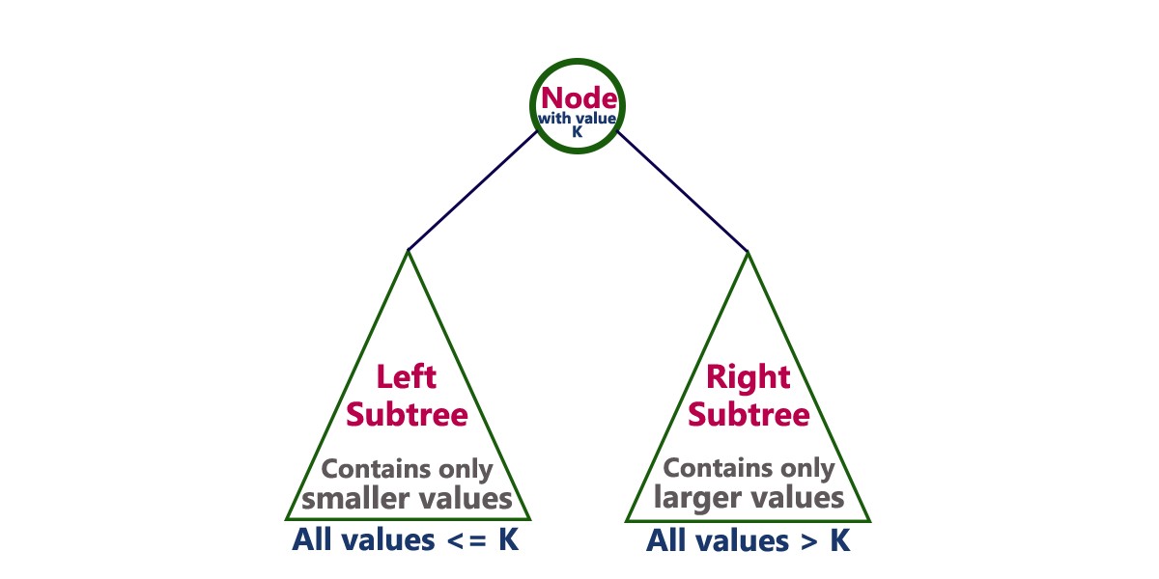
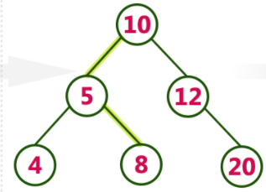
1.Binary Search Tree
A binary search tree is a binary tree that may be empty. A nonempty binary search tree satisfy the following properties:
1.Every element has a key , and no two elements have the same key; therefore all key elements are distinct.
2. The keys in the left subtree of the root are smaller than the keys in the root
3.The keys in the right subtree of the root are greater than the keys in the root
4. The left and right subtree of the root are also subtrees
In a binary search tree, all the nodes in left subtree of any node contains smaller values and all the nodes in right subtree of that contains larger values as shown in following figure...
Example

Slide 8
Operations on binary search trees:
The following operations are performed on a binary earch tree...
Search
Insertion
Deletion
Time Complexity of search and insertion: The worst case time complexity of search and insert operations is O(h) where h is height of Binary Search Tree. In worst case, we may have to travel from root to the deepest leaf node. The height of a skewed tree may become n and the time complexity of search and insert operation may become O(n).
Time Complexity of deletion: The worst case time complexity of delete operation is O(h) where h is height of Binary Search Tree. In worst case, we may have to travel from root to the deepest leaf node. The height of a skewed tree may become n and the time complexity of delete operation may become O(n)

Slide 9
Searching a key To search a given key in Binary Search Tree, we first compare it with root, if the key is present at root, we return root. If key is greater than root’s key, we recur for right subtree of root node. Otherwise we recur for left subtree.
Algorithm for search operation
In a binary search tree, the search operation is performed with O(log n) time complexity. The search operation is performed as follows...
Step 1: Read the search element from the user
Step 2: Compare, the search element with the value of root node in the tree.
Step 3: If both are matching, then display "Given node found!!!" and terminate the function
Step 4: If both are not matching, then check whether search element is smaller or larger than that node value.
Step 5: If search element is smaller, then continue the search process in left subtree.
Step 6: If search element is larger, then continue the search process in right subtree.
Step 7: Repeat the same until we found exact element or we completed with a leaf node
Step 8: If we reach to the node with search value, then display "Element is found" and terminate the function.
Step 9: If we reach to a leaf node and it is also not matching, then display "Element not found" and terminate the function.

Slide 10
Illustration to search 6 in below tree: 1. Start from root. 2. Since the element to be searched is less than root ,then traverse for left, then towards right .

Slide 11
Insertion of a key into binary search tree A new key is always inserted at leaf. We start searching a key from root till we hit a leaf node. Once a leaf node is found, the new node is added as a child of the leaf node.
The insertion operation is performed as follows...
Step 1: Create a newNode with given value and set its left and right to NULL.
Step 2: Check whether tree is Empty.
Step 3: If the tree is Empty, then set root to newNode.
Step 4: If the tree is Not Empty, then check whether value of newNode is smaller or larger than the node (here it is root node).
Step 5: If newNode is smaller than or equal to the node, then move to its left child. If newNode is larger than the node, then move to its right child.
Step 6: Repeat the above step until we reach to a leaf node (e.i., reach to NULL).
Step 7: After reaching a leaf node, then insert the newNode as left child if newNode is smaller or equal to that leaf else insert it as right child.

Slide 12
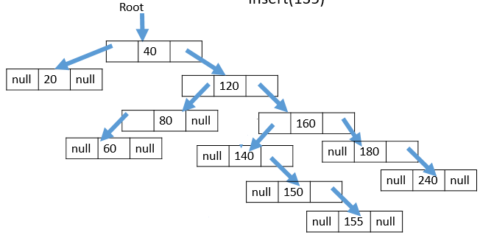
Example:Before insertion of 135 into binary search tree

Slide 13
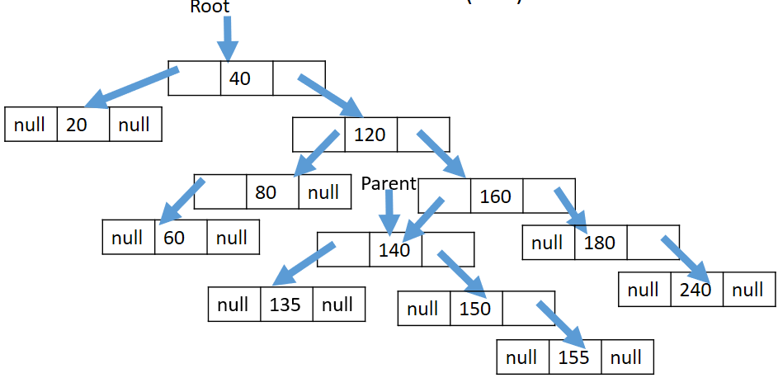
After insertion into BST

Slide 14
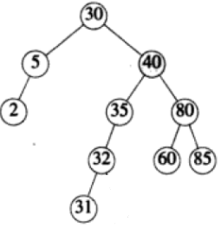
Deletion of node from Binary search tree
Case 1: Deleting a leaf node
We use the following steps to delete a leaf node from BST...
Step 1: Find the node to be deleted using search operation
Step 2: Delete the node using free function (If it is a leaf) and terminate the function.
Example: To remove 33 from thee below tree, we set right child of 32 to null, and the node is discarded.

Slide 15
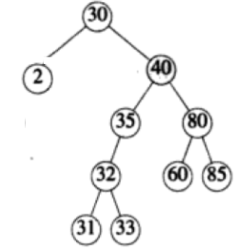
Case 2: Deletion of a node with one child
We use the following steps to delete a node with one child from BST...
Step 1: Find the node to be deleted using search operation
Step 2: If it has only one child, then create a link between its parent and child nodes.
Step 3: Delete the node and terminate the function.
Example: To delete 5 from the below tree , we change the left child field of its parent to point to the node containing 2.

Slide 16
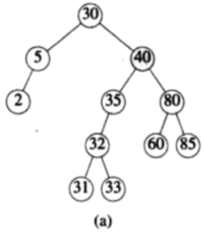
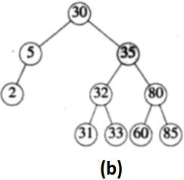
Case 3: Deletion of a node with two children We use the following steps to delete a node with two children from BST... Step 1: Find the node to be deleted using search operation Step 2: If it has two children, then find the largest node in its left subtree (OR) the smallest node in its right subtree. Step 3: Then , we replace deleting element with an element which found in above step. Step 4: Following the replacement, the replacing element is removed from the original node Example: Suppose we wish to remove an element with key 40 from the tree of the following figure a. Either the largest element in its left subtree or smallest element in its right subtree replace this. If we opt for largest element in its left sub tree , we move the key element with key 35 to the node from which 40 was removed; in addition the node from which 35 is moved is removed. The resultant tree appears as in the following figure b.

Slide 17
2. Balanced Binary Search Trees
If the height of a binary tree is always O(log n), we can guarantee O(log n) performance for each search tree operation
Trees with a worst-case height of O(log n) are called balanced trees
An example of a balanced tree is AVL (Adelson-Velsky and Landis) tree
AVL Tree
Definition
Binary tree.
If T is a nonempty binary tree with T_{L} and T_{R} as its left and right subtrees, then T is an AVL tree iff
T_{L} and T_{R} are AVL trees, and
|h_{L} – h_{R}| ≤ 1 where h_{L} and h_{R} are the heights of T_{L} and T_{R}, respectively

Slide 18
Properties of AVL Tree
The height of an AVL tree with n nodes is O(log n)
For every value of n, n ≥ 0, there exists an AVL tree
An n-node AVL search tree can be searched in O(height) = O(log n) time
A new node can be inserted into an n-node AVL search tree so that the result is an n+1 node AVL tree and insertion can be done in O(log n) time
A node can be deleted from an n-node AVL search tree, n>0, so that the result is an n-1 node AVL tree and deletion can be done in O(log n) time
Balance Factor
AVL trees are normally represented using the linked representation
To facilitate insertion and deletion, a balance factor (bf) is associated with each node
The balance factor bf(x) of a node x is defined as height(x→leftChild) – height(x→rightChild)
Balance factor of each node in an AVL tree must be –1, 0, or 1

Slide 19
AVL Tree with Balance Factors
-1
10
1
7
1
40
0
3
0
8
1
30
45
-1
0
0
0
1
5
-1
20
0
35
60
0
25

Slide 20
Operations on AVL Trees
The following operations are performed on an AVL tree...
1.Search
2.Insertion
3.Deletion
Search Operation in AVL Tree:
In an AVL tree, the search operation is performed with O(log n) time complexity. The search operation is performed similar to Binary search tree search operation. We use the following steps to search an element in AVL tree...
Step 1: Read the search element from the user
Step 2: Compare, the search element with the value of root node in the tree.
Step 3: If both are matching, then display "Given node found!!!" and terminate the function
Step 4: If both are not matching, then check whether search element is smaller or larger than that node value.
Step 5: If search element is smaller, then continue the search process in left subtree.
Step 6: If search element is larger, then continue the search process in right subtree.
Step 7: Repeat the same until we found exact element or we completed with a leaf node
Step 8: If we reach to the node with search value, then display "Element is found" and terminate the function.
Step 9: If we reach to a leaf node and it is also not matching, then display "Element not found" and terminate the function.

Slide 21
Insertion Operation in AVL Tree In an AVL tree, the insertion operation is performed with O(log n) time complexity. In AVL Tree, new node is always inserted as a leaf node. The insertion operation is performed as follows...
Step 1:Find the place to insert the new element by following path from the root ,then insert the new node and set the balance factor of new node as zero(0).During this process , keep track of most recently visited node with Say “A” with balance factor as either 1 or -1.
Step 2:If there is no node “A” ,then make another pass from the root , updating balance factors .Then terminate,Otherwise go to step 3
Step 3: If bf( A) =1 and the new node was inserted on the right side of “A” or if bf(A)=-1 and the new node was inserted on the left side of “A” ,then set the bf(A)=0 and terminate. Otherwise go to step 4.
Step 4: classify the imbalance at “A” and perform the appropriate rotations .Change balance factors as required by the rotations.

Slide 22
Inserting into an AVL Search Tree
Insert(9)
-1
10
1
7
1
40
0
3
0
8
1
30
45
-1
0
0
0
1
5
0
9
-1
20
0
35
60
0
25
Where is 9 going to be inserted into?
After the insertion, is the tree still an AVL search tree? (i.e., still balanced? yes)

Slide 23
Imbalance Types in AVL insertion
After an insertion, when the balance factor of node A is –2 or 2, the node A is one of the following four imbalance types
LL: new node is in the left subtree of the left subtree of A
LR: new node is in the right subtree of the left subtree of A
RR: new node is in the right subtree of the right subtree of A
RL: new node is in the left subtree of the right subtree of A

Slide 24
LL Imbalance
A generic LL type imbalance is shown in the following figure .Figure (a) shows the conditions before the insertion ,(b) shows the situation following the insertion of an element into the left subtree BL of B. The subtree movement needed to restore balance at A appears in the figure (c). B becomes the root of the subtree that A was previously root of , B’L remains the left subtree of B, A becomes the root of B’s right subtree, BR becomes the left subtree of A, and the right subtree of A is unchanged. The balance factors of nodes in B’L that are on the path from B to the newly inserted node change as does the balance factors A.
This kind of rotation is called LL rotation. Here , only single rotation is required.

Slide 25
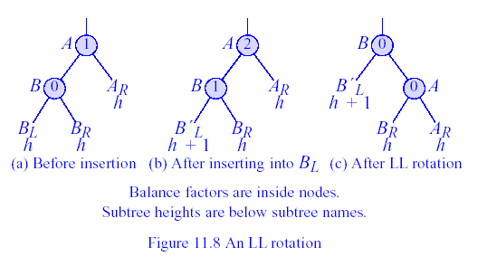
An LL Rotation
Figure An LL Rotation
1
1
LL Rotation
1
100
100
0
100
1
A
2
0
0
50
200
25
0
50
200
1
200
0
B
0
1
0
25
0
75
0
10
0
50
0
0
25
0
75
0
150
300
150
300
150
300
1
0
0
0
0
0
10
40
5
0
10
40
75
40
0
5

Slide 26
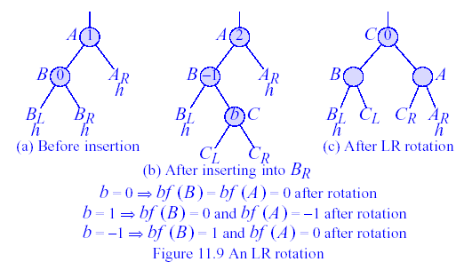
An LR Rotation
LR rotation:Following figure LR type imbalance . Here, the insertion takes place in the right subtree of B.The rearrangement of subtrees needed to rebalance appears in the figure (c ) .
Figure An LR Rotation
1
1
1
100
100
0
100
1
A
2
0
Lr Rotation
0
50
0
200
50
200
40
0
-1
0
-1
200
0
B
25
0
0
0
25
0
0
0
75
150
300
25
50
75
0
150
300
0
0
150
300
0
1
0
0
0
10
40
10
35
75
10
40
0
35

Slide 27
Single and Double Rotations
Single rotations: the transformations done to correct LL and RR imbalances
Double rotations: the transformations done to correct LR and RL imbalances
The transformation to correct LR imbalance can be achieved by an RR rotation followed by an LL rotation

Slide 28
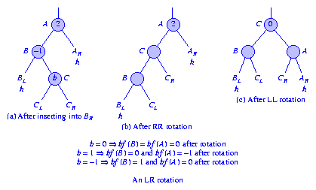
LR Rotation
Single and Double Rotations
Single rotations: the transformations done to correct LL and RR imbalances
Double rotations: the transformations done to correct LR and RL imbalances
The transformation to correct LR imbalance can be achieved by an RR rotation followed by an LL rotation as shown below
Figure (b) shows the tree after an RR rotation at vertex B
Figure (c) shows the result of performing an LL rotation at vertex A of the tree of Figure (b).
The resulting tree is the same as that shown in Figure (c).

Slide 29
RR imbalance: A generic RR type imbalance is shown in the following figure . Figure (a) shows the conditions before the insertion ,(b) shows the situation following the insetion of an element into the right subtree BR of B. The subtree movement needed to restore balance at A appears in the figure (c). B becomes the root of the subtree that A was previously root of , B’R remains the right subree of B, A becomes the left subtree of B,BL becomes the fight subtree of A, and the left subtree of A is unchanged. The balance factors of nodes in B’R that are on the path from B to the newly inserted node will be changed.

Slide 30
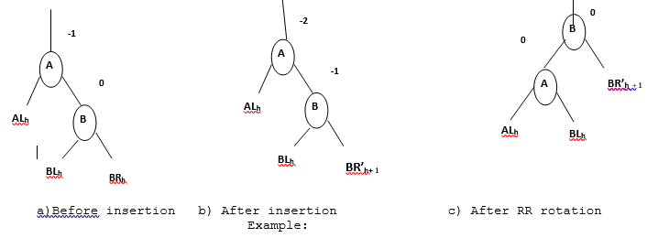
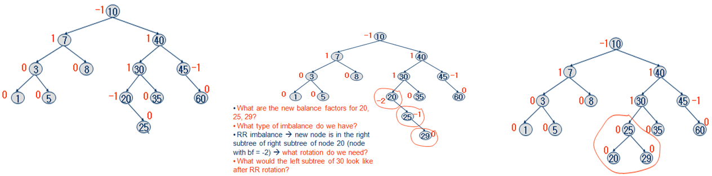
An RR Rotation

Slide 31
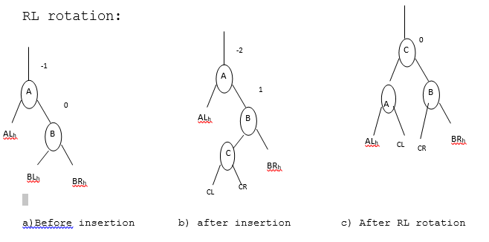
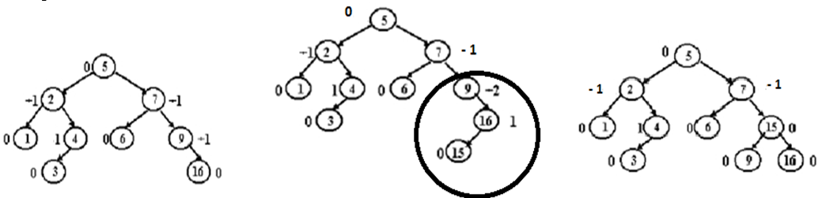

Slide 32
Example for insertion into an AVL
1)Insert “JAN”
2)Insert “FEB”
3)Insert “MAR”
JAN
0
1
JAN
0
JAN
0
0
FEB
0
FEB
MAR
4)Insert “APR”
5)Insert “MAY”
6)Insert “JUN”
1
0
JAN
JAN
0
JAN
1
0
1
1
-1
0
FEB
MAR
FEB
MAR
FEB
MAR
0
0
0
0
0
0
APR
APR
MAY
APR
JUN
MAY

Slide 33
6)Insert “JUL”
6)Insert “AUG”
6)Insert “AUG”
LR Rotation
-1
JAN
-1
-1
JAN
JAN
1
1
2
0
1
1
FEB
MAR
FEB
MAR
AUG
MAR
0
0
0
1
0
0
-1
0
1
MAY
APR
JUN
APR
JUN
MAY
APR
FEB
JUN
MAY
0
0
0
JUL
JUL
0
JUL
AUG
LR imbalance

Slide 34
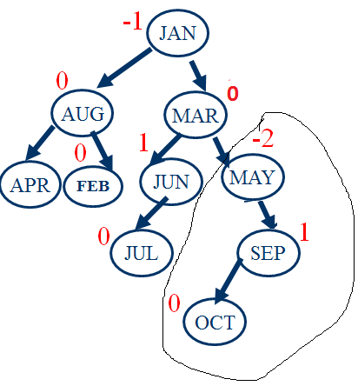
7)Insert “OCT”
6)Insert “SEP”
-1
JAN
0
0
AUG
MAR
0
1
-1
0
0
APR
FEB
JUN
MAY
0
0
JUL
SEP
RL imbalance

Slide 35
RL rotation
Insert NOV
-1
JAN
-2
JAN
0
0
0
-1
AUG
MAR
AUG
MAR
1
0
1
1
0
0
APR
FEB
JUN
OCT
APR
FEB
JUN
OCT
0
0
-1
0
0
0
JUL
MAY
SEP
JUL
MAY
SEP
0
NOV
RR Imbalance

Slide 36
RR Rotation
0
MAR
1
0
JAN
OCT
1
-1
0
0
AUG
JUN
MAY
SEP
0
0
0
APR
FEB
JUL
0
NOV
RR Imbalance

Slide 37
Insert “DEC”
1
MAR
1
1
JAN
OCT
1
-1
0
-1
AUG
JUN
MAY
SEP
0
1
APR
FEB
JUL
0
NOV
0
DEC

Slide 38
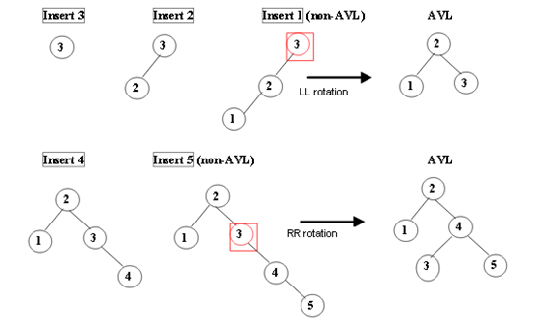
Example for insertion into an AVL

Slide 39
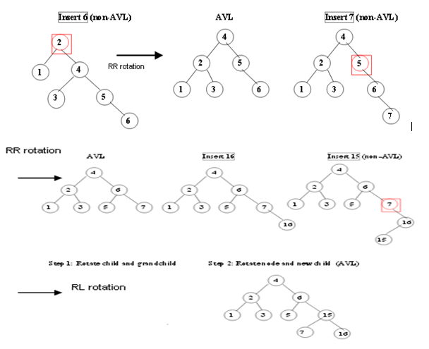

Slide 40
Deletion from an AVL Search Tree:
To delete a node from an AVL tree , the following procedure to be used.
Algorithm Deletion from AVL
Step 1:Search for the node say Q to be deleted. Let PQ is the parent of Q
Step 2:Delete Q by using similar procedure whichever is used for deletion of node from binary search tree , then go to
step 3.
Step 3: //updation of balance factor of PQ which is the parent of Q
if Q is on the left side of PQ decrease balance factor of PQ by 1. If Q is on the right side of PQ
increase the balance factor of PQ by 1. Then go to step 4 , 5 or 6 based on updated balance
factor of PQ.
Step 4: if updated balance factor of PQ is zero means that the height of PQ is reduced by one so
update the balance factors of its ancestors and then terminate.
Step 5: if updated balance factor of PQ is 1 or -1 means that the height of PQ is not changed, so no
need of changing balance factors of its ancestors. Simply terminate.
Step 6: if updated balance factor of PQ is 2 or -2 means the tree is imbalanced at PQ. Possible
imbalances are R0 , R1, R-1 , L0,L-1 and L1. So perform appropriate rotation to make the tree
as balanced and then terminate. In case of R1 , R-1 ,L1 and L-1 imbalances, after performing concerned
rotations, ancestors balance factors also to be updated.

Slide 41
Imbalances in the AVL deletion:
After deletion of a node Q from AVl tree , balance factor changes may propagate up the tree along the path from Q to the root .During this process ,it is possible for the balance factor of a node on this path to become -2 or 2. Let A be the first such node on this path. To restore balance at node A, we classify the type of imbalance.
L imbalance occurs , if the deletion takes place from the left subtree of A.
R imbalance occurs , if the deletion takes place from the right subtree of A.
R imbalance is further classified into three types such as R0, R1 and R-1 imbalances depends on balance factor of B, where B is left child of A.
The Ro refers to the case when the deletion took place from the right subtree of A and bf(B)=0 .
The R1 refers to the case when the deletion took place from the right subtree of A and bf(B)=1.
The R-1 refers to the case when the deletion took place from the right subtree of A and bf(B)=-1.
L imbalance is further classified into three types such as L0, L1 and L-1 imbalances depends on balance factor of B, where B is the right child of A.
The Lo refers to the case when the deletion took place from the left subtree of A and bf(B)=0 .
The L1 refers to the case when the deletion took place from the left subtree of A and bf(B)=1.
The L-1 refers to the case when the deletion took place from the left subtree of A and bf(B)=-1.

Slide 42
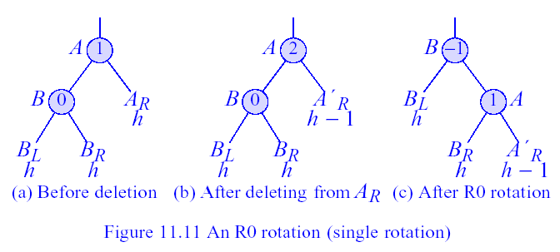
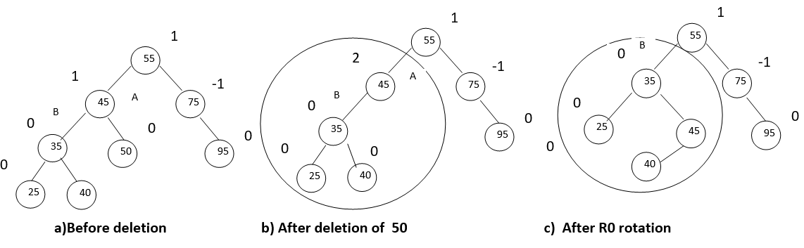
An R0 Rotation
An R0 imbalance at A can be rectified by performing the rotation shown in the following figure. Notice that the height of the subtree was h+2 before deletion and it is h+2 after deletion also. So , the balance factors of the remaining nodes on the path to the root are unchanged.
Figure : An R0 rotation (single rotation)

Slide 43
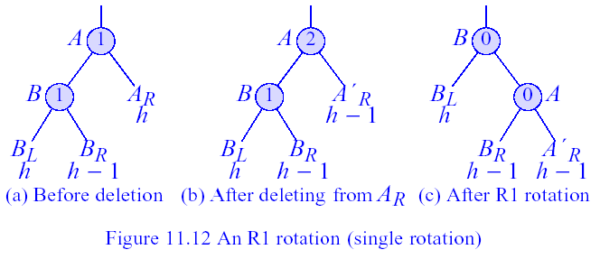
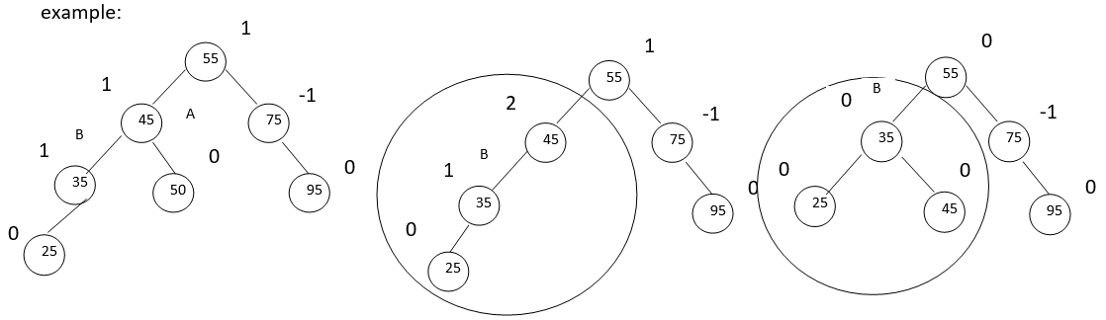
An R1 Rotation
Following figure shows how to handle an R1 imbalance. While he pointer changes ae the same as for an R0 imbalance, the new balance factors for A and B are different and the height of the subtree following the rotations is now h+1, which is 1 less than before deletion. So, if A is not the root, the balance factors of some of its ancestors will change and further rotations may be necessary. Hence, following an R1 rotation , we must continue to examine nodes on the path to the root.
Figure .An R1 rotation (single rotation)

Slide 44
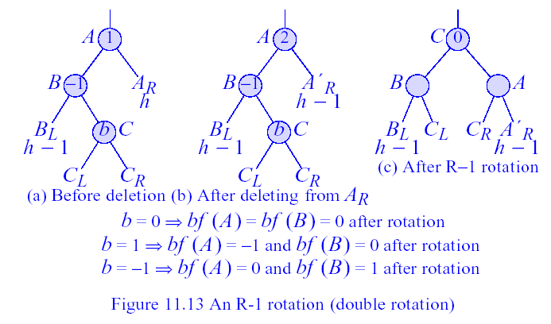
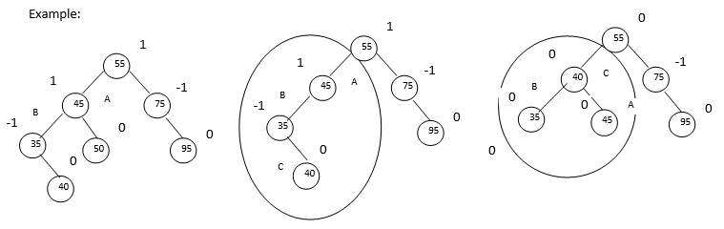
An R-1 Rotation
An R-1 Rotation : The transformation needed when the imabalance is of type R-1 is illustrated in the following figure. The balance factors of A and B following the rotation depends on the balance factor “b” of the right child of B. the rotation leaves a subtree of height h+1, while the subtree height prior to the deletion was h+2. So , we need to continue to examine nodes on the path to the root.
Figure An R-1 rotation (double rotation)

Slide 45
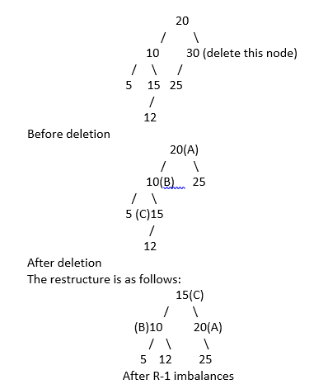
Example 1: Deletion of 30 from the following tree

Slide 46
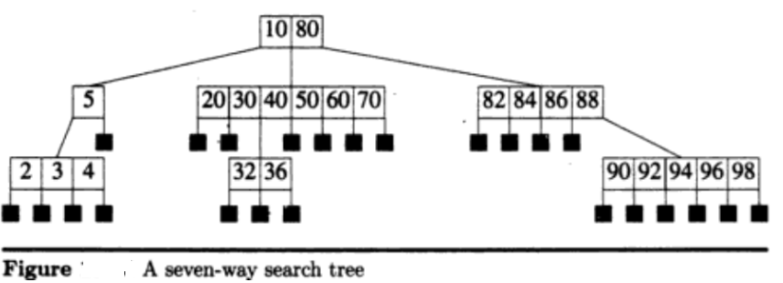
m-way search tree of order m, is a tree in which
A. The nodes hold between 1 to m-1 distinct keys B. The keys in each node are sorted C. A node with k keys has k+1 sub trees, where the sub trees may be empty. D. The ith sub tree of a node [v1, ..., vk], 0 < i < k, may hold only values v in the range vi < v < vi+1 (v0 is assumed to equal - , and vk+1 is assumed to equal infinity).

Slide 47
3.B-Tree
A B-tree of order m is an m-way search tree. If the B-tree is not empty, the corresponding extended tree satisfy the following properties:
Property #1 - All the leaf nodes must be at same level.
Property #2 - All nodes except root must have at least [m/2]-1 keys and maximum of m-1 keys.
Property #3 - All non leaf nodes except root (i.e. all internal nodes) must have at least m/2 children.
Property #4 - If the root node is a non leaf node, then it must have at least 2 children.
Property #5 - All the key values within a node must be in Ascending Order.
For example, B-Tree of Order 4 contains maximum 3 key values in a node and maximum 4 children for a node.

Slide 49
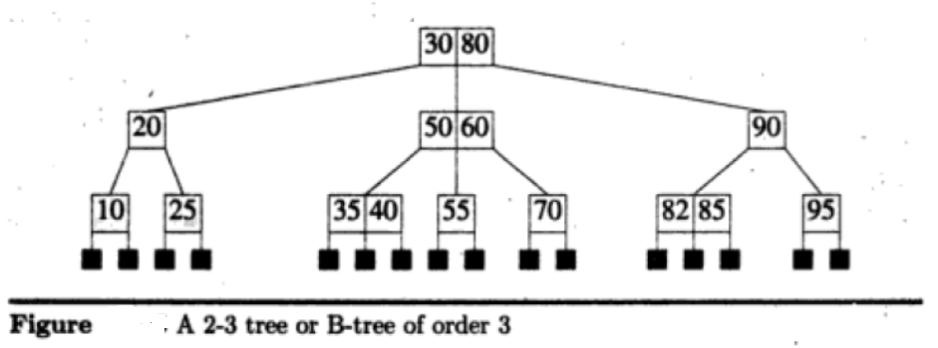
In a B-tree of order 3 , no internal nodes have either 2 or 3 children. So , a B-tree of order 3 is also known as 2-3 tree. Example for 2-3 B Tree is shown below

Slide 50
Operations on B-tree:
The following operations are performed on a B-Tree...
Search
Insertion
Deletion
Search Operation in B-Tree
In a B-Ttree, the search operation is similar to that of Binary Search Tree. In a Binary search tree, the search process starts from the root node and every time we make a 2-way decision (we go to either left subtree or right subtree). In B-Tree also search process starts from the root node but every time we make n-way decision where n is the total number of children that node has. In a B-Ttree, the search operation is performed with O(log n) time complexity. The search operation is performed as follows...
Step 1: Read the search element from the user
Step 2: Compare, the search element with first key value of root node in the tree.
Step 3: If both are matching, then display "Given node found!!!" and terminate the function
Step 4: If both are not matching, then check whether search element is smaller or larger than that key value.
Step 5: If search element is smaller, then continue the search process in left subtree.
Step 6: If search element is larger, then compare with next key value in the same node and repeate step 3, 4, 5 and 6 until we found exact match or comparison completed with last key value in a leaf node.
Step 7: If we completed with last key value in a leaf node, then display "Element is not found" and terminate the function.

Slide 51
Insertion Operation in B-Tree
In a B-Tree, the new element must be added only at leaf node. That means, always the new keyValue is attached to leaf node only. The insertion operation is performed as follows...
Step 1: Check whether tree is Empty.
Step 2: If tree is Empty, then create a new node with new key value and insert into the tree as a root node.
Step 3: If tree is Not Empty, then find a leaf node to which the new key value cab be added using Binary Search Tree logic.
Step 4: If that leaf node has an empty position, then add the new key value to that leaf node by maintaining ascending order of key value within the node.
Step 5: If that leaf node is already full, then split that leaf node by sending middle value to its parent node. Repeat the same until sent value is fixed into a node.
Step 6: If the splitting is occurring to the root node, then the middle value becomes new root node for the tree and the height of the tree is increased by one.

Slide 52
Example: Construct B-tree order 5 for the following data 20,40,30,350,75,375,360,80,60,90,70, 100,110 ,120, 385, 390,380
Step 1: insert (20)
Step 5: insert (75): Split and send middle element up
 | 20
 | 40
Step 2: insert (40)
 | 20 |  | 30
 | 75 |  | 350
 | 20 |  | 40
Step 6: insert (375):
Step3: insert (30)
 | 40
 | 20 |  | 30 |  | 40
 | 20 |  | 30
 | 75 |  | 350 |  | 375
Step 4: insert (350)
Step 7: insert (360):
 | 20 |  | 30 |  | 40 |  | 350
 | 40
 | 20 |  | 30
 | 75 |  | 350 |  | 360 |  | 375

Slide 53
Step 8: insert (80):Split
 | 40 |  | 350
 | 20 |  | 30
 | 75 |  | 80
 | 360 |  | 375
Step 9: insert (60):
 | 40 |  | 350
 | 20 |  | 30
 | 60 |  | 75 |  | 80
 | 360 |  | 375

Slide 54
Step 10: insert (90):
 | 40 |  | 350
 | 20 |  | 30
 | 60 |  | 75 |  | 80 |  | 90
 | 360 |  | 375
Step 11: insert (70):Split
 | 40 |  | 75 |  | 350
 | 20 |  | 30
 | 60 |  | 70
 | 80 |  | 90
 | 360 |  | 375

Slide 55
Step 12: insert (100)
 | 40 |  | 75 |  | 350
 | 20 |  | 30
 | 60 |  | 70
 | 80 |  | 90 |  | 100
 | 360 |  | 375
Step 13: insert (110)
 | 40 |  | 75 |  | 350
 | 20 |  | 30
 | 60 |  | 70
 | 80 |  | 90 |  | 100 |  | 110
 | 360 |  | 375

Slide 56




Step 13: insert (120):Split
 | 40 |  | 75 |  | 100 |  | 350
 | 360 |  | 375
Step 14: insert (385)
 | 40 |  | 75 |  | 100 |  | 350
 | 360 |  | 375 |  | 385

Slide 57





Step 15: insert (390)
 | 40 |  | 75 |  | 100 |  | 350
 | 360 |  | 375 |  | 385 |  | 390
Step 16: insert (380): Split at 2 levels
Split and send 380 to parent
Split and send 380 to parent

Slide 58
Deleting an Element From a B-Tree
Deletion is divided into two cases:
The element to be deleted is in a leaf node
The element to be deleted is in a non leaf node
Case 1:
To delete value X from a B-tree, starting at a leaf node, there are 2 steps:
1.Remove X from the current node. Being a leaf node there are no subtrees to worry about.
2.Removing X might cause the node containing it to have too few
If underflow does not occur, then we are finished the deletion process. If it does occur, it must be fixed.
NOTE: After deleting an element from B tree, the resultant tree must stratify B-tree Properties

Slide 59
Example 1: Let us take as a specific example, deleting 6 from this B-tree (of degree 5):
 | 5 |  | 10 |  | 50
 | 2 |  | 3
 | 6 |  | 7
 | 17 |  | 22 |  | 44 |  | 45
 | 55 |  | 66 |  | 68 |  | 70
Fig.Before Deletion
Here 6 is in the leaf , so simply delete and observe the resultant.
 | 5 |  | 10 |  | 50
 | 2 |  | 3
 | 7
 | 17 |  | 22 |  | 44 |  | 45
 | 55 |  | 66 |  | 68 |  | 70
Removing 6 causes the node it is in to underflow, as it now contains just 1 value (7). Our strategy for fixing this is to try to `borrow' values from a neighbouring node. After borrowing from the neighbour, the resultant tree is shown below:
 | 5 |  | 17 |  | 50
 | 2 |  | 3
 | 7 |  | 10
 | 22 |  | 44 |  | 45
 | 55 |  | 66 |  | 68 |  | 70

Slide 60
Example 2: Let us take as a specific example, deleting 3 from this B-tree (of degree 5):
 | 5 |  | 10 |  | 50
 | 2 |  | 3
 | 6 |  | 7
 | 17 |  | 22 |  | 44 |  | 45
 | 55 |  | 66 |  | 68 |  | 70
Fig.Before Deletion
Here 6 is in the leaf , so simply delete and observe the resultant.
 | 5 |  | 10 |  | 50
 | 2
 | 6 |  | 7
 | 17 |  | 22 |  | 44 |  | 45
 | 55 |  | 66 |  | 68 |  | 70
Removing 3 causes the node it is in to underflow, as it now contains just 1 value (2). Our strategy for fixing this is to try to `borrow' values from a neighbouring node. However ,sib link too does not have ufficient number of elements .So , follow the combine strategy. The resultant tree is shown below:
 | 17 |  | 50
 | 2 |  | 5 |  | 7 |  | 10
 | 22 |  | 44 |  | 45
 | 55 |  | 66 |  | 68 |  | 70

Slide 61
Case 2:The element to be deleted is in a non leaf node
Case 2 is transformed into case 1 by replacing deleted element with either largest element in its left sub tree or smallest element in its right sub tree and then the replacing element is deleted from its original position. The replacing element is guaranteed to be in leaf.
Example :Delete 350 from below tree
Fig a: Before deletion

Slide 62

Fig a: After replacing 350 with largest element in its left subtree .

Slide 63

Now , delete 120 from its original position. The resultant tree is shown below
Fig b: After deleting 120 from its original position. Resultant tree is not B tree

Slide 64
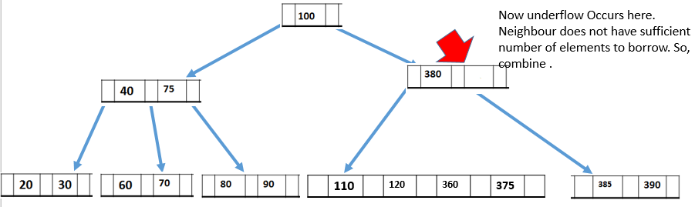
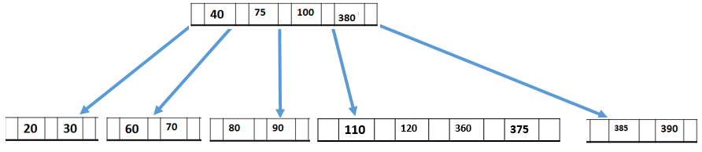
Observe the previous tree. After deleting 120, the corresponding node suffers from underflow. So, borrow from neighbour. However neighbour does not have sufficient number of elements. Then the solution is combine sib links along with their parent. The resultant tree is shown next.
Fig c: After combining at leaf level
Fig d: After combining at 2nd level. Final tree

Slide 65
Note 1: Refer Sahani& Good Rich text books to know the applications of various data structures
Note 2: Refer Record for programs

