Slide 1
UNIT-I
Operating System – Introduction
Structures - Simple Batch, Multiprogrammed, Time-shared, Personal Computer, Parallel, Distributed Systems, Real-Time Systems
System components,
Operating System services
System Calls.
Process - Process concepts and scheduling,
Operations on processes, Cooperating Processes
Threads.
Process-related system calls – fork, exit, wait, and exec.

Slide 2
Operating System:
An operating system acts as an interface between the software and different parts of the computer or the computer hardware.
Operating System is a fully integrated set of specialized programs that handle all the operations of the computer.
Operating System lies in the category of system software.
It basically manages all the resources of the computer.
It controls and monitors the execution of all other programs that reside in the computer, which also includes application programs and other system software of the computer.

Slide 3
An operating system is a software which performs all the basic tasks like file management, memory management, process management, handling input and output, and controlling peripheral devices such as disk drives and printers.
Examples of Operating Systems are Windows, Linux, Mac OS, etc.

Slide 4
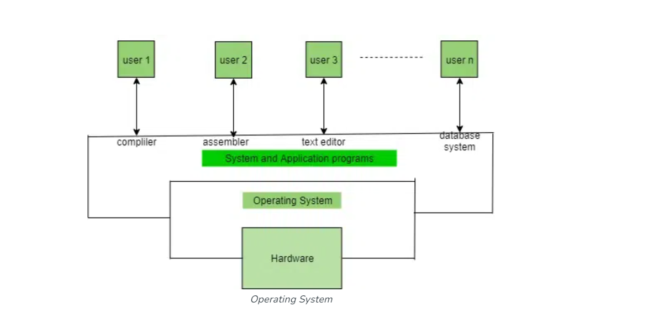
Components of a Computer:

Slide 5
Generally, a Computer System consists of the following components:
Computer Users are the users who use the overall computer system.
Application Softwares are the software which users use directly to perform different activities.
System Softwares are the software which are more complex in nature and they are more near to computer hardware. These software are usually written in low-level languages like assembly language
Computer Hardware includes Monitor, Keyboard, CPU, Disks, Memory, etc.

Slide 6
Functions of the Operating System
Resource Management
Process Management
Memory Management
Device Management
File Management
Security
Job Accounting
Error-detecting Aids
Networking

Slide 7
Resource Management:
The operating system manages and allocates memory, CPU time, and other hardware resources among the various programs and processes running on the computer.
Process Management:
The operating system is responsible for starting, stopping, and managing processes and programs.
It also controls the scheduling of processes and allocates resources to them.
Memory Management:
The operating system manages the computer’s primary memory and provides mechanisms for optimizing memory usage.

Slide 8
Device Management:
The operating system manages input/output devices such as printers, keyboards, mice, and displays. It provides the necessary drivers and interfaces to enable communication between the devices and the computer.
File Management:
The operating system is responsible for organizing and managing the file system, including the creation, deletion, and manipulation of files and directories.
Security:
The operating system provides a secure environment for the user, applications, and data by implementing security policies and mechanisms such as access controls and encryption.

Slide 9
Job Accounting:
It keeps track of time and resources used by various jobs or users.
Error-detecting Aids:
These contain methods that include the production of dumps, traces, error messages, and other debugging and error-detecting methods.
Networking:
The operating system provides networking capabilities such as establishing and managing network connections, handling network protocols, and sharing resources such as printers and files over a network.

Slide 10
Objectives of Operating Systems
Convenient to use: One of the objectives is to make the computer system more convenient to use in an efficient manner.
User Friendly: To make the computer system more interactive with a more convenient interface for the users.
Easy Access: To provide easy access to users for using resources by acting as an intermediary between the hardware and its users.
Management of Resources: For managing the resources of a computer in a better and faster way.
Controls and Monitoring: By keeping track of who is using which resource, granting resource requests, and mediating conflicting requests from different programs and users.
Fair Sharing of Resources: Providing efficient and fair sharing of resources between the users and programs.

Slide 11
Operating System services
An Operating System provides services to both the users and to the programs.
It provides programs an environment to execute.
It provides users the services to execute the programs in a convenient manner.

Slide 12
Following are a few common services provided by an operating system
Program execution
I/O operations
File System manipulation
Communication
Error Detection
Resource Allocation
Protection

Slide 13
Program execution
Loads a program into memory.
Executes the program.
Handles program's execution.
Provides a mechanism for process synchronization.
Provides a mechanism for process communication.
Provides a mechanism for deadlock handling.

Slide 14
I/O Operation
An I/O subsystem comprises of I/O devices and their corresponding driver software. Drivers hide the peculiarities of specific hardware devices from the users.
An Operating System manages the communication between user and device drivers.
I/O operation means read or write operation with any file or any specific I/O device.
Operating system provides the access to the required I/O device when required.

Slide 15
File system manipulation
A file represents a collection of related information. Computers can store files on the disk (secondary storage), for long-term storage purpose.
A file system is normally organized into directories for easy navigation and usage.
Program needs to read a file or write a file.
The operating system gives the permission to the program for operation on file.
Permission varies from read-only, read-write, denied and so on.
Operating System provides an interface to the user to create/delete files.
Operating System provides an interface to the user to create/delete directories.
Operating System provides an interface to create the backup of file system.

Slide 16
Communication
Two processes often require data to be transferred between them
Both the processes can be on one computer or on different computers, but are connected through a computer network.
Communication may be implemented by two methods, either by Shared Memory or by Message Passing.
Error Handling:
Errors can occur anytime and anywhere. An error may occur in CPU, in I/O devices or in the memory hardware.
The OS constantly checks for possible errors.
The OS takes an appropriate action to ensure correct and consistent computing.

Slide 17
Resource Management
In case of multi-user or multi-tasking environment, resources such as main memory, CPU cycles and files storage are to be allocated to each user or job. The OS manages all kinds of resources using schedulers.
CPU scheduling algorithms are used for better utilization of CPU.
The OS manages all kinds of resources using schedulers.
CPU scheduling algorithms are used for better utilization of CPU.
Protection:
The OS ensures that all access to system resources is controlled.
The OS ensures that external I/O devices are protected from invalid access attempts.
The OS provides authentication features for each user by means of passwords.

Slide 18
Types of Operating Systems
Batch Operating System
Multi-Programming Operating System
Multi-Processing Operating System
Multi-Tasking Operating System
Time-Sharing Operating Systems
Distributed Operating System
Network Operating System
Real-Time Operating System

Slide 19
Batch operating system
The users of a batch operating system do not interact with the computer directly.
Each user prepares his job on an off-line device like punch cards and submits it to the computer operator.
To speed up processing, jobs with similar needs are batched together and run as a group.
The programmers leave their programs with the operator and the operator then sorts the programs with similar requirements into batches.

Slide 20
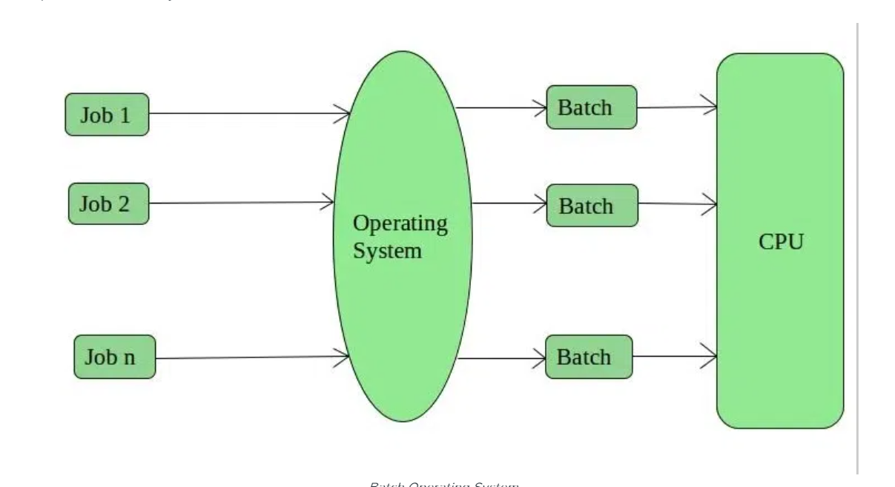

Slide 21
Advantages of Batch Operating System
It is very difficult to guess or know the time required for any job to complete.
Multiple users can share the batch systems.
The idle time for the batch system is very less.
It is easy to manage large work repeatedly in batch systems.
Disadvantages of Batch Operating System
The computer operators should be well known with batch systems.
Batch systems are hard to debug.
It is sometimes costly.
Lack of interaction between the user and job.
Difficult to provide the desired priority.

Slide 22
Multi-Programming Operating System
Multiprogramming in an operating system as the name suggests multi means more than one and programming means the execution of the program.
when more than one program can execute in an operating system then this is termed a multiprogramming operating system.
Before the concept of Multiprogramming, computing takes place in other way which does not use the CPU efficiently.
Earlier, CPU executes only one program at a time.

Slide 23
Multiprogramming addresses this issue and solve this issue.
Multiprogramming was developed in 1950s. It was first used in mainframe computing.
The major task of multiprogramming is to maximize the utilization of resources.
Multiprogramming is broadly classified into two types namely
Multi-user operating system
Multitasking operating system

Slide 24
Multiuser and Multitasking both are different in every aspect.
Multitasking is an operating system that allows you to run more than one program simultaneously.
A multi-user operating system allows many users to share processing time on a powerful central computer on different terminals.
The operating system does this by quickly switching between terminals, each receiving a limited amount of CPU time.

Slide 25
Features of Multiprogramming
Need Single CPU for implementation.
Context switch between process.
Switching happens when current process undergoes waiting state.
CPU idle time is reduced.
High resource utilization.
High Performance.
Disadvantages of Multiprogramming
Prior knowledge of scheduling algorithms is required.
If it has a large number of jobs, then long-term jobs will have to require a long wait.
Memory management is needed in the operating system because all types of tasks are stored in the main memory.

Slide 26
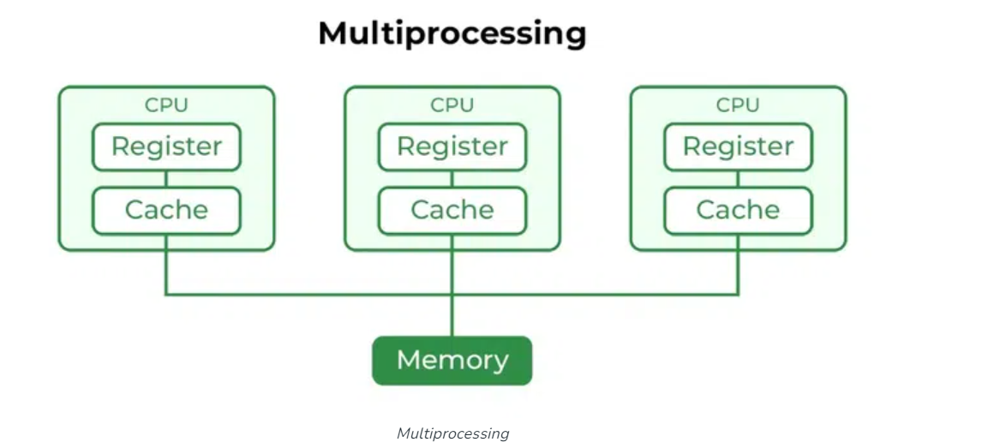
Multi-Processing Operating System
Multi-Processing Operating System is a type of Operating System in which more than one CPU is used for the execution of resources. It betters the throughput of the System.

Slide 27
Advantages of Multi-Processing Operating System
It increases the throughput of the system.
As it has several processors, so, if one processor fails, we can proceed with another processor.
Disadvantages of Multi-Processing Operating System
Due to the multiple CPU, it can be more complex and somehow difficult to understand.

Slide 28
Time-sharing operating systems
Time-sharing is a technique which enables many people, located at various terminals, to use a particular computer system at the same time.
Time-sharing or multitasking is a logical extension of multiprogramming.
Processor's time which is shared among multiple users simultaneously is termed as time-sharing.
The objective of the multi programming is to maximize processor use, whereas in Time-Sharing Systems, the objective is to minimize response time.

Slide 29
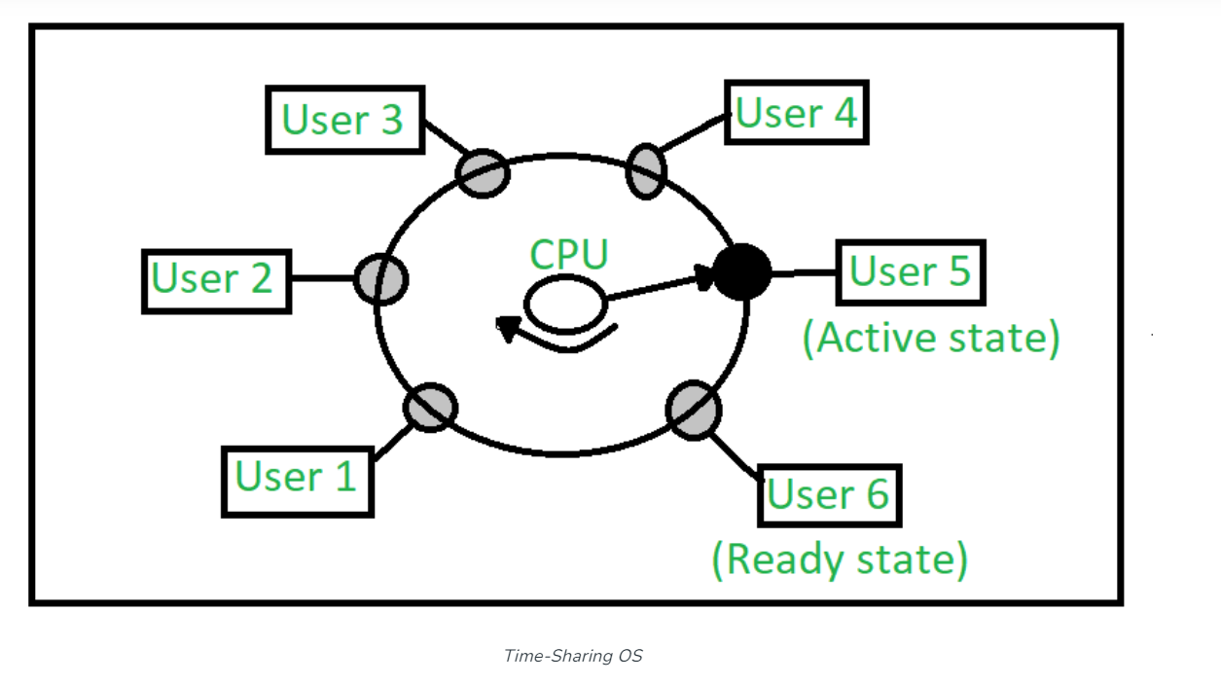
Multiple jobs are executed by the CPU by switching between them, but the switches occur so frequently. Thus, the user can receive an immediate response.

Slide 30
Advantages of Time-Sharing OS
Each task gets an equal opportunity.
Fewer chances of duplication of software.
CPU idle time can be reduced.
Resource Sharing: Time-sharing systems allow multiple users to share hardware resources such as the CPU, memory, and peripherals, reducing the cost of hardware and increasing efficiency.
Improved Productivity: Time-sharing allows users to work concurrently, thereby reducing the waiting time for their turn to use the computer. This increased productivity translates to more work getting done in less time.
Improved User Experience: Time-sharing provides an interactive environment that allows users to communicate with the computer in real time, providing a better user experience than batch processing.

Slide 31
Disadvantages of Time-Sharing OS
Reliability problem.
One must have to take care of the security and integrity of user programs and data.
Data communication problem.

Slide 32
Distributed Operating System
These types of operating system is a recent advancement in the world of computer technology and are being widely accepted all over the world.
Various autonomous interconnected computers communicate with each other using a shared communication network.
Independent systems possess their own memory unit and CPU.
These are referred to as loosely coupled systems or distributed systems.
These systems’ processors differ in size and function.

Slide 33
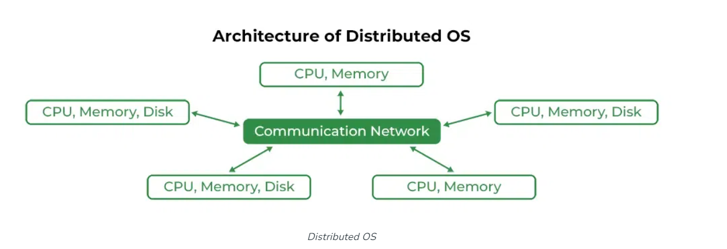
The major benefit of working with these types of the operating system is that it is always possible that one user can access the files or software which are not actually present on his system but some other system connected within this network
i.e., remote access is enabled within the devices connected in that network.

Slide 34
Advantages of Distributed Operating System
Failure of one will not affect the other network communication, as all systems are independent of each other.
Electronic mail increases the data exchange speed.
Since resources are being shared, computation is highly fast and durable.
Load on host computer reduces.
Delay in data processing reduces.
Disadvantages of Distributed Operating System
Failure of the main network will stop the entire communication.
To establish distributed systems the language is used not well-defined yet.
These types of systems are not readily available as they are very expensive.

Slide 35
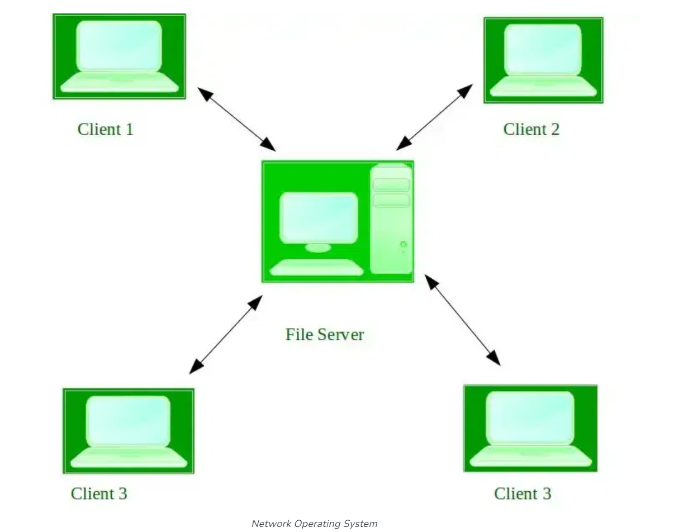
Network operating System

Slide 36
A Network Operating System runs on a server and provides the server the capability to manage data, users, groups, security, applications, and other networking functions.
The primary purpose of the network operating system is to allow shared file and printer access among multiple computers in a network, typically a local area network (LAN), a private network or to other networks.
Examples of network operating systems include Microsoft Windows Server 2003, Microsoft Windows Server 2008, UNIX, Linux, Mac OS X, Novell NetWare, and BSD.

Slide 37
Advantages of Network Operating System
Highly stable centralized servers.
Security concerns are handled through servers.
New technologies and hardware up-gradation are easily integrated into the system.
Server access is possible remotely from different locations and types of systems.
Disadvantages of Network Operating System
Servers are costly.
User has to depend on a central location for most operations.
Maintenance and updates are required regularly.

Slide 38
Real-Time Operating System
These types of OSs serve real-time systems. The time interval required to process and respond to inputs is very small. This time interval is called response time.
Real-time systems are used when there are time requirements that are very strict like missile systems, air traffic control systems, robots, etc.
Examples of Real-Time Operating Systems are Scientific experiments, medical imaging systems, industrial control systems, weapon systems, robots, air traffic control systems, etc.

Slide 39
Types of Real-Time Operating Systems
Hard Real-Time Systems:
Hard Real-Time OSs are meant for applications where time constraints are very strict and even the shortest possible delay is not acceptable.
These systems are built for saving life like automatic parachutes or airbags which are required to be readily available in case of an accident. Virtual memory is rarely found in these systems.
Soft Real-Time Systems: These OSs are for applications where time-constraint is less strict.

Slide 40
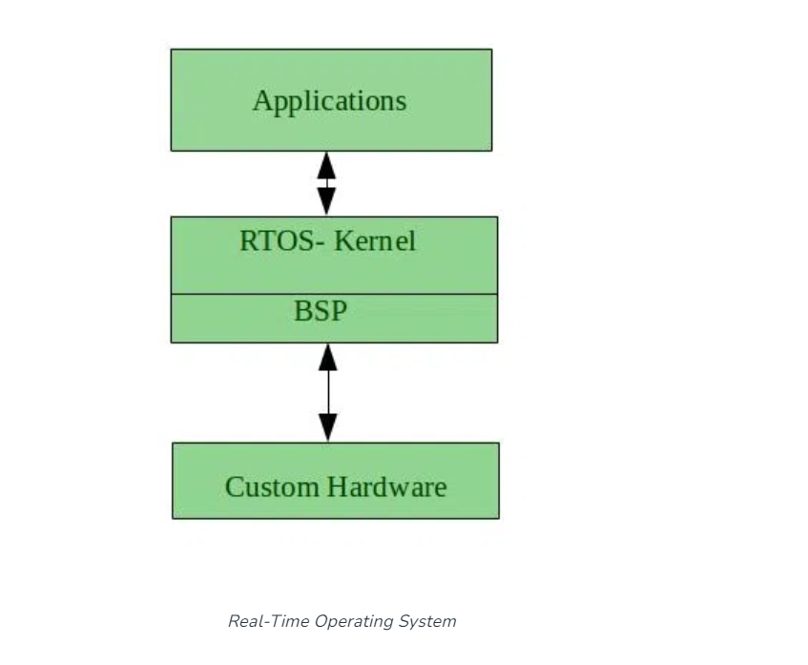

Slide 41
Advantages of RTOS
Maximum Consumption: Maximum utilization of devices and systems, thus more output from all the resources.
Task Shifting: The time assigned for shifting tasks in these systems is very less.
Focus on Application: Focus on running applications and less importance on applications that are in the queue.
Real-time operating system in the embedded system: Since the size of programs is small, RTOS can also be used in embedded systems like in transport and others.
Error Free: These types of systems are error-free.
Memory Allocation: Memory allocation is best managed in these types of systems.

Slide 42
Disadvantages of RTOS
Limited Tasks: Very few tasks run at the same time and their concentration is very less on a few applications to avoid errors.
Use heavy system resources: Sometimes the system resources are not so good and they are expensive as well.
Complex Algorithms: The algorithms are very complex and difficult for the designer to write on.
Device driver and interrupt signals: It needs specific device drivers and interrupts signal to respond earliest to interrupts.
Thread Priority: It is not good to set thread priority as these systems are very less prone to switching tasks.

Slide 43
Introduction of System Call
A system call is a mechanism used by programs to request services from the operating system (OS).
In simpler terms, it is a way for a program to interact with the underlying system, such as accessing hardware resources or performing privileged operations.
A computer program makes a system call when it makes a request to the operating system’s kernel.
System call provides the services of the operating system to the user programs via Application Program Interface(API).
System calls are essential for the proper functioning of an operating system, as they provide a standardized way for programs to access system resources.

Slide 44
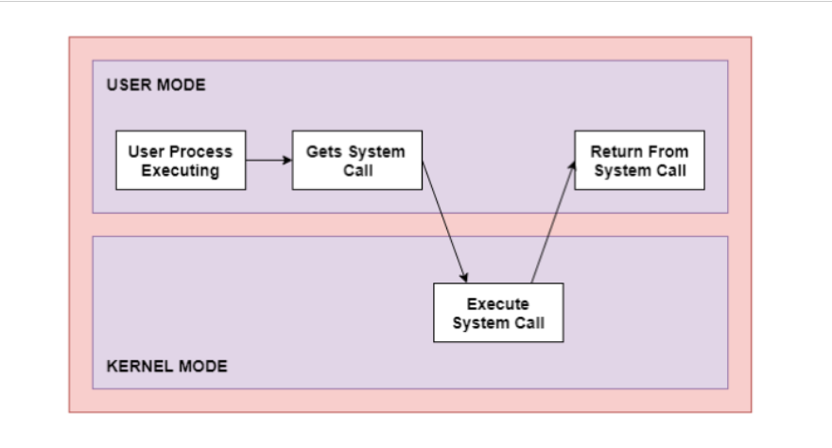
The processes execute normally in the user mode until a system call interrupts this.
Then the system call is executed on a priority basis in the kernel mode.
After the execution of the system call, the control returns to the user mode, and execution of user processes can be resumed.

Slide 45
Types of System Calls
There are mainly five types of system calls. These are explained in detail as follows −
Process Control
These system calls deal with processes such as process creation, process termination etc.
File Management
These system calls are responsible for file manipulation such as creating a file, reading a file, writing into a file etc.

Slide 46
Device Management
These system calls are responsible for device manipulation such as reading from device buffers, writing into device buffers etc.
Information Maintenance
These system calls handle information and its transfer between the operating system and the user program.
Communication
These system calls are useful for interprocess communication. They also deal with creating and deleting a communication connection.

Slide 47
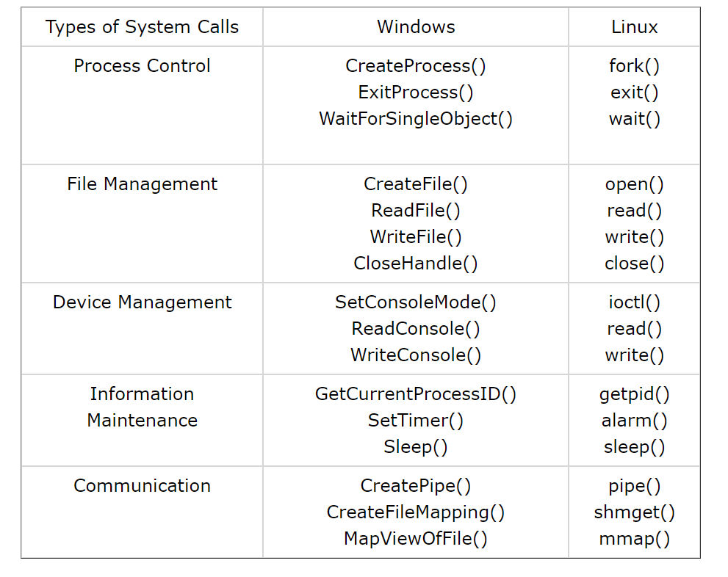
These are the types of system calls in Windows and Unix are given as follows −

Slide 48
Process:
Process
Definition: “A program in the execution is called a Process .it is an entity which represents the basic unit of work to be implemented in the system.”
Program:
A program by itself is not a process. It is a static entity made up of program statement while process is a dynamic entity. Program contains the instructions to be executed by processor.
A program takes a space at single place in main memory and continues to stay there. A program does not perform any action by itself.

Slide 49
To put it in simple terms, we write our computer programs in a text file and when we execute this program, it becomes a process that performs all the tasks mentioned in the program.
A program becomes a Process when an executable file is loaded into main memory and when its PCB is created.

Slide 50
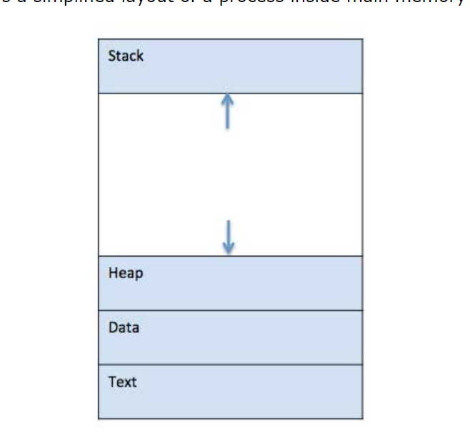
Process in Memory:
When a program is loaded into the memory and it becomes a process, it can be divided into four sections ─ stack, heap, text and data.

Slide 51
Stack
The process Stack contains the temporary data such as method/function parameters, return address and local variables.
Heap
This is dynamically allocated memory to a process during its run time.
Data
This section contains the global and static variables.
Text
Program code is called as Text.(Compiled code)

Slide 52
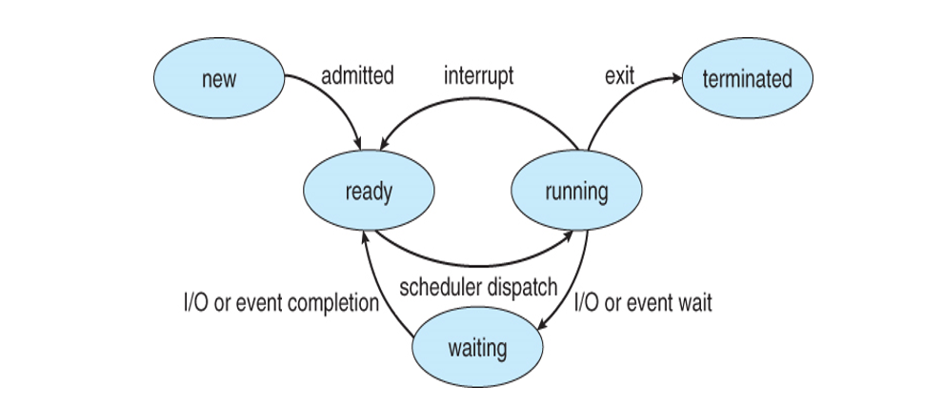
Process States
As a process executes, it changes state. The state of a process is defined as the current activity of the process.
Process can have one of the following five states at a time.

Slide 53
Processes can be any of the following states:
New - The process is in the stage of being created.
Ready - The process has all the resources available that it needs to run, but the CPU is not currently working on this process's instructions.
Running - The CPU is working on this process's instructions.
Waiting - The process cannot run at the moment, because it is waiting for some resource to become available or for some event to occur.
Terminated - The process has completed.

Slide 54
Process Control Block, PCB
Each process is represented in the operating system by a process control block (PCB) also called a task control block.
PCB is the data structure used by the operating system. Operating system groups all information that needs about particular process.
PCB simply serves as the repository for any information that may vary from process to process.
PCB contains many pieces of information associated with a specific process.

Slide 55
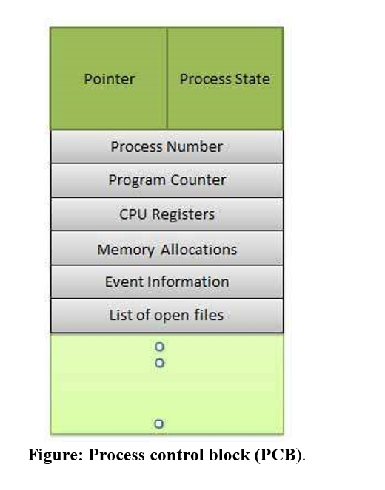

Slide 56
Pointer Pointer points to another process control block. Pointer is used for maintaining the scheduling list.
Process State
Process state may be new, ready, running, waiting and so on.
Process Number
A unique identification number for each process in the operating system.
Program Counter
Program Counter indicates the address of the next instruction to be executed for this process.
CPU registers
CPU registers include general purpose register, stack pointers, index registers and accumulators etc. number of register and type of register totally depends upon the computer architecture.

Slide 57
Memory management information
This information may include the value of base and limit registers, the page tables, or the segment tables depending on the memory system used by the operating system. This information is useful for deallocating the memory when the process terminates.
Accounting information
This information includes the amount of CPU and real time used time limits, job or process numbers, account numbers etc.
Process control block includes CPU scheduling, I/O resource management, file management information etc.

Slide 58
Process Scheduling
The process scheduling is the activity of the process manager that handles the removal of the running process from the CPU and the selection of another process.
Process scheduling is an essential part of a Multiprogramming operating systems.
Such operating systems allow more than one process to be loaded into the executable memory at a time and the loaded process shares the CPU using time multiplexing.

Slide 59
Process scheduler selects among available processes for next execution on CPU
Goal -- Maximize CPU use, quickly switch processes onto CPU
Maintains scheduling queues of processes
Ready queue – set of all processes residing in main memory, ready and waiting to execute
Wait queues – set of processes waiting for an event (i.e., I/O)
Processes migrate among the various queues

Slide 60
Process Scheduling Queues
The OS maintains all Process Control Blocks (PCBs) in Process Scheduling Queues.
The OS maintains a separate queue for each of the process states and PCBs of all processes in the same execution state are placed in the same queue.
When the state of a process is changed, its PCB is unlinked from its current queue and moved to its new state queue.

Slide 61
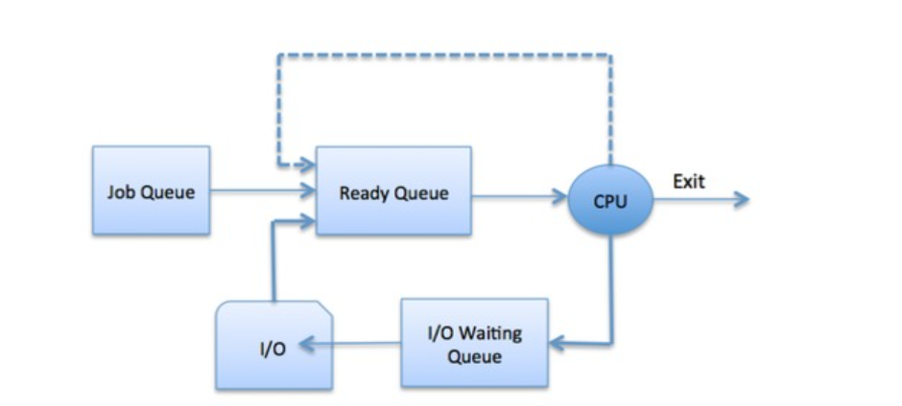

Slide 62
The Operating System maintains the following important process scheduling queues −
Job queue − This queue keeps all the processes in the system.
Ready queue − This queue keeps a set of all processes residing in main memory, ready and waiting to execute. A new process is always put in this queue.
Device queues − The processes which are blocked due to unavailability of an I/O device constitute this queue.

Slide 63
Categories of Scheduling
There are two categories of scheduling:
Non-preemptive: Here the resource can’t be taken from a process until the process completes execution.
The switching of resources occurs when the running process terminates and moves to a waiting state.
Preemptive: Here the OS allocates the resources to a process for a fixed amount of time. During resource allocation, the process switches from running state to ready state or from waiting state to ready state.
This switching occurs as the CPU may give priority to other processes and replace the process with higher priority with the running process.

Slide 64
Two State Process Model:
Two state process model refers to running and non-running states Running when new process is created by Operating System that process enters into the system as in the running state.
Not Running
Processes that are not running are kept in queue, waiting for their turn to execute.
Each entry in the queue is a pointer to a particular process.
Queue is implemented by using linked list.
Use of dispatcher is as follows. When a process is interrupted, that process is transferred in the waiting queue.
If the process has completed or aborted, the process is discarded.
In either case, the dispatcher then selects a process from the queue to execute.

Slide 65
Schedulers
Schedulers are special system software and it is used for the selection of processes from different scheduling queues for execution purposes.
Their main task is to select the jobs to be submitted into the system and to decide which process to run.
Schedulers are of three types −
Long-Term Scheduler
Short-Term Scheduler
Medium-Term Scheduler

Slide 66
Long-Term Scheduler
It is also called a job scheduler.
Long term scheduler determines which programs are admitted to the system for processing.
Job scheduler selects processes from the queue and loads them into memory for execution.
It brings the new process to the ‘Ready State’.
Process loads into the memory for CPU scheduling.
The primary objective of the job scheduler is to provide a balanced mix of jobs, such as I/O bound and processor bound.
It also controls the degree of multiprogramming.

Slide 67
Short Term Scheduler
It is also called as CPU scheduler.
Short-term schedulers, also known as dispatchers, make the decision of which process to execute next. Short-term schedulers are faster than long-term schedulers.
It is the change of ready state to running state of the process.
CPU scheduler selects a process among the processes that are ready to execute and allocates CPU to one of them.
Its main objective is to increase system performance in accordance with the chosen set of criteria.

Slide 68
Medium-Term Scheduler
Medium term scheduling is part of the swapping.
Running process may become suspended if it makes an I/O request. Suspended processes cannot make any progress towards completion.
In this condition, to remove the process from memory and make space for other process, the suspended process is moved to the secondary storage.
This process is called swapping, and the process is said to be swapped out or rolled out. Swapping may be necessary to improve the process mix.
The medium term scheduler is in-charge of handling the swapped out-processes.
It reduces the degree of multiprogramming.

Slide 69
S.N. | Long Term Scheduler | Short Term Scheduler | Medium Term Scheduler
1 | It is a job scheduler | It is a CPU scheduler | It is a process swapping scheduler.
2 | Speed is lesser than short term scheduler | Speed is fastest among other two | Speed is in between both short and long term scheduler.
3 | It controls the degree of multiprogramming | It provides lesser control over degree of multiprogramming | It reduces the degree of multiprogramming.
4 | It is almost absent or minimal in time sharing system | It is also minimal in time sharing system | It is a part of Time sharing systems.
5 | It selects processes from pool and loads them into memory for execution | It selects those processes which are ready to execute | It can re-introduce the process into memory and execution can be continued.

Slide 70
Operations on Processes
There are many operations that can be performed on processes. Some of these are
Process Creation,
Process Scheduling,
Process Preemption,
Process Blocking, And
Process Termination.

Slide 71
Process Creation
Processes need to be created in the system for different operations. This can be done by the following events −
User request for process creation
System initialization
Execution of a process creation system call by a running process
A process may be created by another process using fork().
The creating process is called the parent process and the created process is the child process.
A child process can have only one parent but a parent process may have many children.
Both the parent and child processes have the same memory image, open files, and environment strings.

Slide 72
Scheduling/Dispatching
The event or activity in which the state of the process is changed from ready to run.
It means the operating system puts the process from the ready state into the running state.
Process Preemption
An interrupt mechanism is used in preemption that suspends the process executing currently and the next process to execute is determined by the short-term scheduler.
Preemption makes sure that all processes get some CPU time for execution.

Slide 73
Process Blocking
The process is blocked if it is waiting for some event to occur.
This event may be I/O as the I/O events are executed in the main memory and don't require the processor.
After the event is complete, the process again goes to the ready state.

Slide 74
Process Termination
After the process has completed the execution of its last instruction, it is terminated. The resources held by a process are released after it is terminated.
A child process can be terminated by its parent process if its task is no longer relevant.
The child process sends its status information to the parent process before it terminates.
Also, when a parent process is terminated, its child processes are terminated as well as the child processes cannot run if the parent processes are terminated.

Slide 75
Cooperating Processes
Cooperating Processes are those processes that depend on other processes or processes.
They work together to achieve a common task in an operating system.
These processes interact with each other by sharing the resources such as CPU, memory, and I/O devices to complete the task.

Slide 76
Reasons for needing cooperating processes
Modularity:
Modularity involves dividing complicated tasks into smaller subtasks.
These subtasks can completed by different cooperating processes.
This leads to faster and more efficient completion of the required tasks.
Information Sharing:
Sharing of information between multiple processes can be accomplished using cooperating processes.
This may include access to the same files.
A mechanism is required so that the processes can access the files in parallel to each other.

Slide 77
Convenience:
There are many tasks that a user needs to do such as compiling, printing, editing, etc.
It is convenient if these tasks can be managed by cooperating processes.
Computation Speedup:
Subtasks of a single task can be performed parallelly using cooperating processes.
This increases the computation speedup as the task can be executed faster.
However, this is only possible if the system has multiple processing elements.

Slide 78
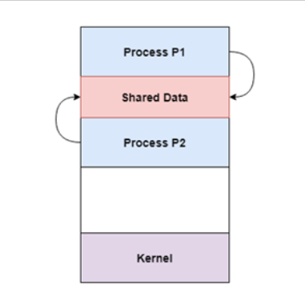
Methods of Cooperation
Cooperating processes can coordinate with each other using shared data or messages.
Cooperation by Sharing
The cooperating processes can cooperate with each other using shared data such as memory, variables, files, databases etc.
Critical section is used to provide data integrity and writing is mutually exclusive to prevent inconsistent data.

Slide 79
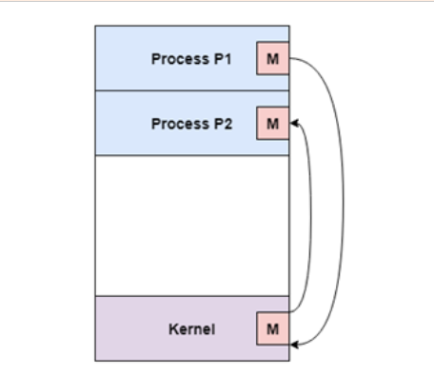
Cooperation by Communication:
The cooperating processes can cooperate with each other using messages.
This may lead to deadlock if each process is waiting for a message from the other to perform a operation.
Starvation is also possible if a process never receives a message.

Slide 80
Threads:
It is a lightweight process.
Thread is a part of the process.
Each process may have multiple processes.
Threads improve CPU utilization.
It will increase the performance of the application.
Running multiple threads concurrently is called multithreading.
Running multiple tasks at a time is called multitasking.

Slide 81
If a process has a single thread is called a Single threaded process.
If a process has multiple threads is known as a Multithreaded process.
Threads will share memory and data.
Switching from one thread to another thread is very simple.
Creating a new thread is also very simple.
Communication between threads is also simple.
Termination of threads is also very simple.

Slide 82
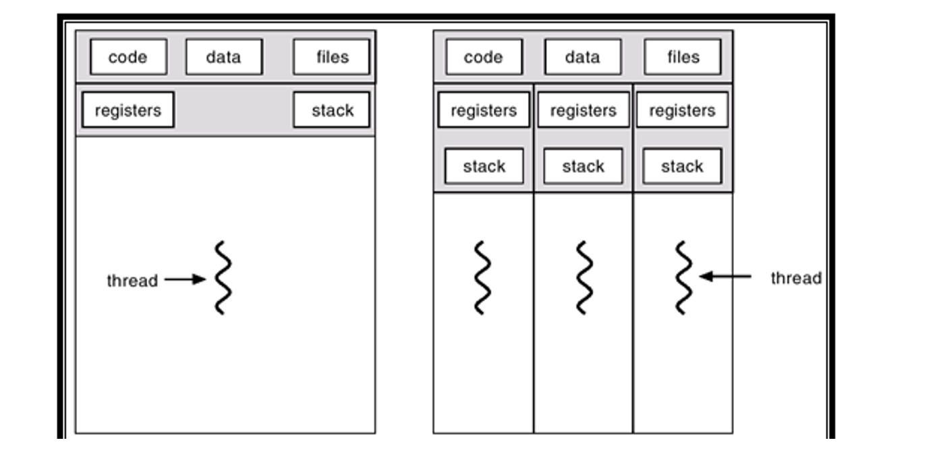

Slide 83
S.NO | Process | Thread
1. | Process means any program is in execution. | Thread means a segment of a process.
2. | The process takes more time to terminate. | The thread takes less time to terminate.
3. | It takes more time for creation. | It takes less time for creation.
4. | It also takes more time for context switching. | It takes less time for context switching.
5. | The process is less efficient in terms of communication. | Thread is more efficient in terms of communication.
6. | Process doesn’t share memory and data with other processes. | Threads share memory and data with other threads.
7. | The process is isolated. | Threads share memory.
8. | The process is called the heavyweight process. | A Thread is lightweight as each thread in a process shares code, data, and resources.

Slide 84
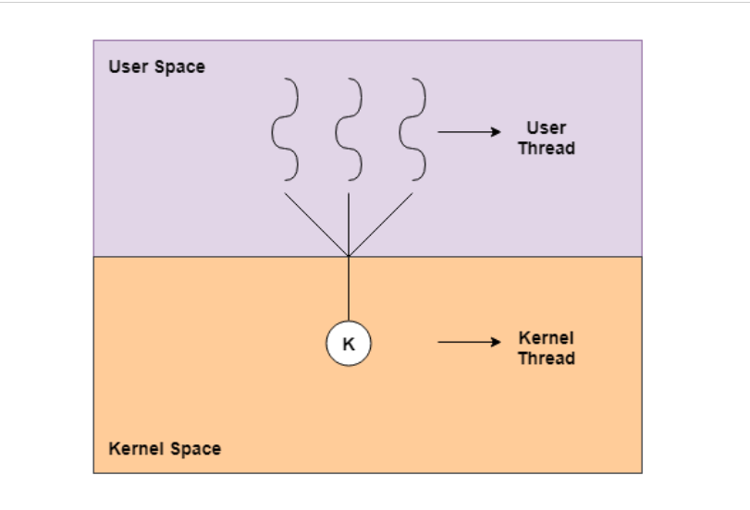
Types of Threads:
The two main types of threads.
Those are user-level threads and kernel-level threads.

Slide 85
User - Level Threads
The user-level threads are implemented by users and the kernel is not aware of the existence of these threads.
It handles them as if they were single-threaded processes. User-level threads are small and much faster than kernel level threads.
They are represented by a program counter(PC), stack, registers and a small process control block.
Also, there is no kernel involvement in synchronization for user-level threads.

Slide 86
Advantages of User-Level Threads
User-level threads are easier and faster to create than kernel-level threads. They can also be more easily managed.
User-level threads can be run on any operating system.
There are no kernel mode privileges required for thread switching in user-level threads.
Disadvantages of User-Level Threads
Multithreaded applications in user-level threads cannot use multiprocessing to their advantage.
The entire process is blocked if one user-level thread performs a blocking operation.

Slide 87
Kernel-Level Threads
Kernel-level threads are handled by the operating system directly and the thread management is done by the kernel.
The context information for the process as well as the process threads is all managed by the kernel.
Because of this, kernel-level threads are slower than user-level threads.

Slide 88
Advantages of Kernel-Level Threads
Multiple threads of the same process can be scheduled on different processors in kernel-level threads.
The kernel routines can also be multithreaded.
If a kernel-level thread is blocked, another thread of the same process can be scheduled by the kernel.
Disadvantages of Kernel-Level Threads
Kernel-level threads are slower to create as well as manage as compared to user-level threads.

Slide 89
User Level Threads | Kernel Level Thread
Implemented by user. | Implemented by Kernel.
Context Switching is easy. | Context Switching is
Multithreading is not compitable. | Multithreading is compitable.
Implementation is easy and takes less time. | Implementation is difficult and takes more time.
If any thread is blocked then other threads also goes to block state. | If any thread is blocked then other threads will not be in block state.
Doesn’t recognized by OS. | Recognized by OS.
Hardware support is not required. | Hardware support is required.
User Level Threads | Kernel Level Thread
Implemented by user. | Implemented by Kernel.

Slide 90
Fork() System call:
The fork( ) function is used to create a new process by duplicating the existing process from which it is called.
The existing process from which this function is called becomes the parent process.
?>,mnb vcxzThe newly created process becomes the child process.
As already stated that child is a duplicate copy of the parent but there are some exceptions to it.
Parent and child processes will have different process IDs.
After the fork() system call, both the parent and child processes run independently, each has its own memory space and resources.

Slide 91
The fork() system call declared in the <unistd.h>header file.
The fork() system call has the following return values:
On success it returns twice:
To the parent process, it returns the process ID(PID) of the newly created child process. This PID is a positive integer and is used by the parent process to refer to the child process.
To the child process, it returns 0. this is how the child process can know that it is the child.
On failure:
It returns -1 to the parent process, no child process is created.

Slide 92
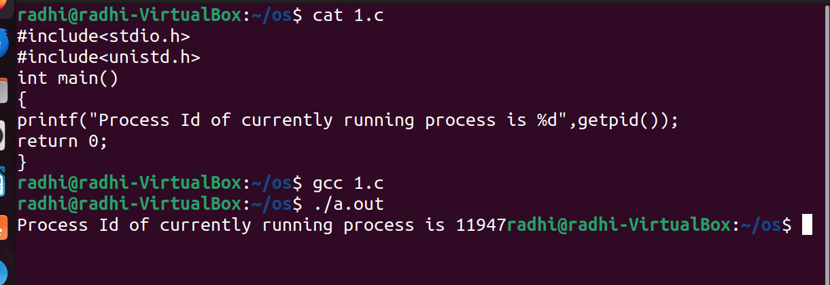

Slide 93
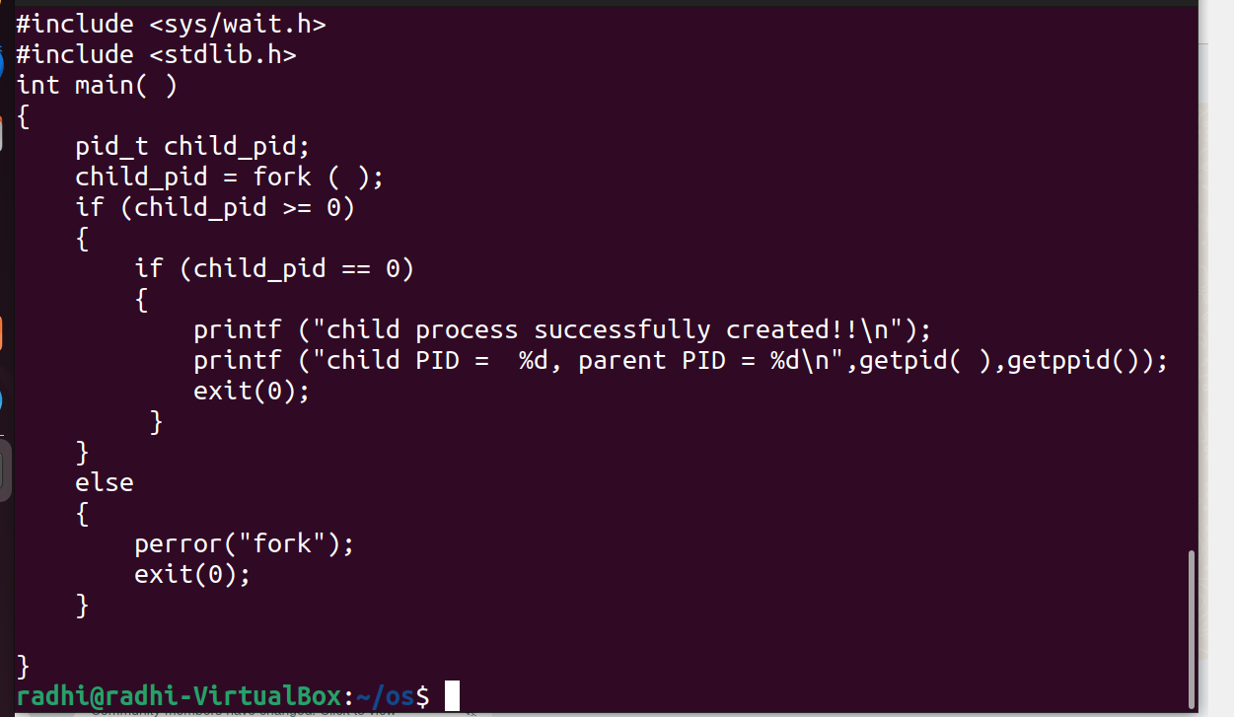

Slide 94
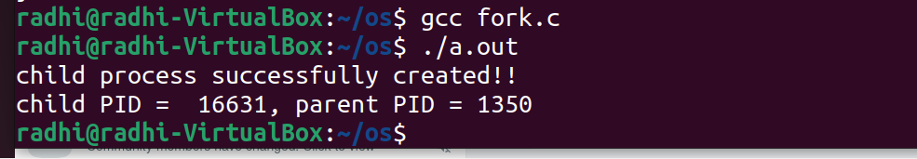

Slide 95
Exit()
The exit ( ) system call terminates the process normally.
It specifies that the program has completed its execution and is ready to be terminated.
The exit system call takes an exit status code ,which is a small integer value that the process returned to the operating syatem.
Status: Status value returned to the parent process.
Generally, a status value of 0 or EXIT_SUCCESS indicates success, and any other value or the constant EXIT_FAILURE is used to indicate an error.

Slide 96
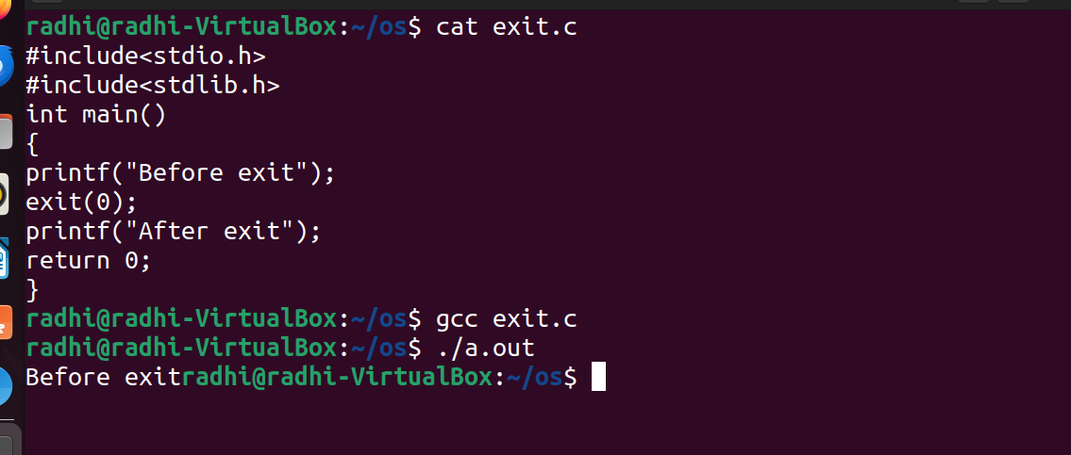

Slide 97
exec( ) system call
The exec family of functions replaces the current running process with a new process. It can be used to run a C program by using another C program”.
exec system call is a collection of functions as follows:
execl
execv.... etc.
execv Syntax:
int execv(const char *path, char *const argv[]);
path: should point to the path of the file being executed. argv[]: is a null terminated array of character pointers.

Slide 98
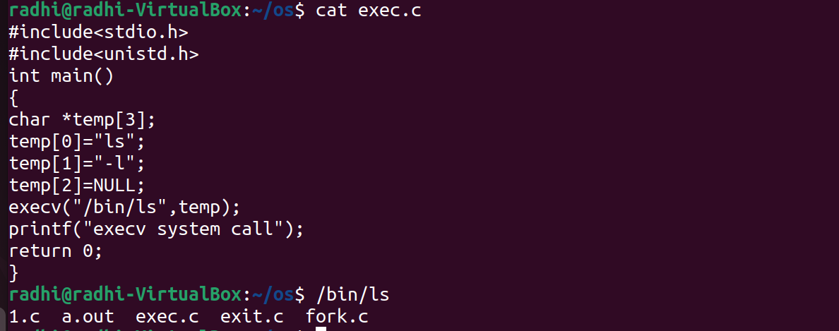

Slide 99
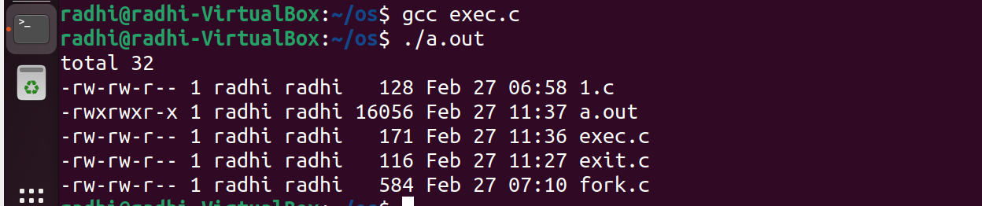

Slide 100
Wait():
A call to wait() blocks the calling process until one of its child processes exits or a signal is received.
After child process terminates, parent continues its execution after wait system call instruction.

Slide 101
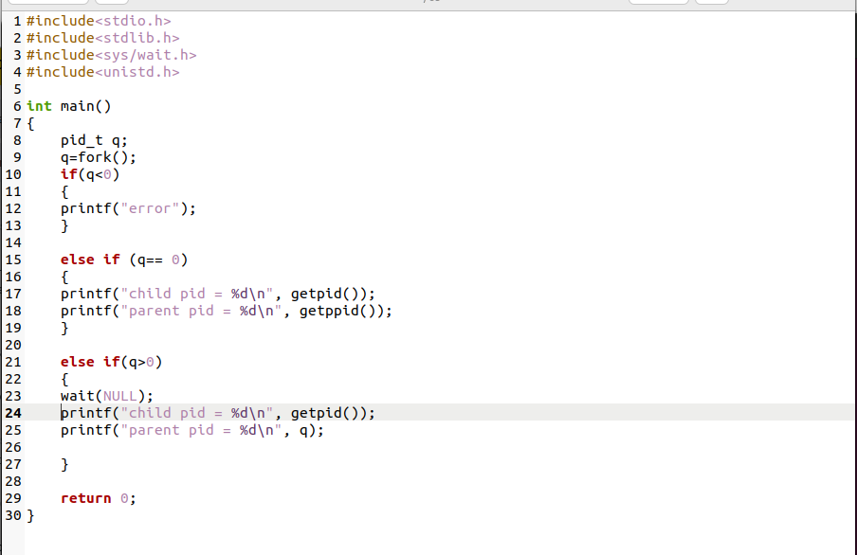

Slide 102
