Slide 1
Analytical Report
Title: | TEM/STEM/EDS Analysis
Author: | Gayan Karunasinghe
Project #:
Requestor:
Executive Summary/Abstract: ‘

Slide 2
Background
Project #:
Sample Number(s): | 200123417, 200123418
Motivation: | Determine the particle size distribution of the catalyst sample.
Method and Parameters:
The sample was prepared using the Drop Casting method. The small amount of catalyst powder (~10 mg) was dissolved in a 100 % ethanol (~5 ml) and sonicated for 15 minutes. Then, a drop of the solution was put on a copper coated lacey carbon grid and dried the sample. TEM/STEM/EDS was performed on FEI Talos F200X at the University of Kentucky.

Slide 3
STEM images for: 200123417
The bright spots are Ag particles (HAADF was used, so heavier elements appear bright) and EDS was used to ensure nothing else was present

Slide 4
Particle Size Distribution (PSD) Graph for: 200123417
A total of 200 particles were analyzed to determine the average particle size of the catalyst

Slide 5
Particle Size Distribution (PSD) Graph for: 200123417
A total of 200 particles were analyzed to determine the average particle size of the catalyst

Slide 6
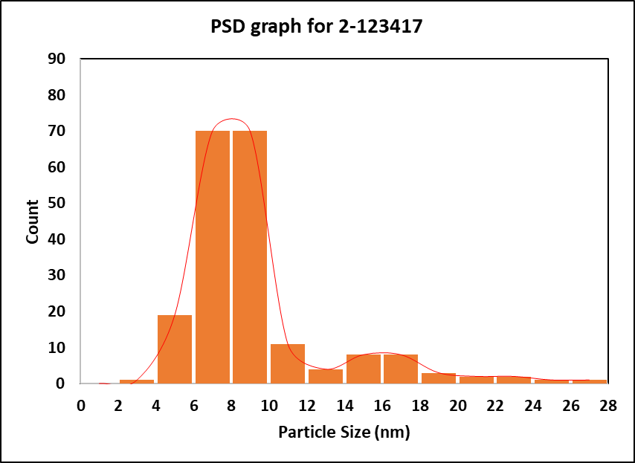
Particle Size Distribution (PSD) Graph for: 2-123417
Average Particle size: 7.3±3.9 nm
A total of 200 particles were analyzed to determine the average particle size of the catalyst

Slide 7
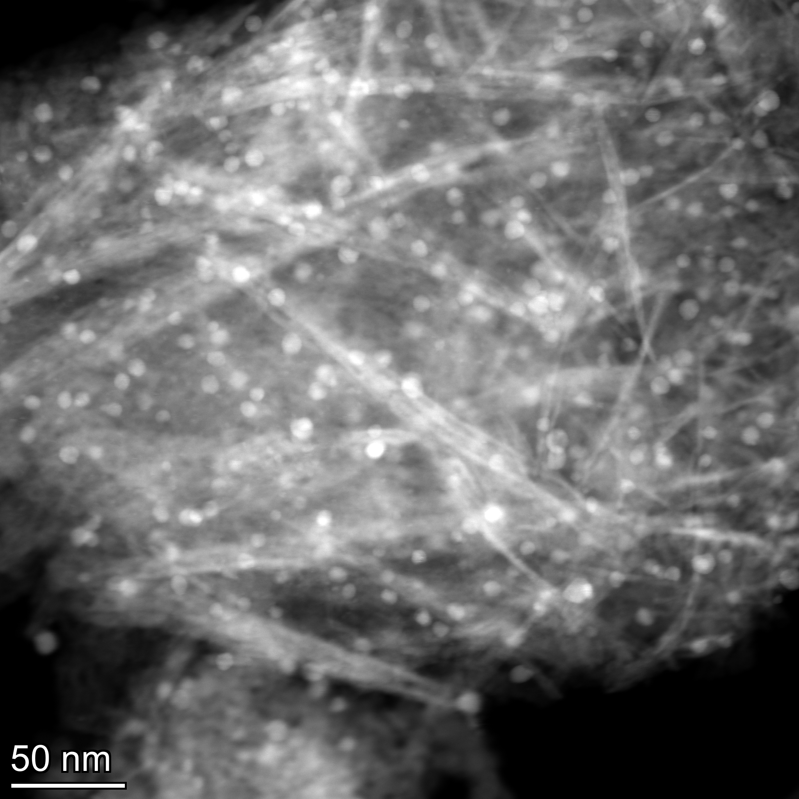
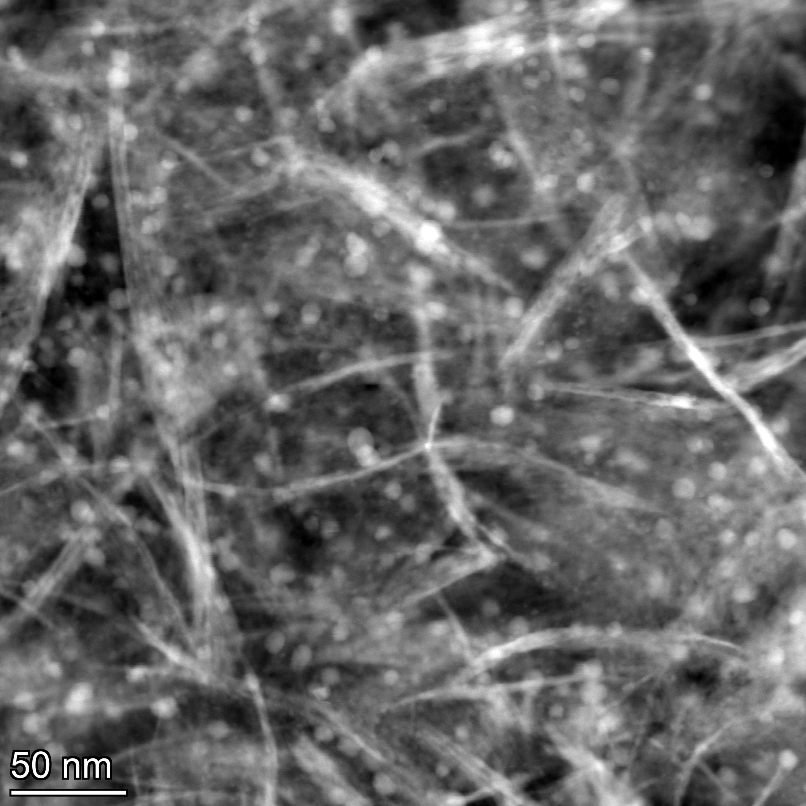
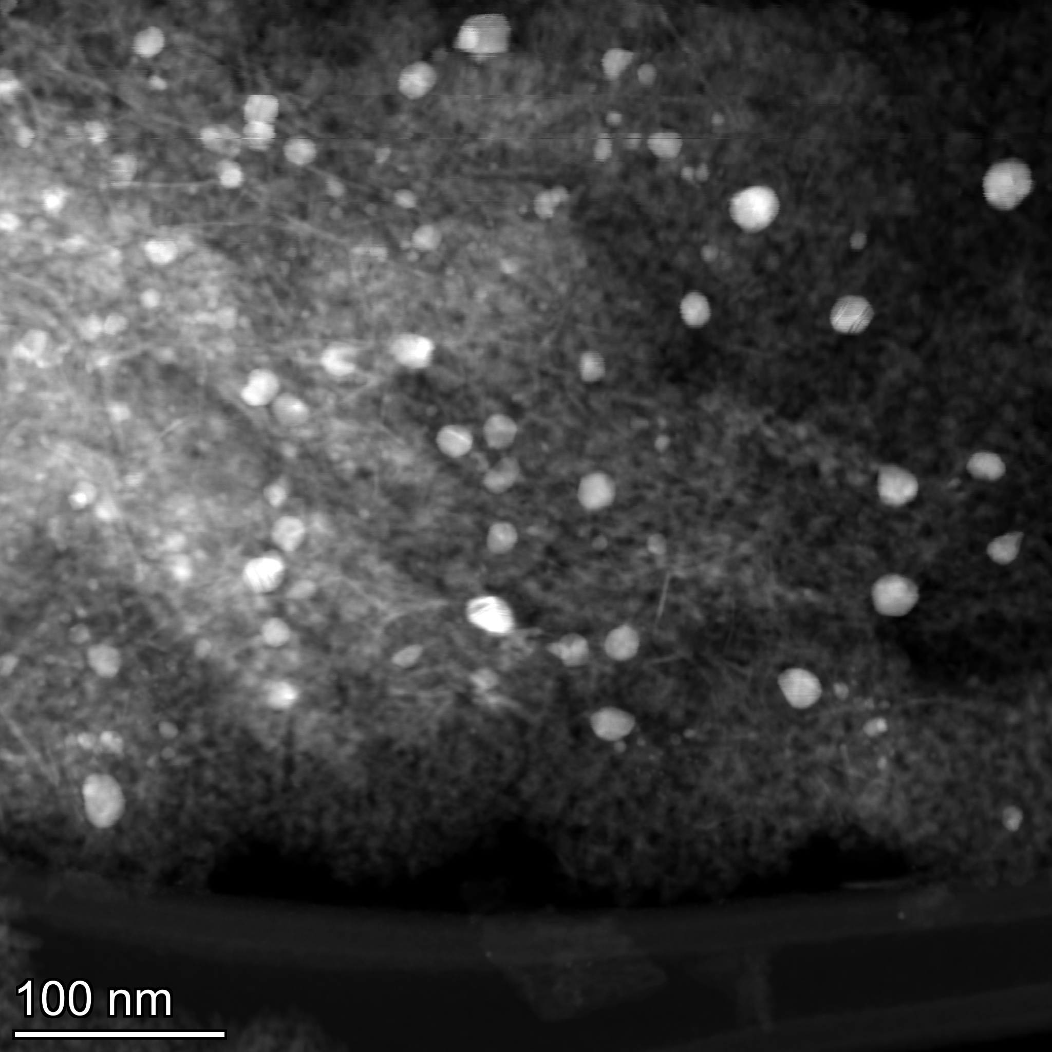
STEM images for : 200120000
The bright spots are Ag particles (HAADF was used, so heavier elements appear bright) and EDS was used to ensure nothing else was present

Slide 8
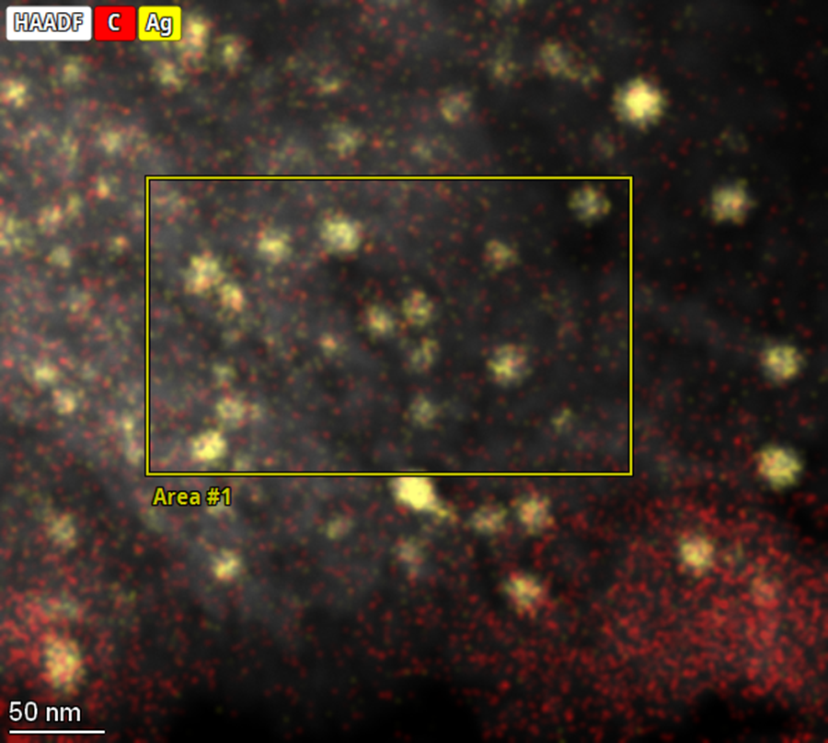
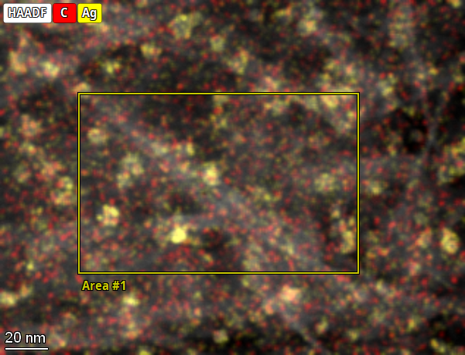
STEM-EDS image for : 2-123417
Spot 1
Element | Atomic Fraction (%) | Mass Fraction (%)
C | 6.34 | 3.80
O | 59.63 | 47.64
Al | 33.35 | 44.93
Ag | 0.67 | 3.62
Spot 2
Element | Atomic Fraction (%) | Mass Fraction (%)
C | 5.41 | 3.25
O | 59.00 | 47.15
Al | 35.18 | 47.41
Ag | 0.41 | 2.20

Slide 9
Background
Project #:
Sample Number(s):
Motivation: | Determine the particle size distribution of the catalyst sample.
Method and Parameters: The sample was prepared using the Drop Casting method. The small amount of catalyst powder (~10 mg) was dissolved in a 100 % ethanol (~5 ml) and sonicated for 15 minutes. Then, a drop of the solution was put on a copper coated lacey carbon grid and dried the sample. TEM/STEM/EDS was performed on FEI Talos F200X at the University of Kentucky.

Slide 10
STEM images for: 200123417

Slide 11
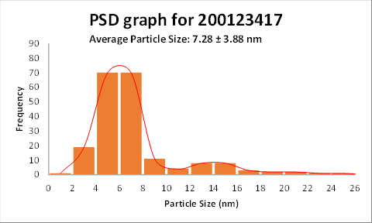
Particle Size Distribution (PSD) Graph for: 200123417
A total of 200 particles were analyzed to determine the average particle size of the catalyst

Slide 12
STEM images for: 200123418

Slide 13
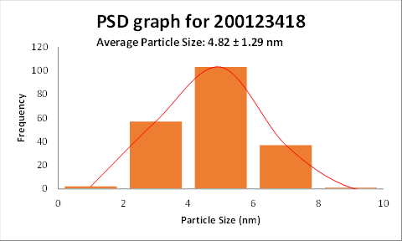
Particle Size Distribution (PSD) Graph for: 200123418
A total of 200 particles were analyzed to determine the average particle size of the catalyst

