Slide 1
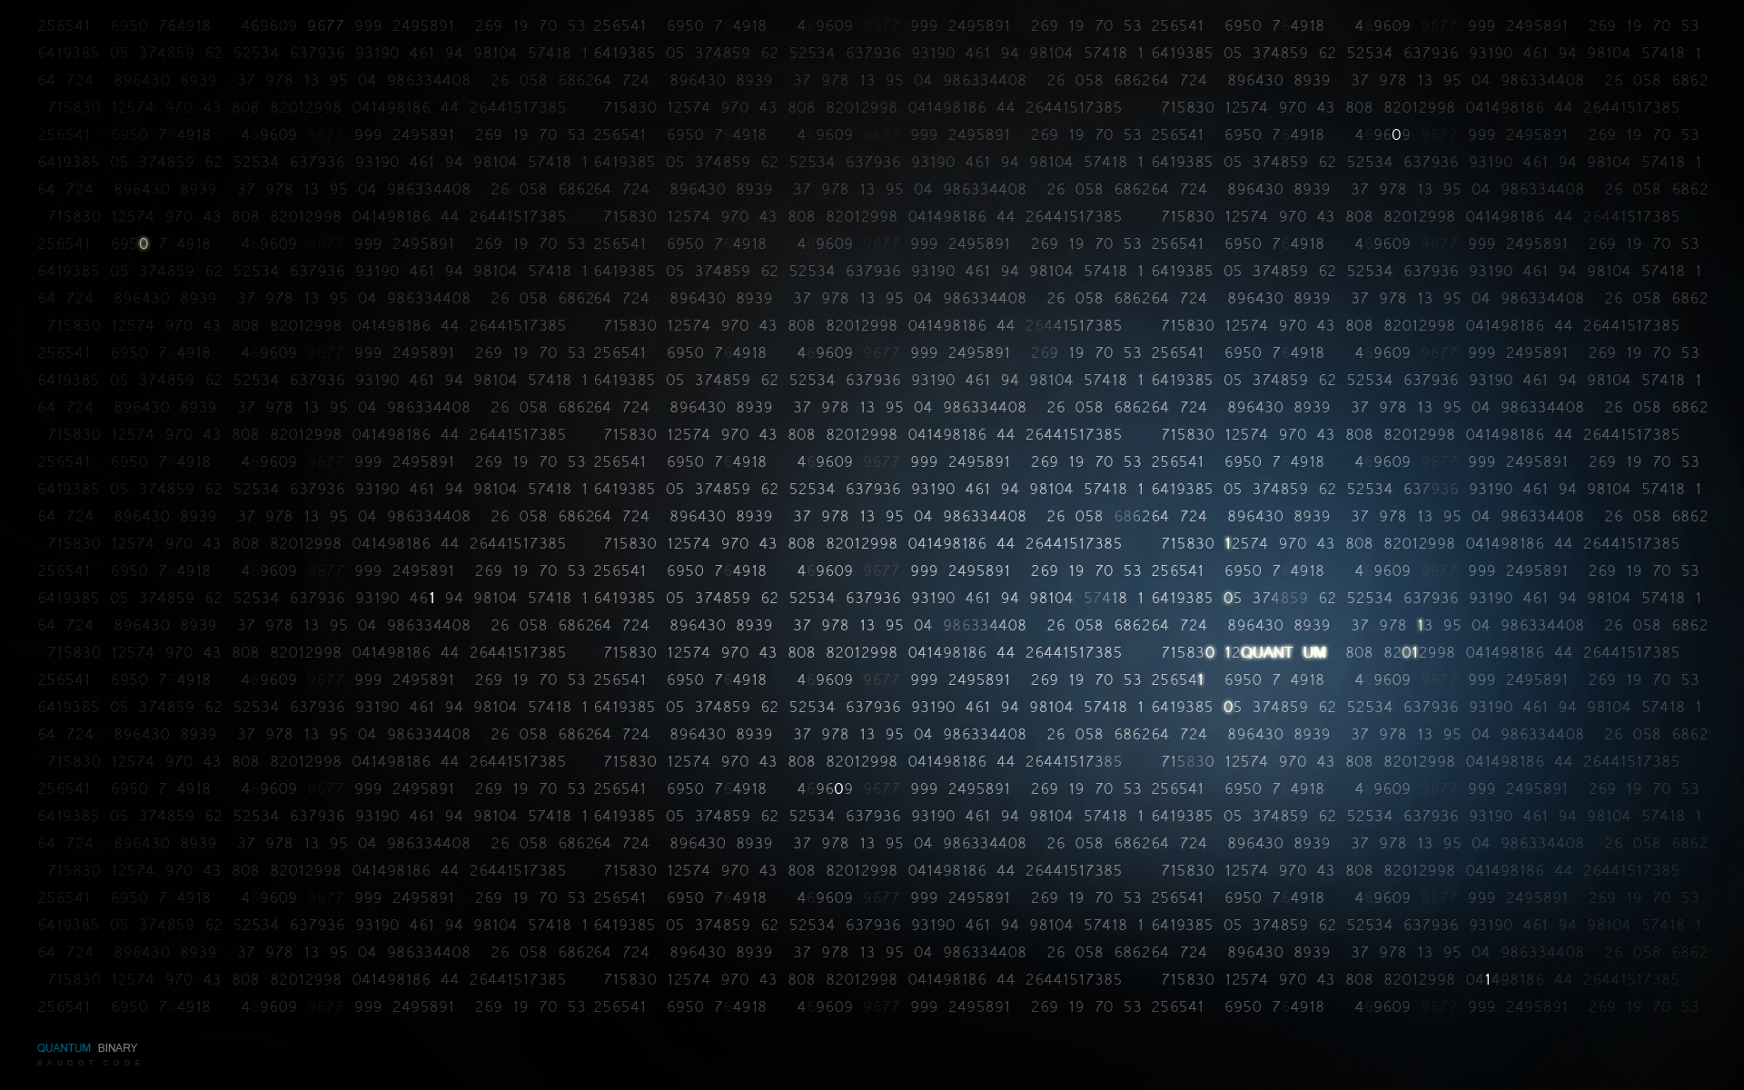
What do you want to
do for a career?
By Alexjandro

Slide 2

Stuxnet - Cyber Warfare
http://www.youtube.com/watch?v=7g0pi4J8auQ

Slide 3
Computer Forensics
Computer Forensics specialist examine digital media in a forensically sound manner with the aim of identifying, preserving, recovering, analyzing and presenting facts and opinions about the information.

Slide 4
Amazing Mind Reader!

Slide 5
What Can You Do To Help Your Self And Your Parents Prevent Your Personal Information From getting In The Hands Of A BAD GUY?!?

Slide 6
Protect your private personal information. Social Security Numbers,
account numbers, passwords etc....
If anything on the internet says "FREE" don't download it unless your parents trust the site.
Some good sites to download from is download.com, itunes, ...
Using strong passwords that are hard to guess.
https://www.microsoft.com/security/pc-security/password-checker.aspx
http://www.microsoft.com/security/online-privacy/passwords-create.aspx
Beware of Peer to Peer sharing, frankly don't do it!
Phishing
Mobile devices

Slide 7
Protect Yourselves

Slide 10
Any more questions
you want to ask?

