Slide 1
Semantic Role Labeling
Team Name: Semantic Sentinels
Team Number: 55
1. D Priyanka - 2023814003
2. S Monica - 2023802005
3. CV Thirumala Kumar - 2023702020

Slide 2
Introduction
Semantic Role Labeling (SRL) is the task of assigning roles to words/phrases in relation to the main verb, such as "agent", "patient", "instrument", etc.​
The police officer detained the suspect at the scene of the crime
Who
did what
to whom
at where
Fig. Pictorial depiction of SRL

Slide 3
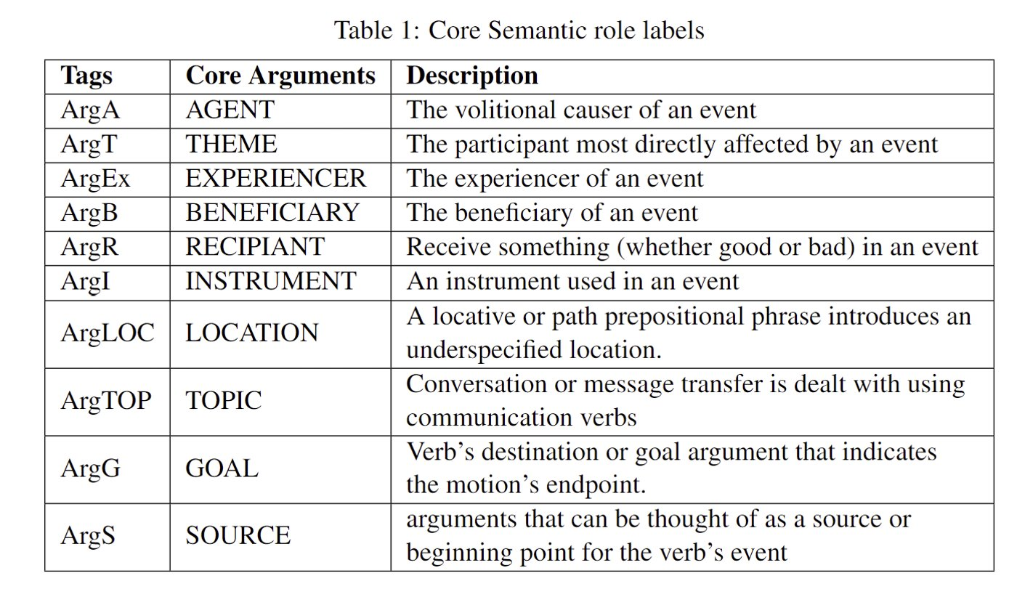
Core Semantic Role Labels

Slide 4
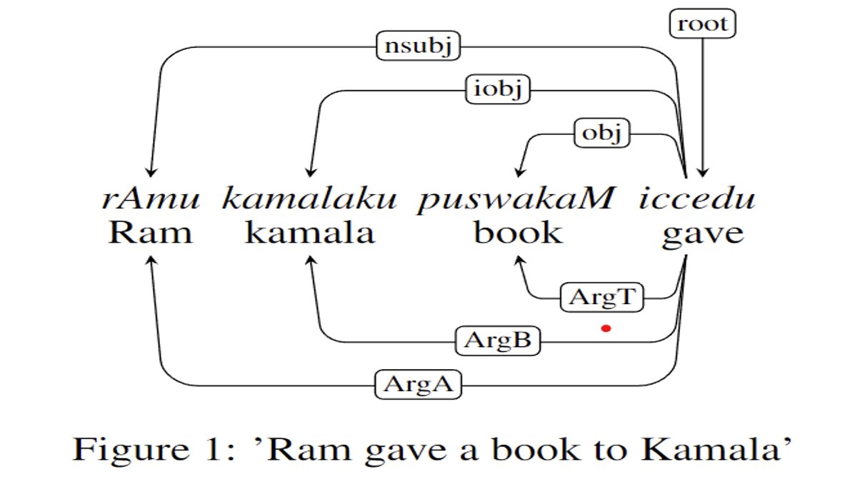
Example

Slide 5
Existing approaches
Argument Identification
Argument
Classification
Semantic
roles
Sentence
Fig. Cascaded approach
Drawbacks:
Requires additional information such as PoS tags, dependency relation etc.
Not feasible for practical usage
Not feasible for multiple languages

Slide 6
Proposed approach
Multilingual
End-to-End
SRL
Semantic
roles
Sentence
Challenges:
Lack of data for Deep learning approach
Lack of Multi-lingual SRL data
Available Data:
Urdu SRL dataset

Slide 7
Data Augmentation Pipeline
Urdu Sentences
Translator
Aligner
Roles Transfer
Multilingual SRL labelled data
Hindi
Tamil
Telugu
Alignments
1. Urdu-Hindi
2. Urdu-Tamil
3. Urdu-Telugu
Urdu roles
Non-SRL Tags:
NAH (Not-A-Head)
NAA (Not-An-Argument)
Predicate

Slide 8
Experimental setup
Fine-tuning 2 bert based models for SRL as a token-classification task.
Indic-Bert (AI4Bharath) - 24 Languages
Multilingual-Bert (Google) - 104 Languages
Model Name | Base Model | Description
Indic-bert | Indic-bert | labelling only first subtoken of the word
Indic-bert -lat |  | labelling all sub tokens of the word
multilingual-bert | multilingual bert | labelling only first subtoken of the word
multilingual-bert-lat |  | labelling all sub tokens of the word
Training Configuration:
Batch size - 16 per 2 device ( 2 GPUs used)
Learning rate 0.00005
Training epochs 20 with Early Stopping with patience 5

Slide 9
Results
Baseline SVM vs Proposed approach
Model | Weighted F1 |  | Macro F1
 | Argument Identification | Argument Classification | Argument Identification | Argument Classification
Indic-bert | 0.60 | 0.54 | 0.59 | 0.21
Indic-bert -lat | 0.64 | 0.60 | 0.628 | 0.22
multilingual-bert | 0.71 | 0.68 | 0.70 | 0.34
multilingual-bert-lat | 0.70 | 0.67 | 0.69 | 0.31
SVM | 0.77 | 0.64 | 0.77 | 0.32
Observation: Proposed approach showed similar performance as baseline

Slide 10
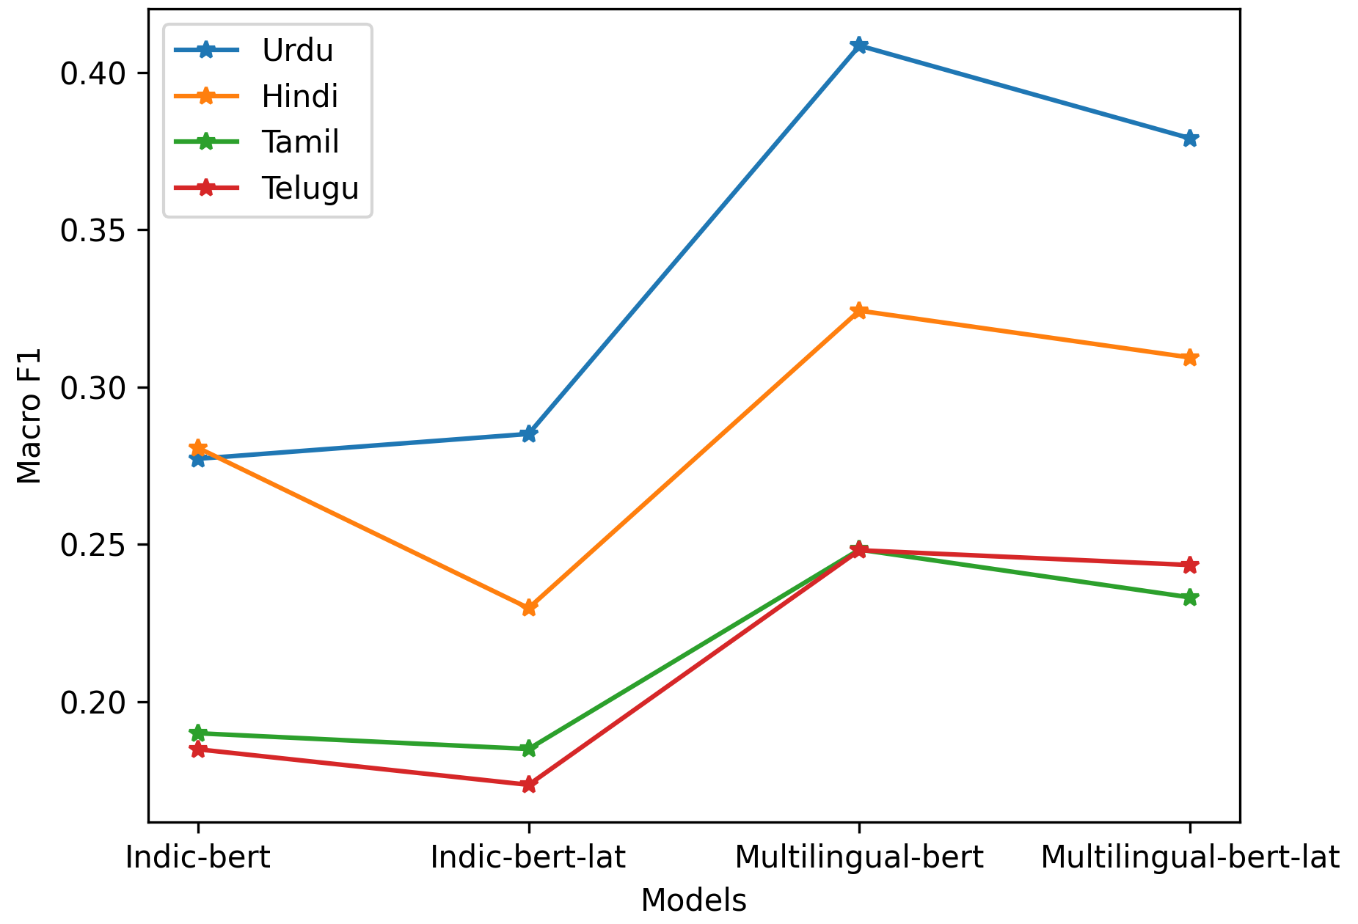
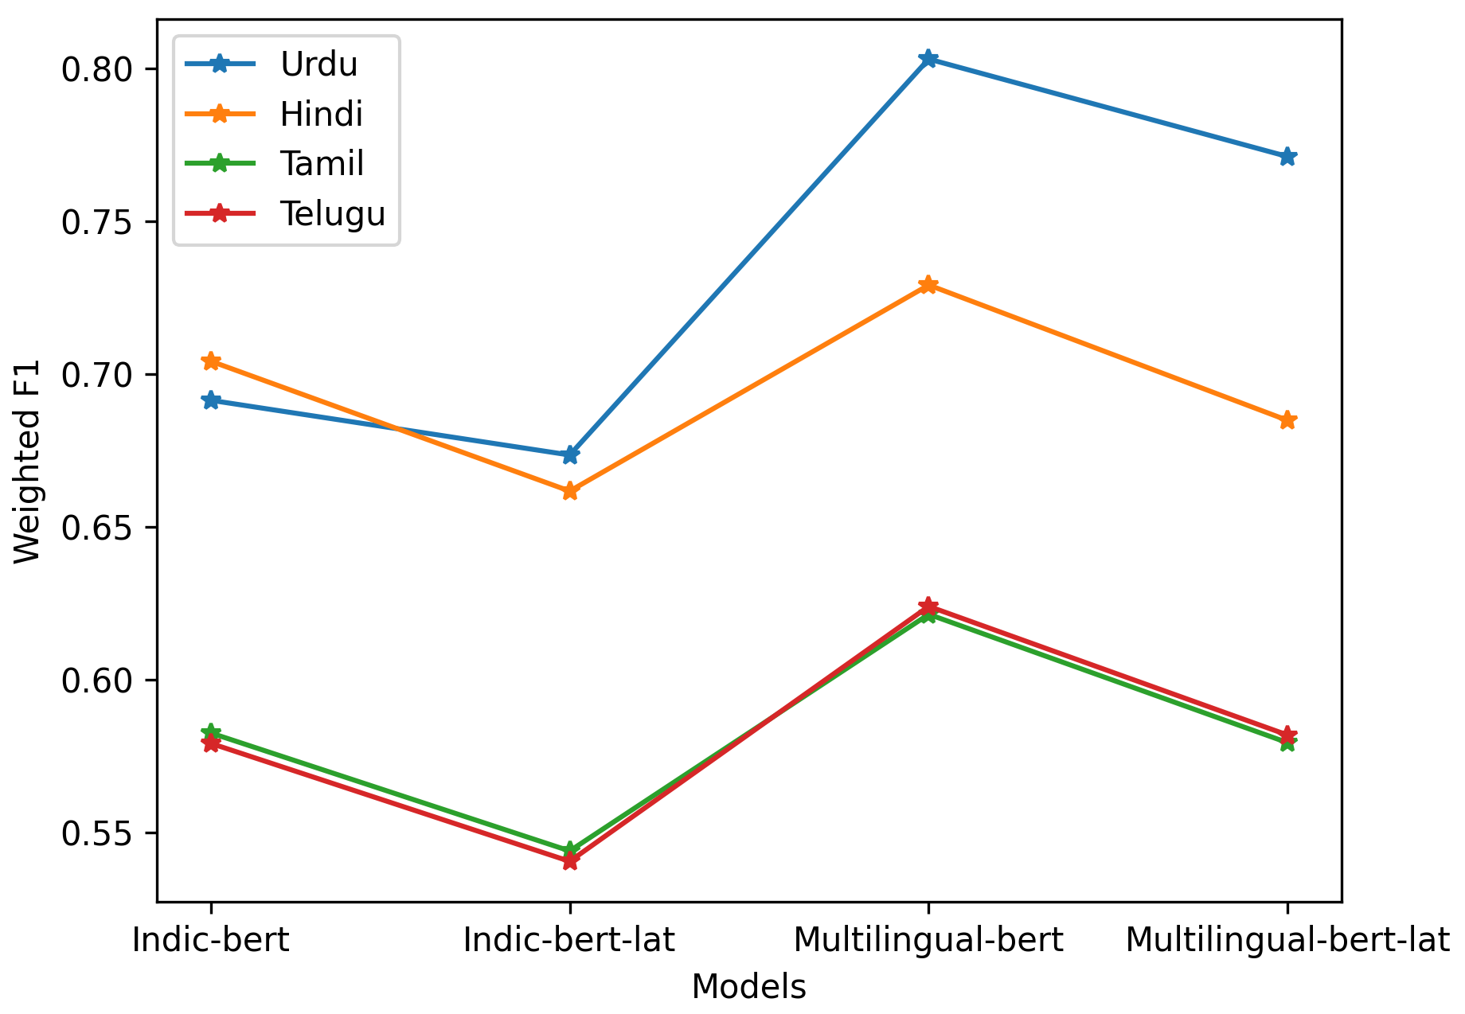
Results
Language wise overall performance comparison
Observations:
Urdu and Hindi showed similar performance
Tamil and Telugu Showed similar performance
Possible reasons:
Urdu-Hindi and Tamil-Telugu belongs to different language families

Slide 11
Conclusion
Multilingual End-to-End SRL method is proposed using multilingual data augmentation from a single language labelled data.
Proposed approach performing similar to the baseline without needing additional information such as PoS tags, dependency relations etc.
Language characteristic based trend is observed in the performance.
Extending this approach for more languages, observing source language impact on target is the future scope of this project

Slide 12
Thank You

