Slide 1
Medicine and Emotions: Analyzing Drug Reviews through the Lens of Natural Language Processing and Deep Learning
Capstone Project
Chandler Vulu

Slide 2
My Project
Customer sentiment analysis
Pharmaceutical industry
“Personalised medicine is the evolution of medicine in a biotechnology and data-rich era”*
Business tactics must change to remaining competitive
* How personalised medicine will transform healthcare by 2030: the ICPerMed vision

Slide 3
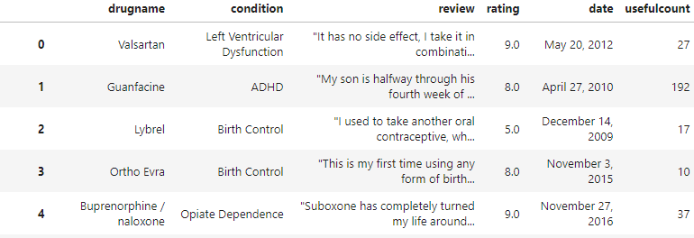
About the Data
215,063 instances, 6 columns
Not excessively large, low dimensionality
Data retrieved from UC Irvine ML Repository* & is publicly available
Dataset taken from 2008 - 2017
* UCI repository link (Drug Review Dataset)

Slide 4
Business Context to Data Questions
My Questions
Can we use customer reviews to find out how they feel about a range of drugs and conditions?
Are there any drugs and conditions with more negative customer optics?
Can we identify any potential research opportunities among these negatively reviewed conditions or drugs?
Can we turn machine learning insights into actionable information for non-technical employees?

Slide 5
Will it be Helpful?
Tools that analyze customer sentiment provide valuable insights to business stakeholders:
Marketing Coordinators
Public Relations
R&D
Product Managers
Sales Teams
Customer Service Representatives
Quality Assurance

Slide 6
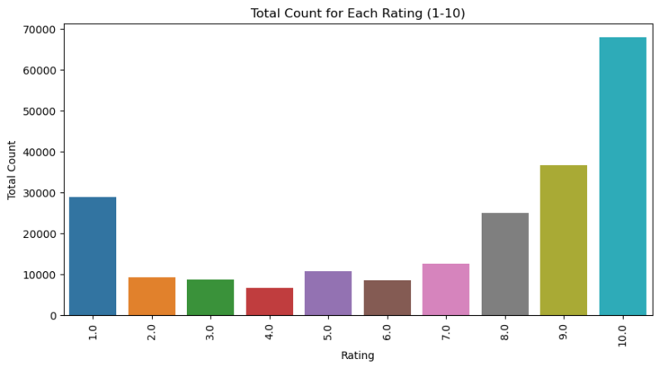
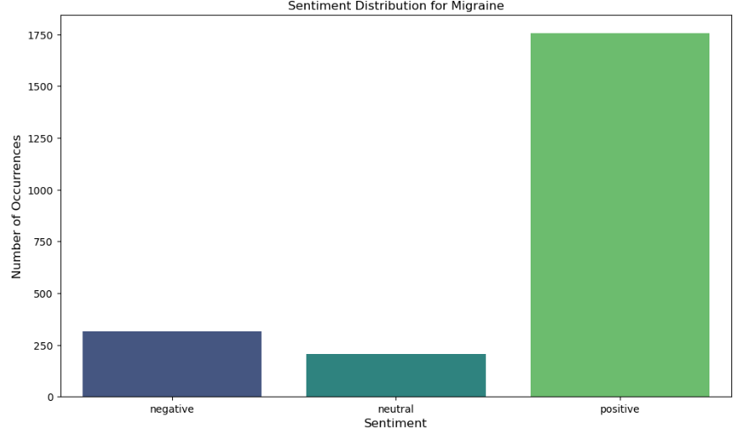
Exploratory Data Analysis
Ratings scale is from 1 (bad) to 10 (good)
Majority of reviews are positive
Average distribution of conditions follow the Migraine shape

Slide 7
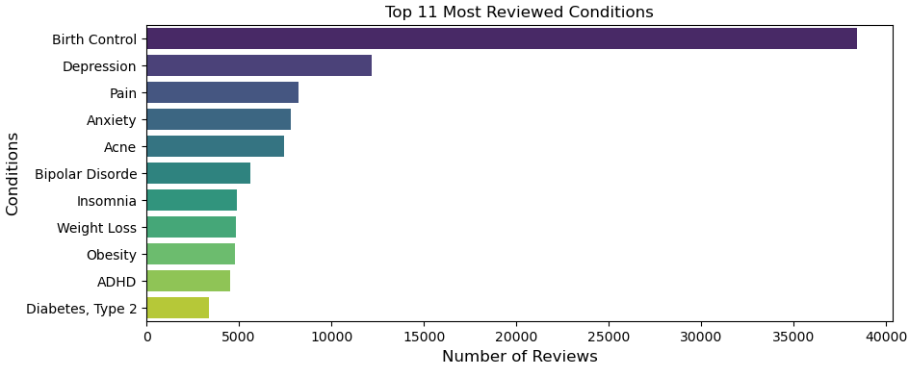
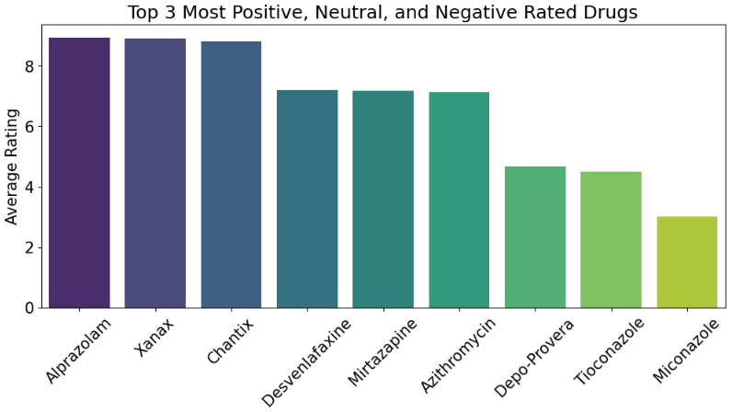
EDA 2 – Conditions & Drugs of Interest
Most Liked Drugs
  Anxiety disorders
  Smoking cessation
Most Disliked Drugs
  Birth control (Depo Provera)
  Antifungal (Tioconazole for yeast, Micoconazole for general)

Slide 8
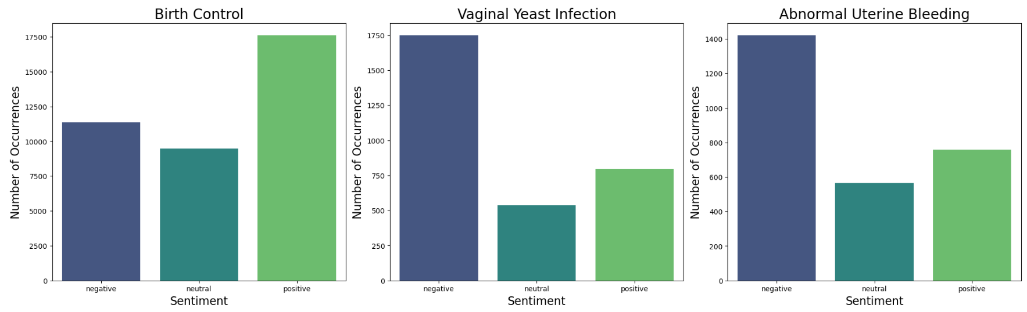
EDA 3 – Atypical Condition Sentiments
3 negative conditions, 2 are very promising
Birth Control (Depo Provera)
Vaginal Yeast Infection (Tioconazole)
Abnormal Uterine Bleeding

Slide 9
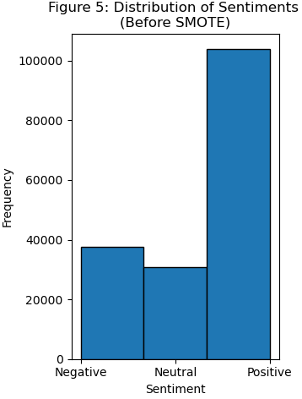
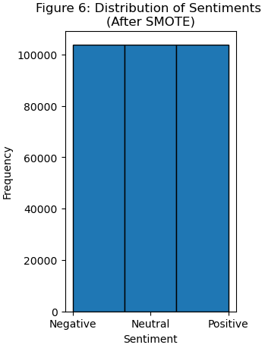
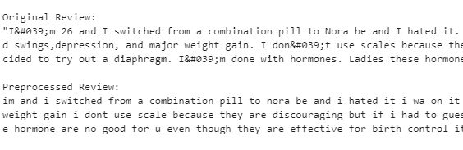
Feature Engineering
Creating Sentiment category
SMOTE data balancing
Text Preprocessing
  Lowercasing
  Remove special characters & numbers
  Tokenization
  Remove Stop words
  Lemmatization
  tfidvectorizer(max_features=5000)
One hot encoding sentiment
Train_test_split

Slide 10
Machine Models and Evaluation Metrics
Machine Model Accuracy Metrics | Training Accuracy | Testing Accuracy
Logistic Regression | 72.5% | 70.0%
Multinomial Naive Bayes | 63.8% | 64.2%
Random Forest | 91.2% | 78.5%
Ensemble Method | 74.9% | 68.7%
XGBoost | 81.7% | 74.0%
Neural Network | 98.9% | 88.5%
Neural Network Evaluation Metrics | Precision | Recall | F1-Score
Negative Sentiment | 89% | 84% | 87%
Neutral Sentiment | 82% | 69% | 75%
Positive Sentiment | 90% | 96% | 93%

Slide 11
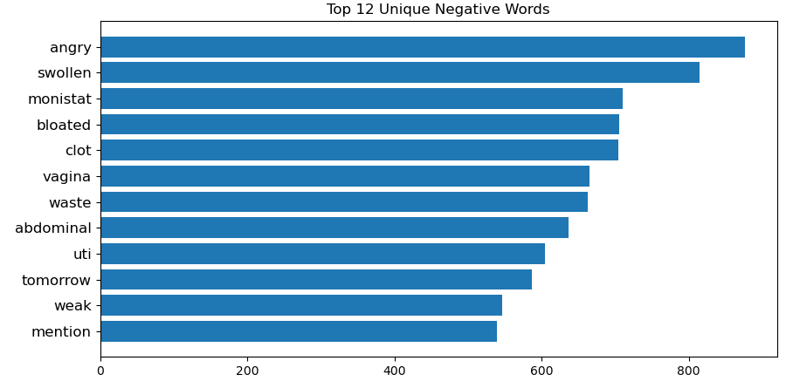
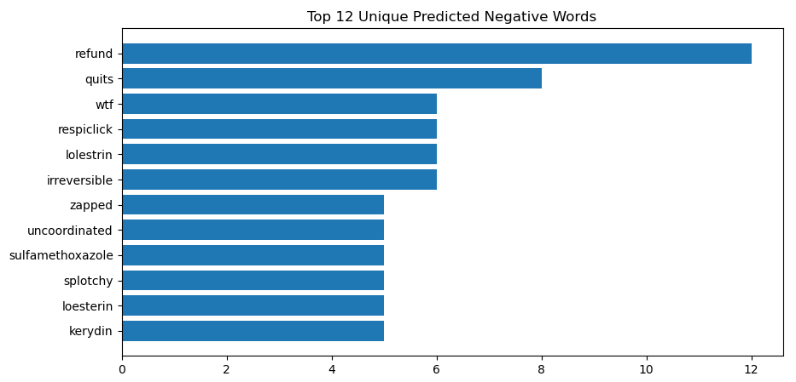
Most Frequent Negative Words Predictions & Actual
Expected Words:
Swollen
Monistat (antifungal, yeast)
Bloated
UTI
Predicted Words:
More drugs predicted
Kerydin (antifungal, foot)
Loestrin (birth control)
Sulfamethoxazole (UTI treatment)

Slide 12
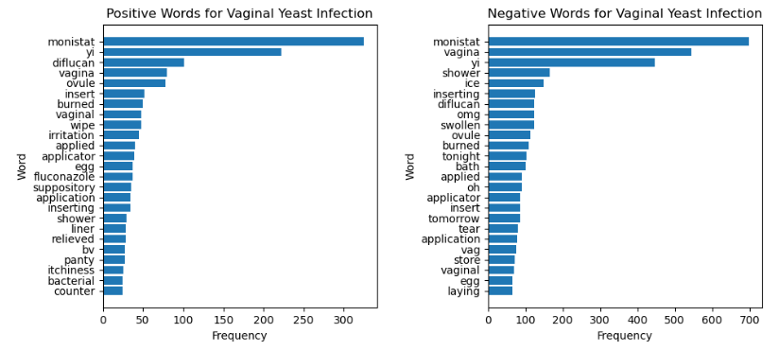
How to use the Model
To make customer predictions scalable to business needs
To evaluate new drug reviews to classify sentiments
To make this data accessible to relevant stakeholders
To reduce human bias and error in classifying reviews

Slide 13
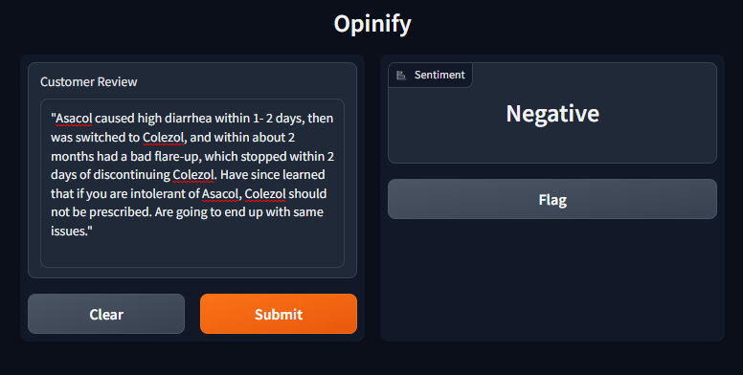
Opinify: My Easy-to-Use Sentiment Predictor
Gradio-based app
Incorporates NLP and my neural network model
Preprocesses customer review input and outputs sentiment

Slide 14
Summary
Q. Can we use customer reviews to predict sentiment about drugs?
Neural network model
  Test accuracy 88.4%
  Negative sentiment precision & recall => 84%
Q. Are there any conditions/drugs customers don’t like? Are they opportunities?
The majority of review sentiment was positive, with 2 good exceptions
  Birth Control (Depo Provera, Loestrin)
  Vaginal Yeast Infections (Tioconazole)
Antifungal drugs in general seem more negatively reviewed
Q. Can non-technical stakeholders utilise these insights?
Using my neural network model and app, we are able to speed up categorisation and understanding of customer needs

Slide 15
Limitations & Future Steps
Instances of brand and drug names appearing concurrently
  Xanax & alprazolam
A weakness of my model was its bias towards drug names rather than descriptions
Would building the model around positive and negative sentiment only improve predictions?
Collecting recent drug reviews to give it relevancy to current market
My still app over-predicts for positive
Can my app be updated to handle multiple reviews?
Opinify: Your #1 Customer Review Sentiment Tool

Slide 16
Thanks for joining me on this journey!

Slide 17
APPENDIX
How personalised medicine will transform healthcare by 2030: the ICPerMed vision
Code was produced with the help of ChatGPT
Data was taken from UCI (Drug Review Dataset)

