Slide 1
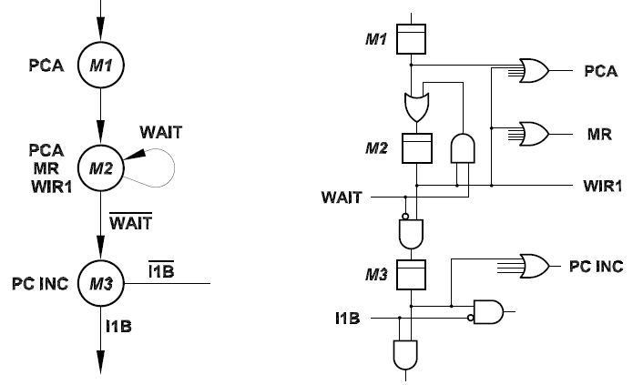
Status signals
Control signals
finite state machine
flip-flop control chain

