Slide 1
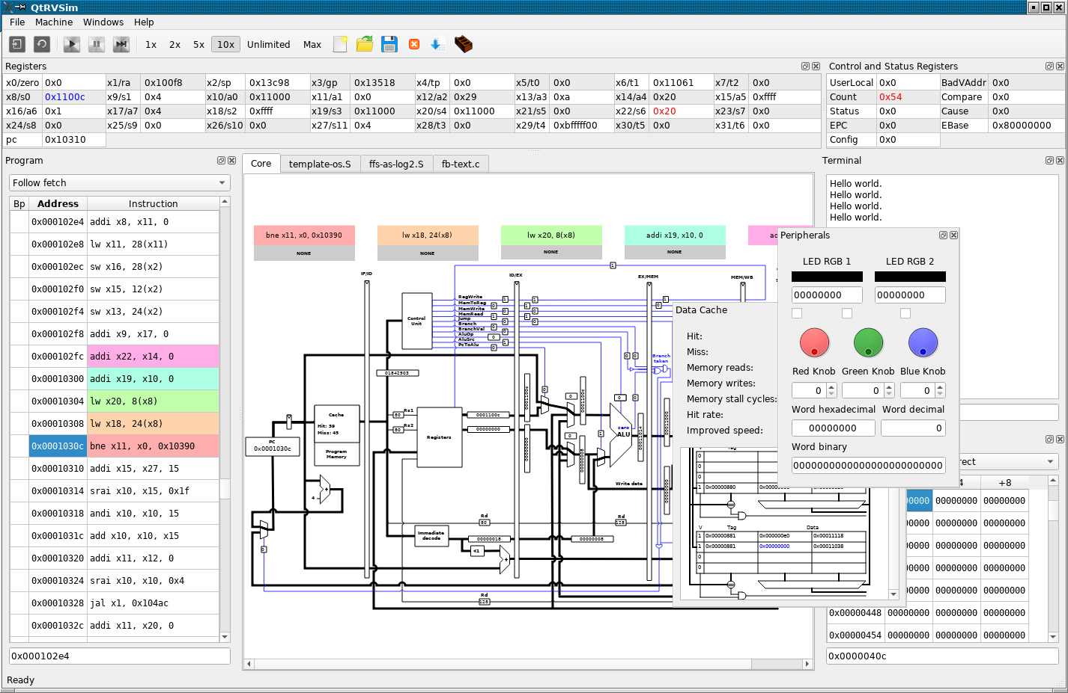
Load
Run
Single Step
Make
Exceptions
control
Registers
Terminal
Terminal
Assembler
Editor
Peripherals
CPU core view
single cycle
pipelined
Code
Cache
Data memory

