Slide 1

Scientific Python
Lecture 8. Classical machine learning. Exploratory data analysis, dimensionality reduction
Vitalii Dravgelis
ITMO University
Slides by Karina Pats
26.03.2026
Saint Petersburg

Slide 2
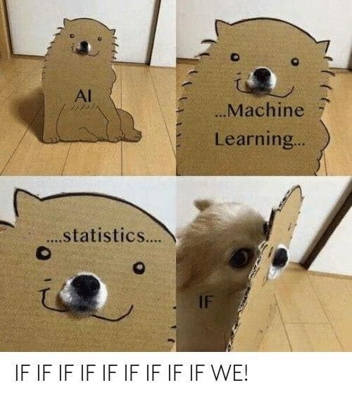
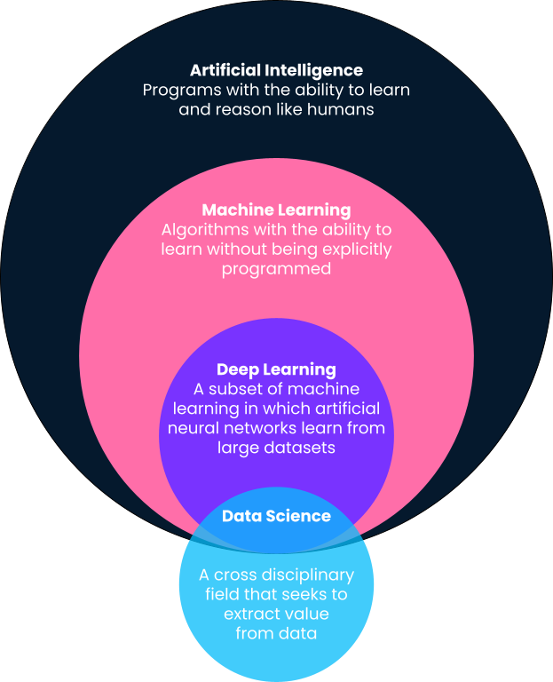

Machine learning (ML)
Machine learning – a subset of artificial intelligence (AI) that focuses on the development of computer algorithms that improve automatically through experience and by the use of data.
Computer is given a set of examples (data) and a task to perform, but it's up to the computer to figure out how to accomplish the task based on the examples it's given.

Slide 3
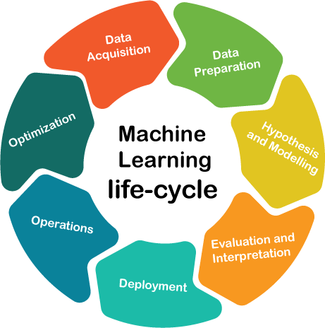
Machine learning lifecycle
Data part – collection of proper datasets, its exploration, optimization and analysis.
Modeling part – selection of the ML model, its application and evaluation.
Engineering part – model deployment, monitoring and support.
today’s focus on data part

Slide 4
Exploratory data analysis
A process to understand the data in depth and learn the different data characteristics, often with visual means.
Why to perform EDA:
Allows to get a better feel of the data and find useful patterns in it.
Helps to choose a better machine learning model.
Allows a machine learning model to fit our dataset better.
Basis for more accurate results.

Slide 5
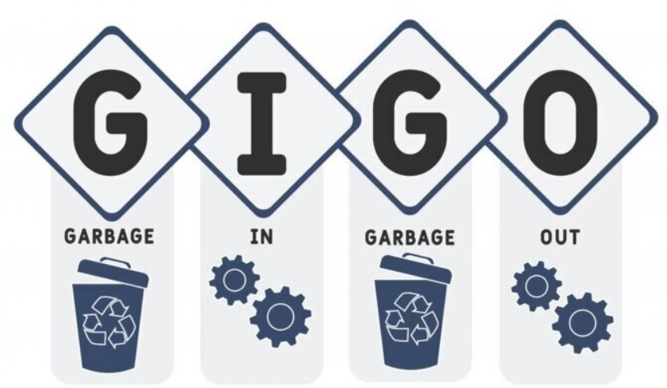
Data collection – the crucial step of ML pipeline
The quality and quantity of the data can directly impact model's performance. Data can be collected from various sources: databases, text files, images, audio files, or scraped from the web.
Once collected, the data needs to be prepared for machine learning. This process involves organizing the data in a suitable format, such as a CSV file or a database, and ensuring that the data is relevant to the problem you're trying to solve.

Slide 6
Data preprocessing
Preprocessing improves the quality of your data and ensures that your machine learning model can interpret it correctly. This step can significantly improve the accuracy of your model.
Data preprocessing involves:
cleaning the data (removing duplicates, correcting errors),
handling missing data (either by removing it or filling it in),
normalizing the data (scaling the data to a standard format).

Slide 7


Missing data – identify the reason
Missing Completely at Random (MCAR) – all the variables and observations have the equal probability of being missing. Consider LEGO example: we can lose some pieces (missing data: shape, color) but it does not affect the data we still have on the rest of our blocks.
Missing at Random (MAR) – probability of the value being missing is related to the value of the variable or other variables in the dataset. Consider an example of taking a professional survey: people who are not upgrading their skills might leave some fields blank in the questionnaire.
Missing Not at Random (MNAR) – probability of being missing is completely different for different values of the same variable, and these reasons can be unknown. Consider an example of married couples survey: they might not want to answer certain questions as they might feel embarrassed to do so.

Slide 8
Missing data (MAR, MNAR) requires more complex approach
Type of missing data | The reason | Imputation method
Missing Completely At Random | Data missing is independent of the observed and unobserved data | Data dropping, Mean/Median, Random Sample or any other imputation method
Missing At Random | Data missing is systematically related to the observed but not the unobserved data | Multiple imputation, Regression imputation
Missing Not At Random | Data missing is systematically related to the unobserved data | Pattern Substitution
Top Techniques to Handle Missing Values Every Data Scientist Should Know | DataCamp

Slide 9
Outliers – anomalies detection
Outlier types:
Outlier effects:
Global outliers – data points that are
significantly different from the rest of
the dataset. Often caused by measurement errors, incorrect data entry, or rare events.
Skewed statistical analysis – significantly affect the mean, variance, and other statistical measures, leading to skewed analysis and inaccurate conclusions.
Misleading visualizations – distort visualizations (scatter plots/histograms), making it difficult to identify patterns and relationships in the data.
Biased machine learning models – have a disproportionate impact on the training of machine learning models, leading to biased or inaccurate predictions.
Decreased model accuracy – outliers can decrease the accuracy of statistical models and machine learning algorithms, as these models are designed to fit the majority of the data and may not be able to account for the unusual values of outliers.
Contextual outliers – data points that are considered outliers only in specific
contexts. (a high income in a low-income neighborhood).
Collective outliers – groups of data points that are collectively different from the rest of the dataset. Might indicate a subgroup or a different underlying distribution of data.
11

Slide 10
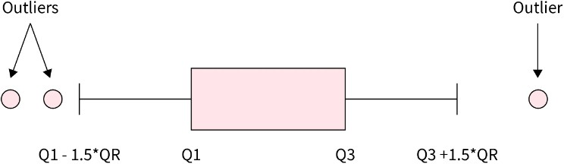
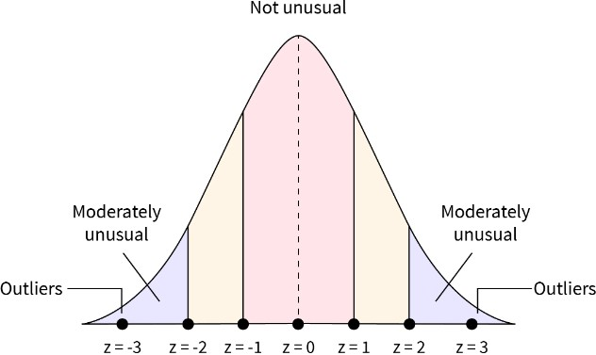
Handling outliers
Box-plot: using Inter-Quartile Range (IQR) method. A data point is usually considered an outlier if it falls over 1.5 times the IQR outside the box.
𝑋 − 𝜇
𝑍 − 𝑠𝑐𝑜𝑟𝑒 =
𝜎
Z-score: a data point’s distance from the mean in terms of the standard deviation (number of standard deviations a data point falls away from the mean of the dataset). A data point with a Z-score greater than a certain threshold (usually 2.5 or 3) is considered an outlier.
What are the Outlier Detection Methods in Data Mining? - Scaler Topics

Slide 11
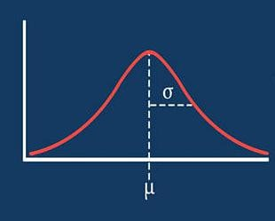
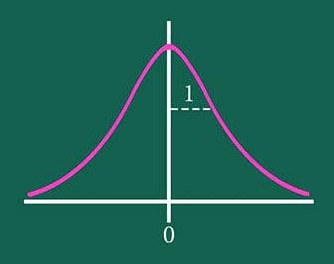
Data scaling – normalization vs standardization
Normalization – a scaling method that transforms the range of features to a standard scale between 0 and 1. Normalization is useful when there are no outliers as it cannot cope up with them and when we do not have an information about distribution.
_{𝑋′ =} 𝑋 − 𝑋_{𝑚𝑖𝑛}
^{𝑋}𝑚𝑎𝑥 ^{− 𝑋}𝑚𝑖𝑛
Standardization (z-score normalization) – the values are centered around the mean with a unit standard deviation (the mean of the attribute becomes zero, and the resultant distribution has a unit standard deviation). Standardization is not affected by outliers as there is no predefined range of transformed features. Useful when the distribution is normal/Gaussian.
_{𝑋′ =} 𝑋 − 𝜇
𝜎

Slide 12
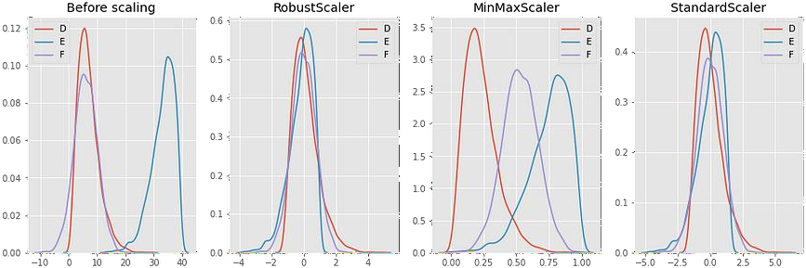
Data scaling using various scalers
_{𝑋′ =} 𝑥_{𝑖} − 𝑄₁(𝑥)
𝑄₃(𝑥) − 𝑄₁(𝑥)
_{𝑋′ =} 𝑋 − 𝑋_{𝑚𝑖𝑛}
^{𝑋}𝑚𝑎𝑥 ^{− 𝑋}𝑚𝑖𝑛
𝑋 − 𝜇
𝑋′ =
𝜎
Preprocessing Data: Feature Scaling | by Kamal Chouhbi | Towards Data Science

Slide 13
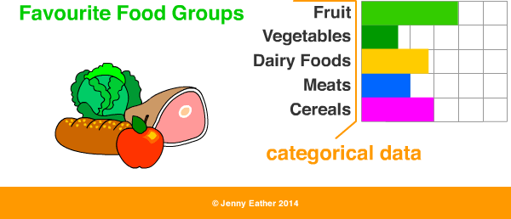
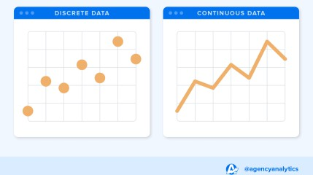
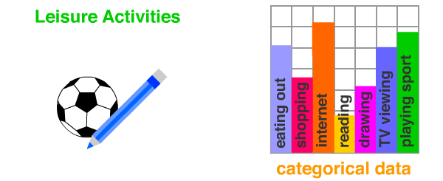
Feature types
Categorical data:
Numerical data:
Categorical data can be stored and identified by names or labels, i.e. qualitative data.
Subtypes:
Nominal data: naming data (e.g. name, gender, address).
Ordinal data: ranked data (e.g. education level, course satisfaction level).
Numerical data are numbers, not words or
descriptions, i.e. quantitative data.
Subtypes:
Discrete data: countable items, finite number (e.g. sugar cubes in a jar).
Continuous data: data that can be measured and have an infinite number of possible values within a given range (e.g. temperature, speed).

Slide 14
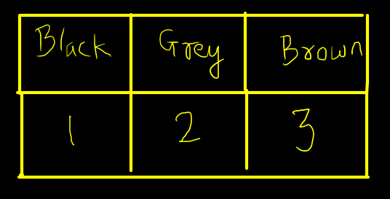
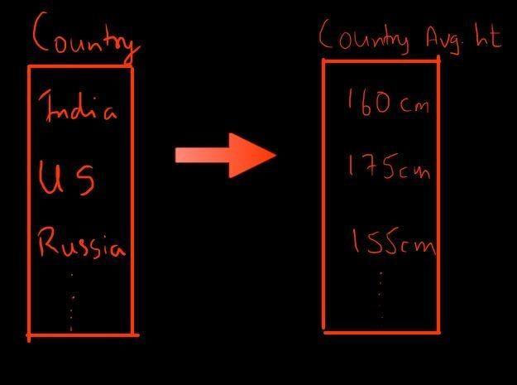
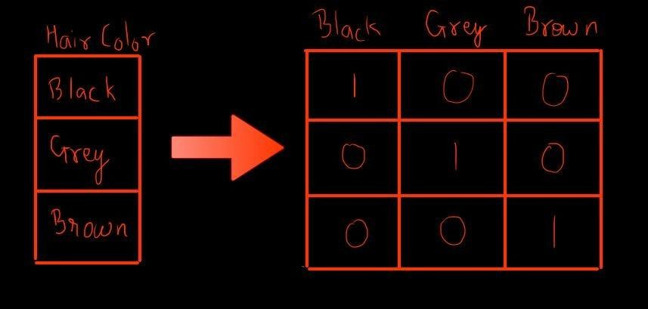
Handling categorical data
1
3
2
Assigning some values
One-hot encoding
Replacing with average or other domain knowledge engineering (e.g. replacing with distance from India)
Feature Handling: Categorical and Numerical | by Deepak Jain | Towards Data Science

Slide 15
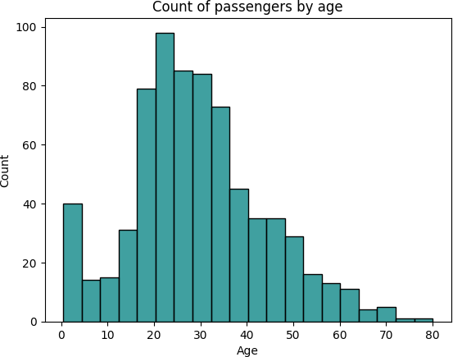
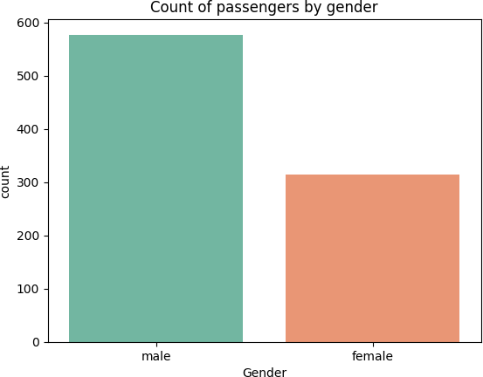
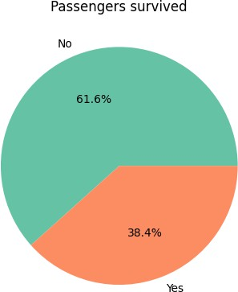
Univariate analysis – visualize a single variable at a time
Univariate analysis helps to analyze the distribution of the variable present in the data so that we can perform further analysis.
Titanic dataset

Slide 16
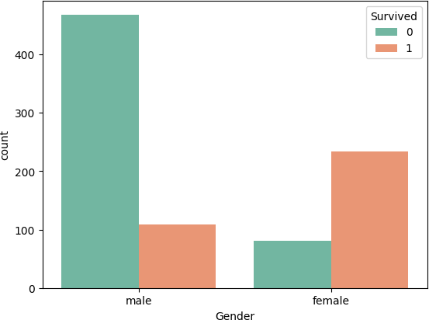
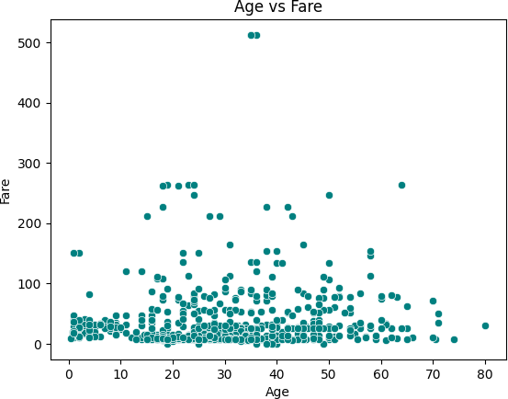
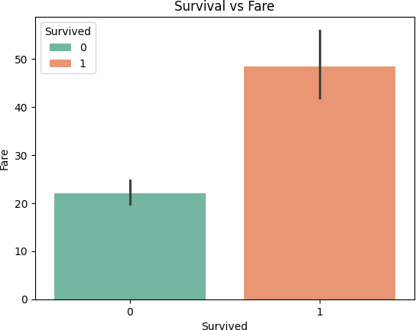
Bivariate analysis – simultaneous analysis of two variables
Bivariate analysis explores the relationship between two variables: whether there exists an association and the strength of this association or whether there are differences between two variables and the significance of these differences.
Categorical vs Categorical
Numerical vs Numerical
Categorical vs Numerical

Slide 17

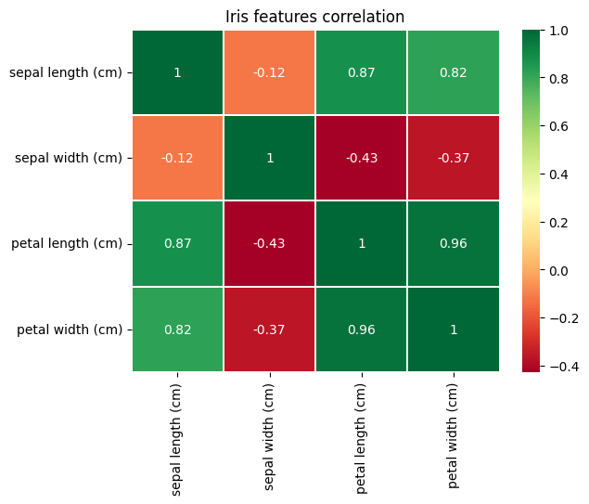
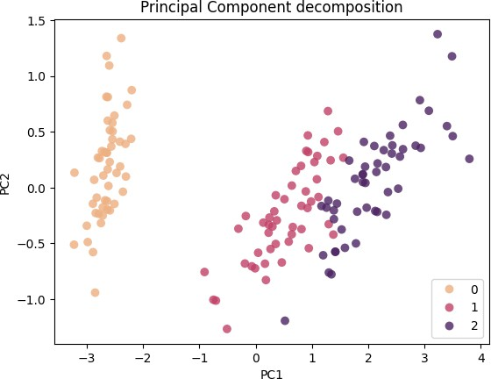
Multivariate analysis – involves multiple variables at the same time
Multivariate Analysis is a set of statistical model that examine patterns in multidimensional data by considering at once, several data variable.
Iris dataset:
Iris dataset

Slide 18
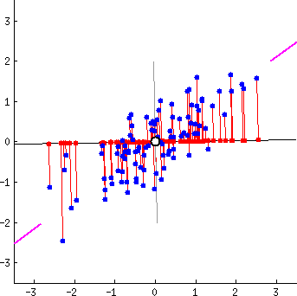
Principal component analysis – a multivariate dimensionality reduction technique
Principal components are new variables that are constructed
as linear combinations or mixtures of the initial variables.
There are as many principal components as there are variables in the data, so principal components are constructed in such a manner that the first principal component accounts for the largest possible variance in the data set.
The first principal component would be the line that matches the purple one, and it’s the line in which the projection of the points (red dots) is the most spread out.
Mathematically speaking, that maximizes the variance (the average of the squared distances from the projected points (red dots) to the origin).
Principal Component Analysis (PCA) Explained | Built In

Slide 19
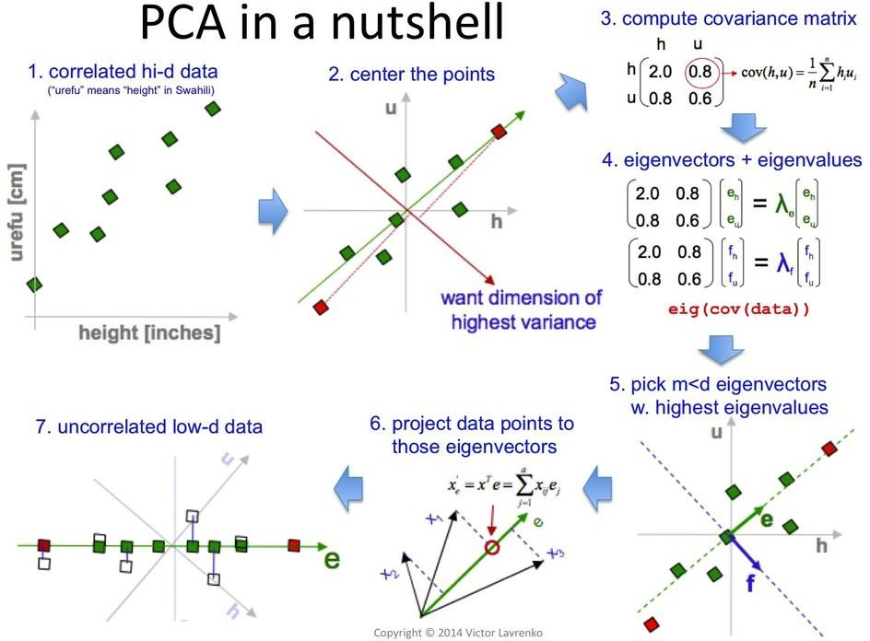
Principal component analysis step-by-step
Standardization.
Covariance Matrix Computation.
Compute the eigenvectors and eigenvalues of the covariance matrix to identify the principal components.
Create a Feature Vector.
Recast the Data Along the
Principal Components Axes.

Slide 20
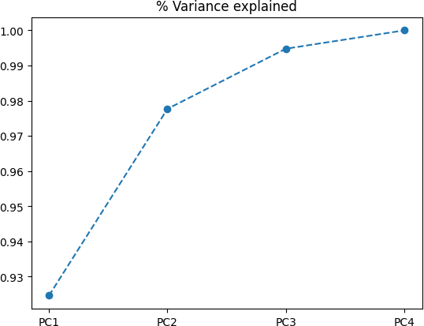
Principal component analysis – iris example

Slide 21


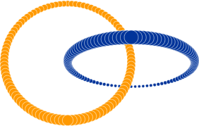
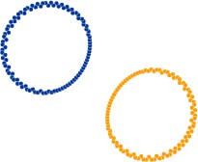
t-distributed Stochastic Neighbor Embedding (t-SNE)
t-SNE is nonlinear dimensionality reduction: allows to separate data that cannot be separated by any straight line.
The first part is to create a probability distribution
that represents similarities between neighbors.
The next part is to create low-dimensional space with the same number of points as in the original space. Points should be spread randomly on a new space.
The goal of this algorithm is to find similar probability distribution in low-dimensional space (student t-distribution with a single degree of freedom is used).
How to Use t-SNE Effectively (distill.pub)
t-SNE clearly explained. An intuitive explanation of t-SNE… | by Kemal Erdem (burnpiro) | Towards Data Science

Slide 22
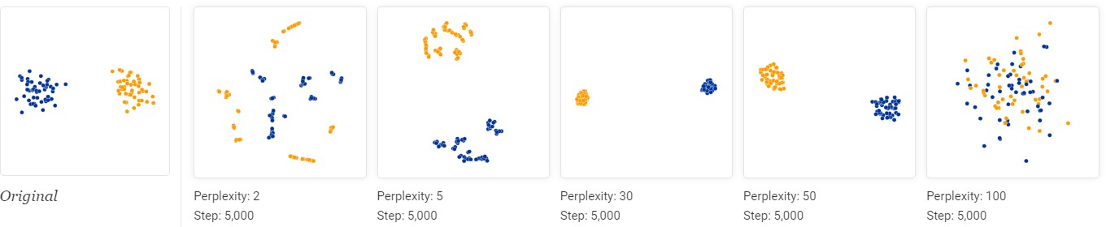
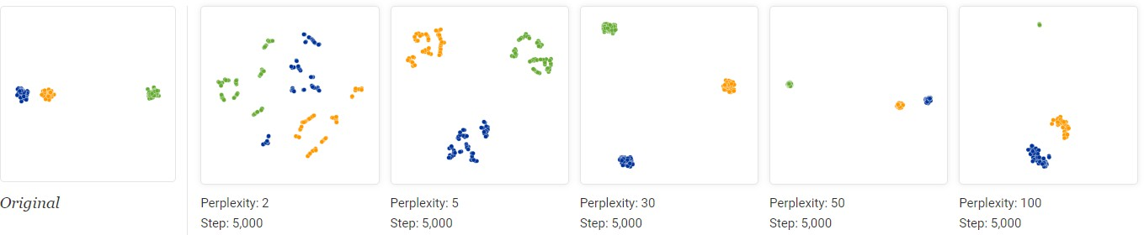
t-SNE: perplexity balances attention between local and global aspects
Perplexity should be smaller than number of samples.
Seeing global geometry requires fine-tuning perplexity.
24

Slide 23
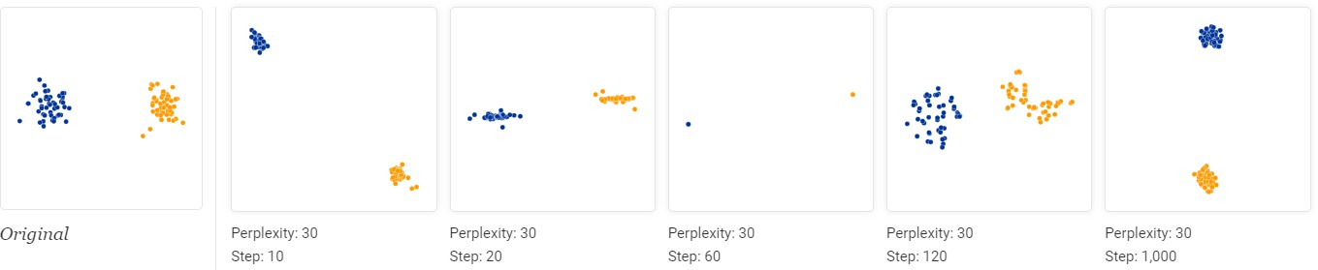
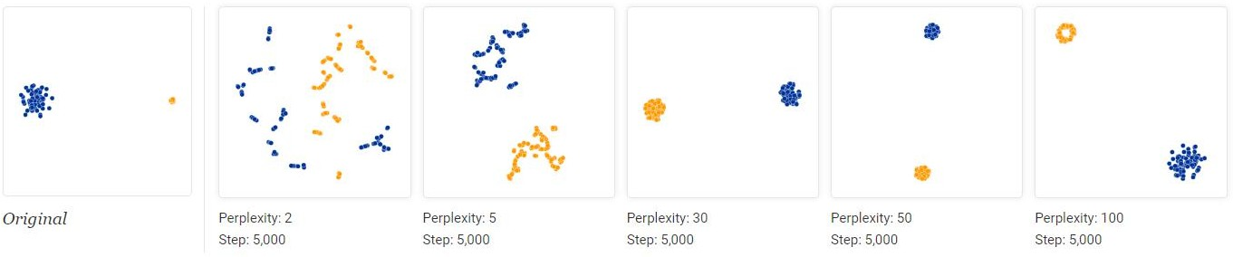
t-SNE: iterative and adaptive algorithm
A learning rate (often called “epsilon”) is one more hyperparameter; a point of stability is reached by step 1,000
Cluster sizes does not have meaning: t-SNE by design adapts its notion of distance to regional density variation.

Slide 24
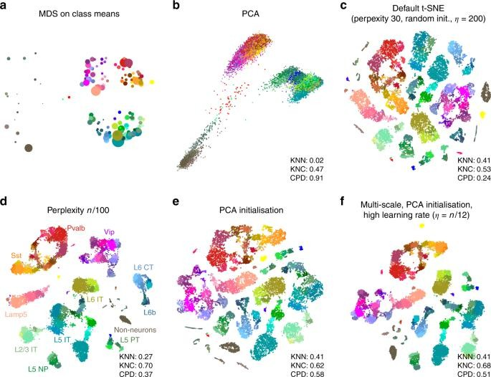
t-SNE for single-cell data
Single-cell RNA sequencing datasets usually contain the expression count of thousands of genes for thousands of single cells.
The location of a cell on a t-SNE plot is determined by its similarity to other cells. Similar cells are placed together, while different cells are placed further apart
Cells within a cluster may have similar functions in a tissue: they may be the same cell type or react identically to treatment. Different cell groups may have different functions in a tissue or may be at diverging stages of development.
Sometimes used in tandem with PCA.
The art of using t-SNE for single-cell transcriptomics | Nature Communications
What does a t-SNE plot show? - Single Cell Discoveries (scdiscoveries.com)

Slide 25
EDA tutorials
EDA To Prediction(DieTanic) (kaggle.com) – Titanic dataset, classification problem, today’s tutorial.
Top 1% Approach: EDA, New Models and Stacking (kaggle.com) – Housing prices dataset, regression problem, for you to explore.
K-Mean clustering for Wine Quality Data (kaggle.com) – Wines quality dataset, clustering problem, for you to explore.
Be careful, as these tutorials are from 4-6 years ago, so the libraries syntax might have significantly changed (e.g. sns.factorplot is now sns.catplot).

Slide 26
HW5 – heart failure dataset EDA
Heart Failure Prediction Dataset (kaggle.com)
Your task is to explore this dataset: check the features, explain them, check their effect on target variable (heart failure), check for missing data and outliers. Then go in-depth, providing bivariate and multivariate data analysis, suggest for possible feature engineering or variable encoding, and try forming some conclusions.
Please note:
The description above is just an example of what you can do; the entire analysis is up to you.
You should provide detailed comments similar to what we had in lecture’s tutorial, as you would present the analysis results to a person, who is not familiar with the data. You should tell a story that describes the dataset and the situation around it.
Soft Deadline for this task is 02.04.2026 23.59 MSK.
Hard Deadline for this task is 09.04.2026 23.59 MSK.

Slide 27

Thank you for coming!
See you on the next course ☺
vitdrav@gmail.com
tg: @vitdrav

