Slide 1
Lariocidin-like BGCs in public genomes and MAGs
Do we find additional supported clusters in a fixed MAG collection?
Does one cross-order locus reject the host-order split?
One catalogue · one focal HGT case · prespecified stopping rule
H₀: no additional supported MAG BGC; BGC-gene trees remain compatible with the host-order split.
1 / 4
Notes:
Problem (about 60 seconds). Lariocidin is a recently described lasso peptide. We asked two bounded questions: whether one fixed MGnify collection adds a context-supported BGC with verified metagenomic provenance, and whether one previously chosen cross-order locus conflicts with a host-order constraint. These are operational hypotheses for this dataset, not universal claims. Sources: reviews/2026-09-10-s3-protocol.md; reviews/2026-09-11-s5-protocol.md; reviews/2026-10-08-final-synthesis.md.

Slide 2
Methods and controls
Fixed discovery search
Focal HGT test
399 MGnify records labelled MAG
BioSample audit of sample origin
HMM screen of catalogue proteins and GFF-CDS
BGC context required for a family call
14 published BGC carriers
Host tree: 21 genomes, 34 ribosomal markers
B1/B2/C/D gene trees
AU test versus host-order constraint
Controls: 227/227 known full-length C proteins found; 0/5 reviewed AsnB passed.
Four linked genes are one locus, not four independent transfer events.
2 / 4
Notes:
Methods (about 75 seconds). The 399 entries passed fixed quality filters but MGnify's MAG label was audited against primary BioSample metadata. We screened both catalogue representatives and 1,645,120 annotated CDS; a cyclase hit alone did not define a target BGC. Known positives and AsnB controls checked the pipeline, though they are not a natural sensitivity estimate. For HGT, 14 carriers were fixed in advance. The independent host tree used 34 ribosomal markers; AU tests compared free and order-constrained trees for B1, B2 and D. C was already compatible. Sources: reviews/2026-09-11-s3-analysis.md; reviews/2026-09-11-s5-protocol.md; results/tables/host_tree_summary.json.

Slide 3
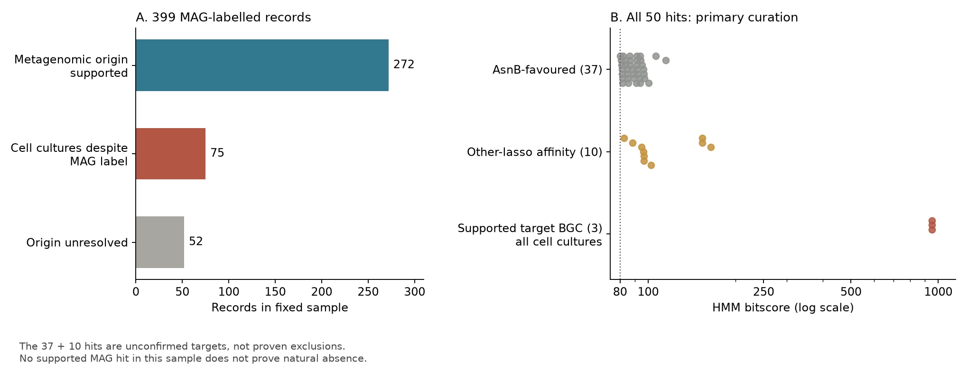
Search result: no supported MAG cluster
0 supported MAG BGCs; 3 near-known canonical BGCs belong to cell cultures.
3 / 4
Notes:
Results, discovery (about 75 seconds). Of 399 MAG-labelled records, metadata support metagenomic origin for 272, show cell culture for 75, and do not resolve 52. Fifty protein hits underwent primary curation: 37 AsnB-favoured, 10 related to other lasso families, and three with a coherent canonical BGC context. All three supported BGCs are Bacillus wiedmannii cultures, so the fixed sample adds no confirmed MAG-derived BGC. The 37 and 10 remain provisional classifications. Absence in this sample does not imply absence in nature or incomplete MAGs. Source: reviews/2026-09-11-s3-analysis.md; results/tables/maize_checkpoint_summary.json; results/figures/s3_search_checkpoint.png.

Slide 4
HGT result: host-order constraint not rejected
Host-order split: SH-aLRT / UFBoot 100 / 100
Gene | AU p for order constraint | Composition failures
B1 | 0.323 | 0 / 14
B2 | 0.337 | 2 / 14
C | Free tree compatible | 13 / 14
D | 0.432 | 13 / 14
HGT remains possible, but is not established in this case.
Short B1/B2 alignments and composition bias limit interpretation. H₀ is not proven.
4 / 4
Notes:
Results and conclusion (about 90 seconds). The host tree robustly separates the two orders. B1, B2 and D appear visually discordant, but the order-constrained alternatives are not rejected by AU tests; Holm correction likewise gives no rejection. The free C tree already meets the order constraint, so it has no measured AU p. C and D fail composition checks for 13 of 14 taxa; B1 and B2 are short after trimming. A targeted DNA audit confirmed every published A–D protein is encoded in its assigned assembly, including two proteins that use TTG alternative starts. We therefore did not support HGT, but cannot prove vertical inheritance. The fixed MAG result likewise does not prove natural absence. This is the planned stopping point. Sources: results/tables/hgt_topology_tests.tsv; results/tables/host_tree_summary.json; results/tables/carrier_bgc_dna_validation.tsv; reviews/2026-10-08-final-synthesis.md.

