Slide 1

An open-source Python framework for reproducible,
database-centred algebraic modelling workflows
Prof. Matteo V. Rocco
SESAM group
Department of Energy, Politecnico di Milano
Notes:
CVXlab is an open-source Python workflow for algebraic models.

Slide 2



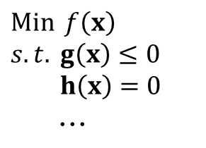
Systems modelling workflow
Model concept and structure
Model generation and solution
Data-related
operations
$\operatorname{Min}{ f\left(x\right)}$
$s.t. g\left(x\right)≤0$
$h\left(x\right)=0$
...
Computer model generation/solution is only a part of the workflow
The path from conceptual to computational model is often project-specific
Data-related operations usually handled by project-specific scripts
The gap: turning a mathematical model into a reproducible workflow
Notes:
workflow for development of models in general implies three fundamental activities
generating and solving the computational model is only one part of the workflow.
there are two fundamental weaknesses in the workflow that make it hardly reproducible:
The path from the conceptual model to the computational model is often specific to each project.
Data-related operations are frequently handled by scripts that are difficult to reuse and inspect.
overall question is:

Slide 3







CVXlab: a workflow layer around CVXPY
Model concept and structure
Model generation and solution
Data-related
operations
www.cvxpy.org
User defines model algebraic structure, CVXlab organizes model life cycle
Centralized I/O data management based on SQLite database
Generates and solves networks of independent, sequential or integrated CVXPY problems
One model: multiple problem instances (handles scenario/uncertainty analysis)
Notes:
CVXlab addresses this surrounding workflow as an open-source Python layer around CVXPY.
The user remains responsible for the algebraic structure, while CVXlab organises the model life cycle.
Model inputs and outputs are centralised in a relational SQLite database instead of being scattered across unrelated arrays and scripts.
CVXlab can generate and solve independent, sequential or integrated networks of CVXPY problems.
One model can therefore produce multiple problem instances for scenario and uncertainty analysis.
The numerical formulation and the solver remain those provided by CVXPY and the configured backend, while CVXlab organises the surrounding workflow.

Slide 4


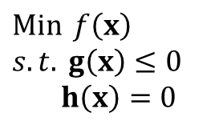
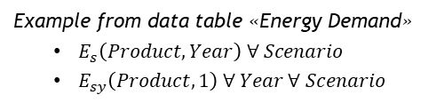
Step #1 – Conceptual model definition
$\operatorname{Min}{ f\left(x\right)}$
$s.t. g\left(x\right)≤0$
$h\left(x\right)=0$
User defines conceptual model (pen on paper!)
Sets
Define the model scope. Sets are associated to coordinates.
Variables
Symbolic items generated from Data Tables (or subset of Data Tables).
Used to compose mathematical expressions.
One or more variables derived from each data table.
Examples:
Scenario: [Business As Usual, Net-Zero]
Technology: [Gas Turbines, Solar PV]
Product: [Natural Gas, Electricity]
Year: [2000, 2010, …, 2050]
Example from data table «Energy Demand»
$E_{s}\left(Product,Year\right) ∀ Scenario$
$E_{sy}\left(Product,1\right) ∀ Year ∀ Scenario$
Data tables
Endogenous/exogenous data containers indexed by Sets.
Expressions/Problems
Symbolic expressions define one/more mathematical problems.
Include variables and custom operators.
Must be dimensionally and structurally consistent.
Multiple problems can be defined, eventually sharing
the same variables.
Examples:
Energy Demand (Scenario, Product, Year)
Efficiency (Technology)
Capacity (Scenario, Technology)

Slide 5

Step #2 – Generation of model directory
import cvxlab
cvxlab.create_model_dir(
model_dir_name="my_model",
main_dir_path="path/to/parent",
settings_file_type="yml",
)
templates for settings (xlsx/YML formats):
  sets
  data tables / variables
  expressions /problems
Package API create a new model directory with settings template files.
optional templates:
  custom symbolic operators
  custom constants

Slide 6
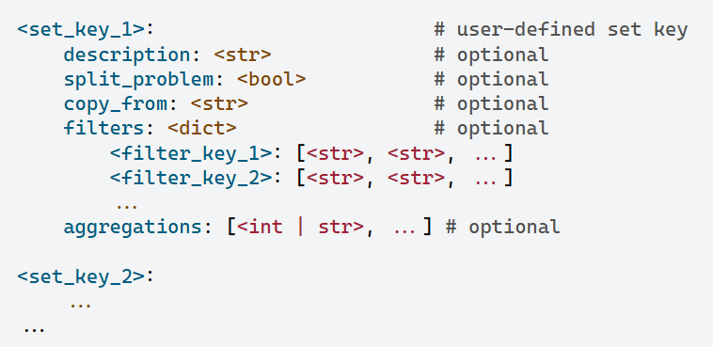
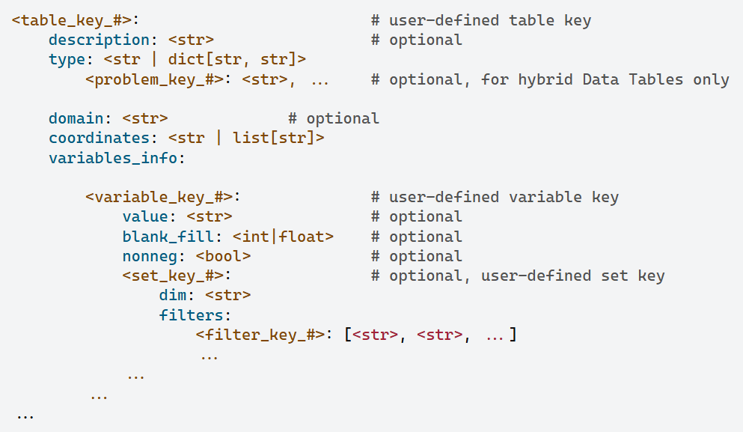
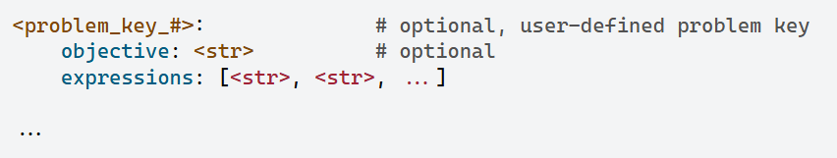
Step #3 – Fill model setup templates
User completes the generated YAML settings files (xls format also available)
structure_sets.yml
structure_variables.yml
problem.yml

Slide 7

Step #4 – Model class instance generation
model = cvxlab.Model(
model_dir_name="my_model",
main_dir_path="path/to/parent",
model_settings_from="yml",
log_level="info",
input_data_files_type="xlsx",
)
Model class instance initialized with settings configuration
Problems structure is validated (sets, data tables, variables, expressions, problems)
sets.xlsx file template is generated, to be filled with coordinates by the user
Technology | Type | Energy output | ...
Power by PV | Renewable | True
Power by Wind | Renewable | True
Steel factory |  | False
... | ... | ... | ...
sets.xls

Slide 8

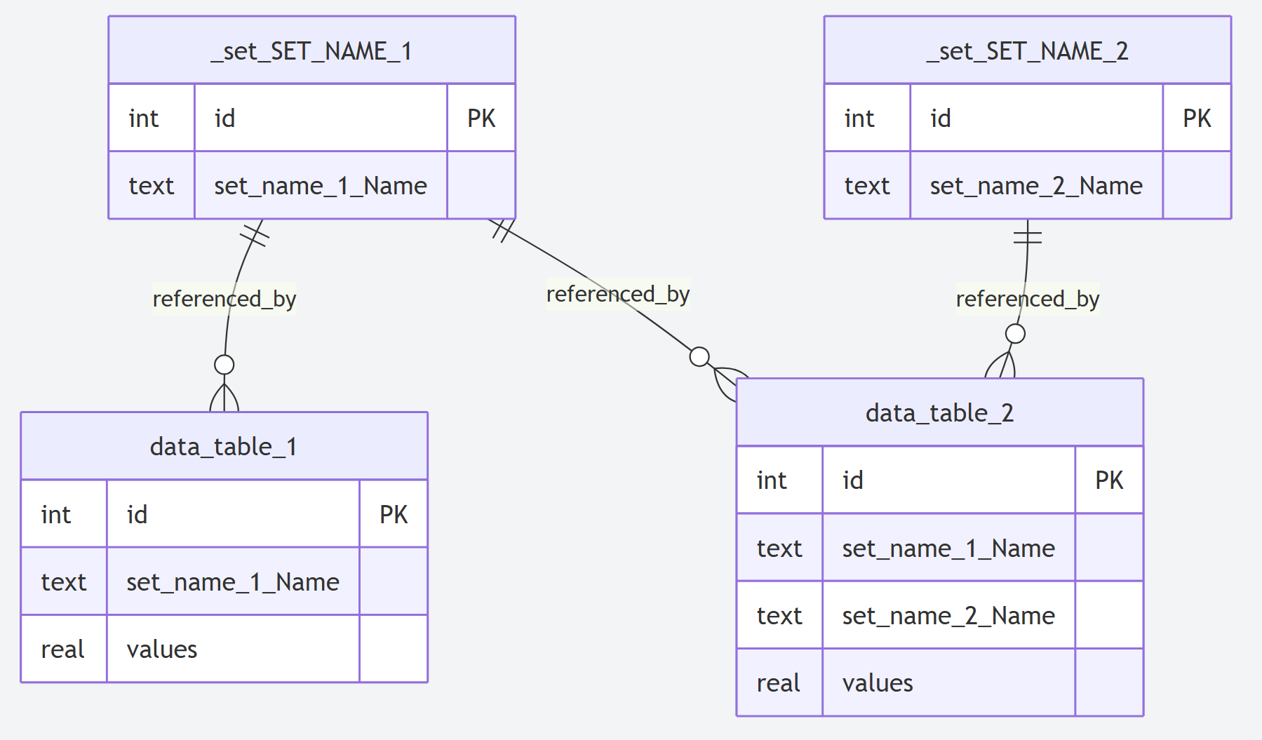
Step #5 – Initialization of data structures, data input
model.initialize_model_environment()
Loads sets coordinates from sets.xls, loads data table attributes
Generates SQLite relational database with structure of Sets Tables and Data Tables
Generates exogenous input data files (normalized data tables in xls or csv formats)
input_data.xls | energy-demand table
# | Product | Sector | Year | Scenario | value
1 | Electricity | Industry | 2020 | Baseline | 100
2 | Electricity | Industry | 2021 | Baseline | 105
... | ... | ... | ... | ... | ...

Slide 9
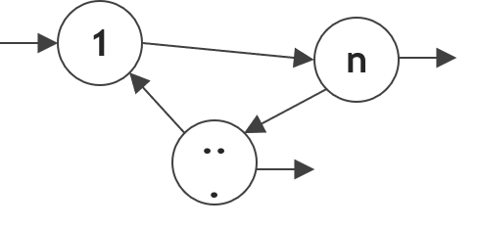
Step #6 – Initialization/solution of numerical problem/s
model.refresh_database_and_initialize_problem()
Fetches input data from xls/csv templates to the SQLite database
Loads and validates symbolic problem structure and expressions
Initializes numerical problem/s for each scenario (with CVXPY engine)
Solves numerical problems according to user-defined logic
www.cvxpy.org
model.run_model( solver_settings={...},
...
    solution mode=
    ‘parallel’
    ‘sequential’
    ‘integrated’
)

Slide 10



Step #7 – Endogenous results export/inspection
model.load_results_to_database()
Exports solved endogenous Data Tables from model instance to SQLite database
Database relational structure in line with data engineering standards:
  relations across data tables automatically recognized by BI software
  easy data inspection through SQL/DAX queries

Slide 11


Future developments
Global Sensitivity Analysis (GSA)
  developed by Valeria Baiocco
  integrating features of SALIB Python package
  early access available in cvxlab/cvxlab at feature/integration-gsa
+
Automatic model documentation
Orchestrating solution of multiple model instance with related databases

Slide 12



Conclusions
CVXlab keeps model structure, scenario data, problem generation and result inspection in one reusable workflow.
Matteo V. Rocco,
Department of Energy,
Politecnico di Milano
matteovincenzo.rocco@polimi.it
Package repository
https://github.com/cvxlab
Package documentation
https://cvxlab.readthedocs.io/
Try the tutorial! Tell me where this workflow helps or gets in your way.
Notes:
Please try the tutorial through the links on this slide and tell me where this workflow helps your modelling practice and where it gets in your way.

