Slide 1
pyEMS
Input-output general purpose system modelling framework
Prof. Matteo V. Rocco
SESAM group
Department of Energy, Politecnico di Milano

Slide 2
Outline
LCA model
Energy system model

Slide 3
Reference Production System
Figure collects transactions of physical flows (energy, products, air emissions) in a defined time frame.
Product system is enclosed within red boundaries
fuel b
20 MWh
oil refinery
heat
10 ton
50 MWh
60 MWh
boiler
40 MWh
75 ton
final demand
10 MWh
product a
120 ton
CHP engine
80 MWh
15 ton
Air emissions
30 MWh
industry
fuel a
PV plant
60 MWh
5 ton
electricity
product b

Slide 4
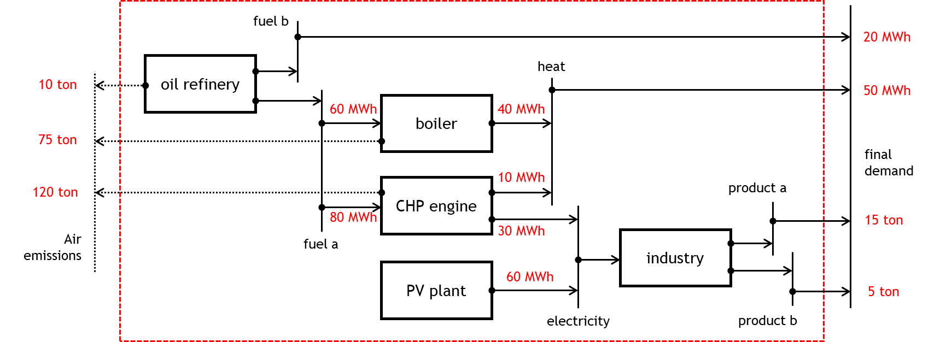
LCA model
Research needs:
Calculation of air emissions embodied in the marginal units of products delivered as final demand
Calculation of air emissions embodied in the marginal unit of technology activity
Assumptions
production lines of industry for products a and b of industry are subsidiary (industry technology assumption

Slide 5

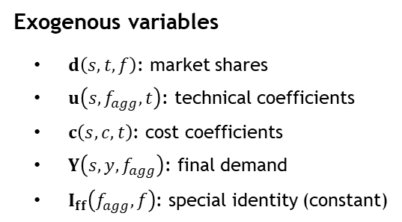
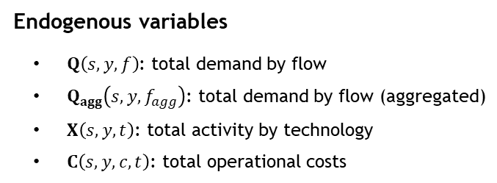
A simple SUT model
Mathematical model definition (sets, variables, symbolic problem)
gas power plant
Sets definition
Scenarios (s): “Reference”, “Energy transition”
Time (y): five years
Flows(f): “electricity, gas”, “electricity, pv”
Flows, aggregated (f_agg): “electricity, gas”, “electricity, pv”
Technologies (t): “gas power plant”, “photovoltaic plant”
Costs (c): “operational costs”
households (final demand)
Operational cost
photovoltaic plant
Electricity
Exogenous variables
$d\left(s,t,f\right)$: market shares
$u\left(s,f_{agg},t\right)$: technical coefficients
$c\left(s,c,t\right)$: cost coefficients
$Y\left(s,y,f_{agg}\right)$: final demand
$I_{ff}\left(f_{agg},f\right)$: special identity (constant)
Endogenous variables
$Q\left(s,y,f\right)$: total demand by flow
$Q_{agg}\left(s,y,f_{agg}\right)$: total demand by flow (aggregated)
$X\left(s,y,t\right)$: total activity by technology
$C\left(s,y,c,t\right)$: total operational costs
SUT
Linear Programming model

Slide 6


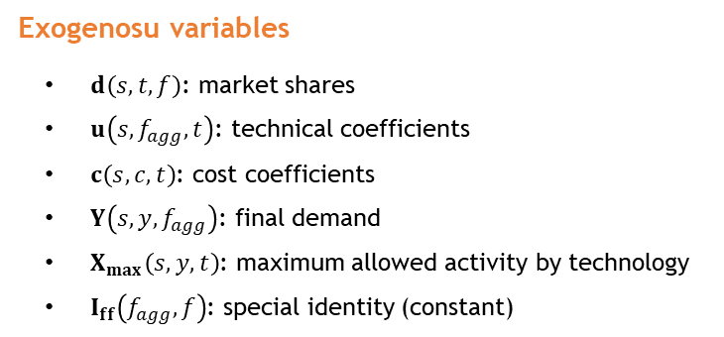


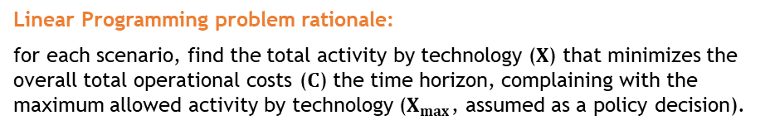




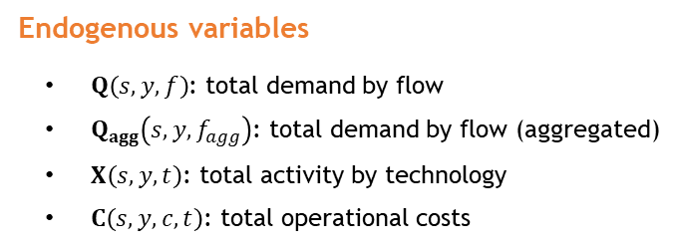


A simple SUT model
Mathematical model definition (sets, variables, symbolic problem)
Linear Programming problem rationale:
for each scenario, find the total activity by technology ($X$) that minimizes the overall total operational costs ($C$) the time horizon, complaining with the maximum allowed activity by technology ($X_{max}$, assumed as a policy decision).
Exogenosu variables
$d\left(s,t,f\right)$: market shares
$u\left(s,f_{agg},t\right)$: technical coefficients
$c\left(s,c,t\right)$: cost coefficients
$Y\left(s,y,f_{agg}\right)$: final demand
$X_{max}\left(s,y,t\right)$: maximum allowed activity by technology
$I_{ff}\left(f_{agg},f\right)$: special identity (constant)
For each scenario ($s$):
$Objective: \operatorname{Min}\left(c X\right)$
$$s.t. :$$
$$Q_{agg}−u X−Y=0$$
Total supply equals total demand
$$Q_{agg}−I_{ff}Q′=0$$
Competition among electricity flows
Endogenous variables
$Q\left(s,y,f\right)$: total demand by flow
$Q_{agg}\left(s,y,f_{agg}\right)$: total demand by flow (aggregated)
$X\left(s,y,t\right)$: total activity by technology
$C\left(s,y,c,t\right)$: total operational costs
$X−d Q′≥0$
Industry-technology assumption
$C=X′\hat{c}$
Total operational costs
$X≤X_{max}$
Total activity constraint
$X≥0$
Positivity of decision variables
$Q≥0$

Slide 7
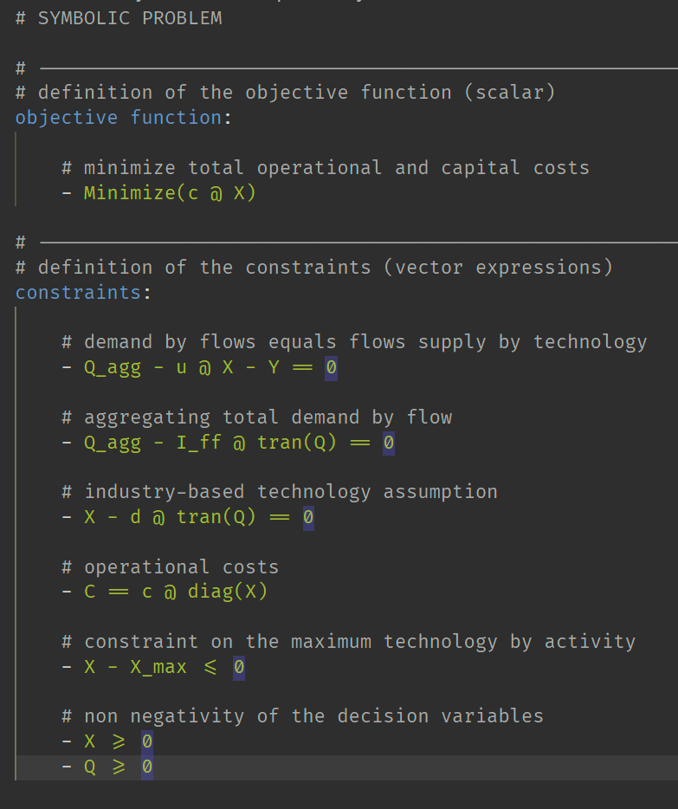
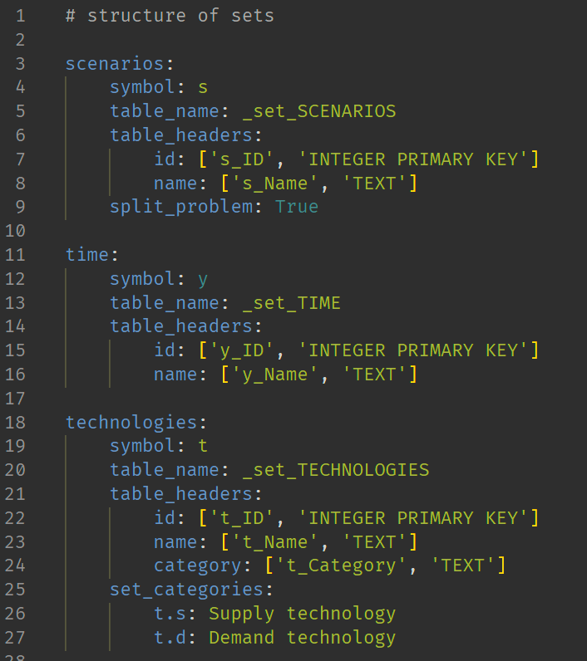
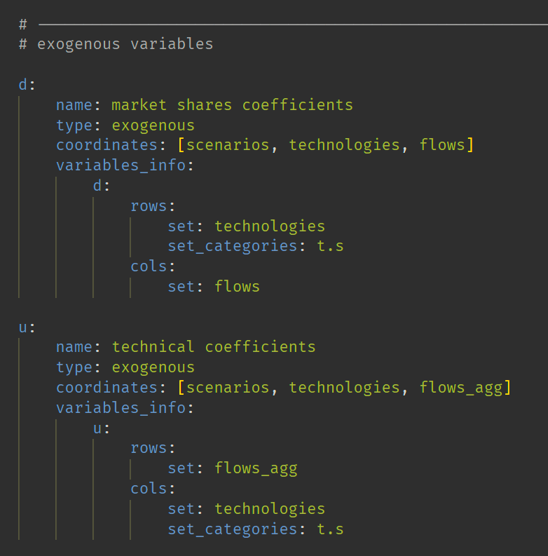
Application example
Solving the example via pyESM
Step 1 - pyESM generates directory with default setup files
Step 2 - User fills setup files, defining model sets, variables, equations
problem.yml
sets.yml
variables.yml

Slide 8
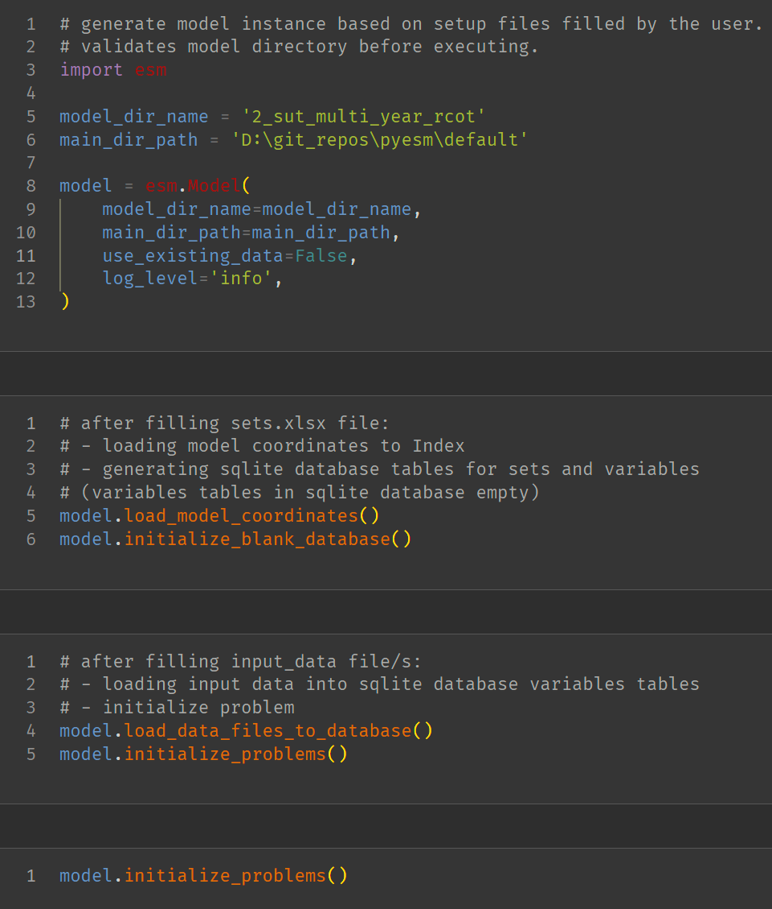
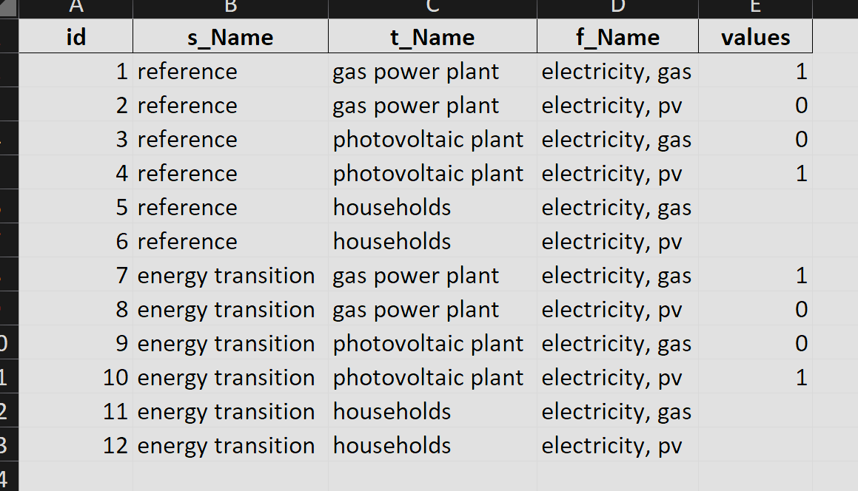
Application example
Solving the example via pyESM
Step 1 - pyESM generates directory with default setup files
Step 2 - User fills setup files, defining model sets, variables, equations
Step 3 - pyESM imports setup files and generates Model as Python object. Outputs: Blank SQLite database, Excel raw data files
Step 4 - User fills excel files with exogenous model data.
excel data file

Slide 9
py
ESM

