Slide 1
Model generation from scratch
Model generation from existing settings/data structures
Preliminary activities
1. Conceptual model definition
cvxlab.create_model_dir()
2. Generation of model directory
User data input
3. Fill model setup file/s
CVXlab model generation
model = cvxlab.Model()
4. Generation of model class instance
User data input
5. Fill sets data (model coordinates)
model.load_model_coordinates()
model.initialize_blank_data_structure()
6. Initialization of data structures
model.generate_input_data_files()
User data input
7. Fill/update exogenous model data
model.load_exogenous_data_to_sqlite_database()
model.initialize_problems()
8. Initialization of numerical problem/s
model.update_database_and_problem()
Model solution and results export
model.run_model()
9. Solution of numerical problem/s
model. load_results_to_database()
10. Export endogenous model data

Slide 2
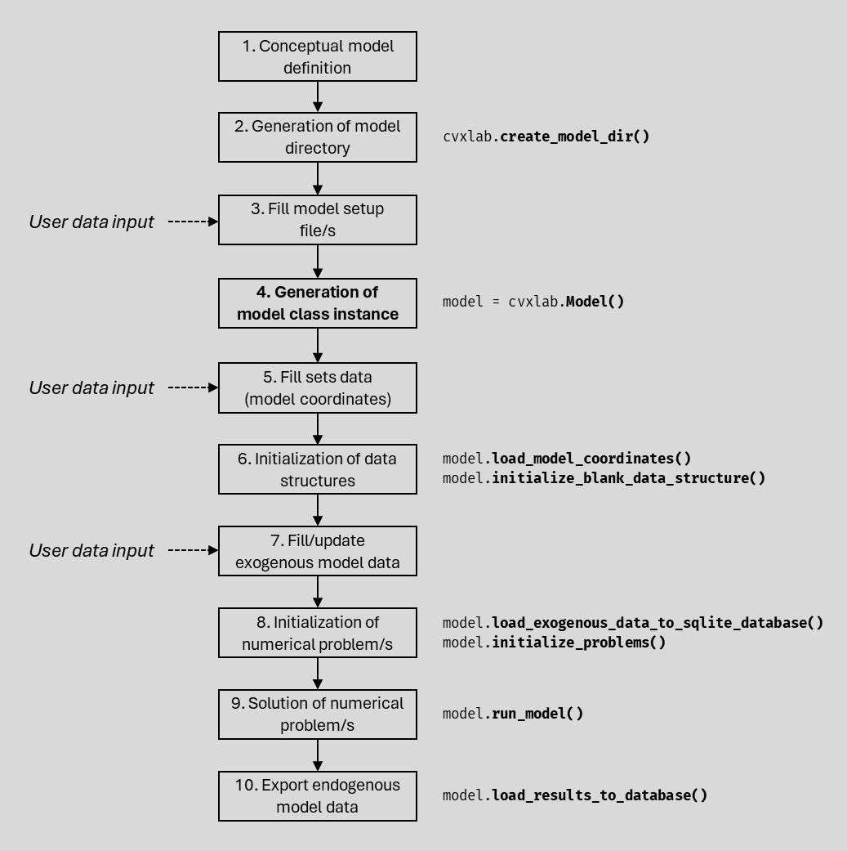
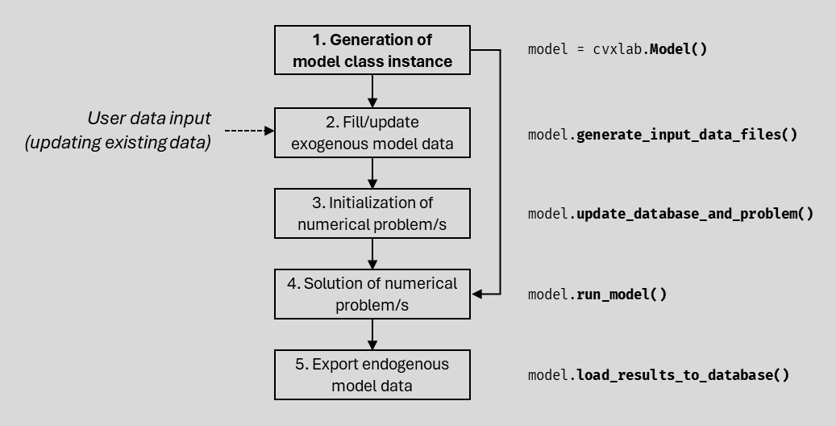
1. Conceptual model definition
2. Generation of model directory
cvxlab.create_model_dir()
User data input
3. Fill model setup file/s
4. Generation of model class instance
model = cvxlab.Model()
User data input
5. Fill sets data (model coordinates)
6. Initialization of data structures
model.load_model_coordinates()
model.initialize_blank_data_structure()
User data input
7. Fill/update exogenous model data
8. Initialization of numerical problem/s
model.load_exogenous_data_to_sqlite_database()
model.initialize_problems()
9. Solution of numerical problem/s
model.run_model()
10. Export endogenous model data
model.load_results_to_database()
1. Generation of model class instance
model = cvxlab.Model()
User data input
(updating existing data)
2. Fill/update exogenous model data
model.generate_input_data_files()
3. Initialization of numerical problem/s
model.update_database_and_problem()
4. Solution of numerical problem/s
model.run_model()
5. Export endogenous model data
model.load_results_to_database()

Slide 3





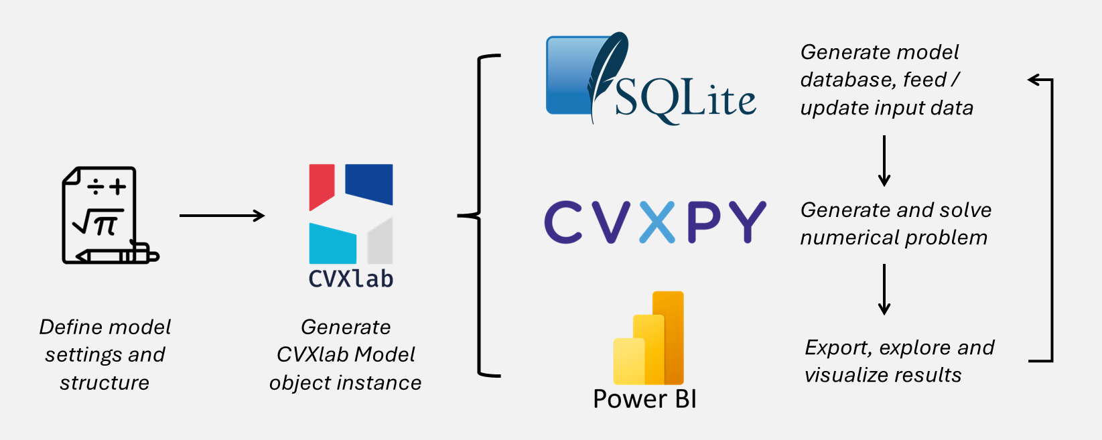

Generate model database, feed / update input data
Generate and solve numerical problem
Define model settings and structure
Generate CVXlab Model object instance
Export, explore and visualize results

