Slide 1

Open-source Python laboratory
for convex algebraic modeling
Prof. Matteo V. Rocco
SESAM group
Department of Energy, Politecnico di Milano

Slide 2
Outline
Background
CVXlab concept and purpose
Modeling algebraic systems

Slide 3
Background
Needs to support activities @SESAM
One group, one (modeling) way
Focus on what matters → more time spent on conceptualization/data analysis, less on coding
Reduce data management efforts → data engineering (sql, sdmx, api)
Make data inspection and visualization easy → business intelligence (pbi)
Modeling efforts must be scalable and reproducible → collaborative protocols (control versions, git repos, …)

Slide 4








Background
Systems models/modeling frameworks
Several packages already available (Calliope, pyPSA, OSEMoSYS, …)
Shareware/Open-source packages with high modeling capabilities
Focused on model definition → no tools for data handling/visualization
Low flexibility → hard to develop new modeling features)
Designed for end users → difficult to access and customize model behavior
General purpose modeling systems
Shareware/Open-source packages available (GAMS, CVXPY, pyOMO, …)
High flexibility → useful to model a wide range of systems
Focused on mathematical model → no tools for data handling/visualization
Designed for model developers → high experience and modeling knowledge
Databases handlers
Few packages available (MARIO, pyMRIO)
Open-source packages with nearly zero modelling capabilities
Designed to handle multi-sectoral databases (limited scope)

Slide 5





CVXlab concept and purpose
Drawbacks of existing modelling frameworks
Design oriented to end-users (low flexibility in designing new features or controlling models’ rationale)
Unprofessional data management systems (no SQL-based databases)
Difficulties in handling and inspecting data (no Business Intelligence support)
Open-source, python-based modeling framework
General purpose model generator
Embedding cvxpy modeling language (cvxpy.org)
Solves one or more (integrated) convex numerical problems
Mathematical model defined by user (symbolic definition)
Very low coding skills required
Centralized data management based on SQLite databases
Easy data collection for end-users (Excel-based)
Easy data inspection based on PowerBI reports
Desired features
Flexibility (easy to implement model capabilities)
Open source
Design either for end-users and for developers/research
Possibility to handle a variety of physical complexities
Solve linear problems and integrated linear problems
Handling data like a pro
https://github.com/cvxlab

Slide 6
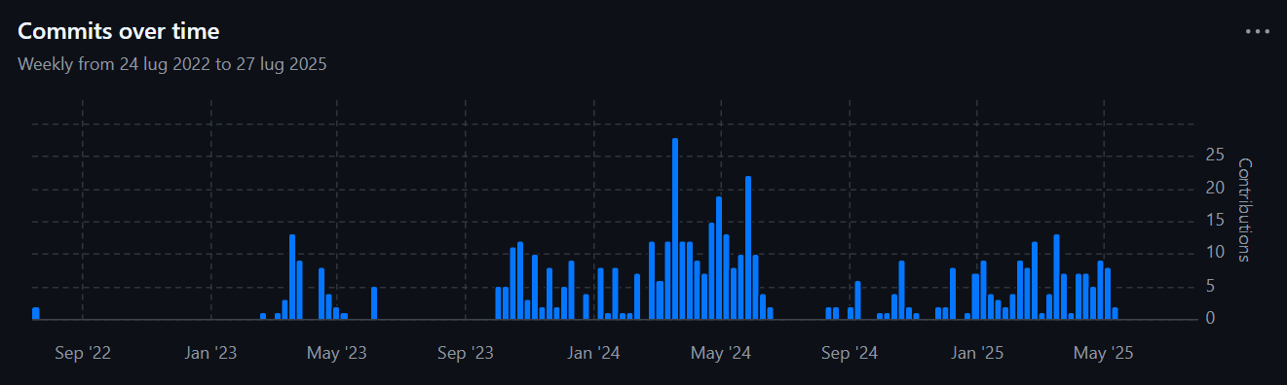
CVXlab concept and purpose
Long journey so far…
First commit 24 Jul 2022 (3 years)
471 commits, several branches
GitHub organization page: https://github.com/cvxlab

Slide 7





CVXlab in a nutshell
…
Define/update exogenous data
Generate/update model database
Define model settings and structure
Generate model instance
Explore and visualize results

Slide 8




CVXlab modeling process
CVXlab generates directory with default setup files (xlsx or yml).
Analyst fills setup files, defining models features (sets, data tables, variables, expressions).
CVXlab imports setup files, producing an empty SQLite database and raw excel data files.
Analyst fills excel files with exogenous model data.
CVXlab imports exogenous data from database, generates/solves numerical problem/s, export endogenous data to database.
Database ready for data exploration and visualization.
2
1
Model setup information
Analysts
4
3
…
Model exogenous data files
Data exploration and visualization
5
Model SQL database

Slide 9


Model SQL database
1. Model directory generation:
model setup files (.yml or .xlsx)
tutorial file (.ipynb, optional)
What analysts do
cvxlab.create_model_dir(…)
4
2
0. User defines analytical problem
2. User fills model setup files, defining:
sets
data tables and related variables
mathematical expressions
model = cvxlab.Model(…)
model.load_model_coordinates(…)
model.generate_input_data_files(…)
model.generate_input_data_files(…)
3. CVXlab model initialization
Model instance
SQLite database
Excel input data files
model.
4. User fills Excel input data files
5. CVXlab solves numerical model
Loads data from SQLite database
Generates/solves numerical problem
Exports results to SQLite database

Slide 10




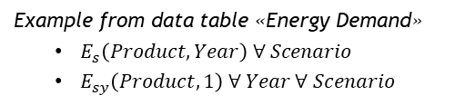

CVXlab fundamental objects
Model SQL database
Model numerical problem
Sets
Dimensions that define the scope of the model. Each set corresponds to a table in SQL database.
Variables
Symbolic items pointing to data in database.
Can be used to compose mathematical expressions.
Multiple variables can be derived from each data table.
Can be defined as subset of data tables (filtering data based on related sets filters)
Examples:
Scenario: [Business As Usual, Net-Zero]
Technology: [Gas Turbines, Solar PV]
Product: [Natural Gas, Electricity]
Year: [2000, 2010, …, 2050]
Example from data table «Energy Demand»
$E_{s}\left(Product,Year\right) ∀ Scenario$
$E_{sy}\left(Product,1\right) ∀ Year ∀ Scenario$
Data tables
Collection of model endogenous/exogenous data identified by a list of sets (coordinates). Each data table corresponds to a table in SQL database, related to one or multiple sets.
Expressions
Symbolic expressions (equations, inequalities, objective functions) that compose mathematical problems.
Defined based on variables and math/custom operators.
Must be dimensionally and structurally consistent.
Can be grouped into separate independent or integrated problems solved in parallel.
Examples:
Energy Demand (Scenario, Product, Year)
Efficiency (Technology)
Capacity (Scenario, Technology)
…
$\operatorname{Max}\left(c x′\right)$
$a x′−b≤0$
$a−a_{0}−lr \hat{x}=0$

Slide 11
CVXlab fundamental objects
Inter-problem set
Define the number of times the problem (all sub-problems) is solved. (e.g. problem solved for all combinations of scenarios and sensitivities)
Sets tables
Model SQL database
Other sets
Necessary to define each variable shapes (row, column, inter-problem set)
Exogenous data
Model object
Data tables
Endogenous data
Sub-problem specific Exogenous or endogenous depending on the sub-problem
Model numerical problem
Sub-problem #1
Variable #1
Point to numeric data in data tables
Used to define sub-problems expressions
Shapes defined by sets as rows, columns, inter-problem. example: efficiency( rows: technology, columns: 1, intra-problem: year, inter-problem: scenario, sensitivity )
Sub-problem #2
Objective (opt.)
Variable #2
…
…
Expression #1
Sub-problem #n
Expression #2
Variable #k
…
Expression #m

Slide 12





CVXlab fundamental objects
Model numerical problem
Numerical problems must be convex
Class of optimization problems with convex objective function and convex feasible set (points satisfying contraints)
Problems where any local optimum is a global optimum.
There are efficient and reliable algorithms that can solve them even at large scale.
They're well-studied and widely applicable across engineering, economics, machine learning, energy systems, etc.
Typical form
$$x=\left(x_{1},x_{2},…,x_{n}\right)$$
Set of endogenous variables
Examples:
Linear Programs (LPs)
Quadratic Programs (QPs)
Second-Order Cone Programs (SOCPs)
...Visit cvxpy.org for detailed description of allowed problems
$$min f\left(x\right)$$
Convex objective function
$$s.t.$$
$$g_{i}\left(x\right)≤0$$
Convex inequality constraints
$$h_{j}\left(x\right)=0$$
Linear (affine) equality constraints

Slide 13
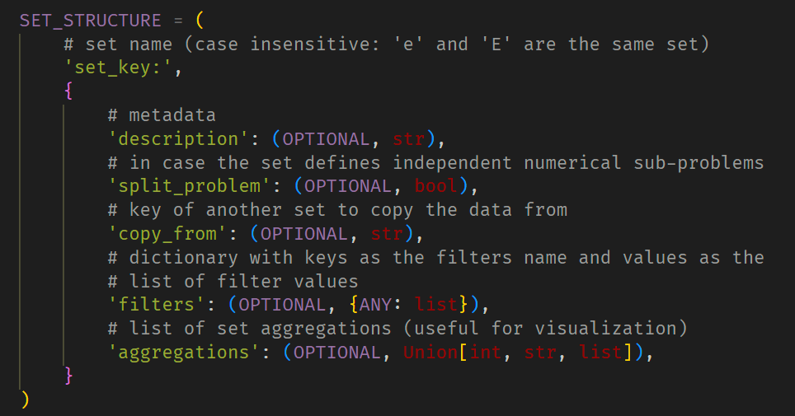
Defining models: sets, variables, symbolic problem
Sets
Are the dimensions that define the scope of model and the analysis to be performed.
Python objects corresponding to SQLite tables with information on model sets. Example: list of scenarios, technologies, products, …
Examples:
Technology: processes that compose the system;
Product: flows supplied/demanded by every technology;
Year: defining the time scope to be analyzed;
Scenario: collecting sets of assumptions to be analyzed;
…
https://github.com/pyESM-project

Slide 14
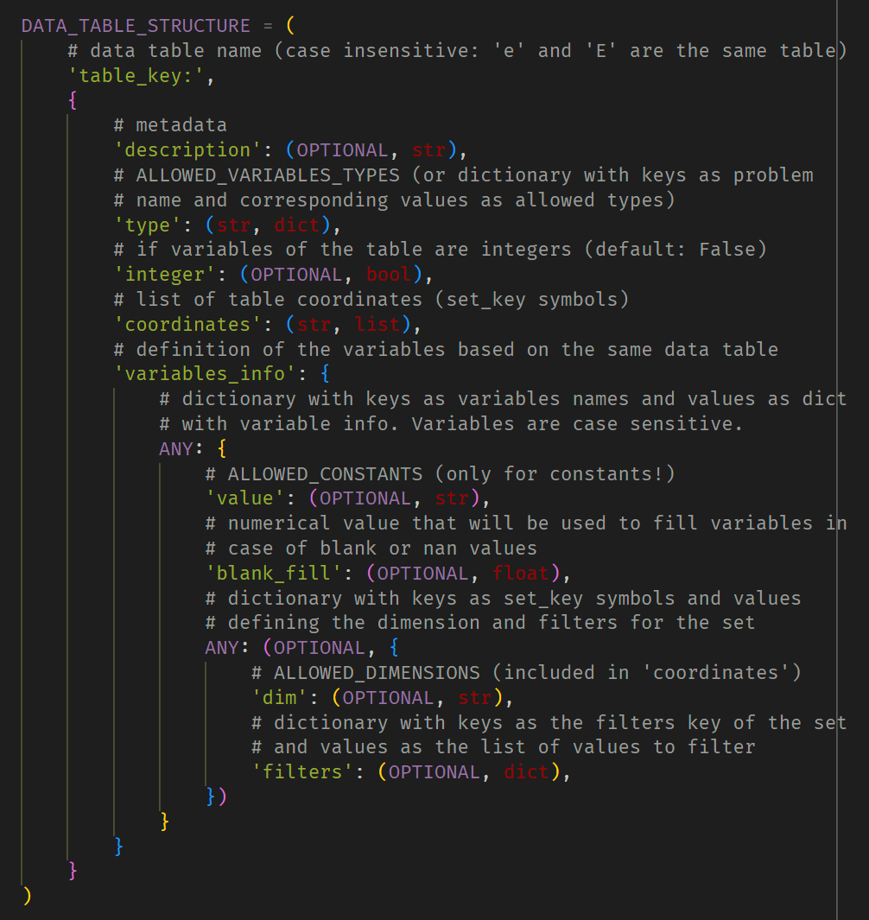
Defining models: sets, variables, symbolic problem
Data tables
Python objects corresponding to SQLite tables with model data.
Each table is identified by a list of sets (coordinates). Example: products unit prices may be defined by products and by scenarios.
Data tables are classified as:
Exogenous: input data of the problem (defined by user in excel files)
Endogenous: results of the problem (returned as output in sqlite database)
Constant: predefined value not defined by user
Sub-problem specific: variables can be endogenous/exogenous, depending on the type of problems for which are defined. This category is relevant for integrated numerical models.
Variables
Python objects corresponding to problem variables, representing the whole or a part of data tables.
Multiple variables of different shapes may be sliced from a same data table.
A same variable can be endogenous or exogenous or exogenous depending on the symbolic problem.
https://github.com/pyESM-project

Slide 15
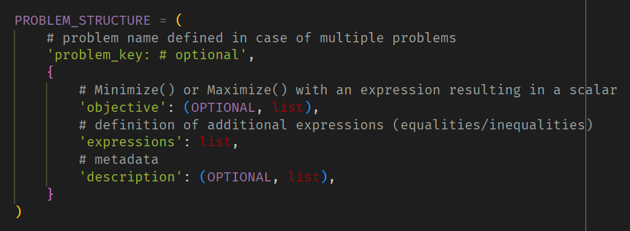
Defining models: sets, variables, symbolic problem
Problems
Python objects corresponding to numerical problems, all referring to the same set of variables, data and sets.
One or more symbolic problems can be defined, each composed by equations/inequalities with variables previously defined.
Multiple problems can be solved independently, or as integrated models (i.e. exchanging values of endogenous/exogenous variables iteratively)
https://github.com/pyESM-project

Slide 16
Example of application
Prof. Matteo V. Rocco
SESAM group
Department of Energy, Politecnico di Milano

Slide 17
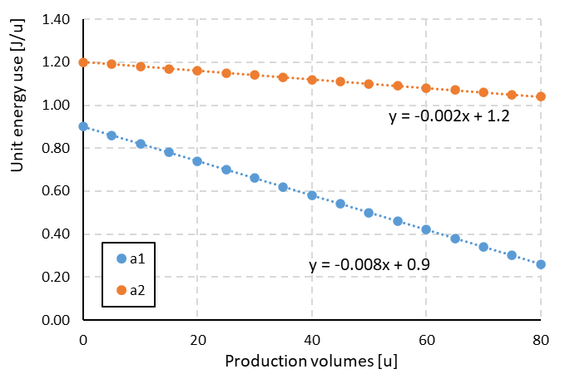
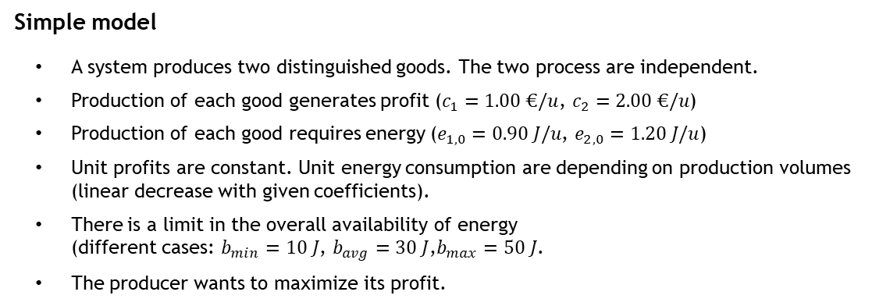
Conceptual model definition
Step 2
User fills setup files, defining:
model sets
model variables
problem equations
Simple model
A system produces two distinguished goods. The two process are independent.
Production of each good generates profit ($c_{1}=1.00 €/u$, $c_{2}=2.00 €/u$)
Production of each good requires energy ($e_{1,0}=0.90 J/u$, $e_{2,0}=1.20 J/u$)
Unit profits are constant. Unit energy consumption are depending on production volumes (linear decrease with given coefficients).
There is a limit in the overall availability of energy (different cases: $b_{min}=10 J$, $b_{avg}=30 J$,$b_{max}=50 J$.
The producer wants to maximize its profit.
Energy use 1
process 1
Product 1
Profit 1
Energy use 2
process 2
Product 1
Case study
Quantify the production yields for the two products that lead to the maximization of producer’s profit.
Define different scenarios corresponding to different energy availabilities.
Profit 2
https://github.com/pyESM-project

Slide 18
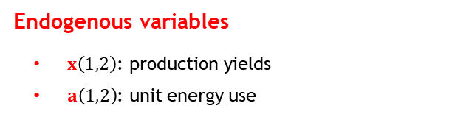


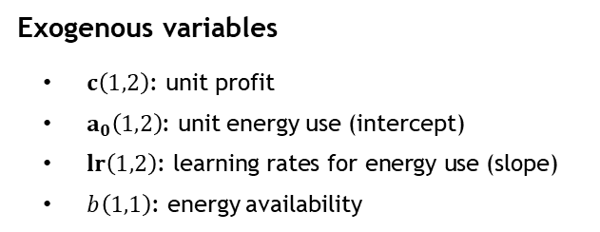



Conceptual model definition
Definition of the conceptual optimization problem
Same problem defined for each energy availability
Objective function: maximization of producer’s profit
Constraints:
Total use of energy less than or equal to limit energy availability
Unit energy consumption by product defined by the product’s production yield
Positive products production
Energy use 1
process 1
Product 1
Profit 1
Energy use 2
process 2
Product 1
Profit 2
Exogenous variables
$c\left(1,2\right)\text{: }\text{unit} \text{profit}$
$a_{0}\left(1,2\right)$: unit energy use (intercept)
$lr\left(1,2\right)\text{: }\text{learning} \text{rates} \text{for} \text{energy} \text{use}\text{ (}\text{slope}\text{)}$
$b\left(1,1\right)$: energy availability
For each value of energy availability ($b$):
$Objective: \operatorname{Max}\left(c x′\right)$
Maximization of total profit
$$s.t. :$$
$$a x′−b≤0$$
Energy use not exceeding availability
Non-linear
Endogenous variables
$x\left(1,2\right)$: production yields
$a\left(1,2\right)$: unit energy use
$$a−a_{0}−lr \hat{x}=0$$
Unit energy use depends on production
$x≥0$
Positive production yields
https://github.com/pyESM-project

Slide 19







Conceptual model definition
Dealing with non-linear expressions
Solve both problems with exogenous variables (including first guesses for variables that are both exogenous/endogenous)
Update values of exogenous variables derived as endogenous from both problems (x and a in the example)
Repeat the process until convergence is met under a defined criteria.
Problem 1 (LP problem)
$Objective: \operatorname{Max}\left(c x′\right)$
Maximization of total profit
Exogenous variables
$c\left(1,2\right)\text{: }\text{unit} \text{profit}$
$a_{0}\left(1,2\right)$: unit energy use (intercept)
$lr\left(1,2\right)\text{: }\text{learning} \text{rates} \text{for} \text{energy} \text{use}$
$b\left(1,1\right)$: energy availability
$a\left(1,2\right)$: unit energy use
$x\left(1,2\right)$: production yields
$$s.t. :$$
$$a x′−b≤0$$
Energy use not exceeding availability
Endogenous variables
$x\left(1,2\right)$: production yields
$a\left(1,2\right)$: unit energy use
$x≥0$
Positive production yields
Problem 2 (Linear expression)
$$a−a_{0}−lr \hat{x}=0$$
Unit energy use depends on production
https://github.com/pyESM-project

Slide 20
CVXlab modeling process
CVXlab generates directory with default setup files (xlsx or yml).
Analyst fills setup files, defining models features (sets, data tables, variables, expressions).
CVXlab imports setup files, producing an empty SQLite database and raw excel data files.
Analyst fills excel files with exogenous model data.
CVXlab imports exogenous data from database, generates/solves numerical problem/s, export endogenous data to database.
Database ready for data exploration and visualization.
2
1
Model setup information
Analysts
4
3
…
Model exogenous data files
Data exploration and visualization
5
Model SQL database

Slide 21
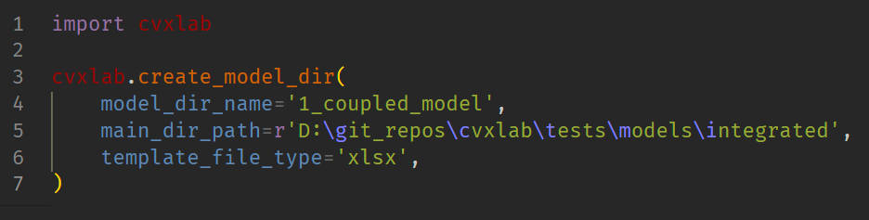
CVXlab modeling process
CVXlab generates directory with default setup files (xlsx or yml).
Create a new python script (or jupyter notebook), import pyesm package, run the.create_model_dir() method with arguments:
Name of model directory to be generated
Path of the root directory
Type of template file to be generated (yml or xlsx)
Model setup information
Setup files will be generated in the defined directory:
case of .yml format: structure_sets.yml, structure_variables.yml, problem.yml
case of .xlsx format: model_settings.xlsx

Slide 22
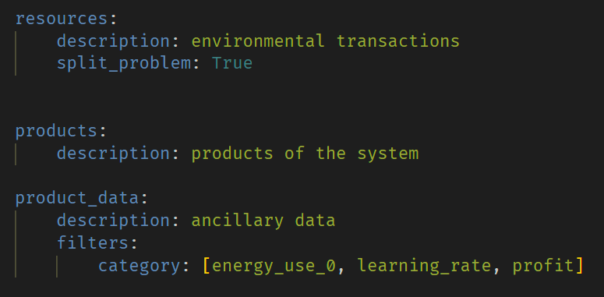
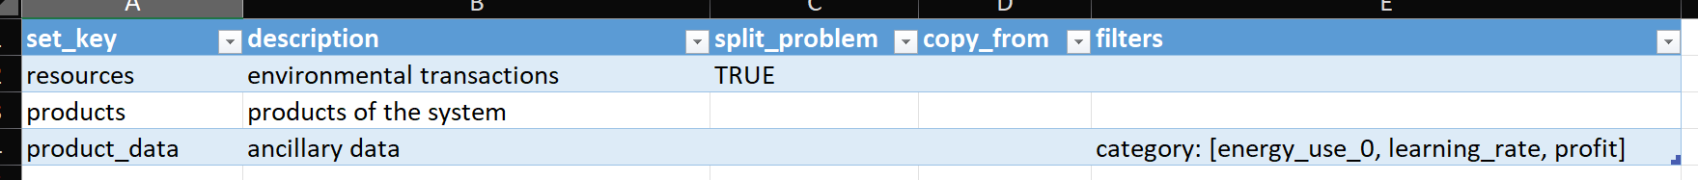
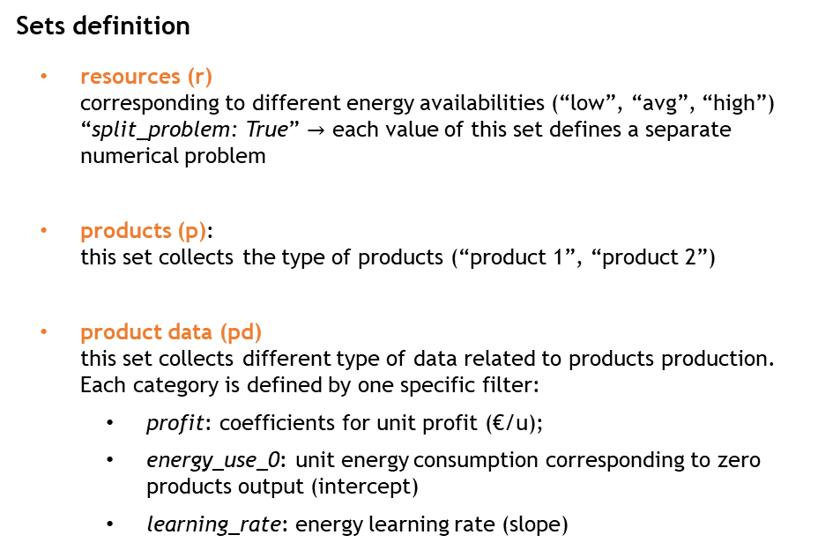
CVXlab modeling process
Analyst fills setup files, defining models features (sets, data tables, variables, expressions).
Sets definition
resources (r) corresponding to different energy availabilities (“low”, “avg”, “high”) “split_problem: True” $→$ each value of this set defines a separate numerical problem
products (p): this set collects the type of products (“product 1”, “product 2”)
product data (pd) this set collects different type of data related to products production. Each category is defined by one specific filter:
profit: coefficients for unit profit (€/u);
energy_use_0: unit energy consumption corresponding to zero products output (intercept)
learning_rate: energy learning rate (slope)
.yml file:
.xlsx file:
https://github.com/pyESM-project

Slide 23
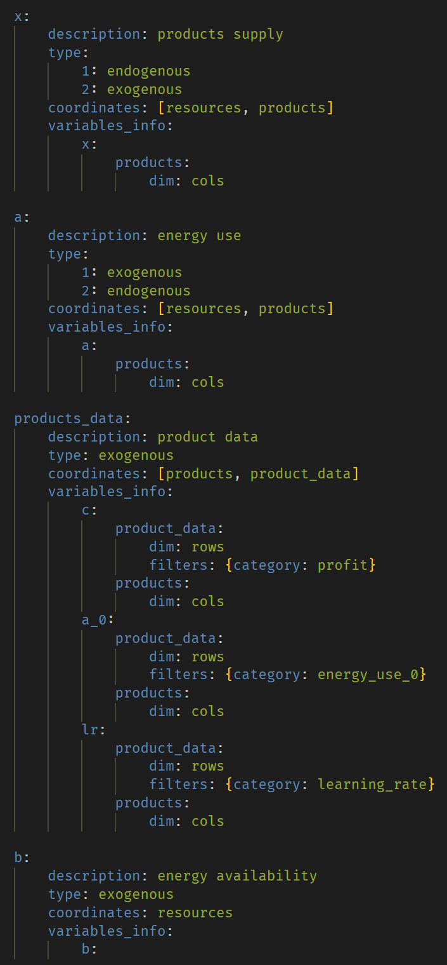
CVXlab modeling process
Analyst fills setup files, defining models features (sets, data tables, variables, expressions).
Data tables and Variables definition
.yml file:
.xlsx file:
https://github.com/pyESM-project

Slide 24
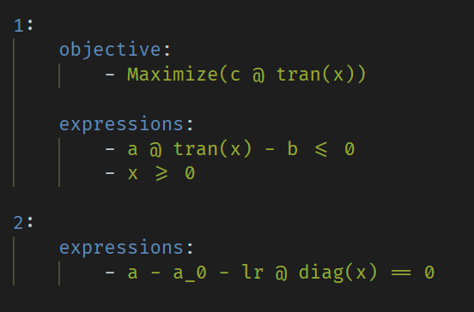
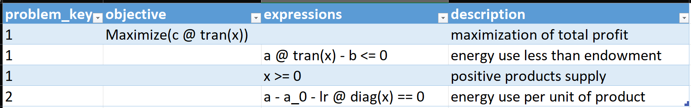
CVXlab modeling process
Analyst fills setup files, defining models features (sets, data tables, variables, expressions).
Symbolic problem definition
.yml file:
.xlsx file:
https://github.com/pyESM-project

Slide 25

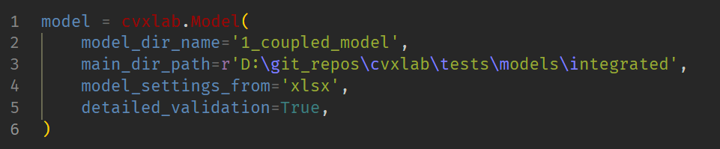
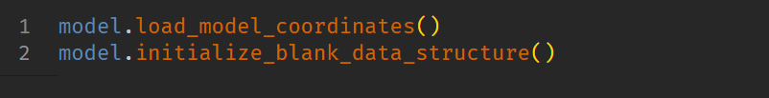
CVXlab modeling process
CVXlab imports setup files, producing an empty SQLite database and raw excel data files.
This will generate Model object and provide xlsx file for set information to be filled by user
Model set file
Analysts
…
Model exogenous data files
This will generate empty SQLite database file and raw excel data tables files based on sets information provided by users.
Model SQL database

Slide 26
CVXlab modeling process
a (first guess)
x (first guess)
Analyst fills excel files with exogenous model data.
id | resources_Name | products_Name | values
1 | low energy | product 1 | 0.90
2 | low energy | product 2 | 1.20
3 | avg energy | product 1 | 1.30
4 | avg energy | product 2 | 1.60
5 | high energy | product 1 | 1.80
6 | high energy | product 2 | 2.20
id | resources_Name | products_Name | values
1 | low energy | product 1 | 1
2 | low energy | product 2 | 2
3 | avg energy | product 1 | 3
4 | avg energy | product 2 | 4
5 | high energy | product 1 | 5
6 | high energy | product 2 | 6
…
Analysts
Model exogenous data files
products_data
id | products_Name | product_data_Name | values
1 | product 1 | unit energy use, initial | 0.90
2 | product 1 | unit profit | 1
3 | product 1 | learning rate | -0.008
4 | product 2 | unit energy use, initial | 1.20
5 | product 2 | unit profit | 2
6 | product 2 | learning rate | -0.002
b
id | resources_Name | values
1 | low energy | 10
2 | avg energy | 30
3 | high energy | 50

Slide 27
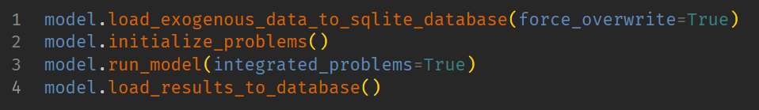
CVXlab modeling process
CVXlab imports exogenous data from database, generates/solves numerical problem/s, export endogenous data to database.
Database ready for data exploration and visualization.
…
Model exogenous data files
Model SQL database

Slide 28
Package structure, documentation and APIs
Prof. Matteo V. Rocco
SESAM group
Department of Energy, Politecnico di Milano

Slide 29
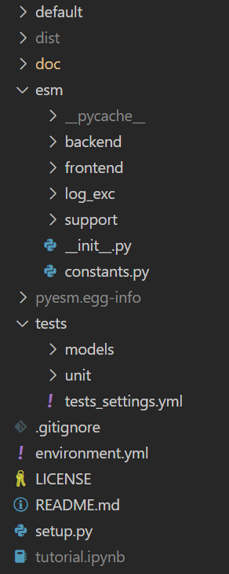
Package OOP structure
“default” directory:
templates of model settings files
template of Jupyter Notebook tutorial with APIs applications examples
“doc” directory:
documentation files (in progress)
Sphinx files to setup online documentation
other illustrative materials (presentations, examples, …)
“esm” directory:
base: directory including basic pyESM classes and methods
log_exc: logging and exceptions directory
support: includes util methods and ancillary classes necessary to handle files and SQLite database
“tests” directory:
pytest infrastructure for testing default models (models dir) and classes/methods (units dir)
Other files with essential settings of the package

Slide 30
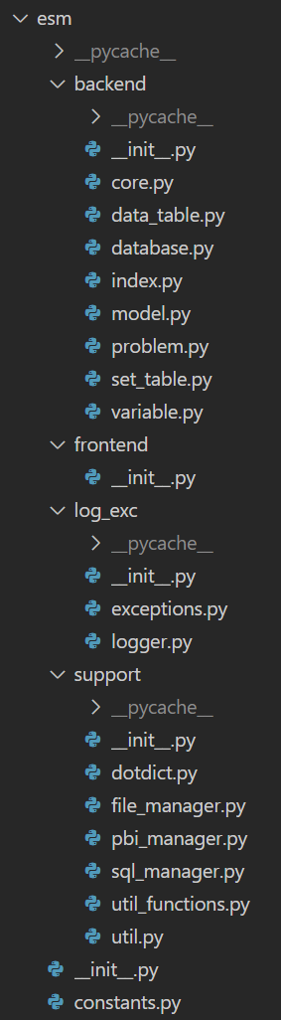
Package OOP structure
esm.backend
.core.Core – inside Model class, composed by fundamental objects for the model
.data_table.DataTable – includes information about SQLite data tables (set coordinates, variables information, …)
.database.Database – class in charge of manipulating the SQLite database (data input/output interface with problem)
.index.Index – includes all fundamental information of the conceptual model (data tables, set tables, variables)
.model.Model – main class of the package, with main methods accessible to users for creating/manipulating the model
.problem.Problem – class in charge of manipulating conceptual and numerical problem
.set_table.SetTable – includes information about SQLite set tables (e.g. technologies, products, …)
.variable.Variable – each instance is a model mathematical variable (use matrix, …)
esm.frontend. …work in progress for GUI
esm.log_exc.
exceptions – set of subclasses defining custom exceptions
logger.Logger – handle log messages during model execution
esm.support.
dotdict.Dotdict – ancillary class working as a normal dictionary but accessing keys with dot (.) notation
file_manager.FileManager – includes all methods to manipulate files (create, import, erase, …)
pbi_manager.PBIManager – includes all methods necessary to create and handle PowerBI report
sql_manager.SQLManager – includes all methods necessary to manage and operate on the SQLite database
util, util_functions – ancillary set of support functions (isolated functions)
esm.constants. – essential constants required by all other modules
Constants – class with getter method for getting constant values

Slide 31
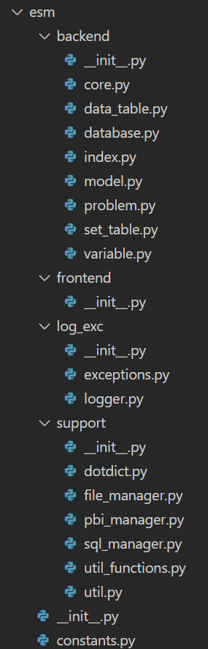
Package OOP structure
esm.backend.model.Model
Model()
Constants()
Logger()
FileManager()
Core()
PBIManager()
Logger()
Logger()
FileManager()
Logger()
SQLManager()
Index()
Database()
Problem()
Logger()
Logger()
FileManager()
Logger()
FileManager()
SQLManager()
Index()
Logger()
FileManager()
Index()
SetTable()
DataTable()
Variable()
Logger()
Logger()
Logger()

Slide 32
API reference
method esm.support.util.create_model_dir
“””
Create a directory structure for the generation of Model instances.
If no default_model is indicated, only basic setup files are generated.
Args:
model_dir_name (str): Name of the model directory.
main_dir_path (str): Path to the main directory where the model directory will be created.
default_model (str, optional): Name of the default modle to use as a template.
List of available templates in /tests/tests_settings.yml (fixtures). Defaults to None.
force_overwrite (bool, optional): if True, avoid asking permission to overwrite existing files/directories. Defaults to False.
export_tutorial (bool): If True, includes a Jupyter notebook tutorial in the model directory.
default_files_prefix (str): Prefix for files to be copied from the template, defaults to 'template_’.
”””

Slide 33
API reference
main methods of class esm.base.model.Model
Method | Description
validate_model_dir | Checks if the model directory and all the required setup files exist.
load_model_coordinates | Load information defined by user to the Index object inside the model (definition of sets and variables of the problem).
initialize_blank_database | Gerates SQLite database tables for sets and variables. Generates exogenous parameters input xlsx files.
load_exogenous_data_to_sqlite_database | Load user data (exogenous variables) to SQLite database.
initialize_problems | Define numerical problem as a series of cvxpy objects based on numerical data and user defined symbolic problem.
update_database_and_problem | In case of modification of exogenous data in xlsx files or symbolic problem, update SQLite database and numerical problem without re-casting Model instance.
run_model | Solve the defined numerical problems.
check_model_results | Checks validity of the results of the model's computations against one database with expected values. This is mainly called for testing purpose.
load_results_to_database | Exports endogenous results to SQLite database.
generate_pbi_report | Generates Power BI report

Slide 34
Start
1. Conceptual model definition
Preliminary activities
2. Generation of model directory
3. Fill model setup file/s
CVXlab model generation
4. Generation of model class instance
Model solution and results export
5. Fill sets data (model coordinates)
6. Initialization of data structures
7. Fill exogenous model data
Updating problem and input data
7. Initialization of numerical problem/s
8. Initialization of numerical problem/s
9. Solution of numerical problem/s
10. Export endogenous model data

