Slide 1
Astute Irrigation System and Crop Management
Lasya Vadapalli (501528)
Suraj Padhy (501541)
Yashshree Patil (501546)
Rashmi Pawar (501548)

Slide 2
Sensors Working with NodeMCU

Slide 3
Block Diagram of the Entire System
Temp
Sensor
Moisture sensor
NodeMCU
Cloud database
Local controller
Power supply
Water level sensor
Mobile application
Water pump
Relay
End user

Slide 4
Implementation Details
Hardware Requirements:
NodeMCU
Soil Temperature Sensor (DS18b20)
Soil Moisture Sensor (KG003)
Ultrasonic Sensor (HC-SR04)
Single Channel 5v Relay
3v-6v DC water pump
Software Requirements:
Visual Studio 2017 with Xamarin tools plugin.
Azure Cloud server Account

Slide 5
Installation of NodeMCU on Arduino.
Start Arduino and open Preferences window.
Enter http://arduino.esp8266.com/stable/package_esp8266com_index.json into
Additional Board Manager URLs field.
Open Boards Manager from Tools > Board menu and find esp8266 platform.
Select the version you need from a drop-down box.
Click install button.
Select your ESP8266 board from Tools > Board menu after installation.

Slide 6
Connecting Temperature sensor to NodeMCU
DS18B20 is used for measuring the soil temperature. It is one wire interface sensor, very common in PCB embedded electrical circuits. Its unique one wire protocol requires only one port pin for communication and needs no other external components to work. It is waterproof sensor hence it can be used in humid and wet environmental conditions. It can operate on 3.3v and 5.5v.
This sensor has 3 pins.
a.Vcc - 5V
b.Gnd - Gnd
c.Data

Slide 7
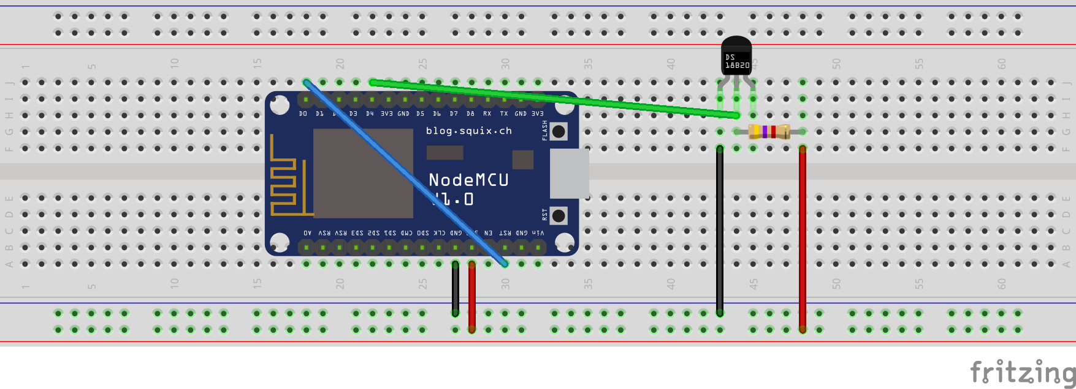
Circuit Diagram

Slide 8
Connecting Soil Moisture Sensor to NodeMCU
KG003 soil moisture sensor is used to measure the soil moisture.
The soil moisture sensor consists of two probes. The two probes allow the current to pass through the soil and then it gets the resistance value to measure the moisture value.
When there is more water, the soil will conduct more electricity which means that there will be less resistance. Therefore, the moisture level will be higher. Dry soil conducts electricity poorly, so when there will be less water, the soil will conduct less electricity which means that there will be more resistance. Therefore, the moisture level will be lower.
The sensor has 4 pins. First two pins are Vcc and GND. The next two pins are output pins.A0 pin is giving analog output and D0 pin is giving digital output. We are using analog output of sensor to get readings.

Slide 9
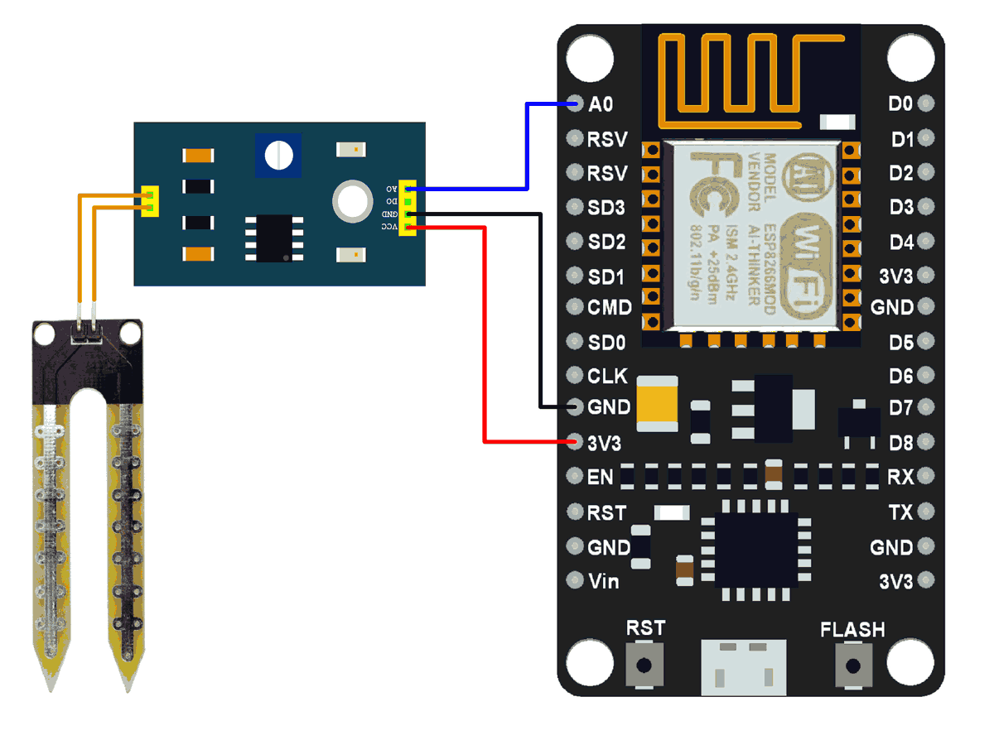
Circuit Diagram The VDD pin is connected to 3.3V supply on breadboard. The GND pin is connected to ground on breadboard. The analog output of the sensor from pin A0 is given to A0 pin of NodeMCU which is analog input pin.

Slide 10
Connecting Ultrasonic sensor to NodeMCU.
HC-SR 04 ultrasonic distance sensor is used to measure water level in storage tank. This sensor operates on 5V.
The maximum measuring distance is 400cm.The Ultrasonic transmitter transmits an ultrasonic wave, this wave travels in air and when it gets objected by water it gets reflected back toward the sensor this reflected wave is observed by the Ultrasonic receiver.
Once the signal is received by receiver using time distance speed formula we can calculate the water level in the tank. A basic ultrasonic sensor consists of one or more ultrasonic transmitters (basically speakers), a receiver, and a control circuit. The transmitters emit a high frequency ultrasonic sound, which bounce off any nearby objects. Some of that ultrasonic noise is reflected and detected by the receiver on the sensor.

Slide 11
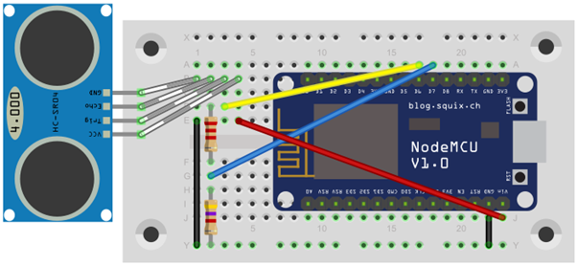
Circuit Diagram

Slide 12
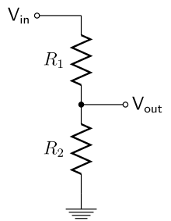
Use of Voltage Divider
The voltage required for ultrasonic sensor is 5V and as NodeMCU can work with voltage 3.3V. We used voltage divider circuit.
Supply the sensor with 5V and use a simple voltage divider before connecting to MCU and therefore measure 0-3.3V.

Slide 13
Installation of AISCM (Work done so far)
Installation VS17 with Xamarin is completed.
Creation and activation of azure account is completed.
Creation of database on azure is completed.
Successfully Build and deployed the previous year project and facing some issues in login page.

Slide 14
Thank You

