Slide 1
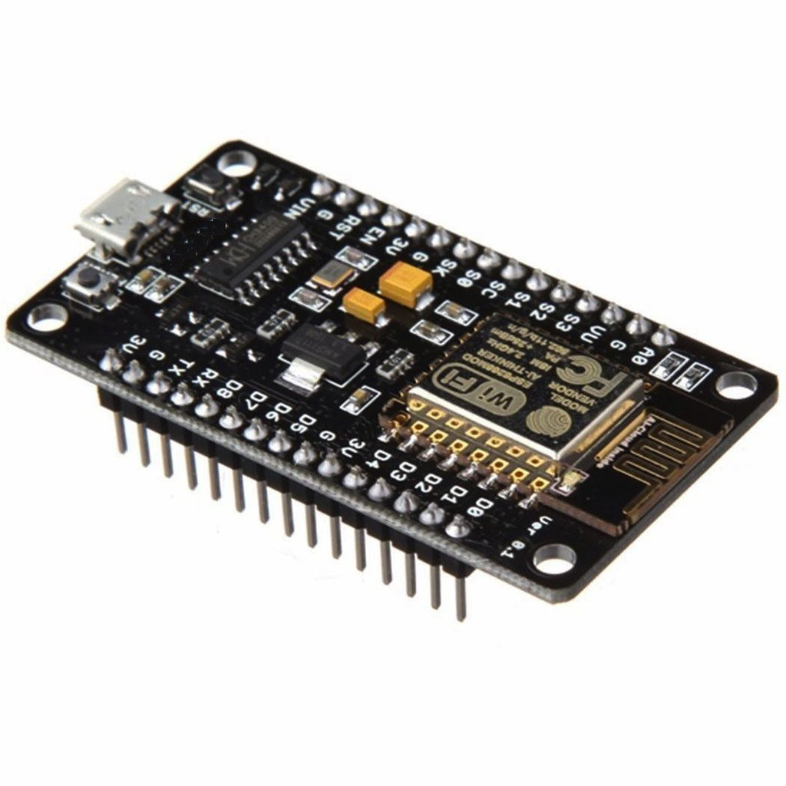
NodeMCU

Slide 2
Introduction:
NodeMCU started on 13 Oct 2014
Open source IoT platform
runs n ESP8266 WiFi SoC
Uses Arduino IDE and C/C++ language

Slide 3
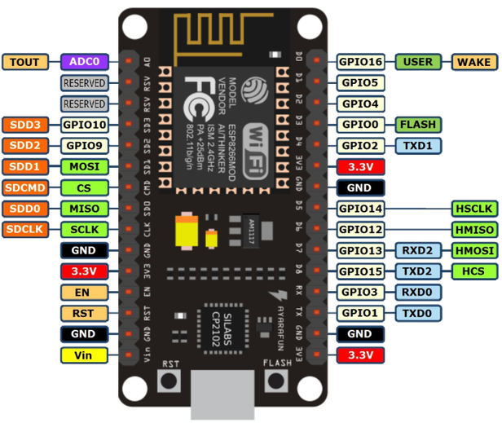
Pin Diagram:-

Slide 4
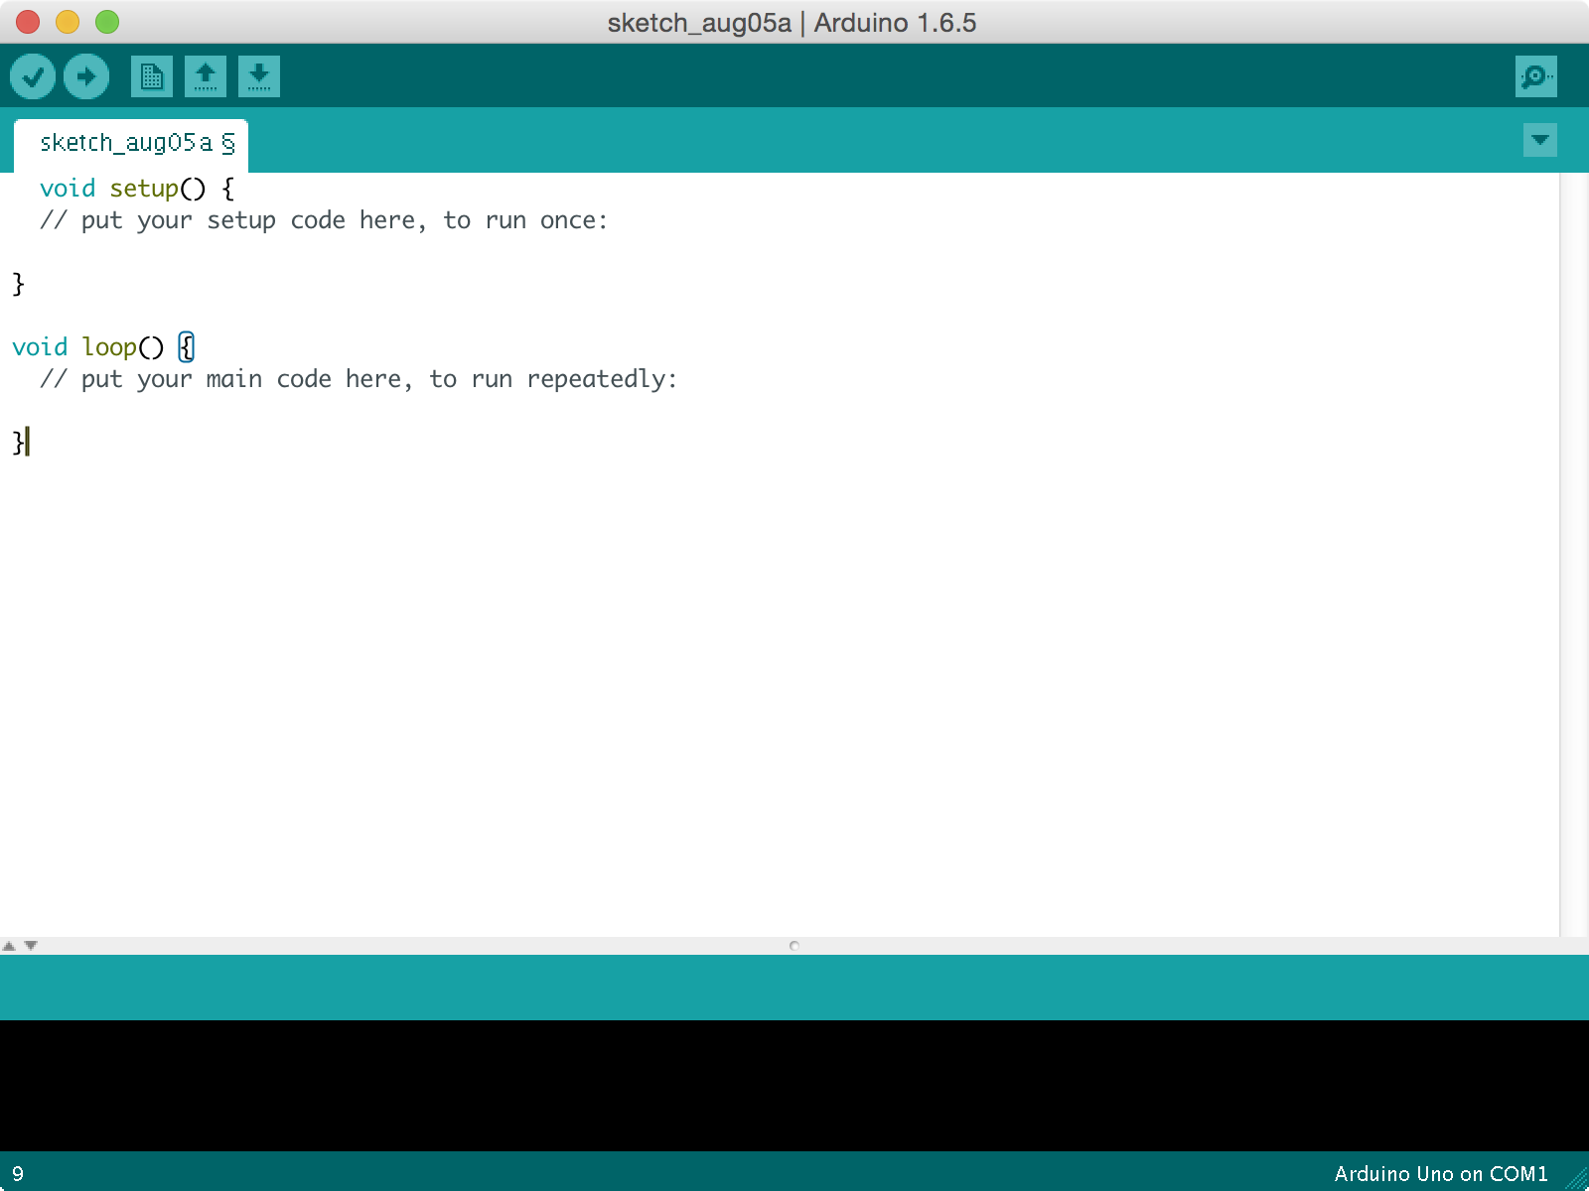
Installation of NodeMCU:-
Install Arduino IDE with latest version

Slide 5
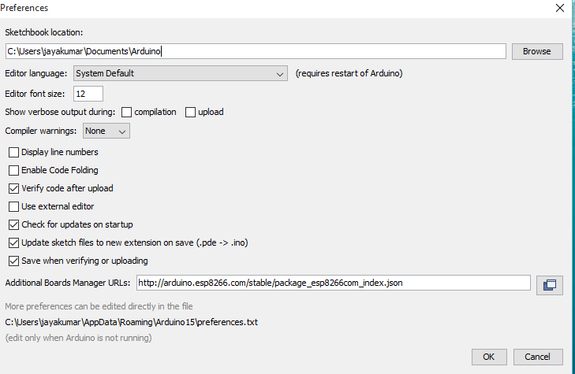
Start Arduino and open Preferences window.

Slide 6
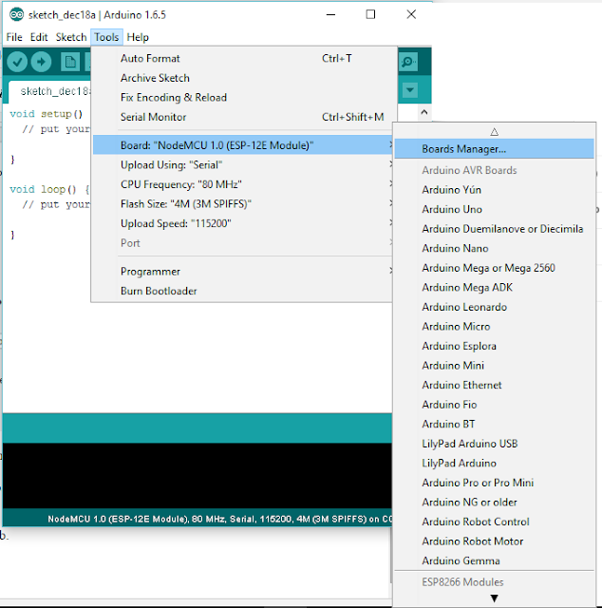
Download ESP8266 library from board Manager

Slide 7
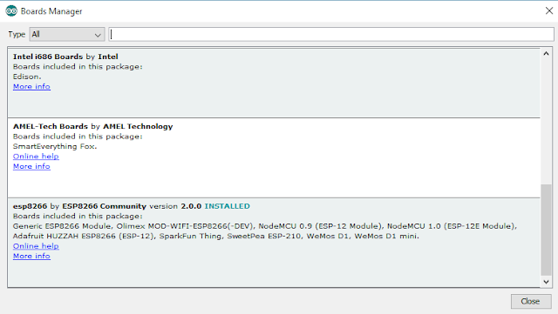

Slide 8
Pros:-
ESP is cheaper than Arduino or clones
ESP has built-in WiFi
ESP is smaller than most Arduinos
ESP can now be programmed with Arduino IDE so you can leverage your Arduino experience
Cons:-
May not be compatible with some peripherals.
WiFi code takes a lot of CPU power, so asking the ESP8266 to do WiFi and devices sometimes get a bit too much causing reliability issues.

