Slide 1
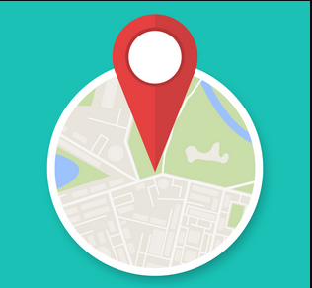

Geolocation and Python

Slide 2
Finding geolocation using Python
Geolocating an IP address can be useful in troubleshooting network connectivity. We can do this in Python somewhat easily.

Slide 3
Example: using a free service
Some services offer a very basic sample API with no key required. (I’ll demo one later.)
The results can contain information such as country, city, postal code, as well as latitude and longitude.
The drawback to a free service is that it’s not very precise. Additionally, the use of a VPN would probably mask the true location.

Slide 4
Options for greater accuracy
Prior to HTML5, geolocation has primarily been done on the server side. The IP address is captured and compared to a publicly available database (IP2Location.com for example).
With HTML5, geolocation info can be captured client-side. A JavaScript-based API is built into some modern browsers and can capture GPS data, as well as infer data from network signals such as RFID, WiFi and Bluetooth MAC addresses, among other things. (https://www.ipgeo5.com/)
These can be useful for troubleshooting. With the MAC address you can tell the brand of router in use. (The first 6 characters in the MAC are specific to a manufacturer.)
Liberty has tools available to gather this info without HTML5 (Zscaler, Netbeez, others).

Slide 5
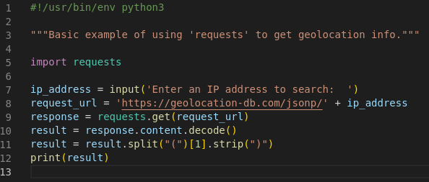
How does this relate to Python?
https://www.abstractapi.com/ offers a free API to test with – no key is required.

Slide 6
What does the import do?
“requests” is a library for making HTTP requests in Python.
In this example, requests.get(request_url)reaches out to the specified URL and pulls the information for the provided IP address.
The response received is
{"country_code":"US","country_name":"United States","city":"Mount Vernon","postal":"98273","latitude":48.4352,"longitude":-122.2082,"IPv4":"73.169.233.183","state":"Washington"}
Naturally this could be reformatted or passed to any number of other formatting options.

Slide 7
Demo
#!/usr/bin/env python3
"""Basic example of using 'requests' to get geolocation info."""
import requests
ip_address = input('Enter an IP address to search: ')
request_url = 'https://geolocation-db.com/jsonp/' + ip_address
response = requests.get(request_url)
result = response.content.decode()
result = result.split("(")[1].strip(")")
print(result)

Slide 8
Questions?

