Slide 1




Towards Explainable Multivariate Time Series
Event Detection via Neuro-Symbolic VLM Agents
Sky Chenwei Wan¹˒², Yifei Y. Wang², Tianjun Hou¹,
Xiqing Chang¹, Aymeric Jan¹
¹ AI Lab, SLB ² LTCI, Télécom Paris, Institut Polytechnique de Paris
Notes:
We study how to turn an expert description into event intervals and inspectable evidence in multivariate time series. The talk introduces the representation first, then the multi-agent system and experimental evidence.
Source: Grammar of the Wave, uploaded arXiv:2603.11479v4 (30 August 2026). https://arxiv.org/pdf/2603.11479v4

Slide 2
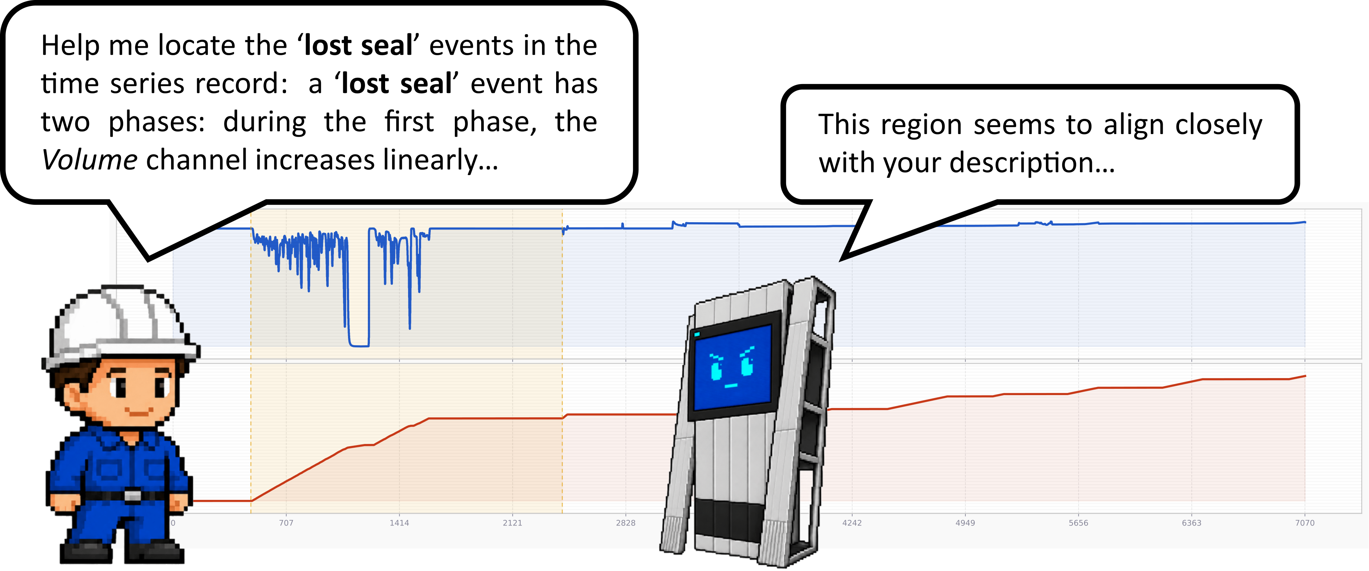
Language-guided event detection
Expert descriptions are available. Dense event labels are expensive.
Input: signals + descriptions Output: event intervals + classes
1
Notes:
Input: a multivariate time series and natural-language descriptions of target event types. Output: all matching intervals and event classes. The example is Lost Seal in a pressure test. Our goal is detection with little or no labeled data, and evidence for the internal phases. Figure 1 reproduced from the paper.
Source: Grammar of the Wave, uploaded arXiv:2603.11479v4 (30 August 2026). https://arxiv.org/pdf/2603.11479v4

Slide 3
The grounding challenge
Semantic alignment, multichannel structure and verifiable evidence
Alignment
Map phrases such as “recover slightly” to signal morphology,
with flexible timing and duration.
Multichannel
Combine patterns across channels through temporal relations,
such as pressure recovery while volume stays stable.
Explainability
Localize the supporting primitives and expose their relations,
so experts can check why an event was detected.
2
Notes:
The three perspectives synthesize Sections 1–3 of the paper. Alignment: natural-language predicates such as recover slightly must be grounded in actual signal morphology, with uncertain boundaries and variable durations; semantic quantification and topological elasticity motivate this. Multichannel: an event is a hierarchical composition of patterns on different physical channels, connected by succession, synchronization, containment and alternatives. Explainability: the prediction should ground each sub-pattern to a concrete segment and expose the relations supporting the global event for expert verification. This is a presentation synthesis of the paper, not a new taxonomy or empirical result.
Source: uploaded Grammar of the Wave, arXiv:2603.11479v4, Sections 1–3. https://arxiv.org/pdf/2603.11479v4

Slide 4
Event Logic Tree
Temporal operators build on Allen’s interval algebra (1983)
Stable(V)
“During the Buildup event, the Volume should remain stable across the entire phase. Simultaneously, the Pressure should either recover slightly with the rate of change decreasing or bounce up quickly, and then reach a steady phase.”
Recover(P)
SYNC
OR
Bounce(P)
SEQ
Steady(P)
V: Volume P: Pressure
3
Notes:
ELT uses a hierarchy of signal primitives and temporal-logic operators. Its temporal operators are inspired by and adapted from Allen’s interval algebra (1983), while OR represents alternative descriptions. SEQ, SYNC and GUARD are ELT operator names, not the names of Allen’s original 13 basic interval relations. The paper describes the adapted operator semantics and conditional completeness under its stated axioms in Appendix A.
Sources: uploaded Grammar of the Wave, arXiv:2603.11479v4, Section 3.1 and Appendix A. https://arxiv.org/pdf/2603.11479v4
James F. Allen. Maintaining Knowledge about Temporal Intervals. Communications of the ACM 26(11), 832–843 (November 1983). DOI: 10.1145/182.358434. Author’s publication listing: https://cs.rochester.edu/u/james/ . Original paper: https://cse.unl.edu/~choueiry/Documents/Allen-CACM1983.pdf .
Portrait source: James F. Allen’s University of Rochester faculty homepage, https://cs.rochester.edu/u/james/home_files/image004.gif . The original GIF is converted to PNG without alteration, preserving transparency. The portrait is used for scholarly identification and attribution. Background on the 13 basic relations: https://ics.uci.edu/~alspaugh/cls/shr/allen.html .
Revision: the Buildup quotation reproduces the complete wording from Section 1, with the accepted poster’s cream quote treatment and semantic highlights. The seven-node, six-edge ELT retains the exact Figure 2 topology and labels, recreated as editable native shapes with the poster’s colored outlines, filled leaves and curved branches. Source figure: original LaTeX example_elt.pdf, the same crop used in the accepted QuRating poster. The diagram changes appearance only, not its semantics. Allen’s full bibliographic citation remains in these notes and on the following mapping slide.
The ELT uses the case-study layout direction: the root is on the left and primitives are on the right. Every node has the same dimensions. Schema operators have unfilled interiors and primitives have dashed outlines. This is the same Buildup schema and not an instantiated detection: neither OR alternative is selected on this slide.

Slide 5
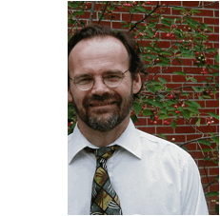
James F. Allen
13 basic interval relations (1983)
A classic theory of temporal reasoning
ELT operators and Allen relations
Allen’s interval algebra, adapted to compact event grounding
ELT
Allen relations
A
B
Self-contained,
compact events
meets
bounded before
overlaps
SEQ
The semantics must cover the event’s full temporal span.
0 < gap < δ
Ψ = 0: no collision
during
starts
finishes
GUARD
undefined gap
equals
OR
Exclude unrestricted
disjoint before / after
SYNC
Semantic alternatives for the same interval
Only a small gap < δ is tolerated as relaxed meets.
Swapping A and B gives the six converse relations:
met-by, after, overlapped-by, contains, started-by, finished-by
Allen (1983). ELT: Appendix A.2–A.4, especially Temporal Compactness and Proposition 1.
4
Notes:
The diagram maps ELT operators to Allen relations according to Grammar of the Wave, arXiv:2603.11479v4, Appendix A.2–A.4. Bars show schematic intervals A (blue) and B (orange), not measured data.
SEQ covers Meets, bounded Before, and Overlaps when Physical Exclusivity is satisfied (Ψ = 0). The gap bound follows Eq. (5): G_coh = 1[(t_B_on - t_A_off - δ) < 0], so a positive gap must be strictly below δ. Before is a relaxed variant of Meets within that horizon. Unconstrained disjoint Before/After with an arbitrarily large undefined gap is excluded by Temporal Compactness. The self-contained interpretation means the event semantics should cover its full temporal span. Do not claim that all positive gaps or every Before relation are excluded.
GUARD covers During, Starts and Finishes; the latter two use suitable boundary constraints. SYNC corresponds to Equal in the ideal case, with an IoU-based soft alignment penalty in the actual operator. Swapping arguments gives Met-by, After, Overlapped-by, Contains, Started-by and Finished-by. The inverse cases inherit the same validity restrictions. OR represents semantic alternatives for one instance and is not an additional Allen base relation.
Conditional completeness in Proposition 1 is stated under all three constitutive axioms: Constructive Composition, Temporal Compactness, and Physical Exclusivity. The mapping should not be interpreted as unrestricted completeness over arbitrary disjoint intervals.
Sources: uploaded paper, https://arxiv.org/pdf/2603.11479v4 , Appendix A.2–A.4. James F. Allen, Maintaining Knowledge about Temporal Intervals, Communications of the ACM 26(11), 832–843 (1983), DOI 10.1145/182.358434.

Slide 6
Topological elasticity
Durations can change while event logic stays valid
SYNC(SEQ(Rise(P), Steady(P)), Stable(V))
Instance A: short rise, long steady
Pressure
Rise
Steady
Volume
Stable
time
Instance B: long rise, short steady
Pressure
Rise
Steady
Volume
Stable
time
Relative phase lengths vary. Order and synchronization remain.
5
Notes:
Illustrative interval diagrams, not measured data. Both instances satisfy the same succession and synchronization structure despite different phase durations. Topological elasticity does not remove all temporal constraints: order, compactness, exclusivity and operator requirements still apply. Section 3, D3 and Appendix A.
Source: Grammar of the Wave, uploaded arXiv:2603.11479v4 (30 August 2026). https://arxiv.org/pdf/2603.11479v4
Updated illustration: Instance A has Rise:Steady duration ratio 1:3 (110:330 display units), whereas Instance B has ratio 3:1 (450:150). Total durations also differ (440 versus 600). The arbitrary display units are schematic, not measured data. Both rise and steady change nonuniformly while succession, compactness, and synchronization with Stable(Volume) remain valid.

Slide 7
Quantifiable evidence
Primitive evidence combines under temporal constraints
SYNC
Raw coherence 0.72
Steady pressure
[20, 50] μ = 0.90
Stable volume
[20, 50] μ = 0.80
Normalized root score: √0.72 ≈ 0.85
6
Notes:
Synthetic numerical example showing the scoring mechanism, not a reported empirical result. With two active primitive leaves and no alignment penalty, product aggregation gives 0.90 × 0.80 = 0.72. Equation 3 normalizes the root by the number of active leaves: μ_norm = μ_root^(1/K), giving approximately 0.85. The engine rejects invalid compositions with hard gates and applies the relevant operator penalties. These are semantic coherence scores, not calibrated probabilities.
Source: Grammar of the Wave, uploaded arXiv:2603.11479v4 (30 August 2026). https://arxiv.org/pdf/2603.11479v4

Slide 8



SELA: a multi-agent system
A reusable schema guides class-specific grounding and explains each detection
Submit schema
Logic engine
Compile / validate
Logic Analyst
Compile status
schema
Event
description
Review tree
against text
Tree display
Visual tools
Hard constraints
Output
Fuzzy aggregation
Root normalization
Compare classes
Multichannel
signals
One agent per class
Signal Inspectors
Inspect & instantiate
Intervals + class
Evidence tree + score
7
Notes:
SELA separates text-only schema construction from signal grounding. The Logic Analyst submits a schema for validation and compilation, receives compile status and the rendered tree, and reviews the structure against the original event description before refining it. The Signal Inspectors use the compiled schemas and signal views. The parallel single-tree configuration assigns each Inspector one candidate event class and its ELT, independently grounding primitive intervals and confidence scores. The overlapping Inspector characters indicate multiple parallel agents, with one Inspector per candidate event class. The backend compares independently computed normalized root scores to obtain the final class prediction. Visual tools expose full/local views, markers and the instantiated tree. The engine enforces constraints, aggregates scores and normalizes the root. Output comprises intervals, classes and supporting evidence trees with scores.
Schema symbols use white operator interiors and dashed primitive outlines. Instantiated symbols use solid fills, with purple SYNC, cyan SEQ, yellow OR, green Volume primitives and orange Pressure primitives, matching the Buildup example on slide 4. These small trees and signal traces are schematic. Their topology illustrates the representation, not the exact class-specific Pressure Test tree.
Source: uploaded Grammar of the Wave, arXiv:2603.11479v4, Section 4, Figure 3 and Appendix B (ELT Schema Parser and Parallel Single-Tree Inspector). https://arxiv.org/pdf/2603.11479v4
Character assets: Kenney Roguelike Characters 2.0, CC0. https://kenney.nl/assets/roguelike-characters . Official atlas roguelikeChar_transparent.png, 16px tiles, 1px spacing. Logic Analyst: column 0 row 6, crop [0,102,16,118]. Lost Seal Inspector: column 0 row 5, crop [0,85,16,101]. Valid Test Inspector: column 1 row 5, crop [17,85,33,101]. All characters use unmodified atlas crops, enlarged with nearest-neighbor resampling.
All three tree icons use the same left-to-right topology and the same 30 by 15 unit node size. Schema operators are unfilled and primitives are dashed. In both instantiated-tree icons, active nodes use a dark semantic border and a light interior. The lower OR child is an inactive alternative, shown with a faint dashed outline and a faint dashed incoming edge. This selected alternative is a schematic explanation of OR, not an additional empirical result.

Slide 9
KITE: knowledge meets signals
Real events with expert descriptions and interval labels
Dataset | Samples | Channels | Event types
Pressure Test 41 North Sea jobs | 62 | 2 | Valid Test Lost Seal
Climate Hazard Open data NOAA + NWS | 86 | 7 | Dense Fog Frost Freeze Extreme Cold
8
Notes:
KITE contains 62 Pressure Test samples from 41 real North Sea jobs, with pressure and volume channels, and 86 Climate Hazard samples with seven channels. Experts supply event descriptions and interval labels. Pressure Test has clear operational boundaries, so the evaluation uses IoU-based macro F1 at 0.5 and 0.9. Climate Hazard has gradual boundaries, motivating coverage metrics. Sections 5 and 6.2. This talk shows both macro coverage F1 and F0.5 for Climate Hazard.
Source: Grammar of the Wave, uploaded arXiv:2603.11479v4 (30 August 2026). https://arxiv.org/pdf/2603.11479v4

Slide 10
Benchmarking ELT parsing
Can models recover event structure from language?
All valid parses reach 1.00 primitive accuracy.
Model | Pass | Structure | Accuracy | Coverage | Semantics
GPT-5 | 1.00 | 0.90 | 1.00 | 1.00 | 1.00
GPT-4.1 | 1.00 | 0.86 | 1.00 | 0.98 | 0.98
Qwen-3.5 27B | 0.88 | 0.92 | 1.00 | 1.00 | 0.99
Gemma-4 31B | 1.00 | 0.70 | 1.00 | 0.96 | 0.85
Qwen: strongest structure when valid, but the lowest pass rate.
9
Notes:
Section 6.1 and Appendix D. The task is to parse the natural-language definition into a reusable ELT schema without seeing the time-series sample. Each of four models parses each of five event descriptions five times, yielding 100 parse runs. Pass rate measures producing a syntactically valid schema within 20 turns. The four quality dimensions apply to valid parses: Structural Fidelity checks logical equivalence of topology, Primitive Accuracy penalizes invented primitives, Primitive Coverage checks inclusion of the reference primitives, and Semantic Alignment checks faithful linguistic meaning. Claude Opus-4.6 and GPT-5.5 independently score the parses on a 0–5 scale; scores are averaged, normalized to [0,1] and validated by humans.
Source: Grammar of the Wave, uploaded arXiv:2603.11479v4, 30 August 2026. https://arxiv.org/pdf/2603.11479v4
All 20 numbers reproduce paper Table 3. Columns are Pass, Structural Fidelity, Primitive Accuracy, Primitive Coverage, and Semantic Alignment. Higher is better. Pass is over all attempts; the four quality metrics are evaluated only on valid parses. All valid parses achieve 1.00 Primitive Accuracy. Qwen-3.5 27B has the highest structural score, 0.92, conditional on validity, but an 0.88 pass rate. GPT-5 has a 1.00 pass rate and perfect primitive accuracy, coverage and semantic alignment, with structural fidelity 0.90. The limited benchmark contains five event types; no claim of universal parsing reliability or statistical significance is intended.
Source: Grammar of the Wave, uploaded arXiv:2603.11479v4, 30 August 2026. https://arxiv.org/pdf/2603.11479v4

Slide 11
Pressure Test: event detection
Macro F1 at two IoU thresholds (%)
F1@0.5
F1@0.9
CNN / Transformer
Time-series foundation models
LLM / VLM methods
SELA
Labels: F1@0.5 / F1@0.9. First six: supervised. GPT-5: FS = few-shot, ZS = zero-shot.
10
Notes:
Means and ± terms are copied from paper Table 4, using GPT-5 thinking for Numeric (few-shot), VL-Time (few-shot) and SELA (zero-shot). The first six models are supervised. The wide light bars show F1@0.5, and the narrow dark bars show F1@0.9. Labels report the two metrics in that order, each as mean ± reported variation. The plotted values are percentages. The reported ± notation is preserved without assigning an unreported statistical interpretation. Both native charts share identical axes and geometry, so the narrow foreground bars overlay the wide background bars. The two metric series remain editable, with literal data retained in embedded workbooks. The common scale starts at zero. F1@0.9 uses the stricter IoU threshold. Combining the two result pages shows the localization drop for each model. SELA exceeds Numeric FS by 9.0 points at IoU 0.5 and 5.8 points at IoU 0.9.
Exact Table 4 values: [{"name":"CNN","F1@0.5":[38.6,2.3],"F1@0.9":[22.4,2.5]},{"name":"Transformer","F1@0.5":[27.7,2.1],"F1@0.9":[17.7,1.1]},{"name":"Timer","F1@0.5":[32,3.4],"F1@0.9":[3.3,0.4]},{"name":"MOMENT","F1@0.5":[43.6,5.4],"F1@0.9":[3.6,1.2]},{"name":"Chronos","F1@0.5":[43.4,5.6],"F1@0.9":[2.6,0.5]},{"name":"TimesFM","F1@0.5":[46.6,6.1],"F1@0.9":[3.9,0.6]},{"name":"Numeric (FS)","F1@0.5":[57.8,6],"F1@0.9":[54.2,3.1]},{"name":"VL-Time (FS)","F1@0.5":[53.6,3.2],"F1@0.9":[46,2.6]},{"name":"SELA (ZS)","F1@0.5":[66.8,3.9],"F1@0.9":[60,3.6]}]
Source: uploaded Grammar of the Wave, arXiv:2603.11479v4, Section 6.2, Table 4. https://arxiv.org/pdf/2603.11479v4

Slide 12
Climate Hazard: event detection
Macro coverage scores (%)
F1
F0.5
CNN / Transformer
Time-series foundation models
LLM / VLM methods
SELA
Labels: F1 / F0.5. First six: supervised. GPT-5: FS = few-shot, ZS = zero-shot.
11
Notes:
Means and ± terms are copied from paper Table 4, using GPT-5 thinking for Numeric (few-shot), VL-Time (few-shot) and SELA (zero-shot). The first six models are supervised. The wide light bars show F1, and the narrow dark bars show F0.5. Labels report the two metrics in that order, each as mean ± reported variation. The plotted values are percentages. The reported ± notation is preserved without assigning an unreported statistical interpretation. Both native charts share identical axes and geometry, so the narrow foreground bars overlay the wide background bars. The two metric series remain editable, with literal data retained in embedded workbooks. The common scale starts at zero. Coverage F1 and F0.5 are different precision/recall weightings, not different IoU thresholds. Neither metric is necessarily larger for all methods. SELA has the largest mean on both among the nine displayed methods.
Exact Table 4 values: [{"name":"CNN","F1":[45.1,3.2],"F0.5":[40.7,2.2]},{"name":"Transformer","F1":[46.4,6.5],"F0.5":[40.8,6.6]},{"name":"Timer","F1":[18,0.4],"F0.5":[17.1,0.6]},{"name":"MOMENT","F1":[20.9,5.3],"F0.5":[20.4,5.6]},{"name":"Chronos","F1":[37.7,6.8],"F0.5":[39.9,8.3]},{"name":"TimesFM","F1":[44.5,3],"F0.5":[47.4,3.4]},{"name":"Numeric (FS)","F1":[43.4,1.6],"F0.5":[49.4,1.1]},{"name":"VL-Time (FS)","F1":[30,3],"F0.5":[33.2,4]},{"name":"SELA (ZS)","F1":[50.7,1.5],"F0.5":[57.1,2.2]}]
Source: uploaded Grammar of the Wave, arXiv:2603.11479v4, Section 6.2, Table 4. https://arxiv.org/pdf/2603.11479v4

Slide 13
Event logic drives the gains
Flat confidence aggregation loses the event structure
−20.9
points on
strict localization
−22.6
points on
Climate Hazard
GPT-5. Pressure Test: macro F1@0.9. Climate Hazard: macro coverage F0.5.
12
Notes:
This ablation removes the tree and directly aggregates primitive confidences by geometric mean. GPT-5 PT macro F1@0.9 falls from 60.0 to 39.1, a 20.9-point drop. CH macro coverage F0.5 falls from 57.1 to 34.5, a 22.6-point drop. The two datasets use different metrics, so the chart compares each full/ablated pair within its dataset. These values are from Table 5, not a new experiment.
Source: Grammar of the Wave, uploaded arXiv:2603.11479v4 (30 August 2026). https://arxiv.org/pdf/2603.11479v4

Slide 14
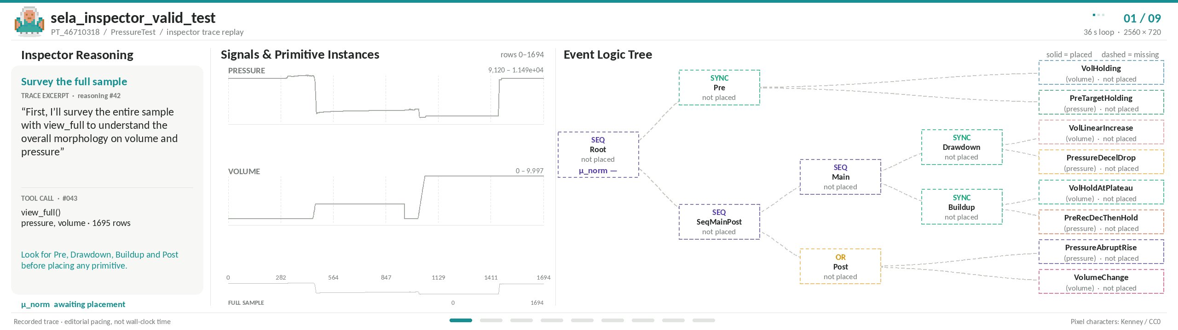
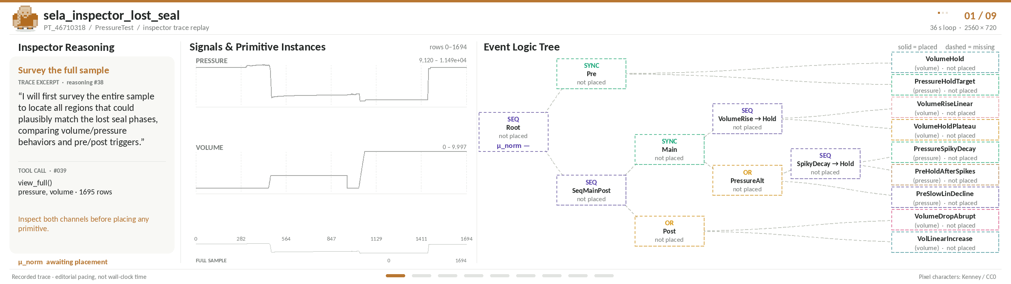
Notes:
The top example is Valid Test and the bottom example is Lost Seal. Follow the synchronized signal display and logic tree to explain how the inspector searches for primitive evidence. Distinguish the inspector trace excerpt from the final checkable evidence: the grounded intervals, primitive scores and temporal relations form the explanation. Sources: user-supplied sela_inspector_valid_test.gif and sela_inspector_lost_seal.gif.
Source: Grammar of the Wave, uploaded arXiv:2603.11479v4 (30 August 2026). https://arxiv.org/pdf/2603.11479v4

Slide 15


Takeaways
Expert descriptions can guide zero-shot detection.
ELT turns domain knowledge into reusable constraints for signal grounding.
Temporal structure matters for precise localization.
Removing ELT costs 20.9 points on Pressure Test F1@0.9 (GPT-5).
Explanations should expose testable evidence.
ELT exposes primitive evidence
for expert review. Primitive-level alignment
still needs objective validation.
Paper
Code & Data
14
Notes:
These takeaways synthesize implications of the paper rather than claiming a new experiment. (1) In the studied language-guided setting, expert descriptions can provide reusable structural constraints for zero-shot grounding. ELT separates a text-only schema from its instantiation on each signal. (2) Temporal structure contributes to precise localization: the GPT-5 ablation removes ELT and directly aggregates primitive scores by geometric mean, reducing Pressure Test macro F1@0.9 from 60.0 to 39.1 (20.9 percentage points). This comparison concerns the evaluated system and benchmark, not all possible detectors. (3) Explanations should expose checkable primitive intervals and temporal relations. Inspectability does not by itself validate primitive-level semantic scores: the paper’s Faithfulness of Instantiation limitation identifies VLM subjectivity and the lack of reliable domain-specific text–signal alignment models as an open problem. The authors propose more objective evaluation of primitive text–signal alignment using a dedicated foundation model as future work.
Sources: uploaded Grammar of the Wave, arXiv:2603.11479v4, Sections 3, 4, 6.3 and 8, Table 5, and Limitations. https://arxiv.org/pdf/2603.11479v4 . Code and data: https://github.com/cw-wan/SELA .

