Slide 1
MICRO SERVICES
C2k_kls_db
C2k_vls_db
C2k_spark
C2k_sms
DATABASE SERVICES
NOTIFICATION SERVICES
C2k_kls
C2k_vls
LISTENER
C2k_ui
USER INTERFACE
C2k_iox
VEHICLE LOCATOR SERVICES (IOX)

Slide 2
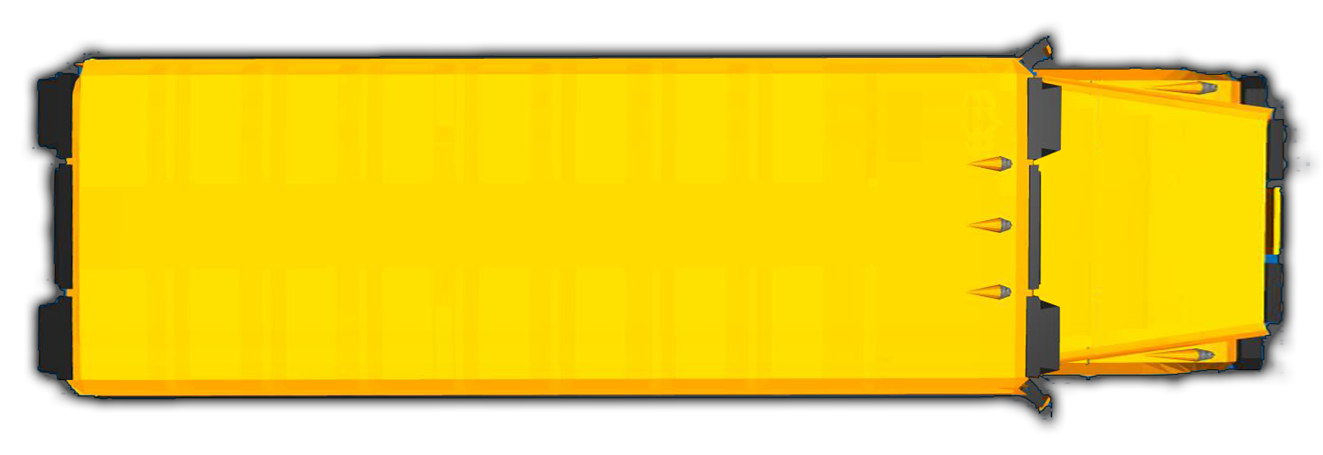
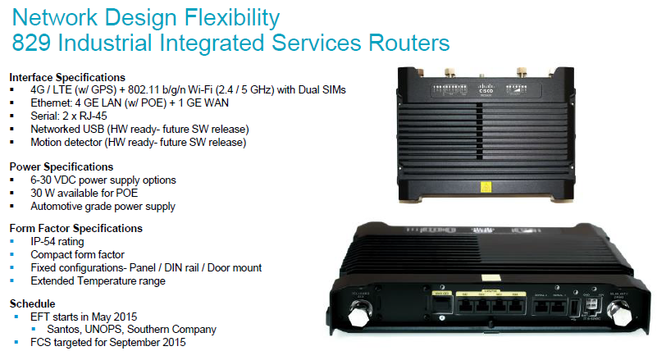
Kid-1
Kid-4
(
(
(
Kid-2
829 IISR
Kid-3

