Slide 1
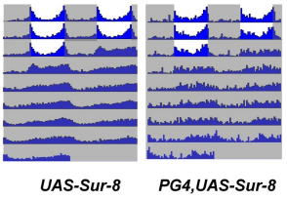

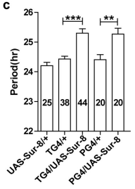
Output:

Slide 2
How:
Actogram
-Bars for hops per designated bin: 5 mins, 30 mins, etc.
-Shade night
Stats
-Calculate period
-Calculate power

Slide 3
Actogram
One sheet of birds and hops?

