Slide 1
Online Pet Store
Caleb Wade
May 3rd, 2022

Slide 2
Real world problem
Pets require love, attention, and a lot of items to be taken care of. When shopping for your pet it can be frustrating not finding what you need at the store
An online pet store allows pet owners to find everything that they need all in one place. The items are delivered directly to the customer, making getting everything you need for your pet easier and less of a hassle.

Slide 3
Initial Approach
Retail pet store that allows customer to view and select products to put into a shopping cart to purchase.
Customer will be able to log in to their account and purchase items. Customers will be able to view all past products purchased
Admin to the website will have access to CRUD (Create, Read, Update, and Delete) functions to control product inventory

Slide 4
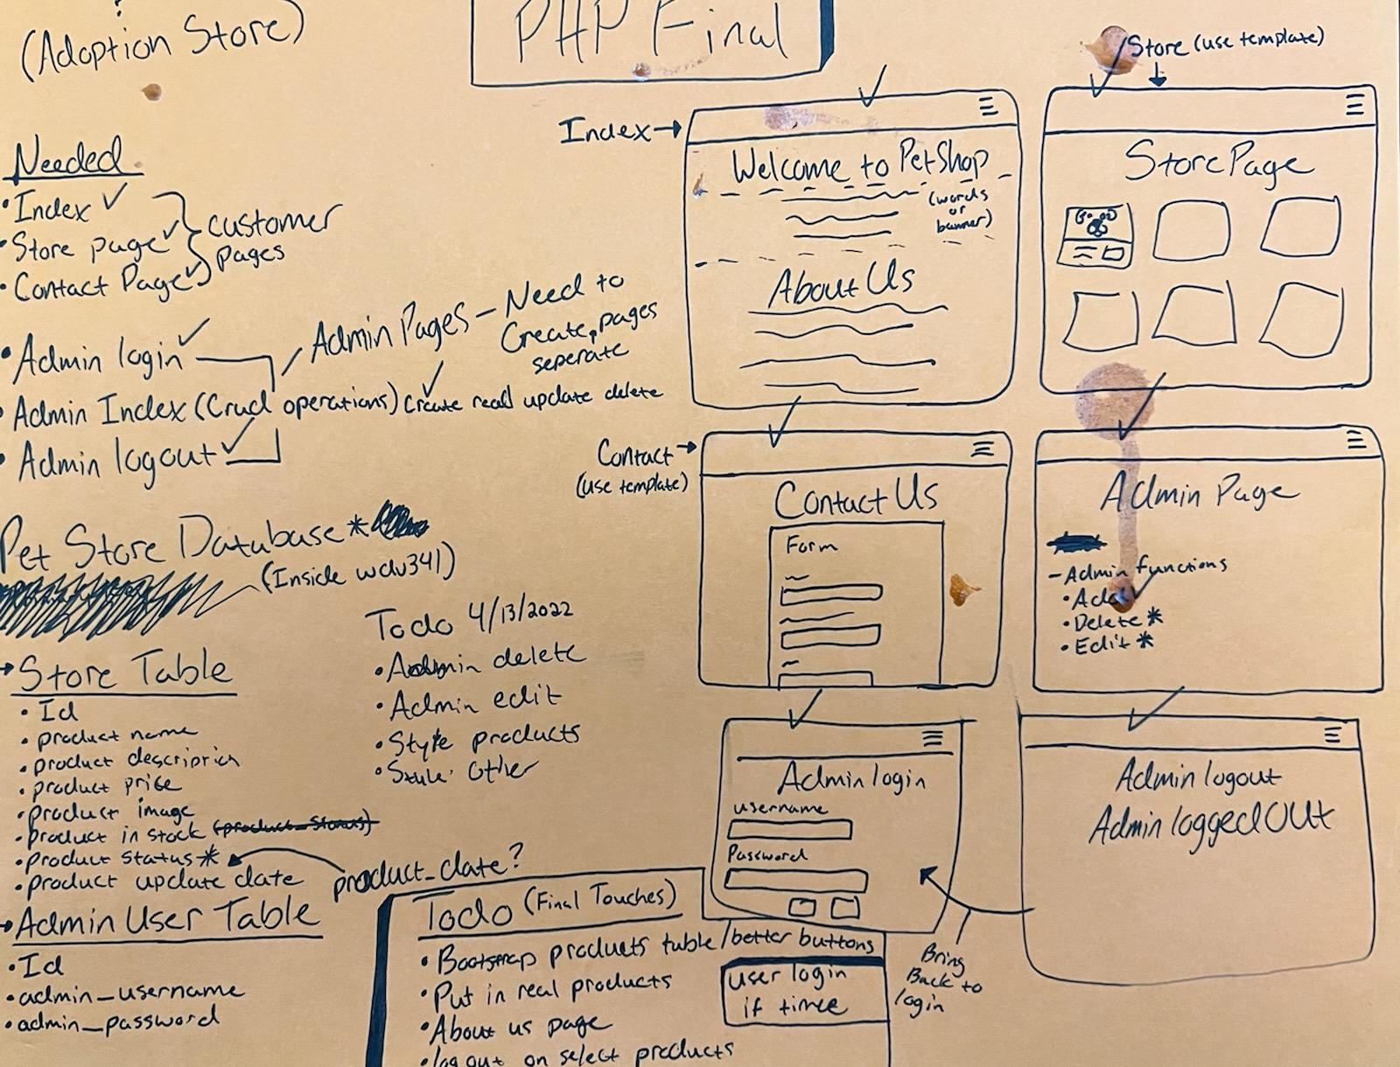
Planning

Slide 5
Refractored Approach
Focused on the main functionality of the website. Displaying products from the database, allow for customer contact, and implement admin operations
Display products to customers to purchase.
Give an option to the customer to contact the Pet Store. An confirmation email is sent to the customer as well as an email is sent to the Pet Store with the contact request.
Valid admin users have access to CRUD functions to manage product inventory

Slide 6
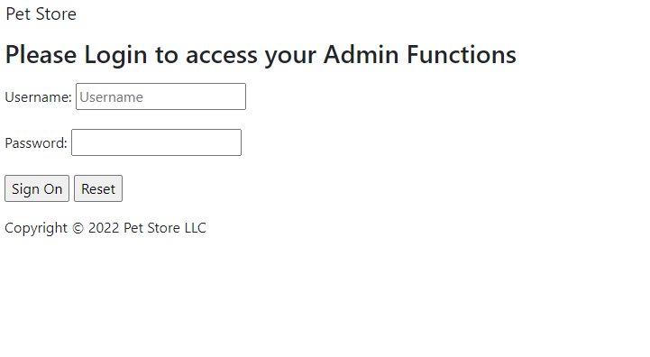
Admin Login

Slide 7
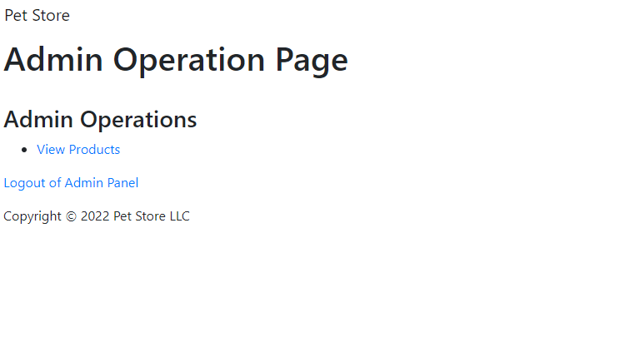
Admin Homepage

Slide 8
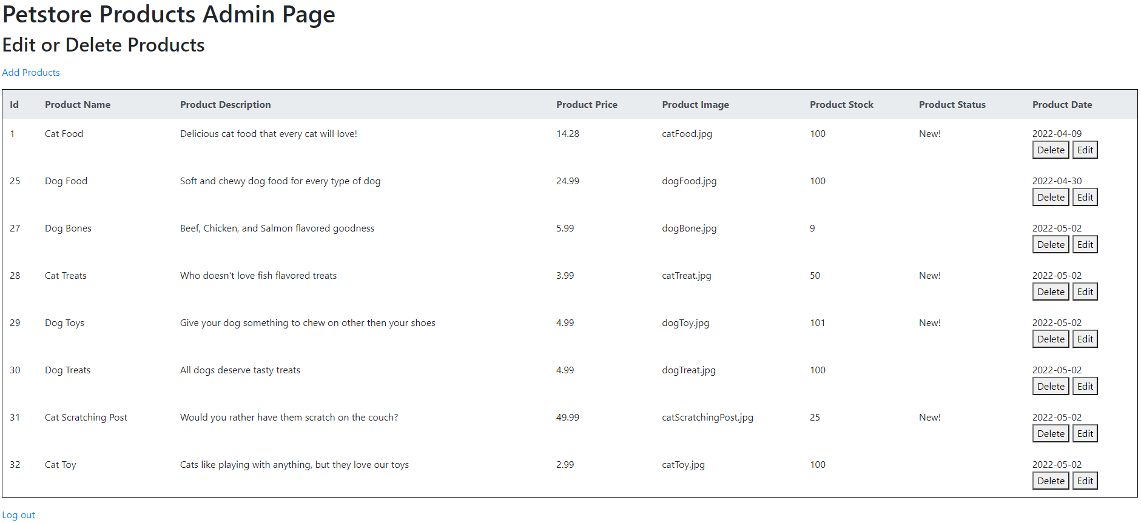
View Product List

Slide 9
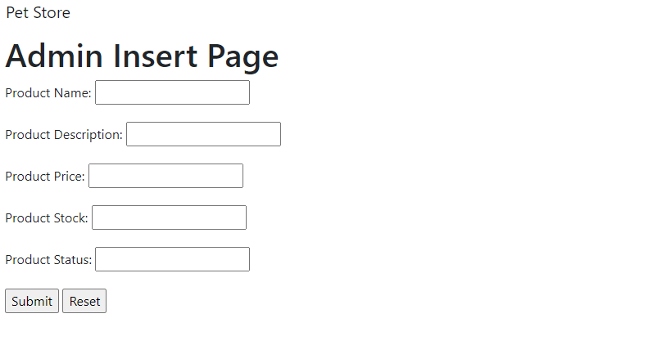
Admin Add Product

Slide 10
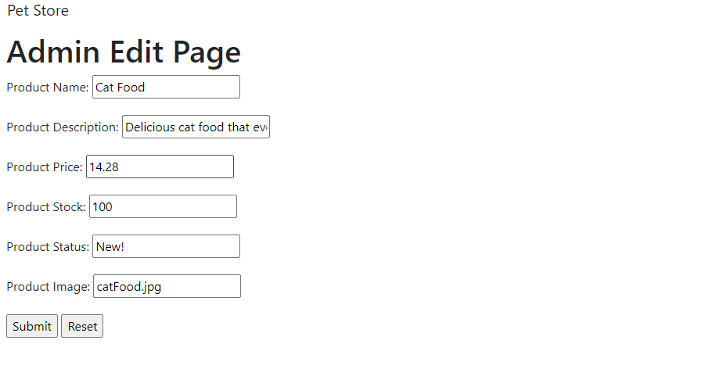
Admin Edit

Slide 11
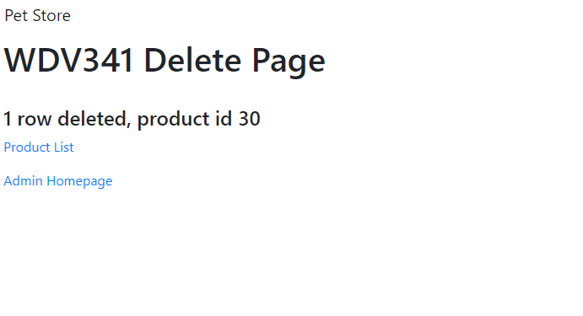
Admin Delete

Slide 12
Pet Store Website
http://ipatchez.com/DogStore/index.html

