Slide 1
PARKING SPACE VACANCY MONITORING
Catherine Wah
CSE 190a: Winter 2009
March 11, 2009
TexPoint fonts used in EMF.
Read the TexPoint manual before you delete this box.: AAAAAAAAA

Slide 2
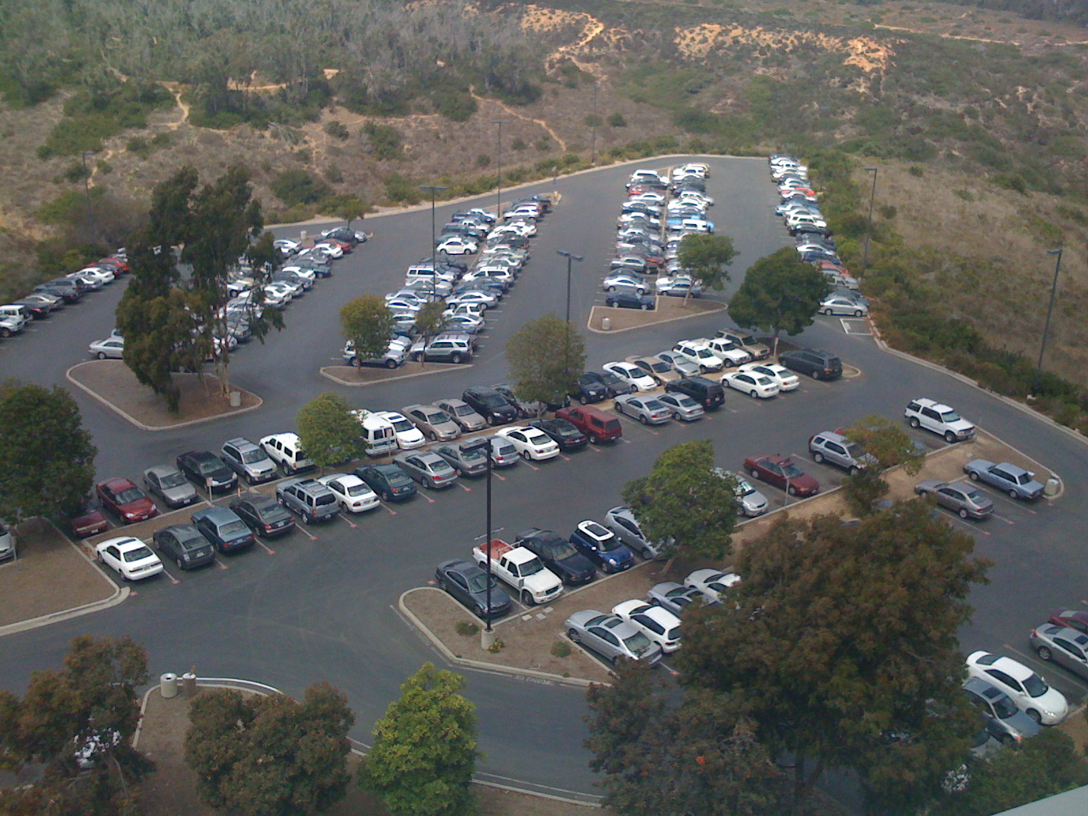
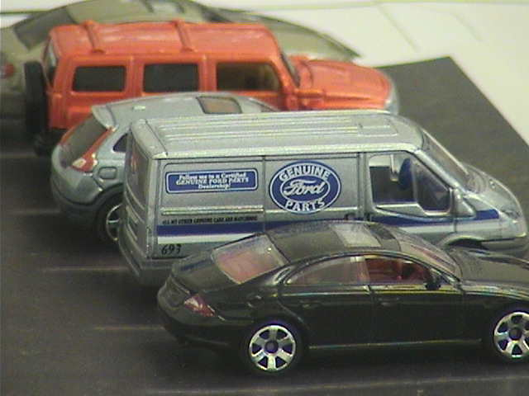

Slide 3
Outline
Approach
Geometry of stereo vision
System overview
  3D reconstruction
Next steps

Slide 4
Approach
Vision-based vs. sensors-based
Other solutions
Stereo vision
  Vehicular occlusion

Slide 5
Outline
Approach
Geometry of stereo vision
System overview
  3D reconstruction
Next steps

Slide 6
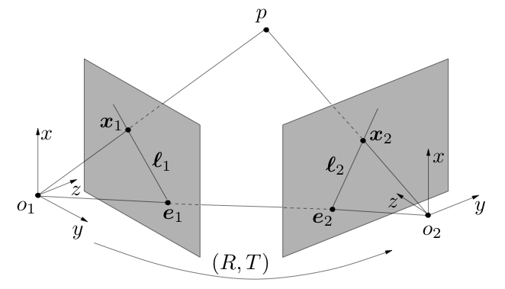
Geometry of stereo vision
Epipolar geometry
  Focal points o₁ and o₂
  Epipoles e₁ and e₂
  Epipoles and focal
  points collinear
  Baseline (o₁, o₂)
[MaSKS ‘03]

Slide 7
Geometry of stereo vision
Epipolar geometry
  Epipolar lines l₁ and l₂
  Image rectification – project camera images onto common image,
  making epipolar
  lines horizontal
  Correspondence
  problem
[MaSKS ‘03]

Slide 8
Outline
Approach
Geometry of stereo vision
System overview
  3D reconstruction
Next steps

Slide 9
System overview
Image capture
Feature extraction
Reconstruction from stereo pairs
Determine vacancy status
Driver notification

Slide 10
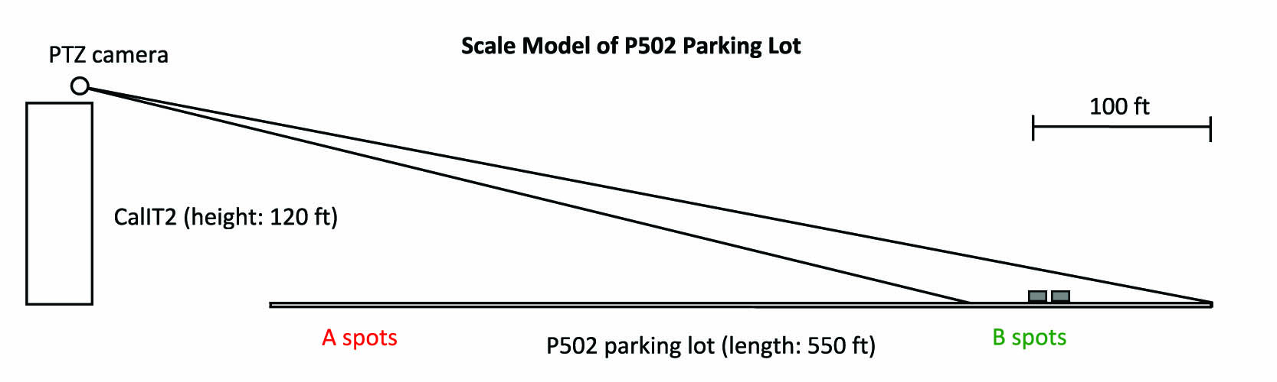
Image capture
Roof-mounted PTZ cameras
Periodic raster scans of the lot
1:64 scale model

Slide 11
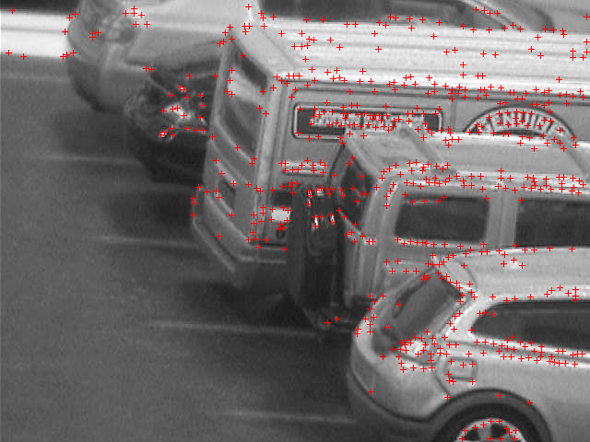
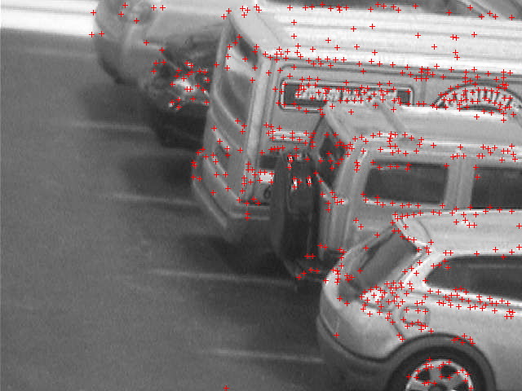
Feature Extraction
Harris Corner Detector
RANSAC-based stereo matching

Slide 12
Outline
Approach
Geometry of stereo vision
System overview
  3D reconstruction
Next steps

Slide 13
3D Reconstruction
Vehicular occlusion
By using stereo pairs of images, we can recover metric information from the fixed length of the baseline
Uncalibrated vs. calibrated?

Slide 14
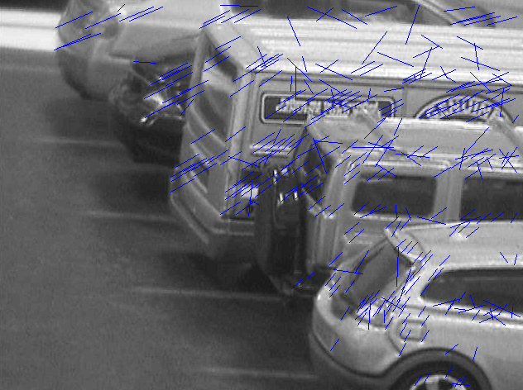
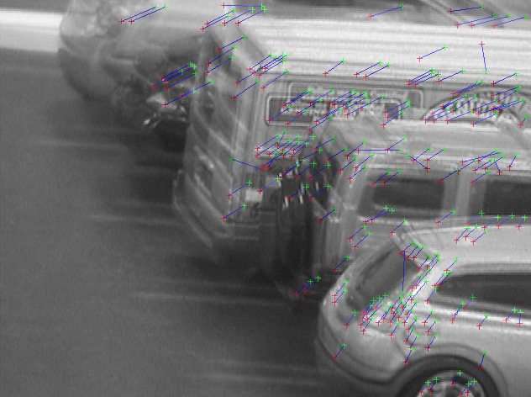
Uncalibrated reconstruction
Feature detection
Find correspondences
RANSAC to find
fundamental matrix
Triangulation
Direct upgrade

Slide 15
Problems
Spurious features
Baseline

Slide 16
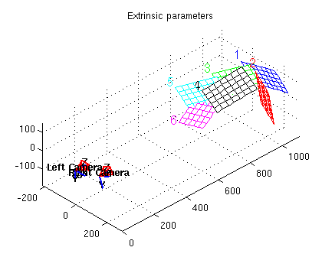
Calibrated reconstruction
Extrinsic parameters
  Rotation
  Translation
Intrinsic parameters
  Focal length
  Skew
  Principal point
[Bouguet ‘00]

Slide 17
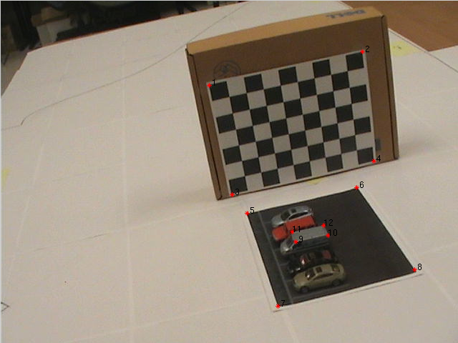
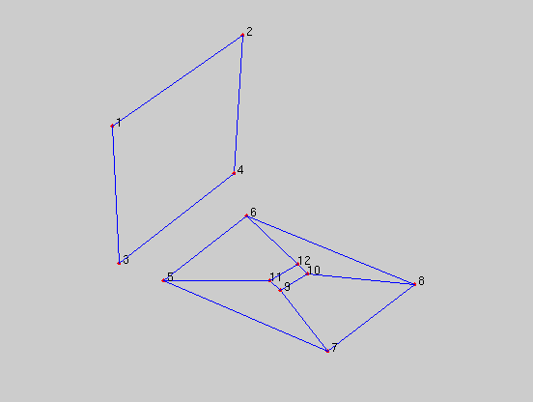
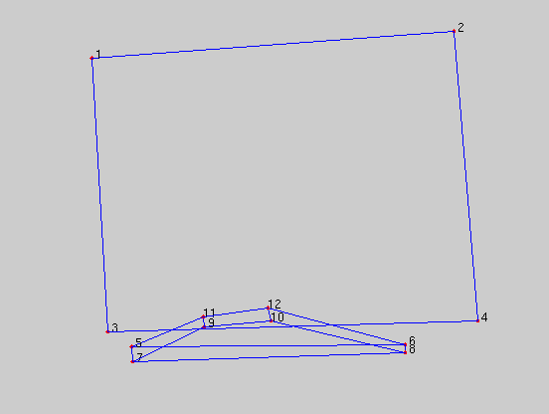

Slide 18



Image rectification
Camera pose
Essential matrix
Epipolar constraint

Slide 19
Vacancy status
Identification of vacancies
  Statistical notion of vacancy
User notification via mobile phone
  SMS
  Voice-activated dialing using VoiceXML

Slide 20
Outline
Approach
Geometry of stereo vision
System overview
  3D reconstruction
Next steps

Slide 21
Next steps
Calibrated reconstruction for automatic correspondences
Camera calibration for varying focal lengths

Slide 22
QUESTIONS?

