Slide 1
Green Marketing
By Casey Walters

Slide 2
Agenda
Problem Definition
Research Objectives
Research Methodology
Data Analysis and Results
Consumer Insights
Recommendations

Slide 3
Problem:
We are buying products that are harming the earth, and sometimes we don’t have an earth friendly alternative
Green products are expensive
Part of the population doesn’t think climate change is an issue, so don’t consider purchasing a new green product
Manufacturers don’t want to make green products
Notes:
As a society, we do not live sustainably. The products we buy and use can harm the environment. Without government regulations on these products, it is often up to the people who are worried about the environment to make the change themselves, through the products they buy and companies they endorse.
There are some green alternatives offered, but they are usually more expensive. Additionally, some products that harm the environment do not have eco friendly alternatives.
As for manufacturing companies, it is hard to take on new eco friendly projects, since the cost to make these products are higher. This deters manufacturing companies from making these green products, giving us very few green alternatives in the store.
Another problem is some people don’t think climate change is an issue. Companies also don’t want to take on green projects because those who don’t believe climate change is an issue may not be motivated to buy the products.

Slide 4
Research Objectives
What kind of customer purchases green products daily?
Who believes climate change is a current issue?
What kind of research goes into putting green product into your cart?
How does a company “going green” change your perception of the company?
Notes:
What kind of consumer purchases green products daily? Weekly? Monthly? By conducting research, we are able to understand who these people are, through demographics, and what percentage of the public do they represent?
Who believes climate change is a current issue? With research, we will be able to find out who believes climate change is an issue, and who is motivated to purchase a green product.
What kind of research goes into putting a green product in your cart? With research, we aim to understand when in the buying process a customer does their research on the product, and when they would be most interested in information about our product.
How does a company “going green” change your perception of the company? By conducting research, we are able to better understand the consumer and what they need from the company.

Slide 5
Research Methodology
Survey Research
Quantitative and Qualitative method
Circulated on Facebook
102 responses
April 13-28
Volunteer Sampling
Notes:
I used both quantitative and qualitative research for my project. I collected this data with a survey that gave me both quantitative and qualitative answers. First, I constructed a survey on Qualtrics and then posted it on social media platforms to get a wide range of perspectives on this issue. My mother and grandmother shared the link, giving me access to opinions of people that aren’t my age.
The survey was taken by 102 people, between the dates of April 13 and April 28 2018.
This is an example of volunteer sampling. Whoever wanted to take my survey could do so if they wished. This type o sampling is slightly biased, since not everyone has a Facebook or the capability to do my survey since it is online only. All of my participants finished my survey. I had great cooperation from my participants. Very few used the ‘other’ text box option, which is good for me because then my data is easier to read and analyze.
My survey was 77% female. Which is not consistent with the population. I attribute this difference to the way the survey was circulated; It was only shared by women.

Slide 6
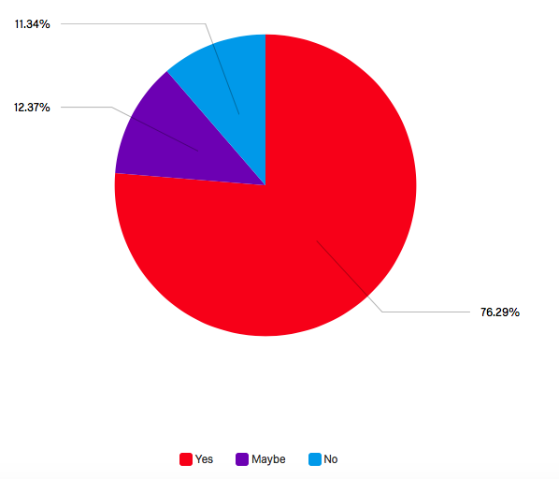
Do you believe Climate Change is a current issue?
Notes:
Overall, 76% of those surveyed believe climate change is a current issue. This is good news for green product providers; 76% of those surveyed are potentially interested in these products.

Slide 7
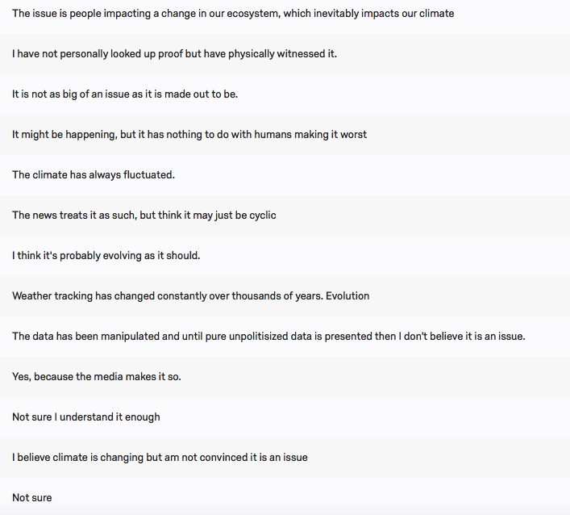
Please elaborate on your answer to the previous question(if you selected ‘No’ or ‘Maybe’)
Notes:
In general, those who selected they don’t think climate change is a current issue said something along the lines of “Its just not as big of a deal. It may be happening, it might not, but it isn’t really an issue.” Since this group of people don’t think climate change is a big deal, they most likely wont be purchasing green products (for environmental reasons). Luckily, this is a smaller group of people. The best way to market our products to these people is by showing the product’s quality, which will be explained later.

Slide 8
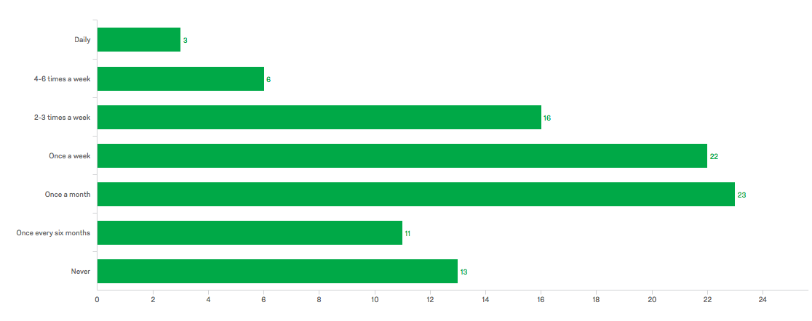
How often do you purchase products that are advertised as "environmentally friendly" or "green"?
Notes:
Most of those surveyed purchase green products once a month, and once a week is closely behind. This tells us that there is a steady demand for green products in grocery stores and super markets, where individuals shop weekly and monthly.

Slide 9
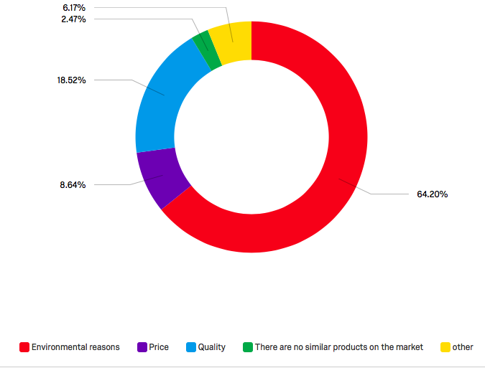
Why do you purchase green products?
Notes:
When asked why they purchased green products, the majority selected environmental reasons, which is expected. However, around 20% of people are purchasing green products for their superior quality. this is a piece of information that should be interesting to the marketing team. If we can also market our green products as higher quality, we will have more success with this 20% segment.

Slide 10
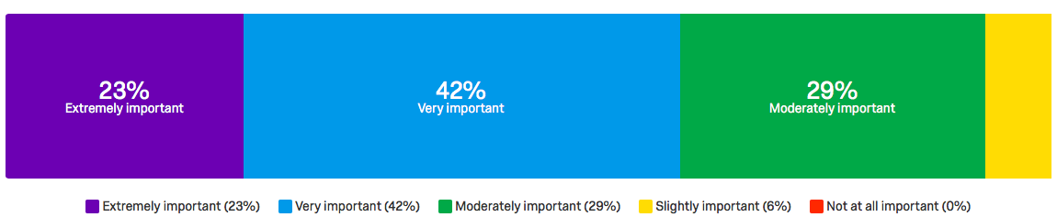
How important is sustainability to you?
Notes:
Here, we asked our survey takers how important sustainability is to them. 42% selected very important, followed by moderately important(29%), and extremely important(23%). With most people finding it very important, I would suggest to our marketing staff that we need to market our products as sustainable. We need biodegradable packaging, things that won’t be thrown away or things that can be reused.

Slide 11
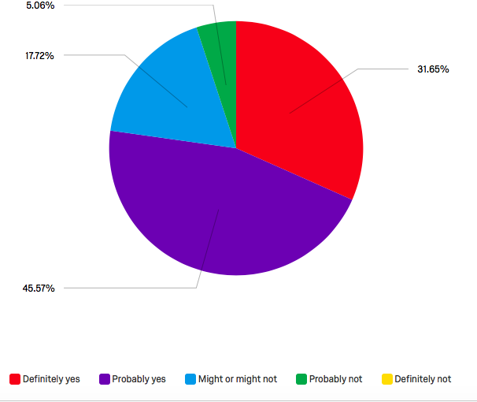
Does a company’s stance on sustainability and environmental impact alter your opinion of that company?
Notes:
When asked, “Does a company's stance on sustainability and environmental impact alter your opinion of that company?” 45% selected “probably yes” and 31% selected “definitely yes”, showing us that most of those surveyed are aware of the effect “green marketing” companies have on customers. Public Relations is going to be extremely important for companies interested in going green, and even taking a stand publicly may increase profits.

Slide 12
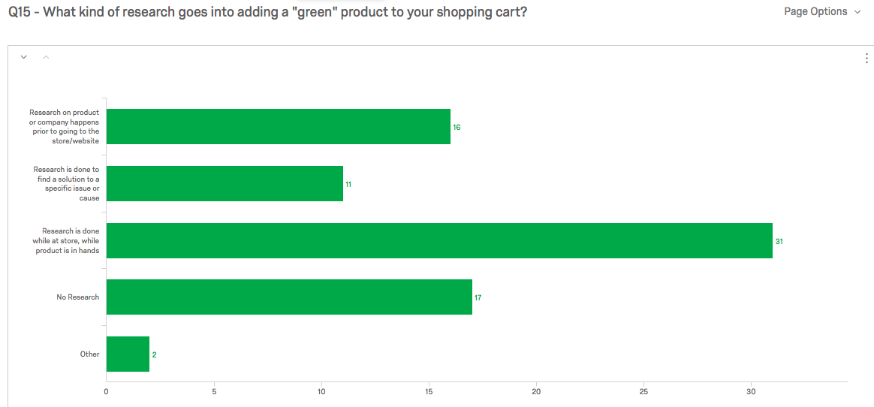
What kind of research goes into adding a ‘green’ product to your shopping cart?
Notes:
I have included a bar chart showing what kind of research goes into adding a ”green” product to a shopping cart. The vast majority of those surveyed do their research in the store with the product in their hand. If my company is selling a green product, I know the packaging will be extremely important. This is when most people decide to purchase a product. The product has to have a good design. It has to be informative and persuasive.

Slide 13
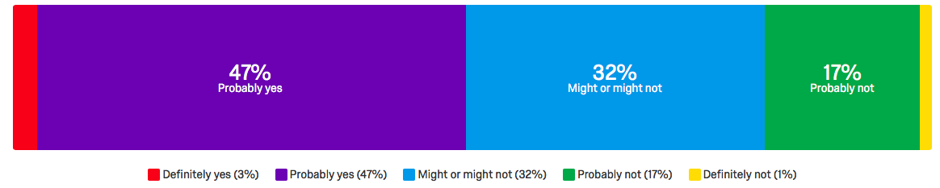
Are you confident in the product's/company's claims that their product is truly "green"?
Notes:
When asked if the surbveyer was confident in the product or company’s claims of being green, 47% selected probably yes, and 3% selected definitely yes. Over 50% of people are convinced by the claims of companies to be environmentally friendly. This information supports my earlier statement that the packaging of these products and the PR work is important. Our packaging needs to convince the consumer while the product is in their hand that the product is indeed green.

Slide 14
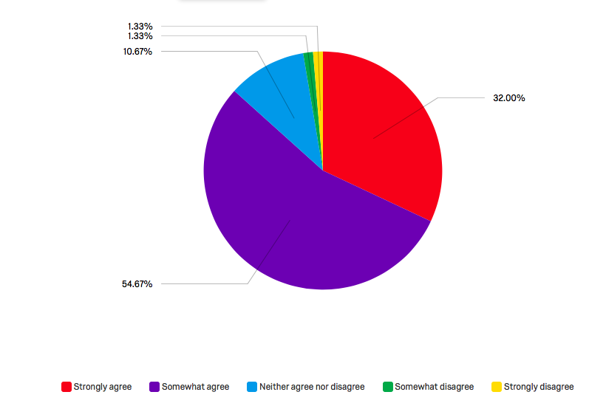
Does "Green Marketing" often target a specific demographic or group?
Notes:
The vast majority of people somewhat/strongly agree that there is a specific demographic being marketed towards. (see next slide for more in depth explanation)

Slide 15
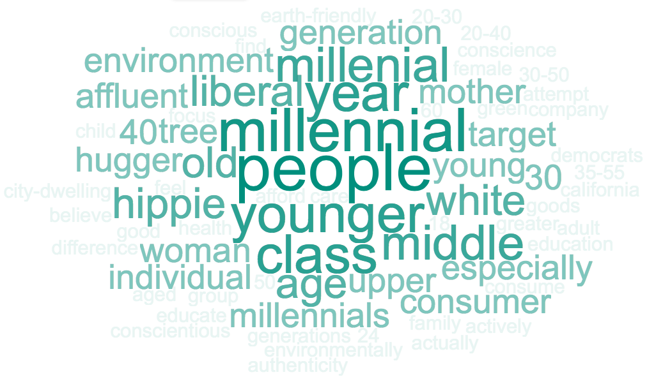
Please describe the demographic or group you believe "Green Marketing" often targets.
Notes:
The most common words used to describe the demographic “Green Marketing” campaigns target according to those surveyed are “millennial”. Other common words include ‘woman’, ‘affluent’, ‘liberal’, ‘upper middle class’, ‘white’, and ‘mother’.
This shows us the group of people that people think we are marketing towards. One area that seems to be totally missing is “men”. If we can gear some marketing campaigns to men, we could increase sales tremendously. Another idea we can capitalize on is making green products affordable to everyone, not just “white affluent women”.

Slide 16
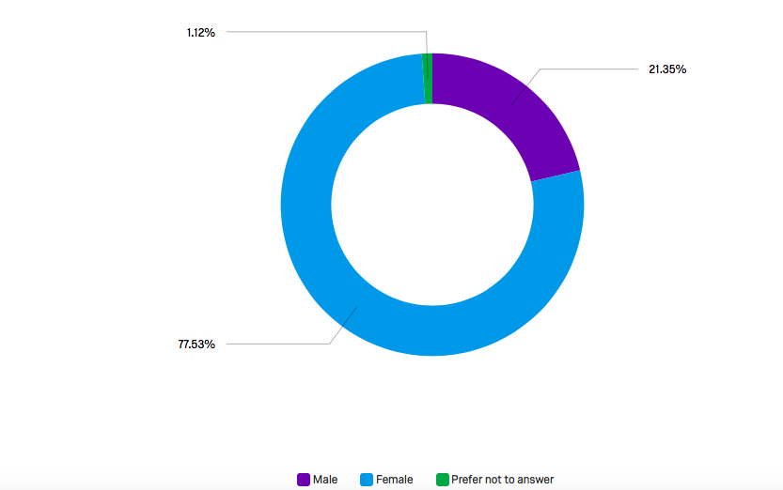
Are you…
Notes:
most of my participants were female. This is something to keep in mind, because our data may be skewed to a female perspective, and is not necessarily reflective of the population.

Slide 17
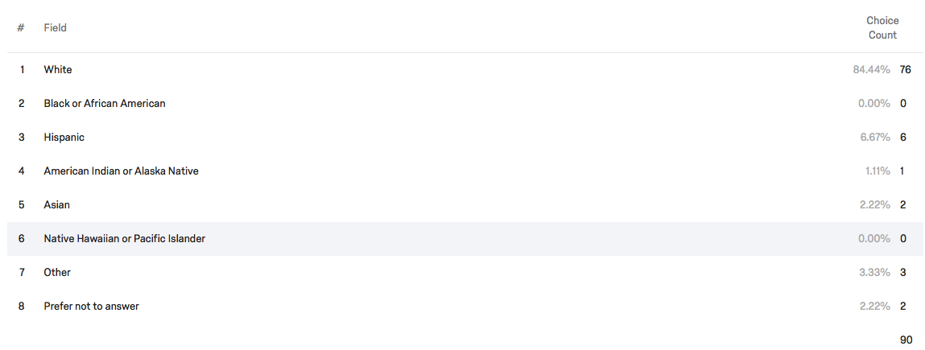
Choose one or more races that you consider yourself to be:
Notes:
The majority of people who took the survey were white(84%) This can skew my data as well, since I was not able to get a diverse collection of data.

Slide 18

What is you year of birth?
Notes:
I was able to get a wide range of ages. The most common birth years were 1965, 1964, and 1997. This is probably because I posted the link on Facebook and my friends (born in 1997) took it, and my mom and dad (born in 1965 and 1964) shared the link with their friends. I have 1941 to 1999, giving me a diverse age group.

Slide 19
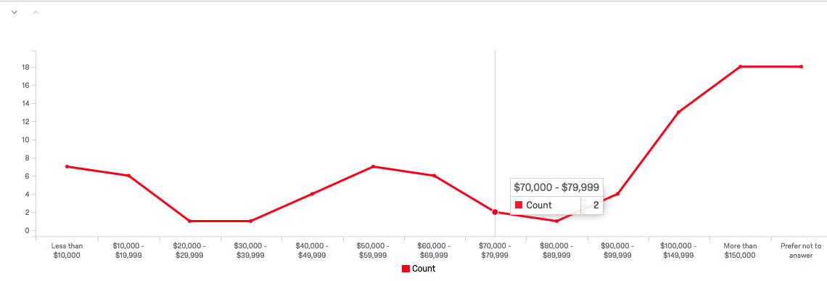
Information about income is very important to understand. Would you please give your best guess?
Notes:
The income levels were mostly represented. I have a low, middle, and high income level group, but I think the data looks to be lacking a low middle and middle high income level group. The can skew my data slightly, but I think since I have low middle high represented, my data is accurate for the population.

Slide 20

What is your Zip Code?
Notes:
I think I was also able to get a wide range of data from people all around the Chicago area. Of course, most people were from my hometown(60175), and my grandparents area(60107). It would have been cool to get data on people from other areas of the US, but we will just have to keep this in mind when analyzing the information.

Slide 21
Consumer Insights
Majority believe climate change is a current issue
Purchase green products relatively often(every month or more)
Research products when products are in hands
Sustainability is important
Believe green marketing targets a specific demographic
Notes:
As you have just seen in the previous slides of data, people believe climate change is a current issue. These people are motivated to purchase a green product, or support brands and companies that share the same opinion.
People are purchasing green products often. They are purchasing them every month and every week.
The consumers are researching products while they have the item in their hand.
Consumers also believe green marketing targets a specific demographic; white, upper-class females.

Slide 22
Recommendations
Start manufacturing more green products
Use PR to announce eco friendly business practices, hold company to high standard
Package products so consumers are not contributing to waste
Packaging needs to convince the consumer of impact
Notes:
There is room for more companies in the green industry. We should start manufacturing more green products, especially in areas where a green alternative does not exist.
Consumers are interested in sustainability for both products and companies. By changing some policies and making a few announcements, we should try to gear our public image as a more environmentally conscious brand. The products should be packaged to contribute as little waste as possible. Biodegradable packaging and reusable containers may be something to look into.
Lastly, packaging should convince consumers on the spot. Research is happening when product is in their hands, so letting them know about our environmental work and green friendly attitude needs to happen in this stage. We may want to add seals of approval and environmental effect stickers.

