Slide 1

SilverLine Superstore Management Presentation

Slide 2

SALES TREND OVER TIME
This sales chart trend is used to display the sales over time. It display the sale distribution over the last 2 years from January to December. As seen in the data point, the order of the sales distribution moves from January to December.

Slide 3
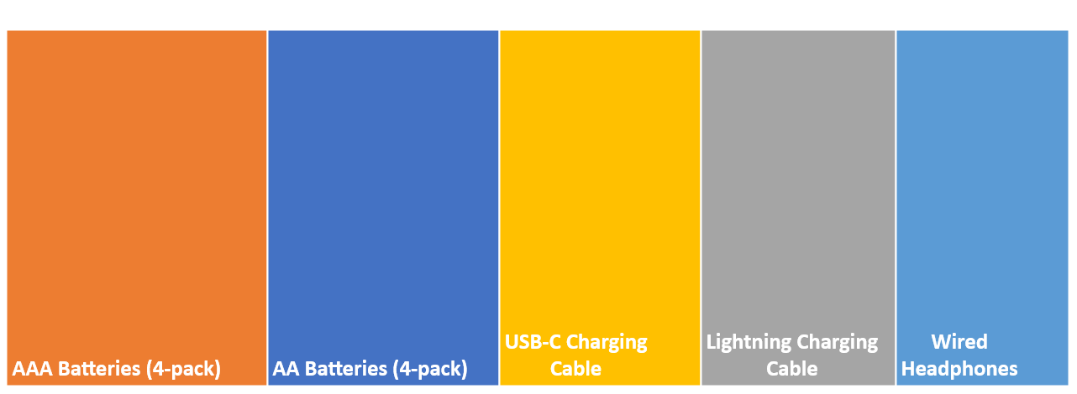
BEST SELLING PRODUCTS
This sale chart display the 5 Best selling product of the organization. The display is the 5 Best selling products over the last two years from 2019 to 2020., the order of the sales distribution ranges from the first ordered products to the first 5 ordered products.

Slide 4
Weekly Sales Distribution
This is a weekly sales distribution. It display the sale distribution from Monday to Friday. As seen in the data point, the order of the sales distribution moves from Monday to Friday..

Slide 5
STATE FILTERS
STATES FILTERS
City | Revenue | Quantity Ordered | Quantity Ordered Selected
Atlanta | $2,795,499 | 16,602 | 16,602
Austin | $1,819,582 | 11,153 | 11,153
Boston | $3,661,642 | 22,528 | 22,528
Dallas | $2,767,975 | 16,730 | 16,730
Los Angeles | $5,452,571 | 33,289 | 33,289
New York City | $4,664,317 | 27,932 | 27,932
Portland | $2,320,491 | 14,053 | 14,053
San Francisco | $8,262,204 | 50,239 | 50,239
Seattle | $2,747,755 | 16,553 | 16,553
Grand Total | $34,492,036 | 209,079 | 209,079

Slide 6


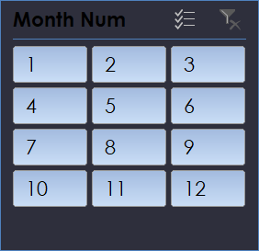


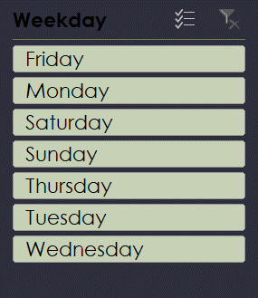
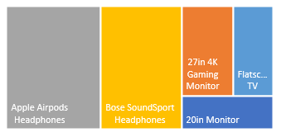
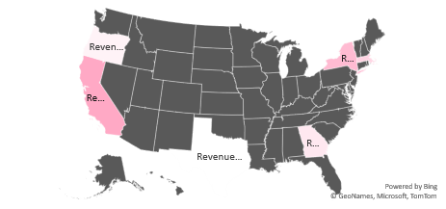
SilverLine Sales Dashboard Analysis
Summary for 20in Monitor
20in Monitor
Total Revenue
Price Each
Profit Margin
$34,492,036
$34,289,131
59%
Total Revenue
Total Qty Sold
34,492,036K

Slide 7
OBJECTIVES
Objective: Analyze sales data to identify trends, top-selling products, and revenue metrics (key performance indicators, KPIs) for business decision-making
To provide executive summary of overall quantities ordered for SilverLine store called "SilverLine Superstore" in order to make data-driven recommendations for optimizing sales strategies.
Context: SilverLine Superstore is a global retail store that sell electronic gadget and phones, theie products consists of 21 main categories e.g (20in Monitor
27in 4K Gaming Monitor, 27in FHD Monitor, 34in Ultrawide Monitor, AA Batteries (4-pack), AAA Batteries (4-pack), Apple Airpods Headphones, Bose SoundSport Headphones, Flatscreen TV, Google Phone, iPhone, LG Dryer, LG Washing Machine, Lightning Charging Cable, Macbook Pro Laptop, ThinkPad Laptop, USB-C Charging Cable, Vareebadd Phone, Wired Headphones) sales are done right inside the stores with different location in different cities, expanding sales and quantities order through visibilities study of most ordered products.

Slide 8
📌 ANALYSIS PROCESS
📌 ANALYSIS PROCESS
Step 1: Load & transform data
- Download SilverLine Superstore Sales (Excel file) containing: Products, Qty Ordered, Price each, Order date, Purchase address, Sales, City and hour.
- Explore table and data fields in each table, identify fact and dimension table.
Step 2: Clean data by using excel function and formats e.g column to text
- Apply column to text to get Date columns like, Month, Day, Weekday, and Year
Step 3: Create measure

Slide 9
Measures
Step 3: Create measure
- Creating some useful Key Performance Index measure for sales analysis (Total Revenue, Profit margin, Cost of good sold)
Step 4: Build report and explore
- Choose theme color using excel built in colours
- Choose visual and information need to analyze

Slide 10
📊 INSIGHTS SUMMARY
📊 INSIGHTS SUMMARY
Sales trend over time:
- Sales trends by month are consistent annually, with normal sales from January and May.
- There is a noticeable increase in sales that occurs in April to May each year.
- While a noticeable decline in sales occurs in June, August and September each year.
- Drastic sales took place from October to December being a festive period, consistently outperforms other months throughout each year.

Slide 11
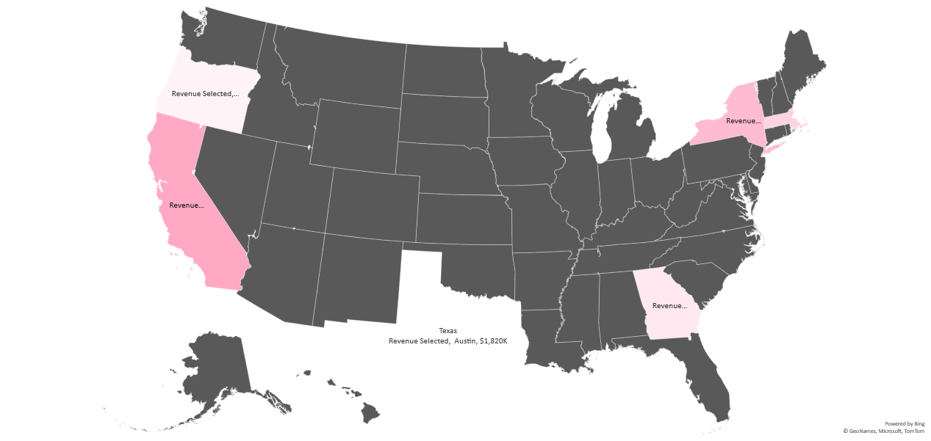
Sales by Cities

Slide 12
Key Performance Indicator
Total Revenue | Price Each | Profit Margin
$34,492,036 | $34,289,131 | 59%%

Slide 13
Top 5 Best Selling Product:
- 31,017K of AAA Batteries (4-pack) products was quantity order in total volume, followed by 27,635K of AA Batteries (4-pack) total quantity ordered, while 23,975K of USB-C Charging Cable
quantity ordered shows the highest from 2019 to 2020. This growth is primarily driven by quantity ordered in a more populated and density cities like New york, florida and
- The distribution of sales across product categories—electronics, phones, batteries and ipads is relatively even.
- The average order value across all cities stands at $492 per order, with San Francisco
city recording the highest average quantity order at 50,239K with a total sales of $8,262, 204

Slide 14
Top 5 Cites By Sales:
- San Francisco city tops the sales chart by a whopping sale figure of $8,262,204 with a quantity ordered of 50,239K
- While Los Angeles generates a sales figure of $5,452,571 with a net quantity ordered of 33,289K
- New York and Boston city makes a total sale figure of $4,664,317 and $3,661,642
while quantity ordered of 27,932 and 22,528 respectively

Slide 15
Weekly Sales Distribution by Weekday:
- Sales are very high on Tuesday, as you can see a total sales of $5,087,957 was made on Tuesday while other days are evenly distributed
Key Performance Indicator (KPI):
- Total Revenue each is $34,492,036, while Sum of Price each is $34,289,131 which gives us a Profit Margin of 59% overall.

Slide 16
RECOMMENDATION:
. - Invest more on the cities with more quantity order, place more advert online and bills distributed around this cities.
- California, Texas, Florida & New York should be the main target as they are the top-populated cities/states in the US market.
- We can also maintain a discount rate below 0.37 generally results in a positive profit margin.
- In the products category, AAA Batteries (4-pack) products are the most frequently ordered item.
- Phones lead in the technology category, while iphone are also popular in the phones category.

Slide 17


LINK TO DASHBOARD

