Slide 1
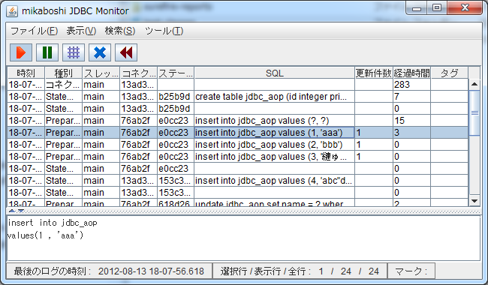
architecture.png
Java VM
Java VM
Java application
mikaboshi-jdbc-moniotor
(JDBC log wrapper)
Log file
JDBC driver
mikaboshi-jdbc-monitor
(log viewer)
Relational
database

