Slide 1
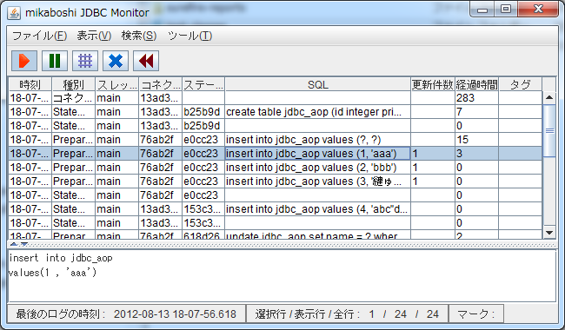
architecture.png
Java VM
Java VM
Java application
mikaboshi JDBC Monitor
(JDBC wrapper)
Log file
JDBC driver
mikaboshi JDBC Monitor
(Log viewer)
Relational
database

