Slide 1
Case Study in
Statistical Learning
with
Experimental Design
The Impact of Combinations of Anticancer Drugs
WANG Chuning

Slide 2
Experimental Design

Slide 3
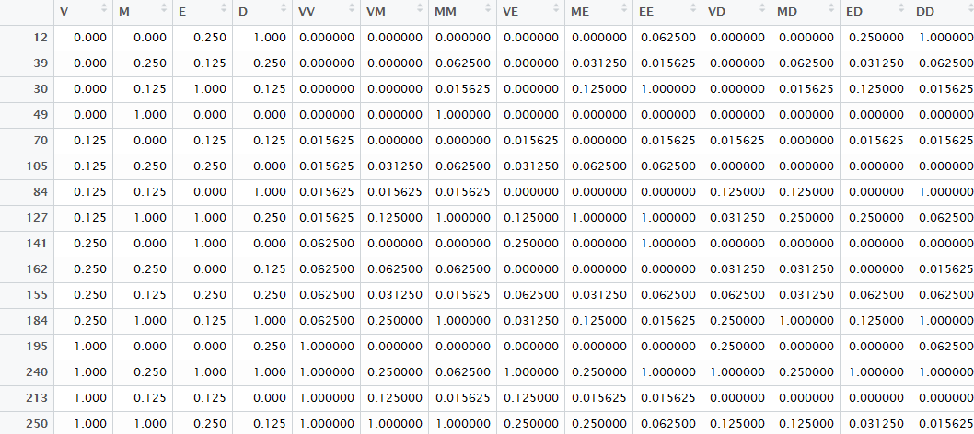
Training Data Selected (1)

Slide 4
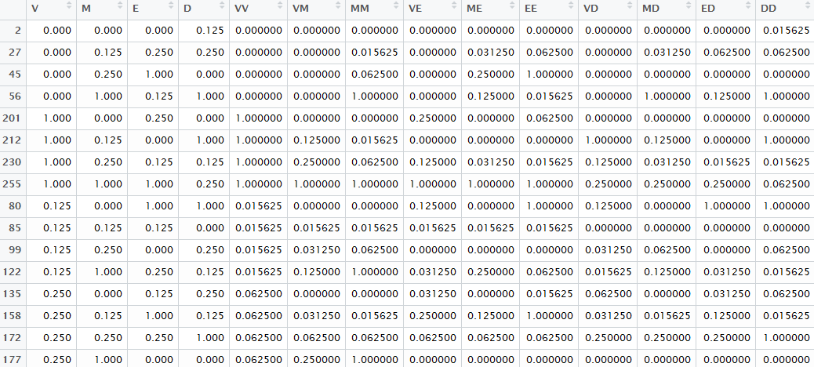
Training Data Selected (2)

Slide 5
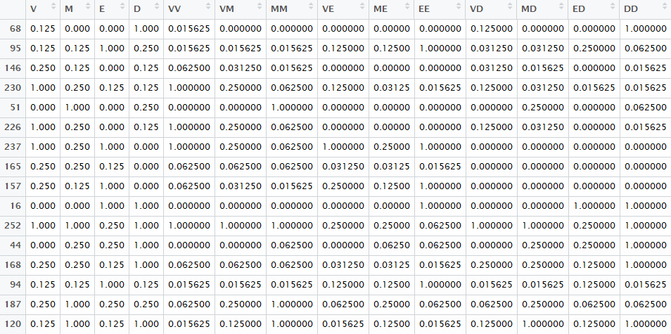
Training Data Selected Randomly
Something here
Something here
Something here

Slide 6
Result

Slide 7
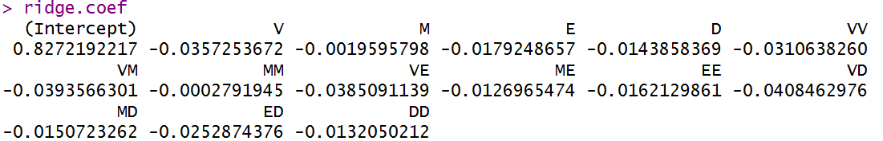
Ridge Regression (1)
VD,VM, VE, V, VV

Slide 8
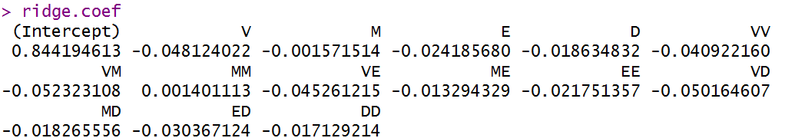
Ridge Regression (2)
VM, VD, V, VE, VV

Slide 9
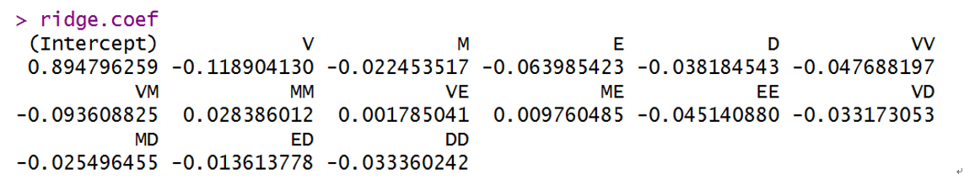
Original Result of Ridge Regression
V, VM, E, VV, EE

Slide 10
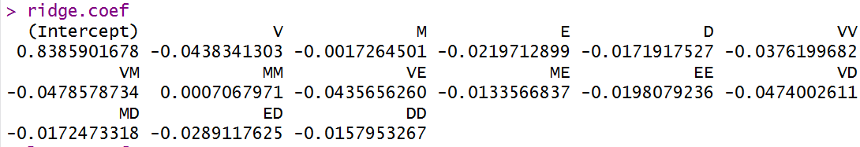
Ridge Regression with Random Chosen Training Data
VM, VD, V, VE, VV

Slide 11
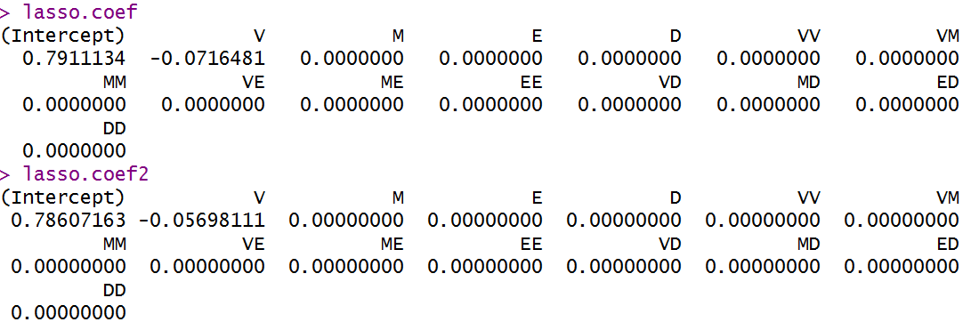
Lasso Regression (1)

Slide 12
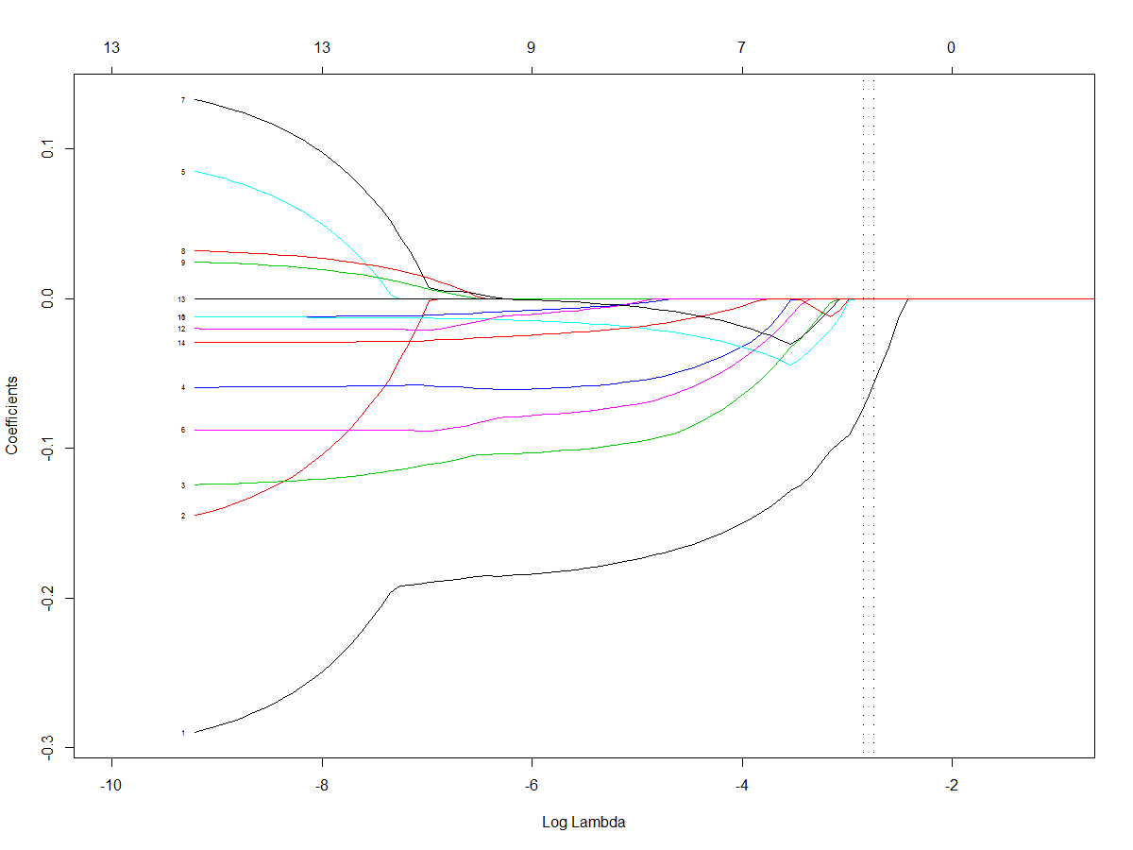

Slide 13
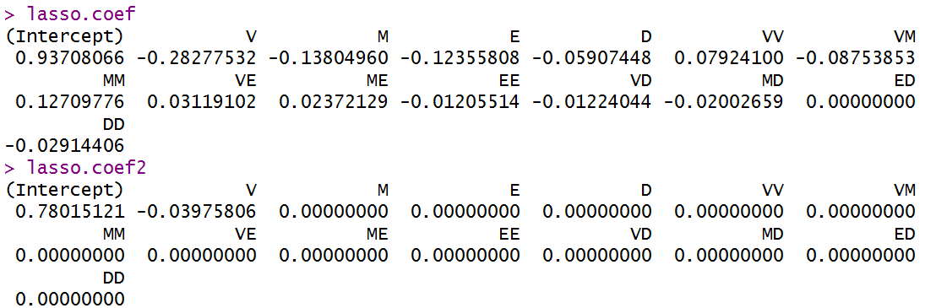
Lasso Regression (2)

Slide 14


Slide 15
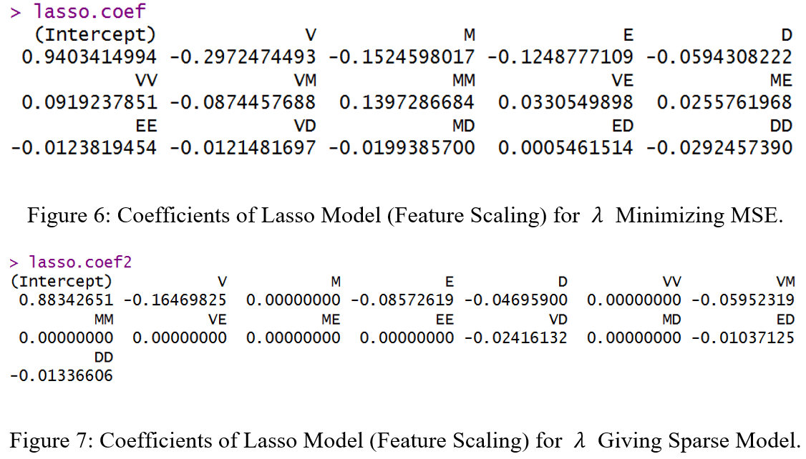
Original Result of Lasso Regression

Slide 16
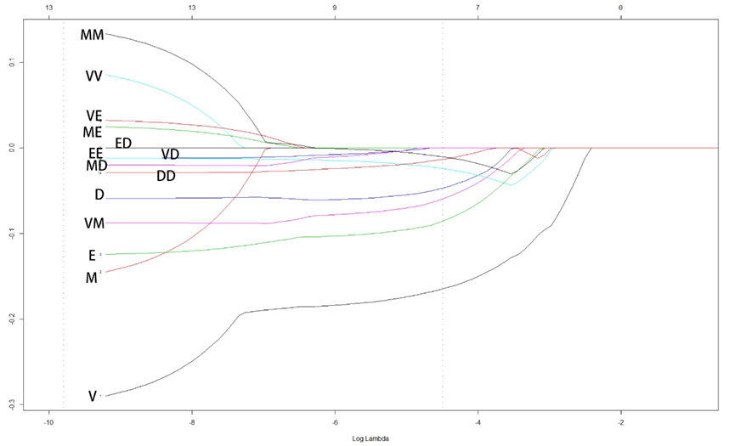
Lasso Regression
λ minimizing MSE
λ giving sparse model

Slide 17
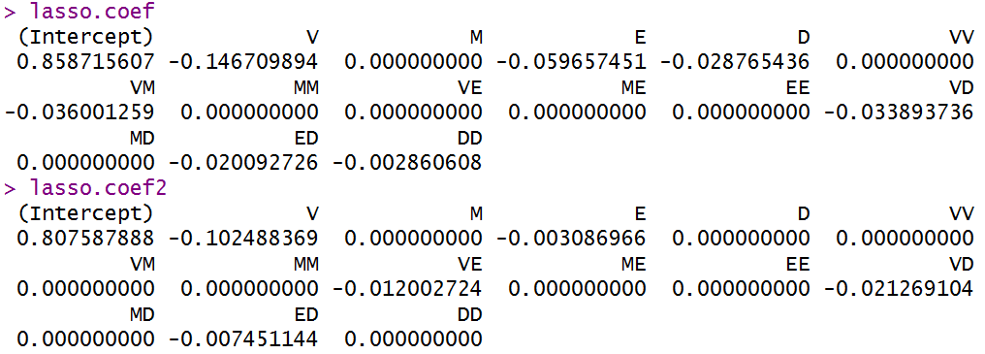
Lasso Regression with Random Chosen Training Data

Slide 18
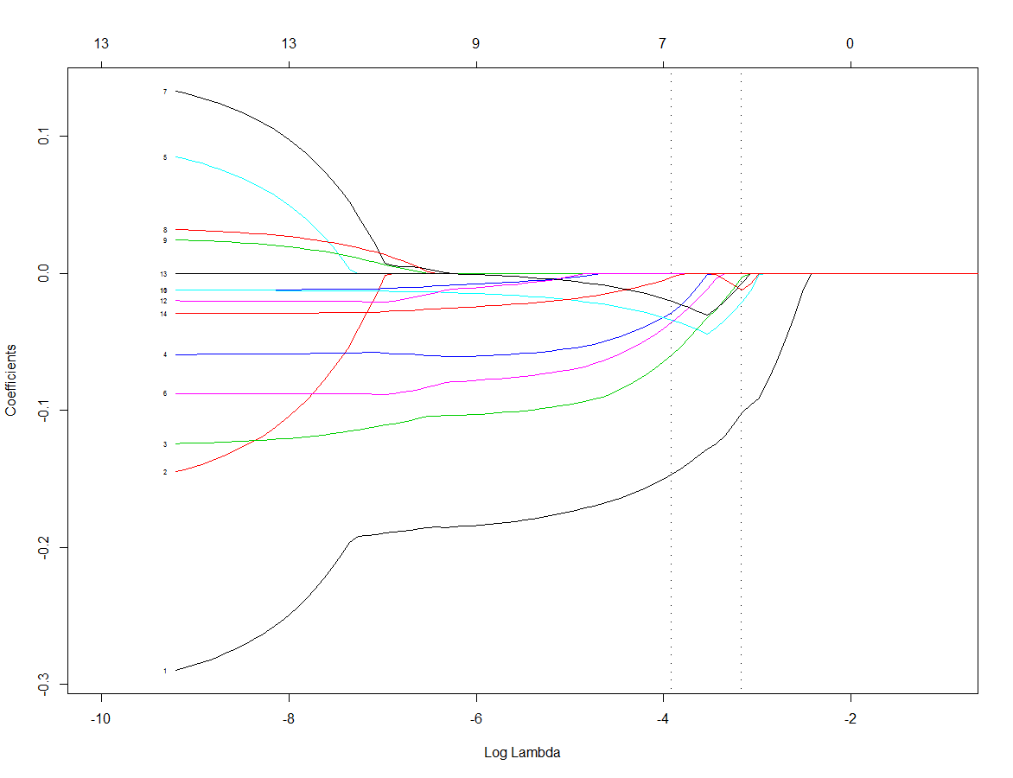

Slide 19
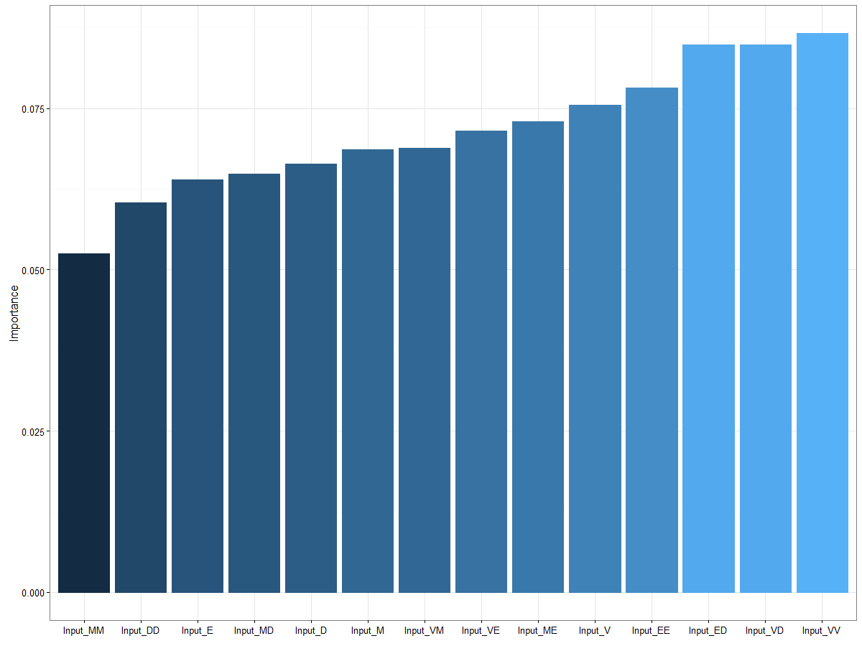
Multi-Layer Perceptron neural network (MLP) (1)

Slide 20
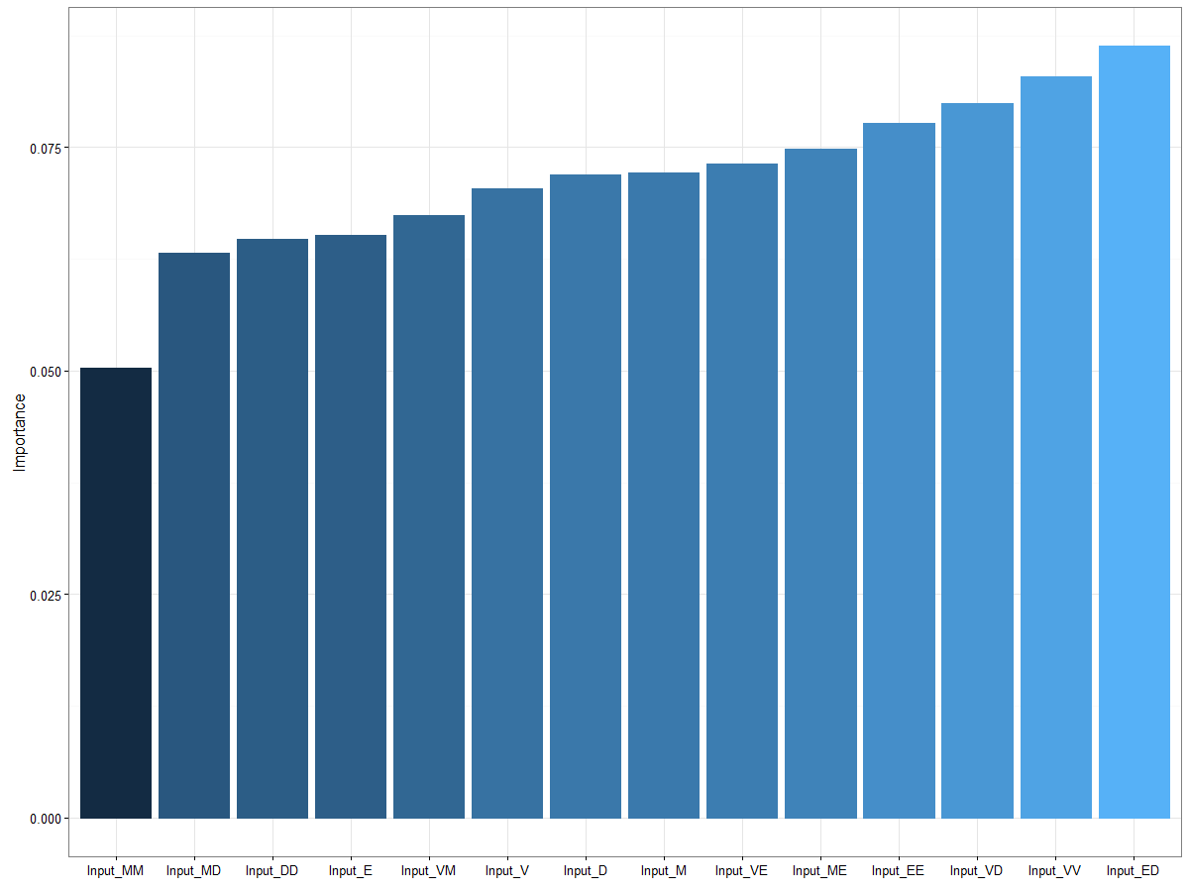
Multi-Layer Perceptron neural network (MLP) (2)

Slide 21
Original Result of MLP

Slide 22
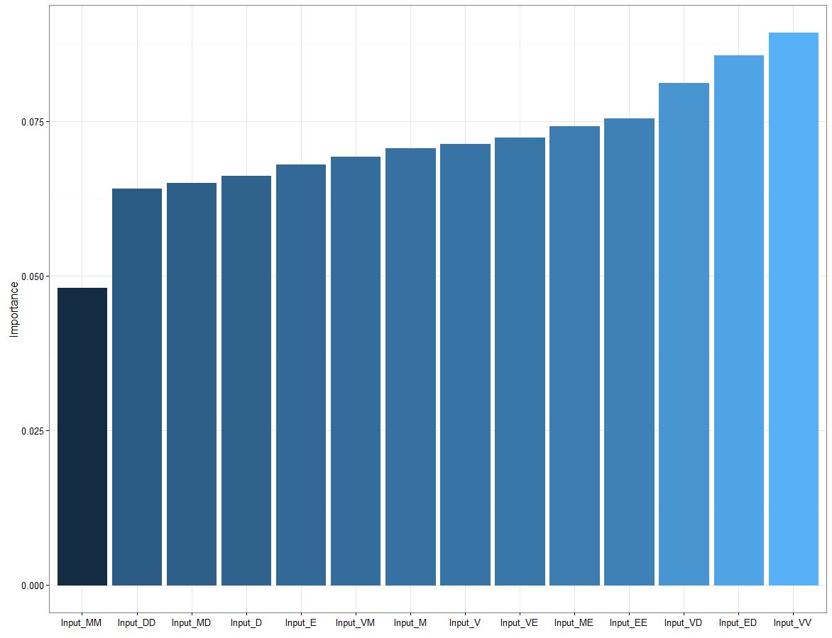
MLP with Random Chosen Training Data

Slide 23
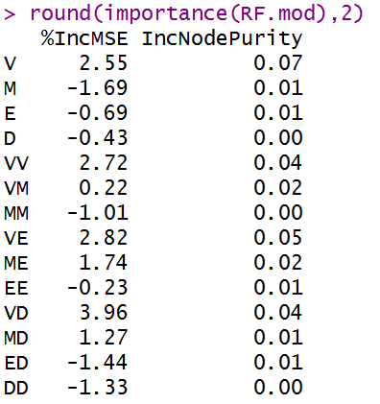
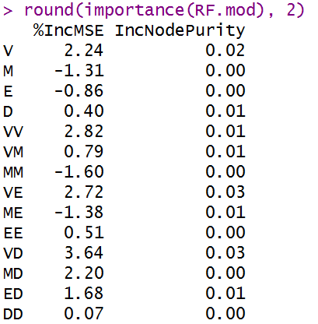
Random Forest (1)
Random Forest (2)

Slide 24
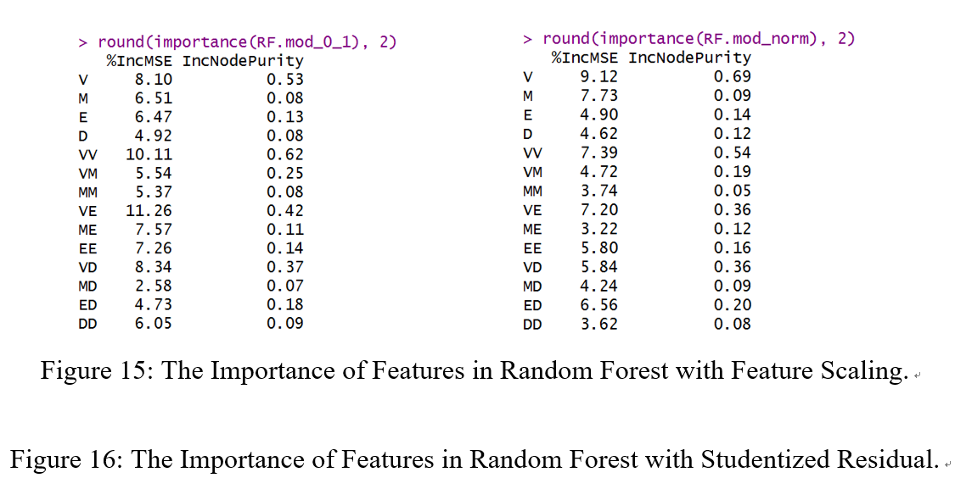
Original Result of Random Forest

Slide 25
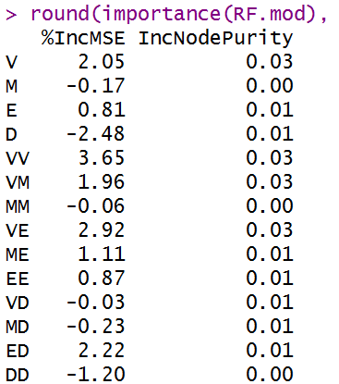
Random Forest with Random Chosen Training Data

Slide 26
Mean Squared
Error

Slide 27
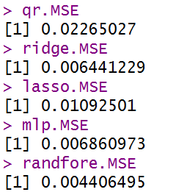
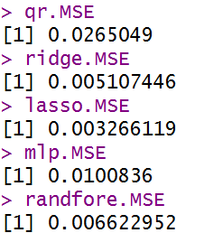
MSE (1)
MSE (2)

Slide 28
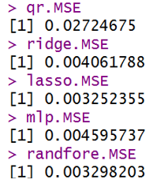
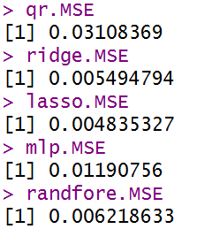
Original MSE
MSE (Random)

