Slide 1
Case Study in
Statistical Learning
with
Experimental Design
The Impact of Combinations of Anticancer Drugs
WANG Chuning

Slide 2
Experimental Design

Slide 3
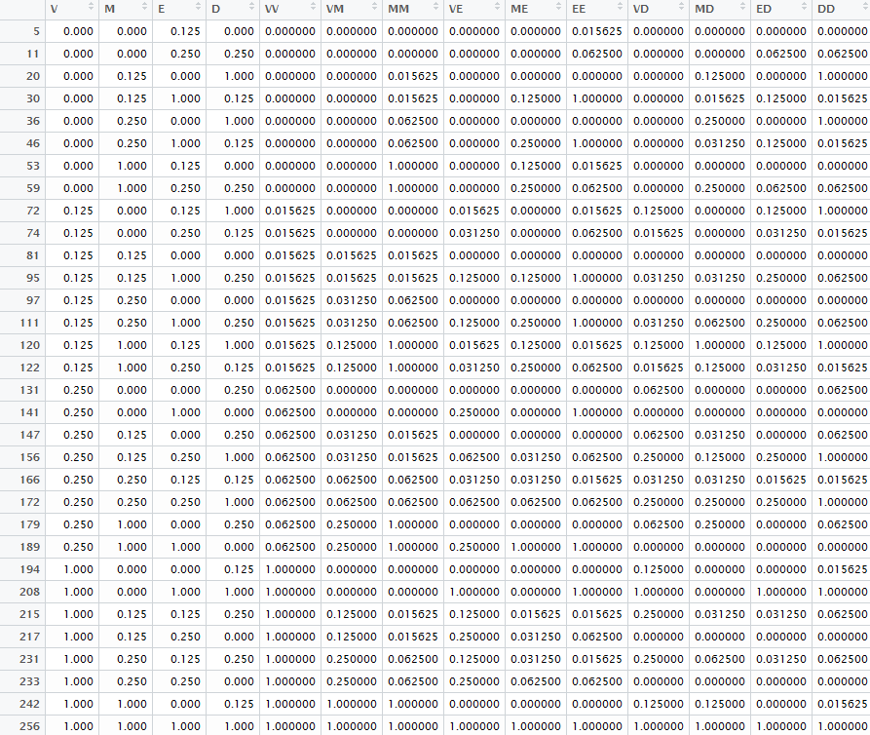
Training Data Selected (2)

Slide 4
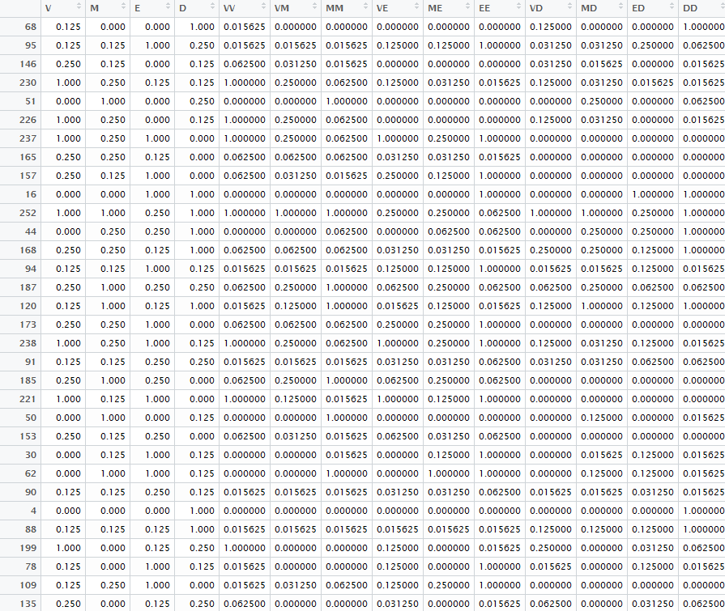
Training Data Selected Randomly
Something here
Something here
Something here

Slide 5
Result

Slide 6

Ridge Regression (2)
V, VM, MD, E, EE

Slide 7
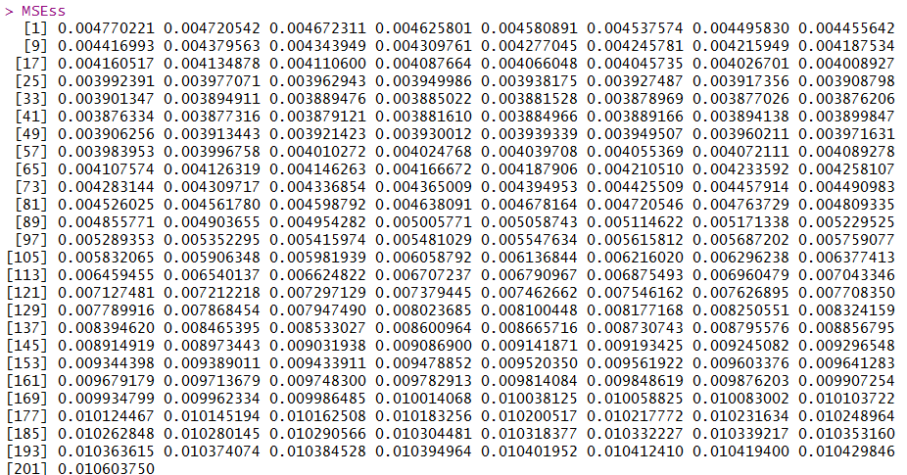

Slide 8
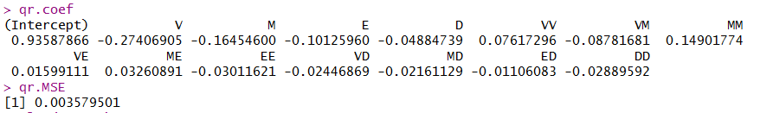
Original Result of Ridge Regression
V, M, E, VM, D

Slide 9
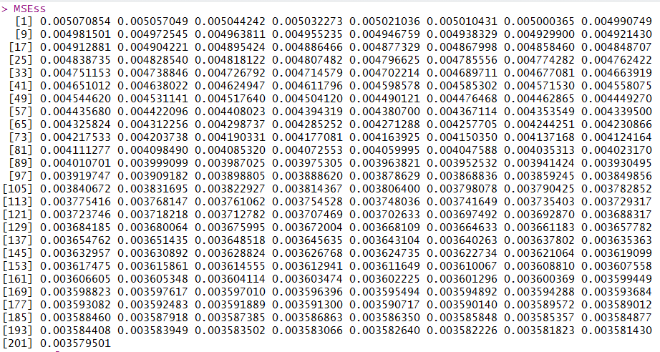

Slide 10
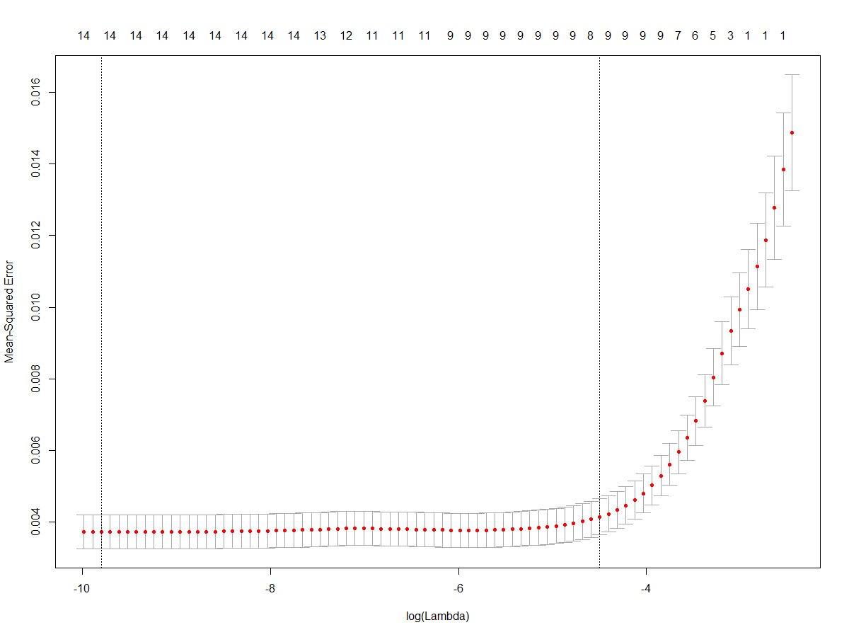

Slide 11

Ridge Regression with
Random Chosen Training Data
VM, MD, VE, V, VD

Slide 12
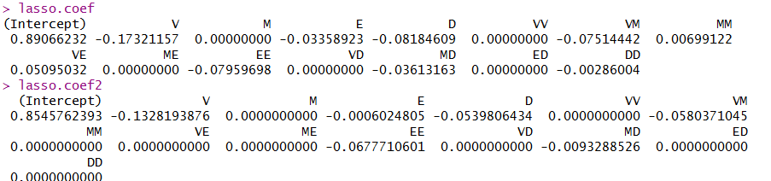
Lasso Regression (2)

Slide 13
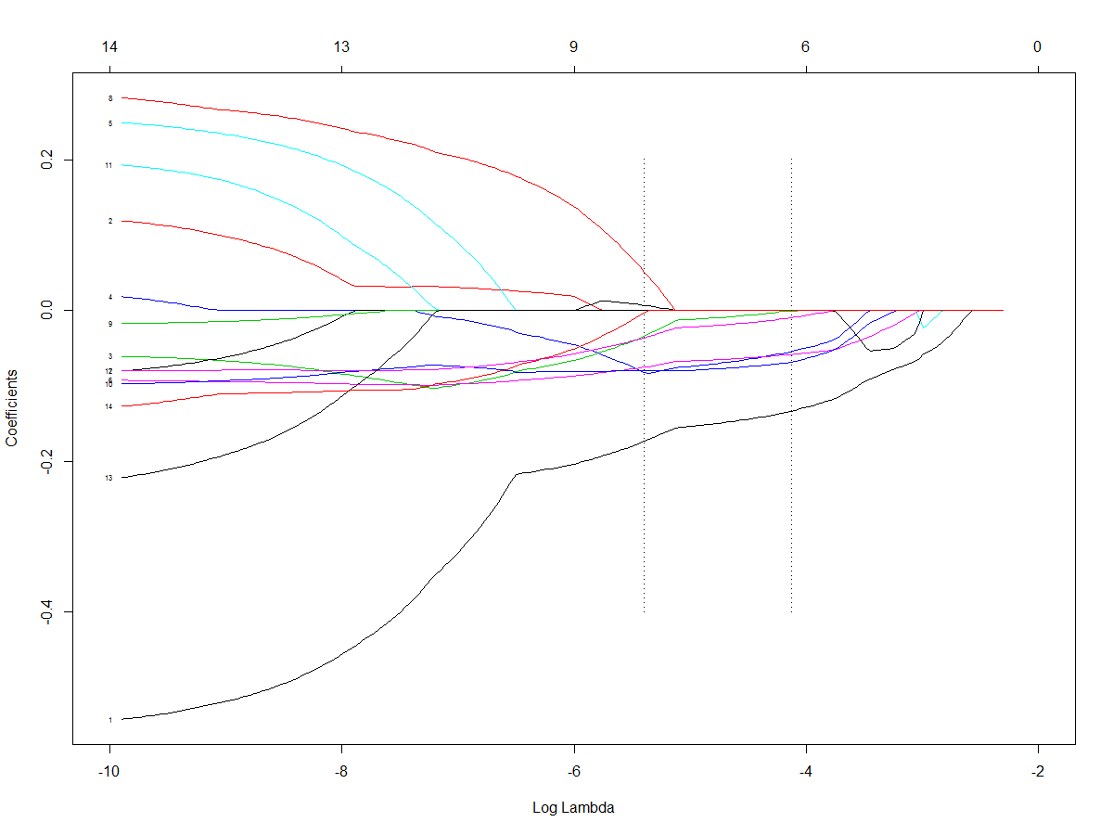

Slide 14
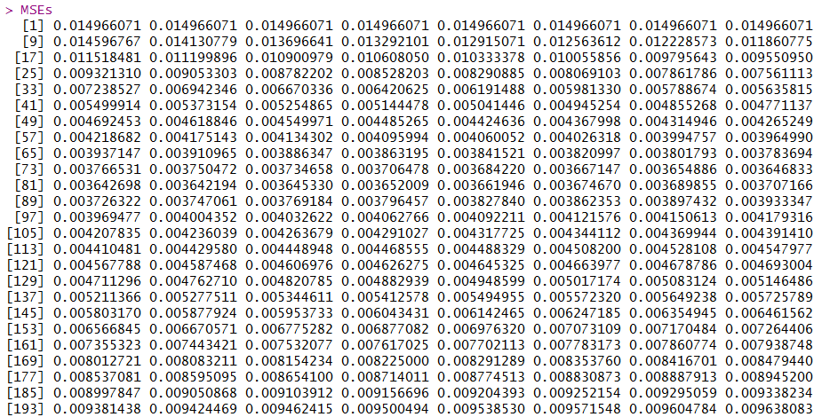

Slide 15
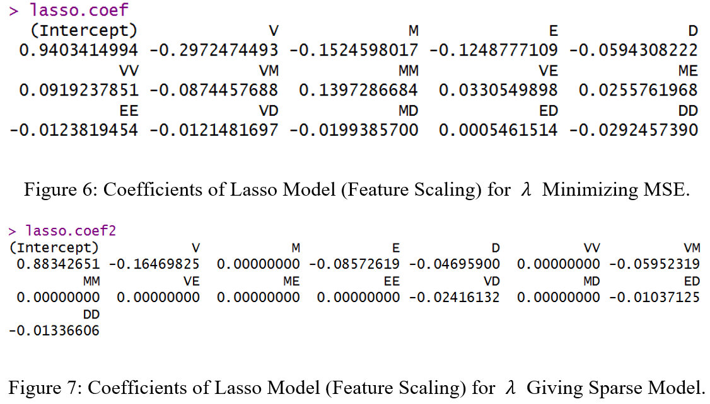
Original Result of Lasso Regression

Slide 16
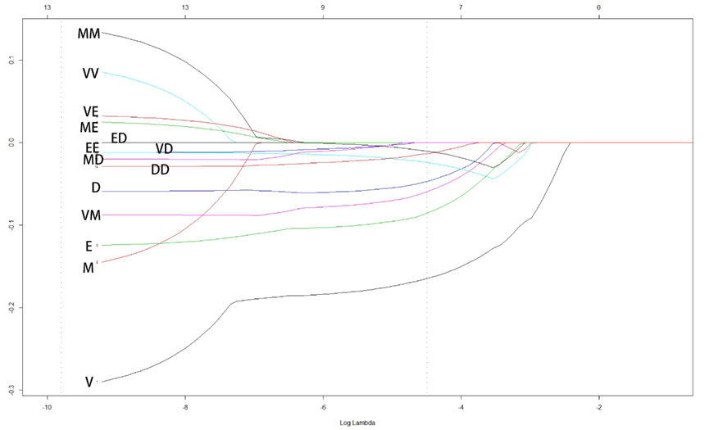
Lasso Regression
λ minimizing MSE
λ giving sparse model

Slide 17
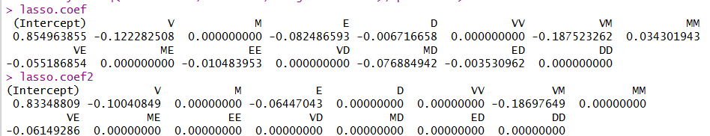
Lasso Regression with
Random Chosen Training Data

Slide 18
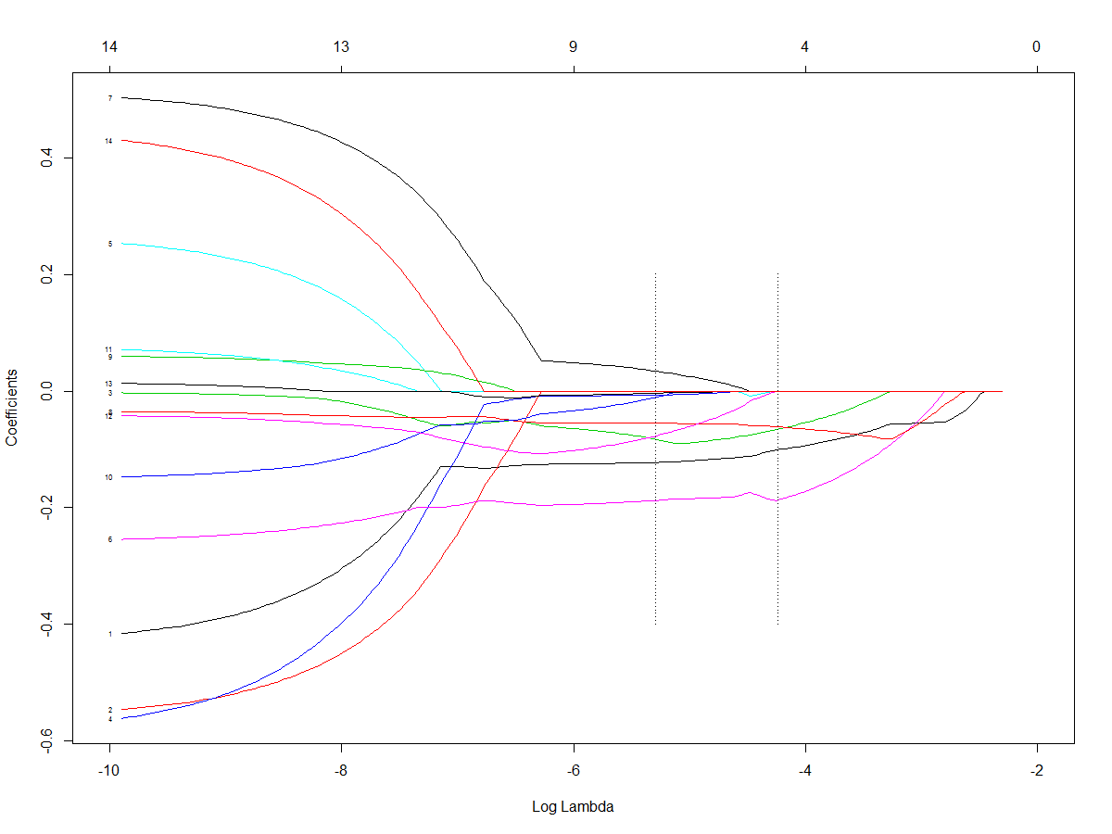

Slide 19
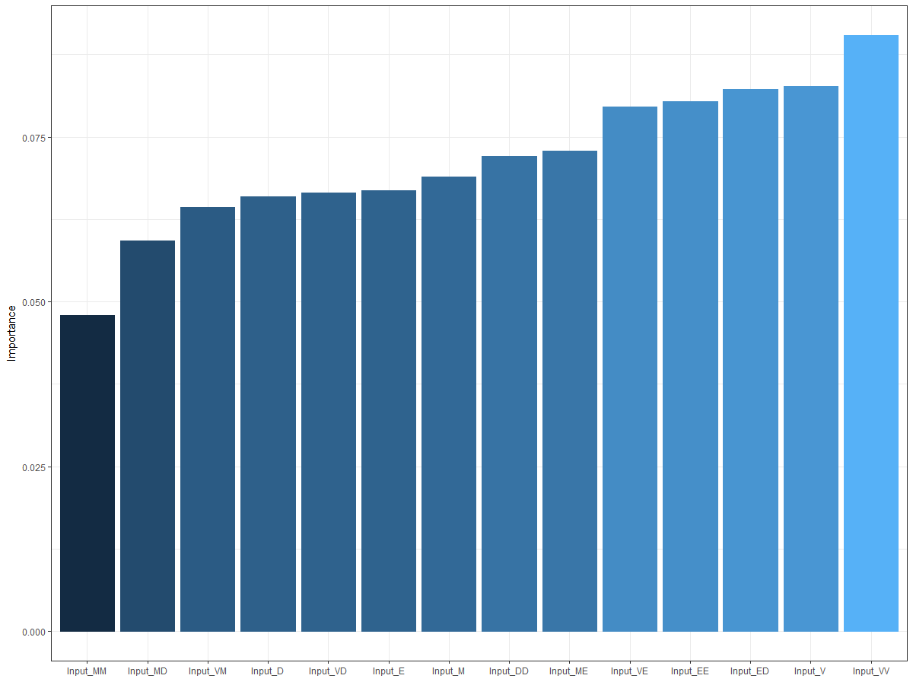
Multi-Layer Perceptron neural network (MLP) (2)

Slide 20
Original Result of MLP

Slide 21
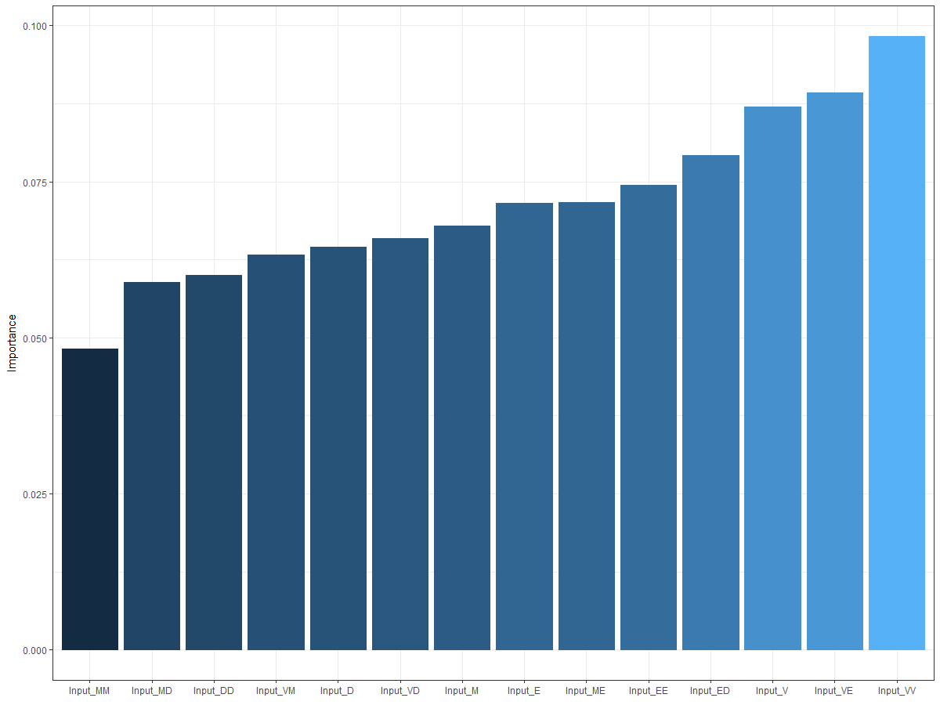
MLP with Random Chosen Training Data

Slide 22
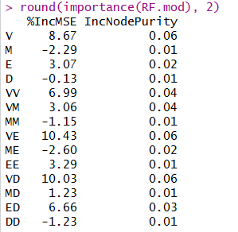
Random Forest (2)

Slide 23
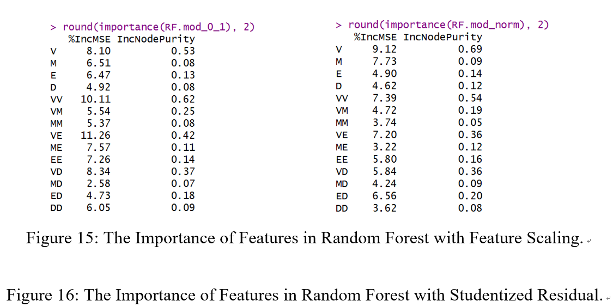
Original Result of Random Forest

Slide 24
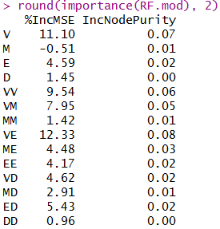
Random Forest with Random Chosen Training Data

Slide 25
Mean Squared
Error

Slide 26
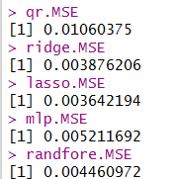
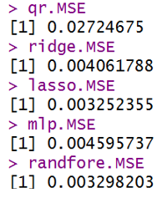
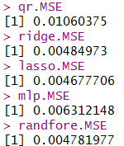
MSE (2)
Original MSE
MSE (Random)

