Slide 1


PowerShell Course
PowerShell is your friend…

Slide 2
Content
Introduction / Basics
What is Git/Github/Gitlab
Datatypes / Hashtables / Lookuptables
Everything is an object-philosophy
PsCustomObjects
The many ways of creating PS Objects (and the «correct» one )
Make better (robust) PowerShell functions
ValidateSet
ValidateScript
«Showcase»

Slide 3
Introduction (Prerequistes)
Your local workplace has (hopefully) PowerShell already installed
PowerShell ISE is working
(VS Code recommended, but not required)
For those with VS Code, Install VS Code LiveShare extension and follow me within your VSCode session.
Or click the link and open in VSCode Web
https://prod.liveshare.vsengsaas.visualstudio.com/join?2AC513F7843BECD0CDA8FEDE24A0CD06E18D

Slide 4
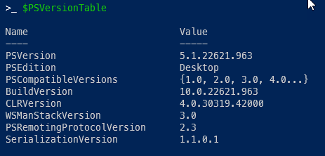
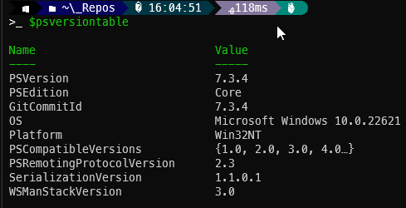
Introduction
WindowsPowerShell = 5.1
Runs only under Windows
SfB requires WindowsPowerShell
PowerShell (Core) = 6/7
Runs on «anything»
The future of PowerShell
MS Cloud modules «prefer» Core

Slide 5
Introduction – Get-Help

Slide 6

Git vs GitHub vs GitLabs vs Bitbucket vs… I
Git ist ein Versionskontrollsystem, das Programmierern hilft, Änderungen an ihrem Code zu verfolgen. Es ermöglicht mehrere Personen, gleichzeitig an demselben Projekt zu arbeiten, ohne sich gegenseitig in die Quere zu kommen. Mit Git kann man:
Änderungen verfolgen: Sie sehen, wer was und wann geändert hat.
Versionen verwalten: Sie können verschiedene Versionen Ihres Projekts speichern und bei Bedarf zu einer früheren Version zurückkehren.
Zusammenarbeiten: Mehrere Entwickler können gleichzeitig am selben Projekt arbeiten.
cwanized/PowerShellAcademy · GitHub
master
3.x.x.x
fb-xxx
integration
master-next-rel
master-next-rel
fbNR-xxx
fbNR-xxx

Slide 7

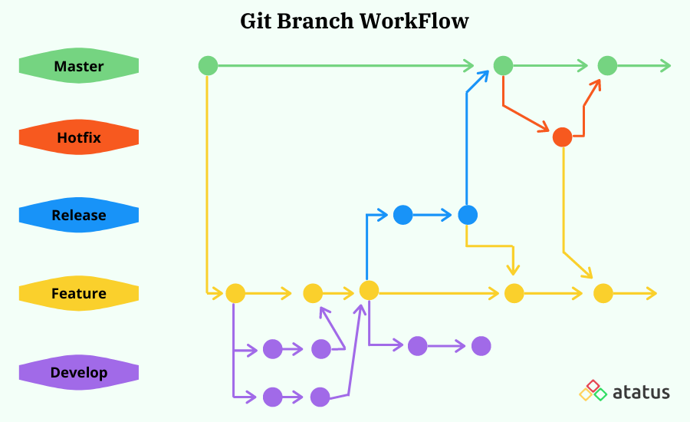
Git vs GitHub vs GitLabs vs Bitbucket vs… II
Git clone
mainbranch
main
s001
s002
Git merge / pull request
s003
Git pull
s…
Git push
s010
Git commit
featurebranch; developerbranch

Slide 8
PsCustomObjects

Slide 9
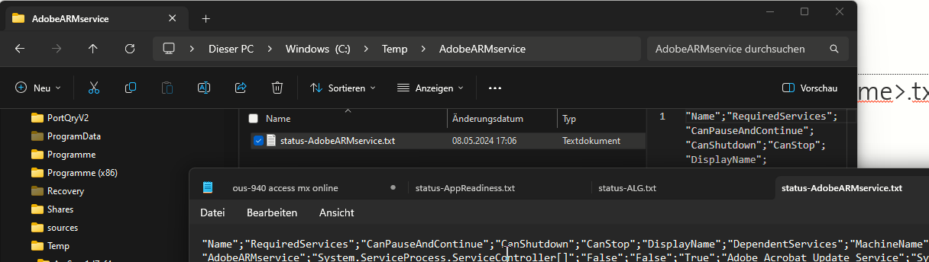
Excercise
Create a script:
that creates for <n> services a sep. folder called <ServiceName>.
In this folder, create a status-<ServiceName>.txt File
that contains details of the corresponding service

Slide 10
Showcase
XmlHandler
Dynamicparamters
PhSM
Splatting / logging
MccSfBBlueprint.json

Slide 11
Document information
Doc ID |  | <…>
Classification |  | <…>
Scope of application |  | <…>
Document owner |  | <…>
Version |  | 0.1
Issue date |  | <…>
Status |  | <…>
Valid from |  | <…>
Valid until |  | <…>
File location |  | <…>
Document Name |  | <…>
Document Subject |  | <…>
Update interval |  | <…>
Archiving |  | <…>

Slide 12
Document pointers
Change control
Version |  | Date |  | Changed by |  | Remarks/Nature of the change
<...> |  | <...> |  | <...> |  | <...>
Checking
Version |  | Date |  | Changed by |  | Remarks/Nature of the change
<...> |  | <...> |  | <...> |  | <...>
Release
Version |  | Date |  | Changed by |  | Remarks/Nature of the change
<...> |  | <...> |  | <...> |  | <...>

Slide 13
Contact information
Company Name Organisation Unit First Name and Surname Street and Number Postal code and City
Phone Mobile Email

