Slide 1
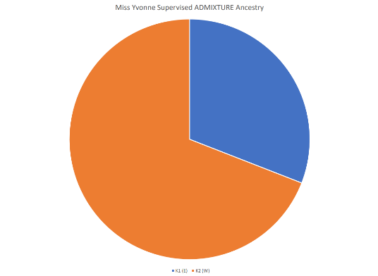
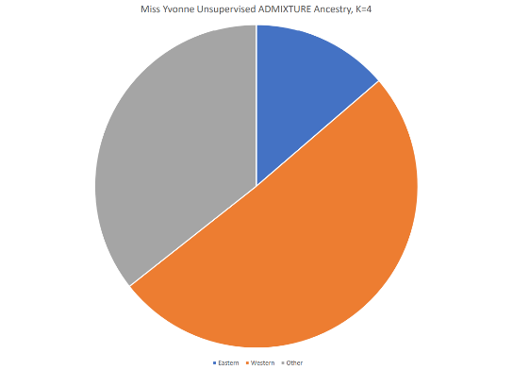
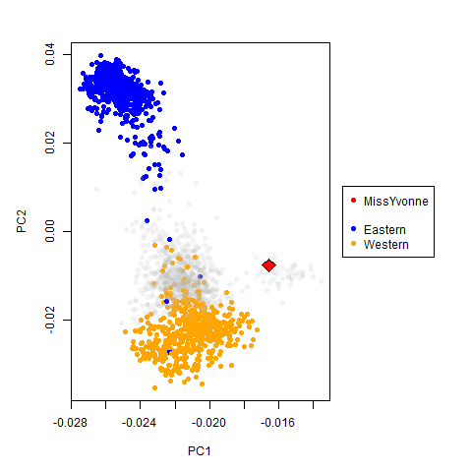
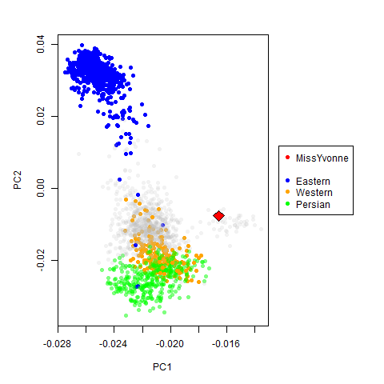
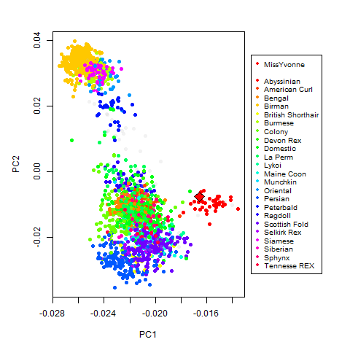
Raw basepaws Re-Analysis (from ~15x WGS)
A.
ADMIXTURE Settings | Eastern | Western
Unsupervised (K=2) | 34% | 66%
Supervised (K=2) | 31% | 69%
Unsupervised (K=4) | 14% | 51%
B.
While hard to see, the outlier in the 20+ cat breeds is Abyssinian
There is still some room for improvement, since I only figured out how to map ~20k of ~60k probes (for reference set)

