Slide 1

About the Presentations
The presentations cover the objectives found in the opening of each chapter.
All chapter objectives are listed in the beginning of each presentation.
You may customize the presentations to fit your class needs.
Some figures from the chapters are included. A complete set of images from the book can be found on the Instructor Resources disc.
©2016. Cengage Learning. All rights reserved.

Slide 2
Oracle 12c: SQL
Chapter 8
Restricting Rows and Sorting Data
©2016. Cengage Learning. All rights reserved.

Slide 3
Objectives
Use a WHERE clause to restrict the rows returned by a query
Create a search condition using mathematical comparison operators
Use the BETWEEN…AND comparison operator to identify records within a range of values
Specify a list of values for a search condition using the IN comparison operator
©2016. Cengage Learning. All rights reserved.

Slide 4
Objectives (continued)
Search for patterns using the LIKE comparison operator
Identify the purpose of the % and _ wildcard characters
Join multiple search conditions using the appropriate logical operator
Perform searches for NULL values
Specify the order for the presentation of query results using an ORDER BY clause
©2016. Cengage Learning. All rights reserved.

Slide 5
WHERE Clause Syntax
A WHERE clause is used to retrieve rows based on a stated condition
Requires:
  Column name
  Comparison operator
  Value or column for comparison
Values are case sensitive
©2016. Cengage Learning. All rights reserved.

Slide 6
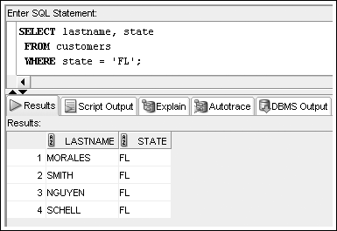
WHERE Clause Example
List WHERE clause after FROM clause
Enclose nonnumeric data in single quotes
©2016. Cengage Learning. All rights reserved.

Slide 7
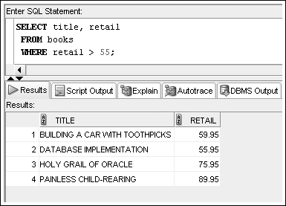
Comparison Operators
Indicate how the data should relate to the given search value
©2016. Cengage Learning. All rights reserved.

Slide 8
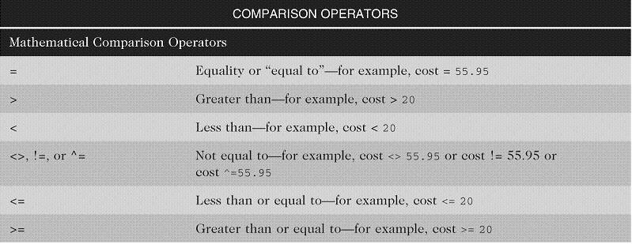
Arithmetic Comparison Operators
©2016. Cengage Learning. All rights reserved.

Slide 9
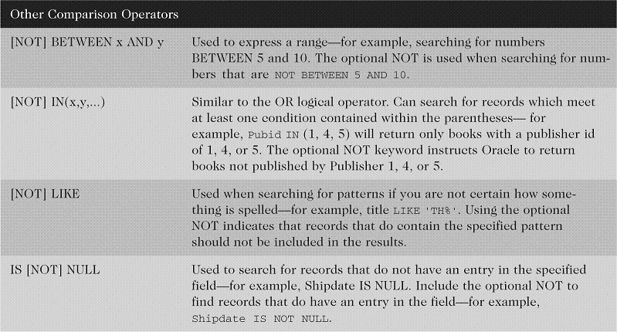
Other Comparison Operators
©2016. Cengage Learning. All rights reserved.

Slide 10
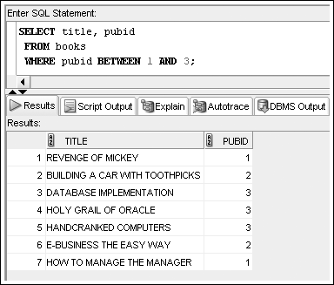
BETWEEN…AND Operator
Finds values in a specified range
©2016. Cengage Learning. All rights reserved.

Slide 11
IN Operator
Returns records that match a value in a specified list
List must be in parentheses
Values are separated by commas
©2016. Cengage Learning. All rights reserved.

Slide 12
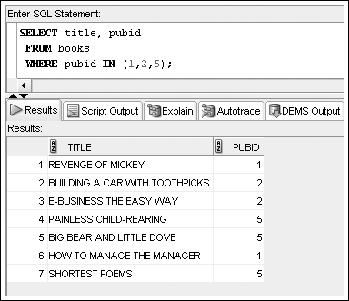
IN Operator Example
©2016. Cengage Learning. All rights reserved.

Slide 13
LIKE Operator
Performs pattern searches
Used with wildcard characters
  Underscore (_) for exactly one character in the indicated position
  Percent sign (%) represents any number of characters
©2016. Cengage Learning. All rights reserved.

Slide 14
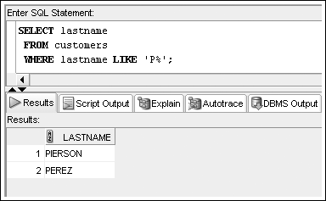
LIKE Operator Example
©2016. Cengage Learning. All rights reserved.

Slide 15
Logical Operators
Used to combine conditions
Evaluated in order of NOT, AND, OR
  NOT – reverses meaning
  AND – both conditions must be TRUE
  OR – at least one condition must be TRUE
©2016. Cengage Learning. All rights reserved.

Slide 16
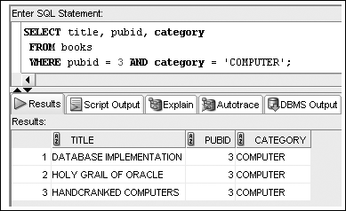
AND Logical Operator Example
©2016. Cengage Learning. All rights reserved.

Slide 17
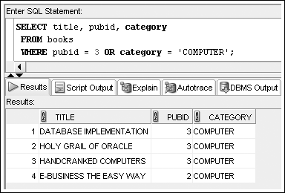
OR Logical Operator Example
©2016. Cengage Learning. All rights reserved.

Slide 18
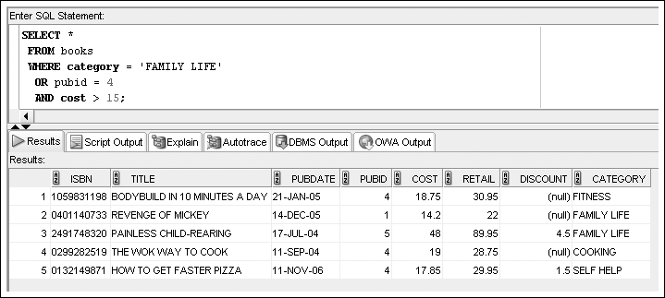
Multiple Logical Operators
Resolved in order of NOT, AND, OR
©2016. Cengage Learning. All rights reserved.

Slide 19
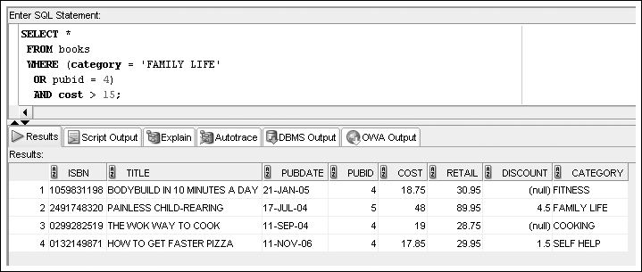
Multiple Logical Operators
Use parentheses to override the order of evaluation
©2016. Cengage Learning. All rights reserved.

Slide 20
Resolving Multiple Types of Operators
Arithmetic operators
Comparison operators
Logical operators
©2016. Cengage Learning. All rights reserved.

Slide 21
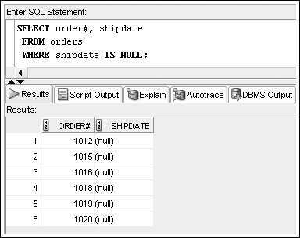
Treatment of NULL Values
Absence of data
Requires use of IS NULL operator
©2016. Cengage Learning. All rights reserved.

Slide 22
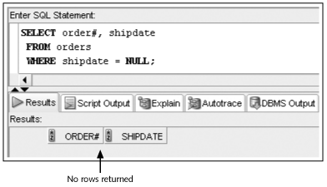
Treatment of NULL Values (continued)
A common error is using = NULL, which does not raise an Oracle error but also does not return any rows
©2016. Cengage Learning. All rights reserved.

Slide 23
ORDER BY Clause Syntax
The ORDER BY clause presents data in sorted order
Ascending order is default
Use DESC keyword to override column default
255 columns maximum
©2016. Cengage Learning. All rights reserved.

Slide 24
ORDER BY Clause Syntax
Sort Sequence
In ascending order, values will be listed in the following sequence:
  Numeric values
  Character values
  NULL values
In descending order, sequence is reversed
©2016. Cengage Learning. All rights reserved.

Slide 25
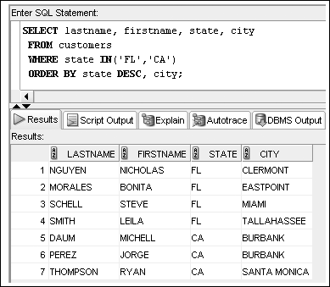
ORDER BY Example
©2016. Cengage Learning. All rights reserved.

Slide 26
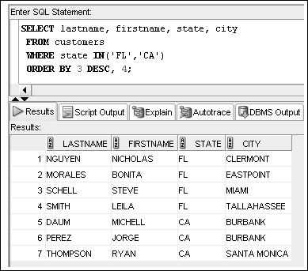
ORDER BY Can Reference
Column Position
©2016. Cengage Learning. All rights reserved.

Slide 27
Summary
The WHERE clause can be included in a SELECT statement to restrict the rows returned by a query to only those meeting a specified condition
When searching a nonnumeric field, the search values must be enclosed in single quotation marks
Comparison operators are used to indicate how the record should relate to the search value
The BETWEEN...AND comparison operator is used to search for records that fall within a certain range of values
©2016. Cengage Learning. All rights reserved.

Slide 28
Summary (continued)
The LIKE comparison operator is used with the percent and underscore symbols (% and _) to establish search patterns
Logical operators such as AND and OR can be used to combine several search conditions
When using the AND operator, all conditions must be TRUE for a record to be returned in the results
  However, with the OR operator, only one condition must be TRUE
A NULL value is the absence of data, not a field with a blank space entered
©2016. Cengage Learning. All rights reserved.

Slide 29
Summary (continued)
Use the IS NULL comparison operator to match NULL values; the IS NOT NULL comparison operator finds records that do not contain NULL values in the indicated column
You can sort the results of queries by using an ORDER BY clause; when used, the ORDER BY clause should be listed last in the SELECT statement
By default, records are sorted in ascending order; entering DESC directly after the column name sorts the records in descending order
A column does not have to be listed in the SELECT clause to serve as a basis for sorting
©2016. Cengage Learning. All rights reserved.

