Slide 1
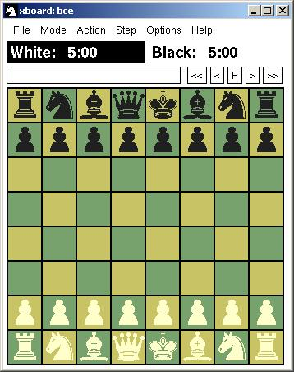
BACE
Bowron – Abernethy Chess Engine
Christopher Bowron
Rob Abernethy

Slide 2
Problem
Create an agent that is capable of playing chess
  Learns importance of board features
  Search through possible moves efficiently

Slide 3
Solution
BACE
Search
  Alpha-Beta
  NegaScout
Learning
  TD(λ)
  TDLeaf

Slide 4
NegaScout
Null window search
Full search when necessary
int NegaScout ( position p; int alpha, beta )
{
int a, b, t, i;
determine successors p_1,...,p_w of p;
if ( w == 0 )
return ( Evaluate(p) ); /* leaf node */
a = alpha;
b = beta;
for ( i = 1; i <= w; i++ )
{
t = -NegaScout ( p_i, -b, -a );
if (t > a) && (t < beta) && (i > 1) && (d < maxdepth-1)
a = -NegaScout ( p_i, -beta, -t ); /* re-search */
a = max( a, t );
if ( a == beta )
return ( a ); /* cut-off */
b = a + 1; /* set new null window */
}
return ( a );
}

Slide 5
TDLeaf
Modified TD(λ) algorithm
Temporal differences based on leaf nodes
Updates weights of features in evaluation function

Slide 6
Evaluation Features
Material
Position
  Each piece has an associated array of values for each possible square
Other
  ~15 features such as castling, king tropism, pawn structure, mating material, rook on open file, etc.

Slide 7
Experiments
Self play for testing purposes
Online Chess Server Play
  fics.org (free internet chess server)
  5 minute Blitz games
  About 200 games in a 24 hour period

Slide 8
Results
Improved rating from ~1300 to ~1600
Peaked at 1666

Slide 9
Conclusions
Achieved class-B level playing ability where class-A level is 1800 to 2000 and master level corresponds to ratings above 2000
Temporal difference learning was successful, but limited by small set of evaluation features

Slide 10
Future Work
Move positional arrays into learned weights
Add evaluation features
Learn book opening strengths
Try different time controls

Slide 11
Related Work
TD-Gammon
KnightCap
  Learning to Play Chess using Temporal Differences. Baxter, et al.
Samuel’s Checkers
Sutton
  Learning to Predict by the Methods of Temporal Differences

