Slide 1
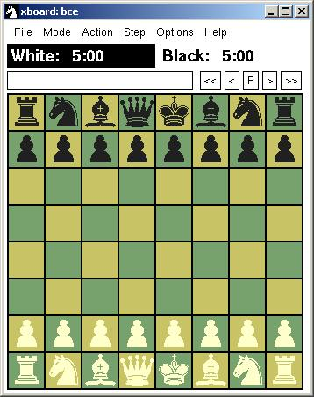
BACE
Bowron – Abernethy Chess Engine
Christopher Bowron
Rob Abernethy

Slide 2
Domain
Chess
  Accessible
  Deterministic
  Non-Episodic
  Semi-Static
    Clock changes while thinking
  Discrete

Slide 3
AI Methods
Searching
  Alpha Beta Search
  Negascout Search (modified alpha-beta with null window)
Learning
  Learn Evaluation Weights
  Learn Book Utility

Slide 4
Experiments
Self Play
Online Chess Server Play
  fics.org (free internet chess server)
Historical Games
Various time controls

Slide 5
Schedule
Basic Chess Engine
Advanced Search (NegaScout)
Learn from self play
Learn from playing others
  Connect to chess server
Learn from historical games
  Obtain game lists
Book Learning
  Record book history

