Slide 1

Data challenge Phase I
To change cover image:
- In the menu: View / Master
- Click on the image center and delete it
- Insert new image and send it to back
- Position it and crop it to fit the shape
(WBL covers & slides available below and in the master)

Slide 2
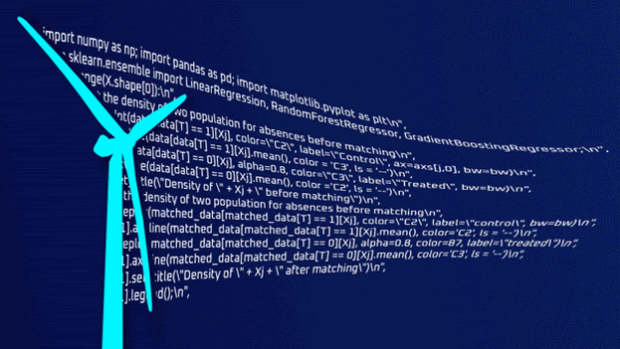
Contents
Hypothesis
Features
Models
Performance
Future directions
https://datascience.total.com/fr/challenge/18/details#tab_brief78
Notes:
Healthcare marketer starting data science
Read up on wind farms
Missing data - geography, weather, number of turbines, consumption,..
Vianney presentation inspired to make simple hypotheses

Slide 3
1
Hypothesis

Slide 4
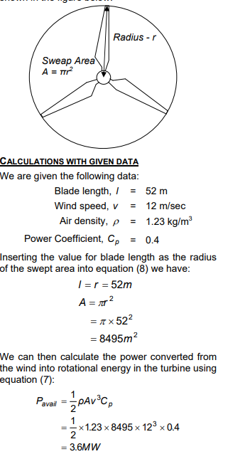

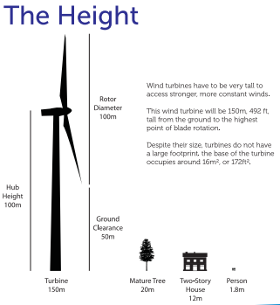
Power approximation
Assumptions
Blade length l = 52m,
Area = 𝛑l²
Air density ⍴ = 1.23 kg/m³
Power coefficient C_{p}= 0.4
Formula
Power = ½ ⍴Aws³ C_{p}
To place an image:
- Click on the grey shape
- Select “replace image”
- Insert new image
- Double click on it to position it and crop it to fit the shape
https://www.raeng.org.uk/publications/other/23-wind-turbine
http://www.scotianwindfields.com/sites/default/files/publications/135-projectdetailsoutlines.pdf
Notes:
Anatomy of a wind turbine 150m tall, 100m diameter
Power = work / time
Work = force * displacement
Force = mass * acceleration
Acceleration = velocity / time
v2=v02+2ad
Density = mass / volume
Kinetic energy = ½ mV2
Max power coefficient (betz) = 0.6, but in reality Betz Limit with values of 0.35-0.45

Slide 5
2
Features

Slide 6
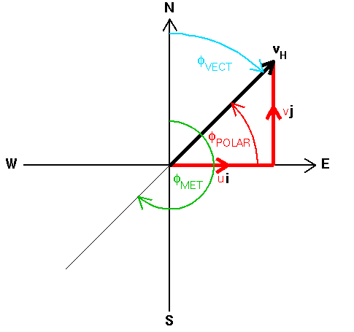
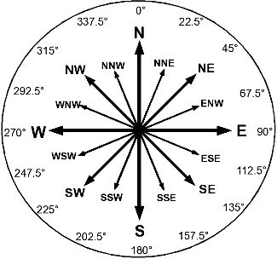
Harnessing wind speed, direction & vector components
Wind Speed
@ 100m height (+25%)
Vector components: u, v & products,...
Vertical velocity
Wind Direction
Degrees encoded:
to cardinal directions,
N-S & E-W components
Wind Vector Azimuth
Meteorological Wind Direction
Relative Wind Direction
http://tornado.sfsu.edu/geosciences/classes/m430/Wind/WindDirection.html

Slide 7



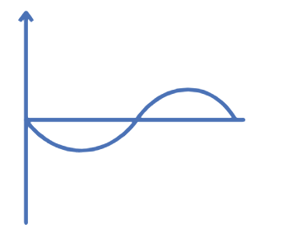
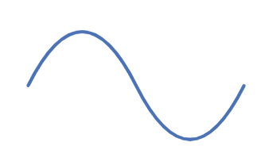
Capturing signals from datetime elements
Datetime features
Hour, day, week, month, year, quarter, ..
Day of year, day of week, …
Seasons
Four seasons encoded
Multiplicative & additive seasonal decomposition encoded
Sin & Cos values
@ various time-stamps
http://tornado.sfsu.edu/geosciences/classes/m430/Wind/WindDirection.html

Slide 8



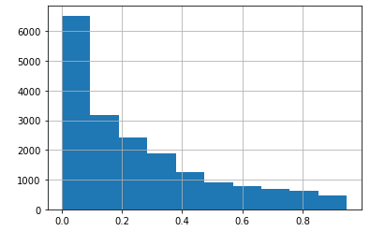


Calculations & approximations
Z-scores:
Wind speed, direction & vectors
q_cuts:
Wind speed cut into quartiles
Ratios & multiplications
Wind speed / mean, u*v, ws³
Averages: hourly, daily, weekly, quarterly,..
Approximations
Wind Power = ws³*𝞹*r²*½
Wind Gust = hourly difference with previous wind speed
Wind Intensity = wind speed standard deviation / wind speed
http://tornado.sfsu.edu/geosciences/classes/m430/Wind/WindDirection.html

Slide 9
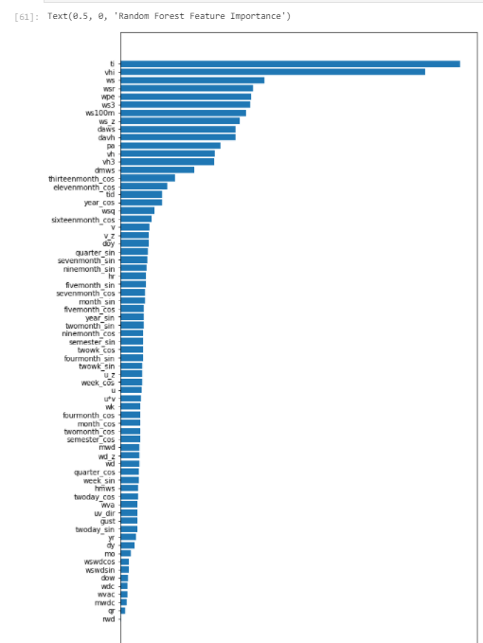
Feature importance - Random Forest

Slide 10
3
Models

Slide 11
Models
First approach:
Linear Regression
Random forest
XGBoost
Light GBM
BaggingRegressor

Slide 12
4
Performance

Slide 13
Performance
Measured on a subset of 70 most impactful features
Results deteriorated outside of this range of features
 | Random Forest | XGBoost | LightGBM | Bagging Regressor
MAE | 0.067 | 0.072 | 0.068 | 0.077

Slide 14
5
Future directions

Slide 15
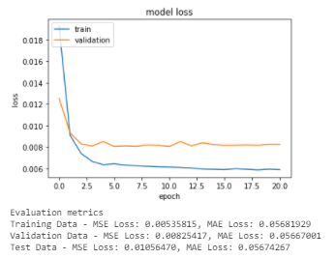
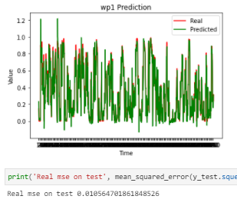
Future directions
Statistical methods:
ARIMA, SARIMAX, PROPHET
Neural Networks:
LSTM,
RNN, NN with message passing, CNN with dilation
Combined statistical, ML & NN models
Interpolation for missing hours
Additional data:
Geographic coordinates, number of turbines, local weather forecasts, local energy consumption

Slide 16
Thank you.
To change image:
- In the menu: View / Master
- Click on the image and delete it
- Insert new image and send it to back
- Position it and crop it to fit the available space

Slide 17
6
Appendix

Slide 18
Recap - Phase I
Features
Wind direction degrees → cardinal direction encoding
Wind speed vector decomposition (WVA, MWD)
Datetime sin, cosine & seasonal decomposition
Theoretic wind power calculation
Wind intensity (gusts)
Models
XGBoost, Random Forest
Performance
0.067 MAE on train and validation sets
Future directions
LSTM, CNN, RNN, NN w/ message passing, CNN w/ dilation, SARIMA, PROPHET, combined models, Interpolation for missing times
To place an image:
- Click on the grey shape
- Select “replace image”
- Insert new image
- Double click on it to position it and crop it to fit the shape

Slide 19

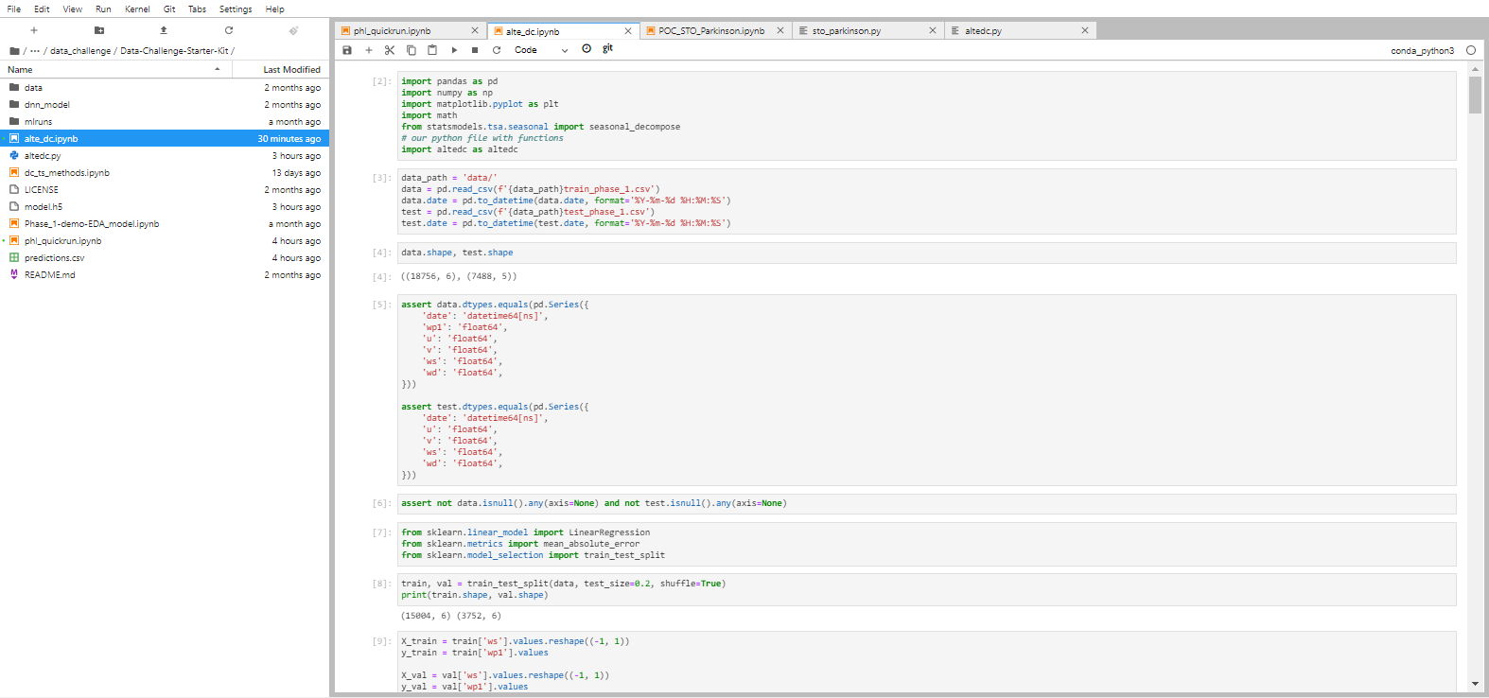
Code organization - Jupyter notebook main code
https://git.apps.airliquide.com/Christopher.CALA/Data-Challenge-Starter-Kit/-/commit/9419a8d6cb321636291759e3056944a79220a22f

Slide 20
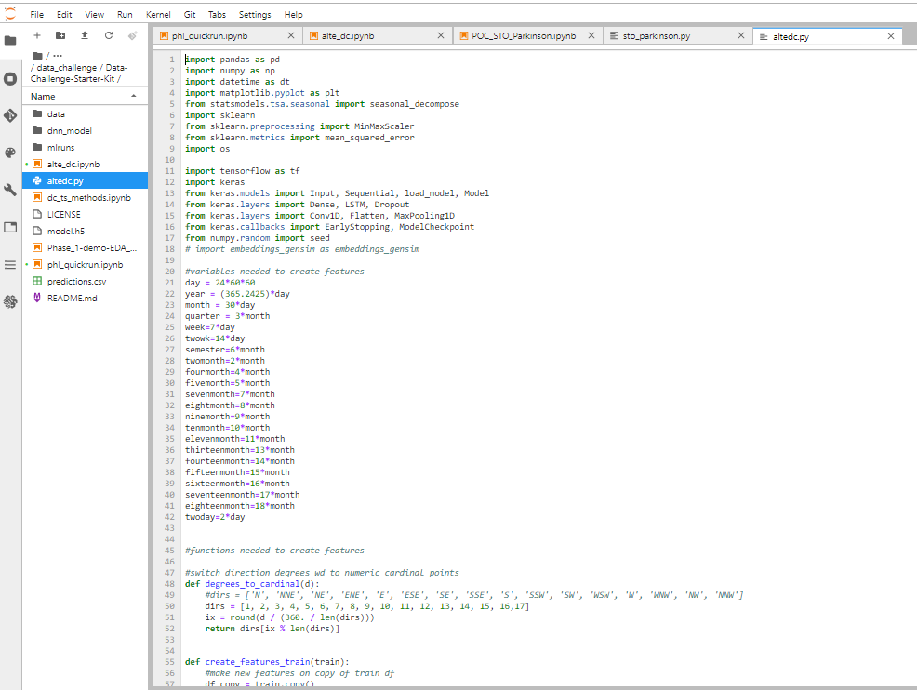
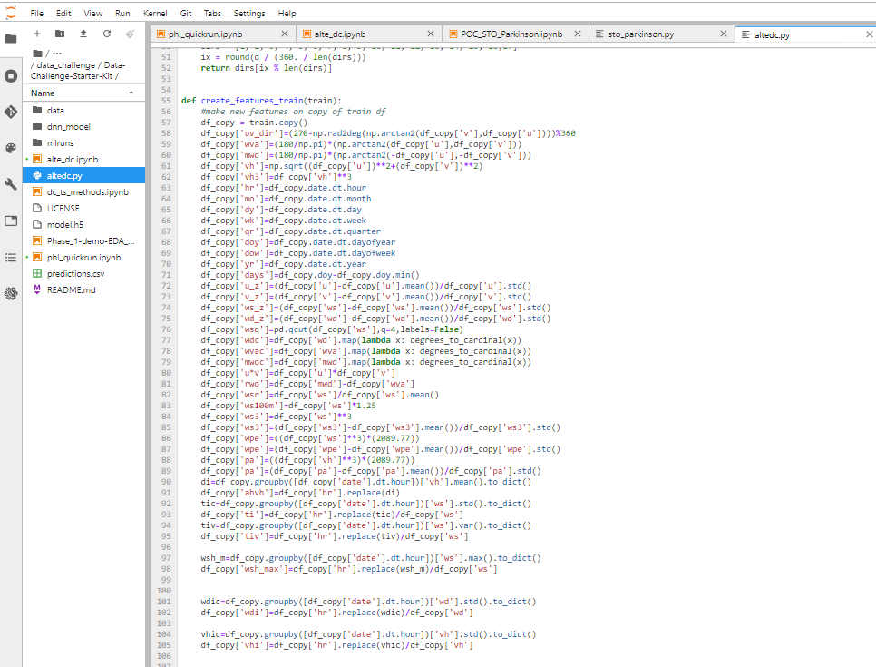
Code organization - call python script for functions
https://git.apps.airliquide.com/Christopher.CALA/Data-Challenge-Starter-Kit/-/commit/9419a8d6cb321636291759e3056944a79220a22f

Slide 21
Practical tools for teamwork
Sharing & versioning code
Github/Gitlab (https://github.com/)
Codeshare.io (https://codeshare.io/)
Google Colab (https://research.google.com/colaboratory/)
Durable chat
Slack (https://slack.com/)
Discord (https://discord.com/)

Slide 22
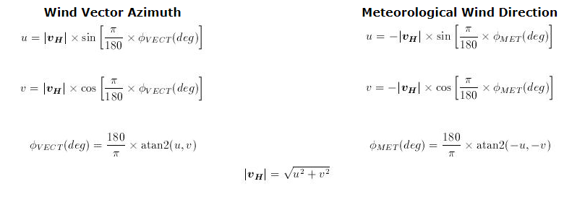
Wind Vector Azimuth & Direction

