Slide 1
Breast Cancer Classification
Chris Comiskey
Anchormen Assessment

Slide 2
Overview
The Data
A Random Forest Model
Fit
Results
Comments
Model Comparison Mini-Study
Summary and Next Steps

Slide 3
SNP Genetic Dataset
Overview
Using categorical genetic markers to predict breast cancer classifications
Particulars
157 observations (patients)
3 level categorical response (breast cancer types)
12180 covariates — genetic characteristics
3045 categorical variables — gene variations, each inferred from trio of numeric variables
9135 numeric variables — groups of three associated with a categorical gene variant variable (9135/3 = 3045 cat. vars)

Slide 4
SNP Genetic Dataset
Noteworthy characteristics
# covariates >> # observations
Response: categorical
Covariates: categorical and numeric
Empirical probability of each/all response categories is approximately 1/3
Question: do the 9135 numeric predictors contain same information as 3045 categorical predictors?
I assume “yes” for this study.
Keep in mind
Overfitting is a concern
Model fitting decisions
Response: [n x 1] categorical vs. [n x 3] numeric indicators
Covariates: [n x 3045] categorical vs. [n x 9135] numeric vs. [n x 9135] numeric indicators

Slide 5
A Random Forest Model
Random forest — favorable option, ensemble method combats overfitting
Method: randomly select covariate subsets, fit decision tree, iterate, average over tree predictions for model prediction
Setup: categorical response, categorical covariates
[155 x 1] ~ [155 x 3145]
Response: factor with three levels
Use R, and randomForest::randomForest()

Slide 6
Fitting the Model
Randomly split into training (140 obs) and test sets (15 obs)
Choose algorithm parameters, including iterative covariate sample size (mtry) and total number of trees fit (ntree)
Fit model in R:
randomForest(class ~ ., data = train, importance = TRUE, mtry = 100, ntree = 500)
Assess fit via prediction success/error on test set
Assess variable importance

Slide 7
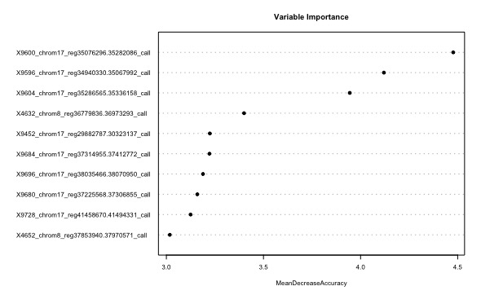
Results
set.seed(101513), for reproducibility
Model fit prediction success probability: 0.867
mean(predict(rf, newdata = test) == Ytest$class)
Most Important Covariates (by MDA)
0.00326 X9676_chrom17_reg37087569.37217581_call
0.00283 X9680_chrom17_reg37225568.37306855_call
0.00262 X4632_chrom8_reg36779836.36973293_call
0.00233 X9728_chrom17_reg41458670.41494331_call
0.00225 X9684_chrom17_reg37314955.37412772_call

Slide 8
Model Interpretation
Ensemble method — challenging to interpret
LIME — an option for local (to an obs.) interpretation
(Locally Interpretable Model-agnostic Explanations)
Three steps in R
Fit model with caret::train()
Create “explainer” with lime::lime()
Create “explanation” with lime::explain()

Slide 9
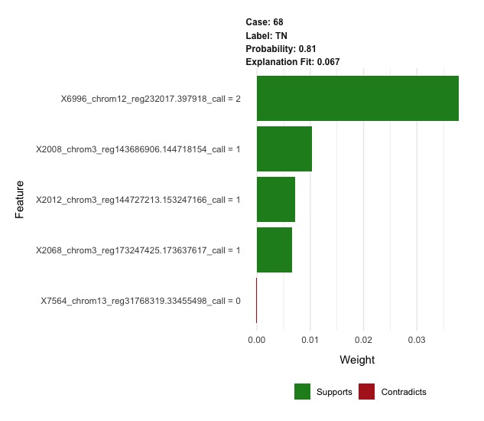
LIME
e.g. observation 68
Local explanation
Top five covariates shown
e.g. X6996 = 2 indicates TN

Slide 10
Comments
Prediction
One train/test sample and fit tells very little
Repeating the train/test sample procedure would yield more insight
Wrap sample-fit-predict procedure into function f()
For 20 iterations: mean(replicate(20, f())) = 0.64
Success rate of 0.64 — more accurately reflects method effectiveness (more iterations ideally)
“Important” Covariates
One train/test iteration tells little
Key is covariate performance persistence across iterations, w.r.t. variable importance measures (VIMs)
Across repeated random train/test splits, do the covariate relative VIM ranks remain similar?
i.e. do “important” covariates tend to stay that way across repeated random train/test splits?
To test, collect ranks across iterations and calculate Spearman rank correlation coefficient

Slide 11
Toy Comparison Study
Four methods/functions:
Multinomial partial least squares: multinom.spls()
Random forest: randomForest()
Neural net: neuralnet()
Support vector machine: ksvm()
Used defaults for all algorithm parameters
15 iterations:
(i) random train/test split
(ii) fit four models
(iii) make four sets of predictions
(iv) record four method-success rates

Slide 12
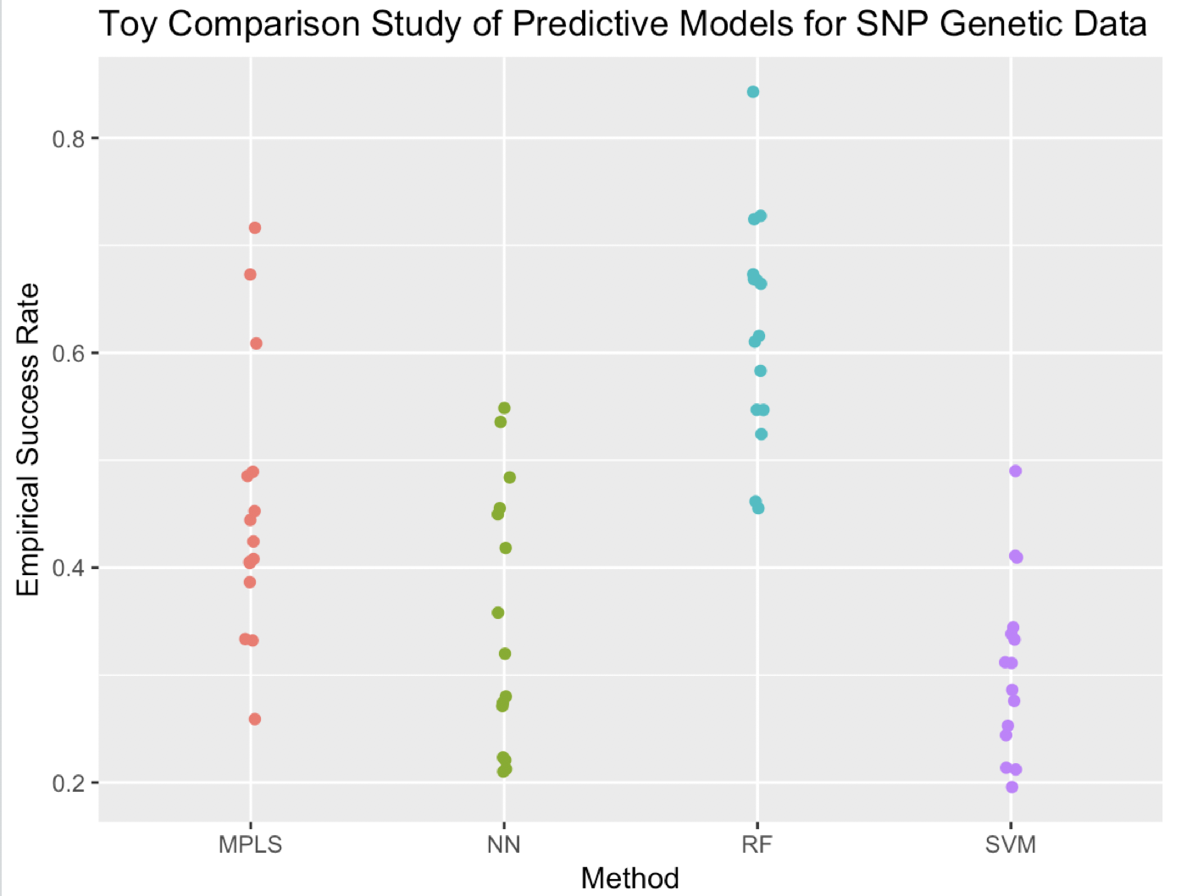
Toy Study Results
Mean Success Rates
MPLS: 0.453
NN: 0.342
RF: 0.622
SVM: 0.307

Slide 13
Summary
Challenging dataset
Random forest model seems to perform well
Ensemble methods make interpretation difficult, LIME provides local “explanations”
Spearman rank correlation coefficient to establish covariate performance persistence
Toy comparison study suggests random forest approach compares quite favorably to alternatives

Slide 14
Next Steps
Hire Chris.
Expand literature review.
Examine approaches in greater depth; e.g. changes in algorithm parameters, changes in train/test split ratio, etc.
True comparison study.

Slide 15
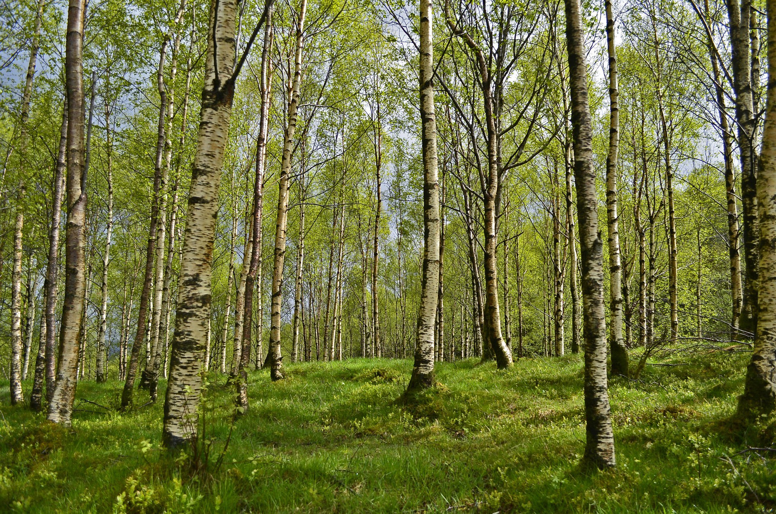
Thanks!

