Slide 1
Features for clustering
Start with 14 features per transaction (~13 million):
'article_number’, 'gross_demand_quantity’, 'sold_qty’, 'net_qty’,
'gross_sales_gross_disc_net_ret’, 'gross_sales_net_disc_gross_ret’,
'net_sales', 'total_markdown’, 'temporary_markdown', 'permanent_markdown’,
'employee_markdown', 'fraction_of_full_price', 'markdown', 'sale’
Then for each article (~14000) calculate:
minimum, median, mean, maximum, standard deviation, and sum

Slide 2
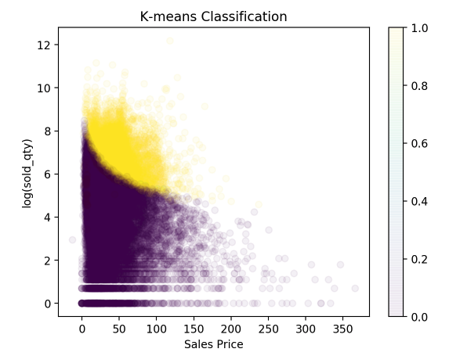
K-means clustering
K-means algorithm yields:
37436 ’basic’ articles
9136 ‘non-basic’ articles
This plot: log(sold_qty) vs. sale_price
Puple = ‘basic’ articles
Yellow = ‘non-basic’ articles
Second method, agglomerative clustering
Supports k-means results
~92% agreement between methods

Slide 3
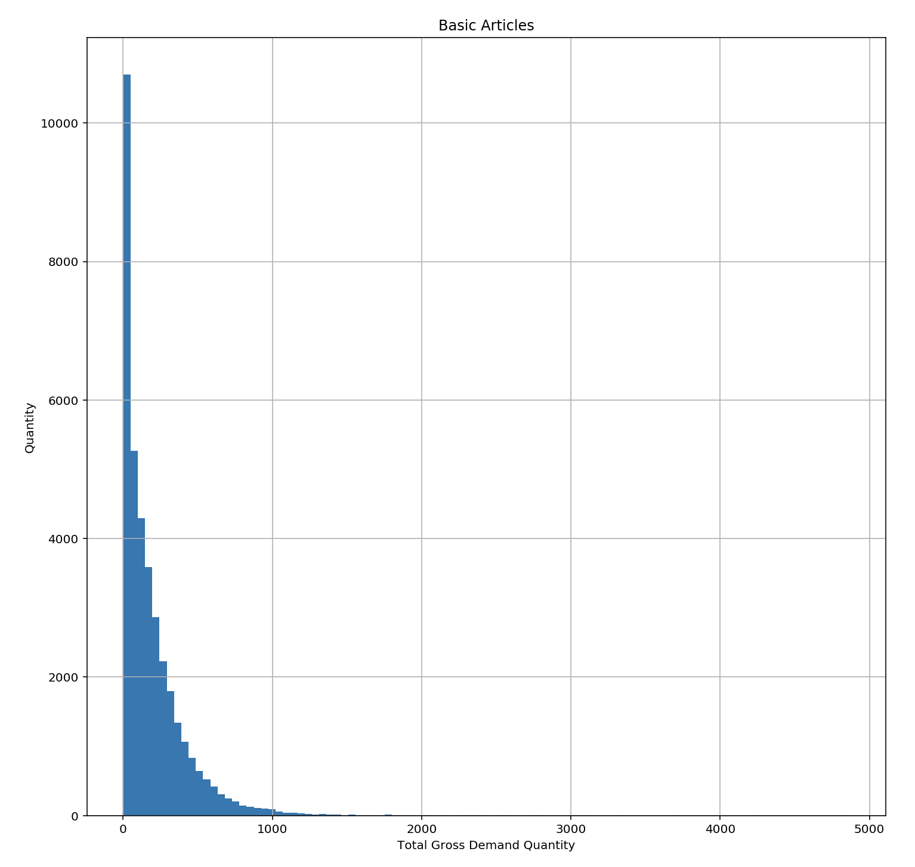
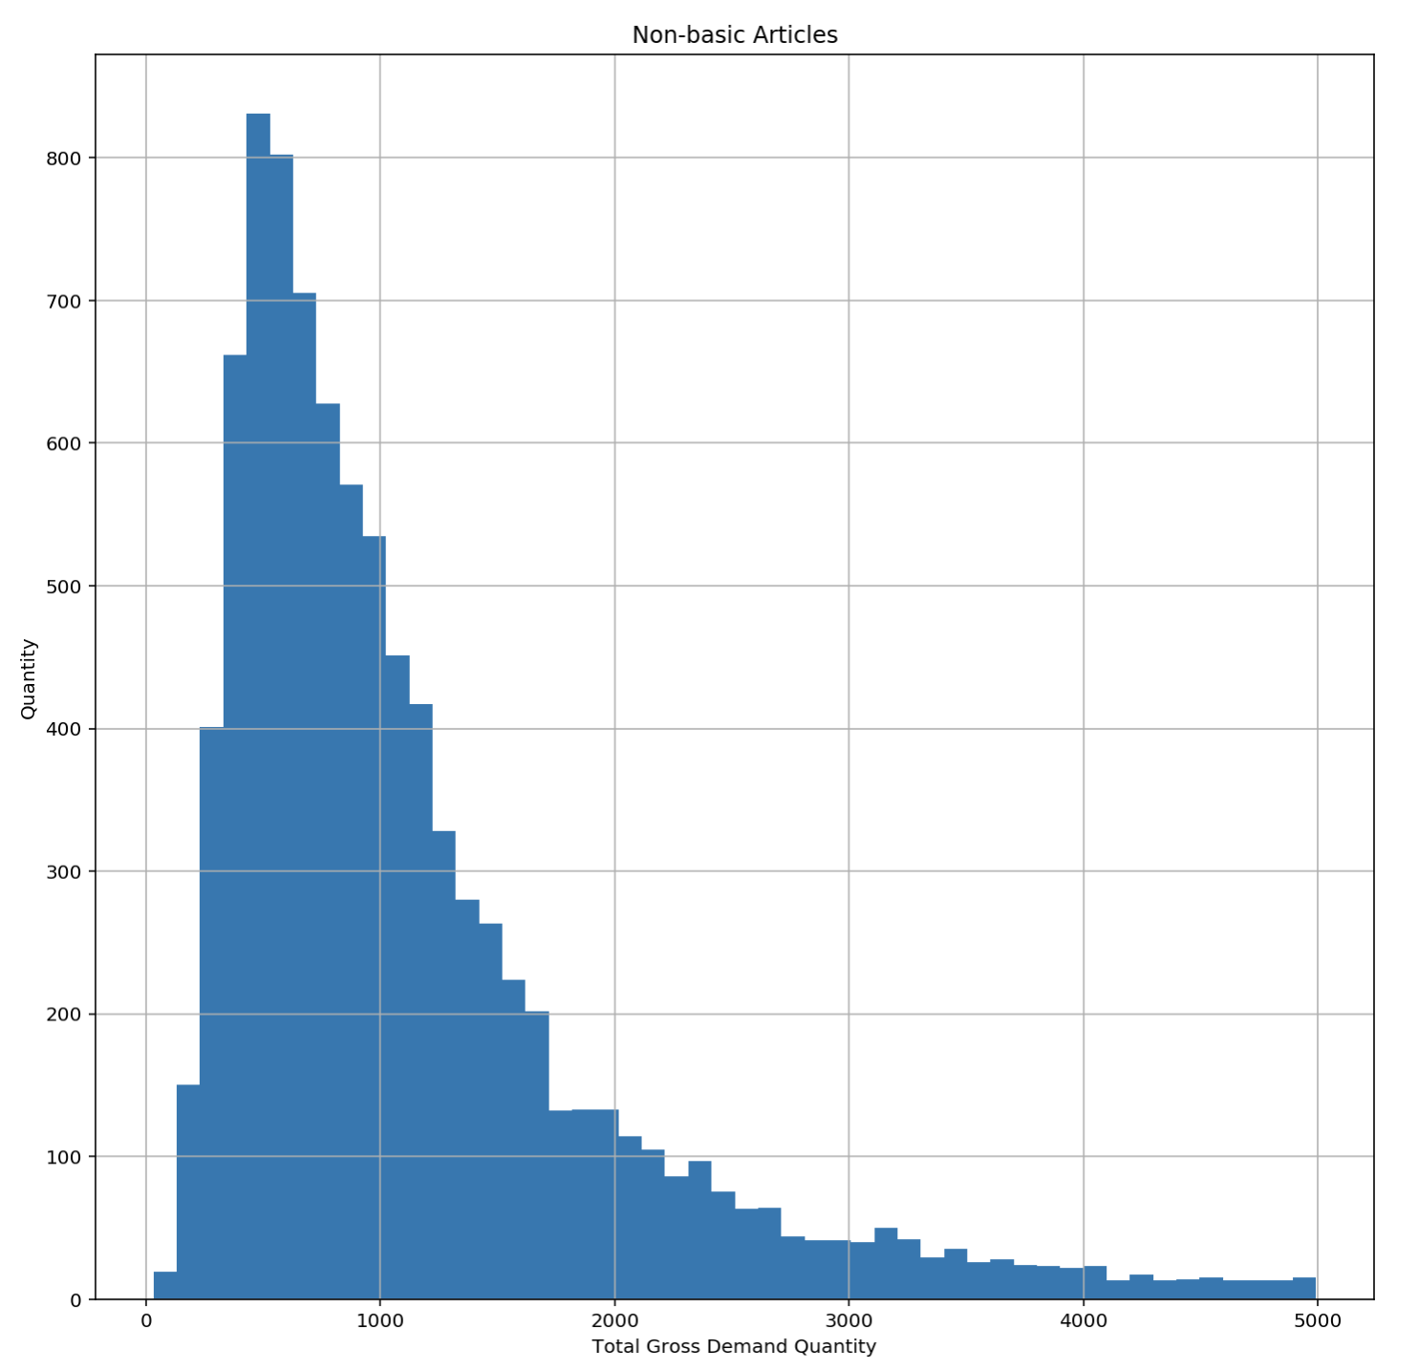
Basic vs. Non-Basic gross_Demand_quantity
gross_demand_quantity – units of requested orders (before cancellations
Histograms show distribution of article total orders
‘basic’ article order totals are lower than ‘non-basic’ average order totals

Slide 4
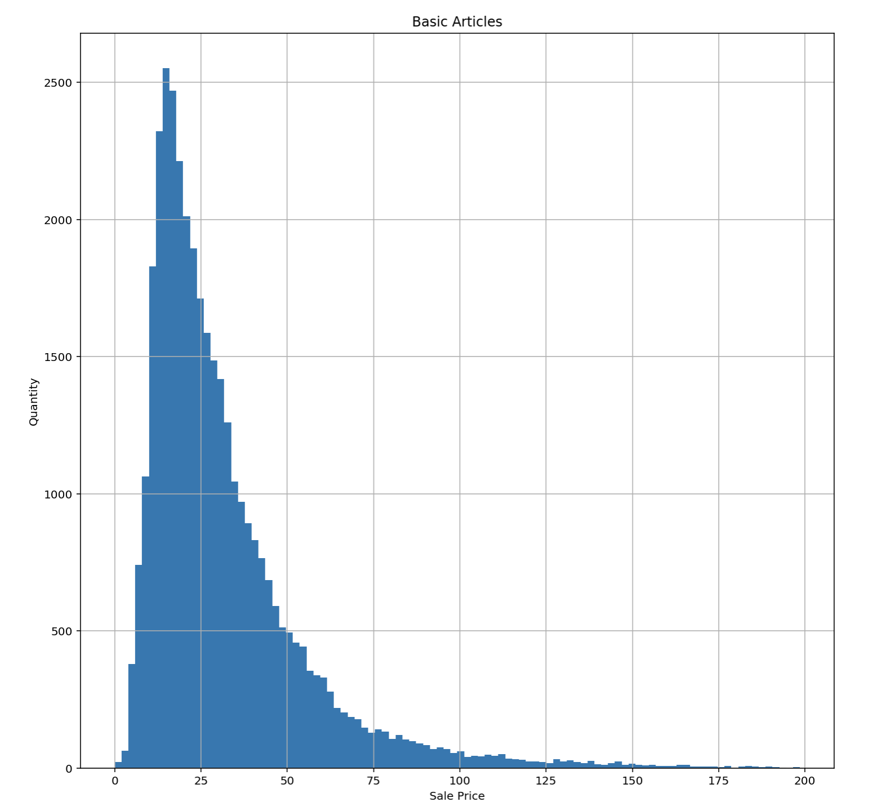
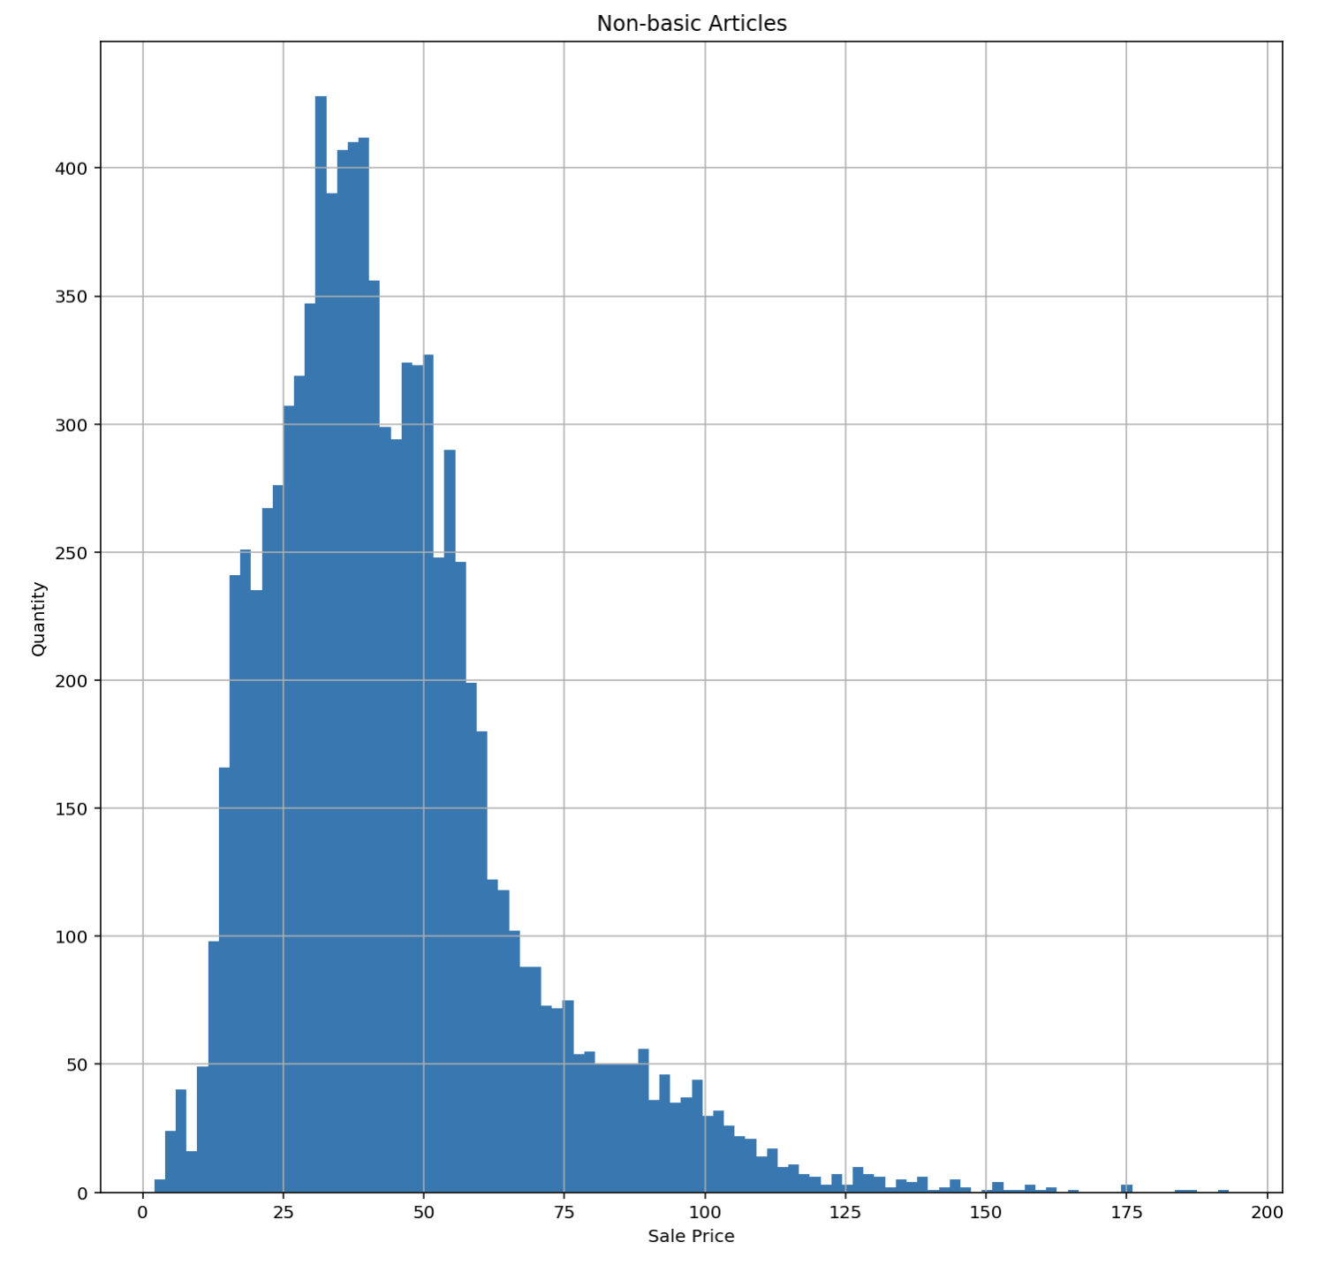
Basic vs. non-basic Article sale price
Histograms show distribution of article prices
Average sale price of basic item is lower than for non-basic items
Non-basic items are more expensive

Slide 5
Basic vs. non-basic
Basic examples
REEBOK ROYAL CLJOG 2 KC
REEBOK ROYAL COMPLETE CLN
CLASSIC LEATHER
RE SS TEE
T-SHIRT
REEBOK CLASSIC SLIDE
TRACK TOP
REEBOK ROYAL PRIM
REEBOK ROYAL CL JOGGER 2
ADIPERFORM POLO
ADI-EASE
Non-basic examples
STAN SMITH
SUPERSTAR
UltraBOOST
GAZELLE
STAN SMITH W
R CROSSFIT NANO 8.0
SUPERSTAR W
PW TENNIS HU
SUPERSTAR 80s
DEERUPT RUNNER
PureBOOST, PROPHERE

