Slide 1

PRESEASON DEMAND FORECASTING
MVP FORECASTS
GAS MODELS FOR ‘TRUE’ NET DEMAND QTY
SEASONALITY FOR UNOBSERVED WEEKS

Slide 2
Demand forecasting FW20 forecasts
FW19 is our leading indicator of FW20
As of 1 October (first delivery) → ~50% of FW19 remains unobserved
Two FW19 estimation interval
Observed (July, Aug, Sep)
GAS estimates of true net demand qty
net_demand_qty = buy availability * true_net_demand_qty + noise
Unobserved (Oct, Nov, Dec)
Use true_net_demand_qty and historical category seasonality

Slide 3
Demand forecasting FW20 forecast… intervals
Generalized Autoregressive Scoring model
As of 1 October (first delivery) → ~50% of FW19 remains unobserved
Two FW19 estimation intervals
Observed (July, Aug, Sep)
GAS estimates of true net demand qty
net_demand_qty = buy availability * true_net_demand_qty + noise
Unobserved (Oct, Nov, Dec)
Use true_net_demand_qty and historical category seasonality

Slide 4
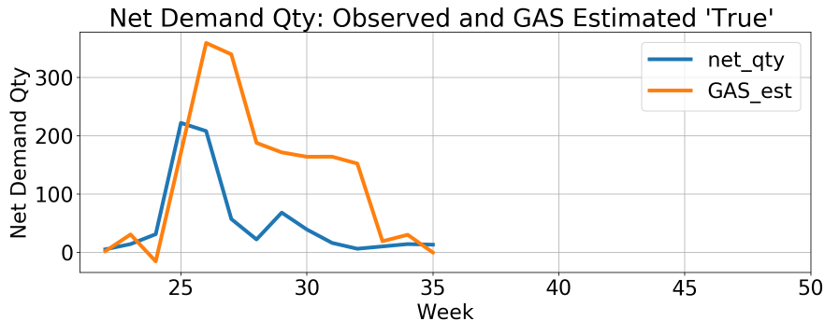
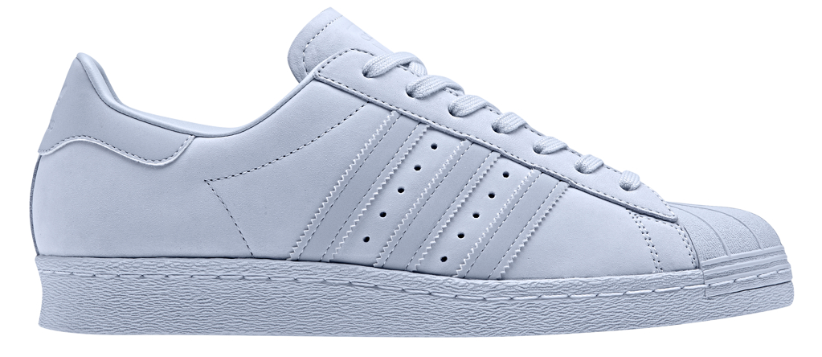
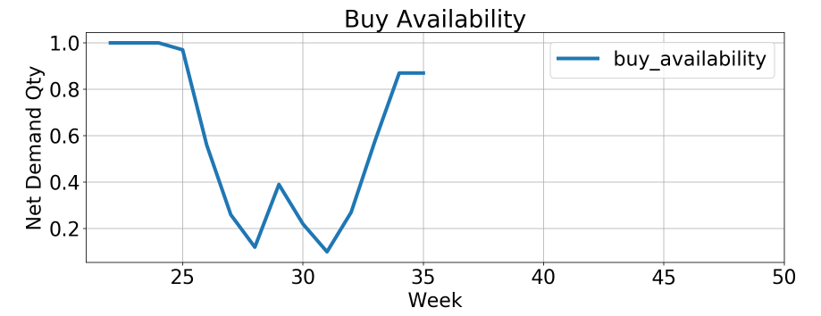
Demand forecasting Observed interval
e.g. SUPERSTAR 80s, CQ2659
*Partial season
FW18 (EU) net demand qty
Observed: 725 units
Estimated: 1774 units

Slide 5
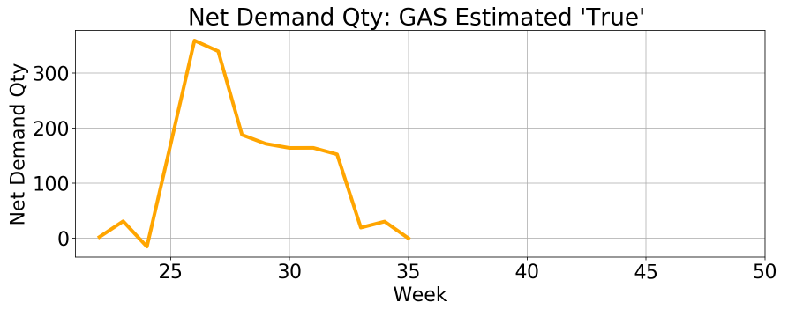
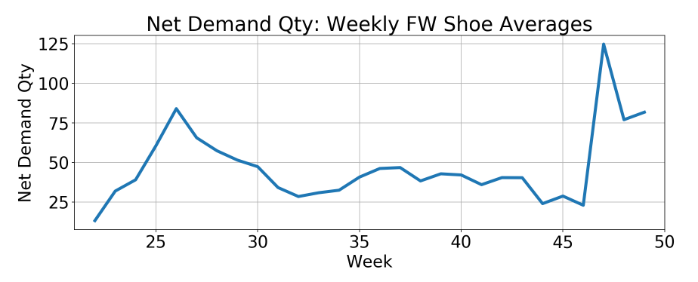
Demand forecasting UnObserved interval
Seasonality
Categories
e.g. prod_grp_desc == SHOES
Weekly FW shoe net demand averages

Slide 6
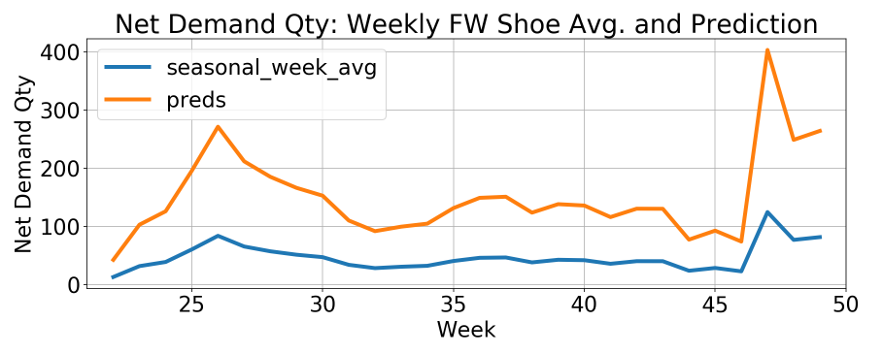
Demand forecasting UnObserved interval
Use observed weeks to establish relationship between shoe seasonality & CQ2659 net demand qty
Use relationship to predict CQ2659 net demand qty for unobserved weeks
‘preds’ line in lower plot for full season

Slide 7
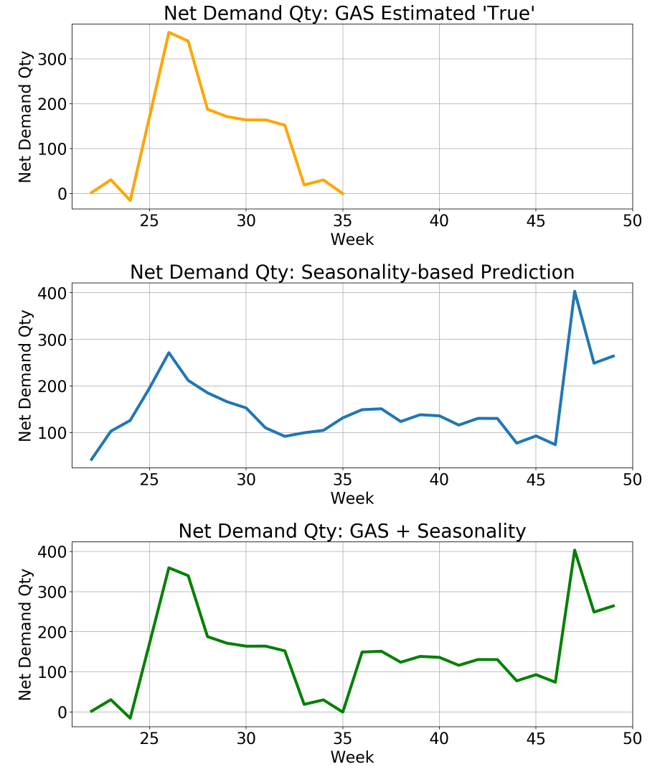
Demand forecasting full season
Full season estimate:
observed-estimated true net demand quantity
+
Seasonally inferred unobserved net demand quantity
=
Estimated full season true net demand quantity

Slide 8
Demand forecasting full season
Full season estimate:
Observed-estimated true net demand quantity
+
Seasonally inferred unobserved net demand quantity
=
Estimated full season true net demand quantity

Slide 9
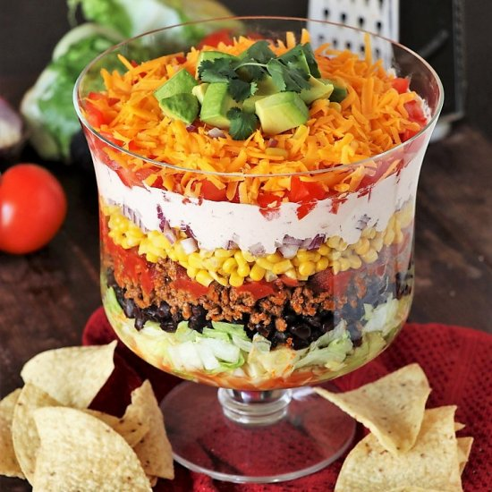
Demand forecasting More layers
GAS
Factors for attributes, to model individual sources of variation; e.g. color, fabric, fit, price.
New articles share the same attributes…
Seasonality
Category experimentation
Model choices

