Slide 1

COOKING WITH GAS…
PRESEASON DEMAND FORECASTING
MVP FORECASTS
GAS MODELS FOR ‘TRUE’ NET DEMAND QTY
SEASONALITY FOR UNOBSERVED WEEKS

Slide 2
Demand forecasting FW20 forecasts
FW19 is our leading indicator of FW20
As of 1 October (first delivery) → ~50% of FW19 remains unobserved
Part 1 – estimate ‘true’ net demand quantity
Generalized Autoregressive Score models
Buy availability is the key
Part 2 – infer article seasonality from similar articles
Type, franchise, color, behavior…

Slide 3

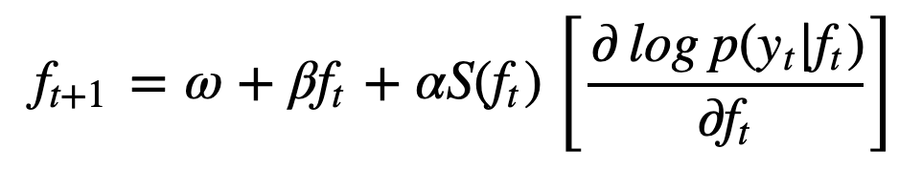

Demand forecasting GAS MODELS
Generalized Autoregressive Scoring models
$y_{t}=f_{t}∗x_{t}+ε_{t}$ where
$ε \sim N\left(0, σ\right)$
$x_{t}$: buy_availability
Time-varying parameter f:

Slide 4

Demand forecasting GAS MODELS
Generalized Autoregressive Scoring models
$y_{t}=f_{t}∗x_{t}+ε_{t}$ where
$ε_{t} \sim N\left(0, σ\right)$
$x_{t}$: buy_availability at time t
Time-varying parameter f:
$y_{t}|(f_{t},x_{t})$ is distributed $N(f_{t}∗x_{t}, σ)$
Scaled score; our usage simplifies to:
$f_{t+1}=ω+βf_{t}+α(y_{t}−f_{t}x_{t})$

Slide 5
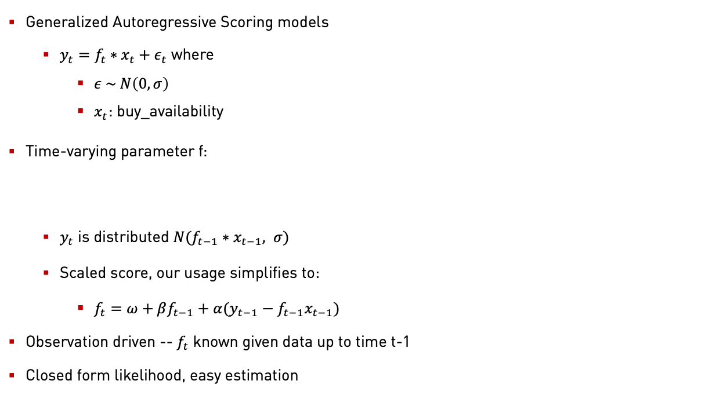
Demand forecasting GAS MODELS
Generalized Autoregressive Scoring models
$y_{t}=f_{t}∗x_{t}+ε_{t}$ where
$ε \sim N\left(0, σ\right)$
$x_{t}$: buy_availability
Time-varying parameter f:
$y_{t}$ is distributed $N(f_{t−1}∗x_{t−1}, σ)$
Scaled score, our usage simplifies to:
$f_{t}=ω+βf_{t−1}+α(y_{t−1}−f_{t−1}x_{t−1})$
Observation driven -- $f_{t}$ known given data up to time t-1
Closed form likelihood, easy estimation

Slide 6
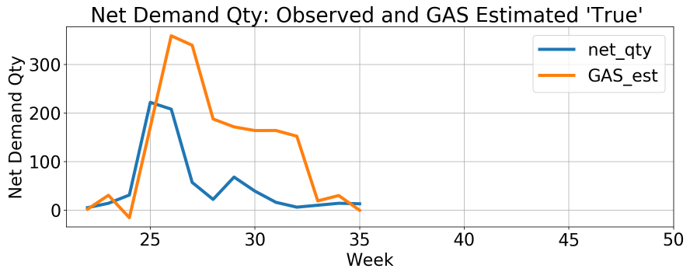

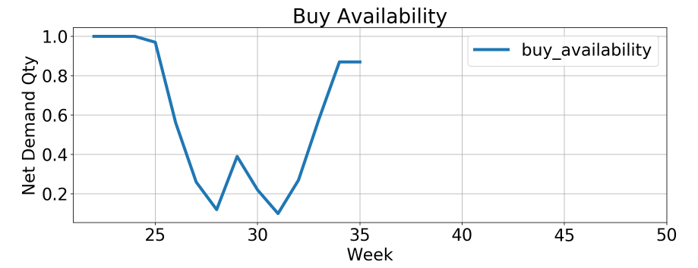
Demand forecasting Observed interval
e.g. SUPERSTAR 80s, CQ2659
*Partial season
FW18 (EU) net demand qty
Observed: 725 units
Estimated: 1774 units

Slide 7
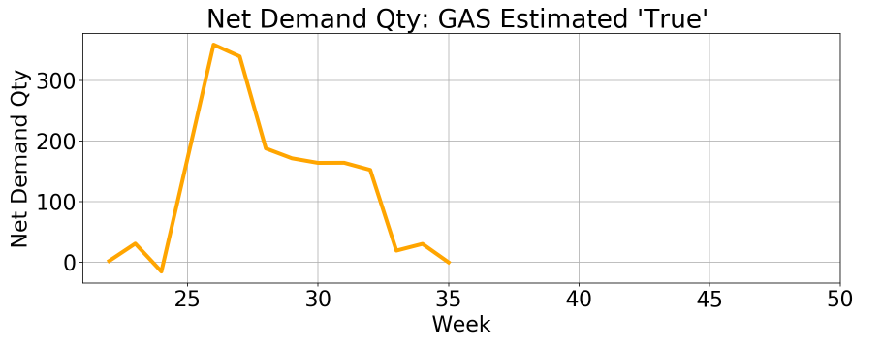
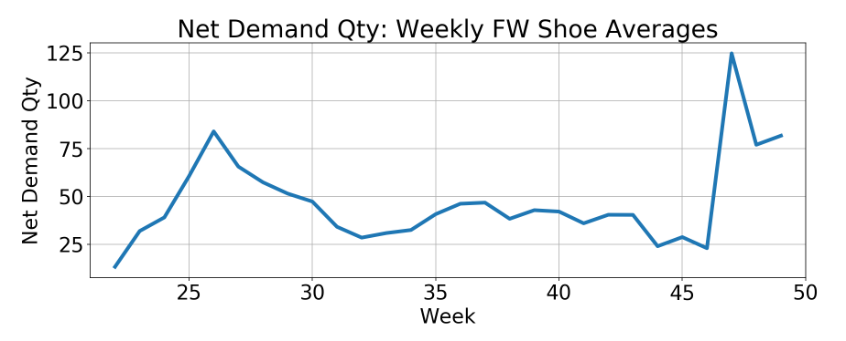
Demand forecasting UnObserved interval
Seasonality
Categories
e.g. prod_grp_desc == SHOES
Weekly FW shoe net demand averages

Slide 8
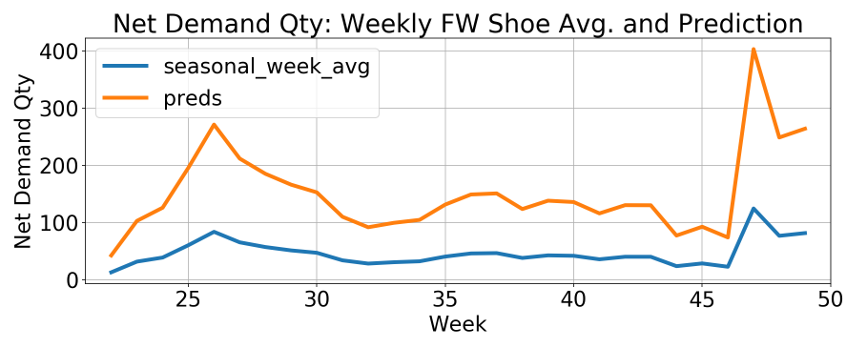
Demand forecasting UnObserved interval
Use observed weeks to establish relationship between shoe seasonality & CQ2659 net demand qty
Use relationship to predict CQ2659 net demand qty for unobserved weeks
‘preds’ line in lower plot for full season

Slide 9
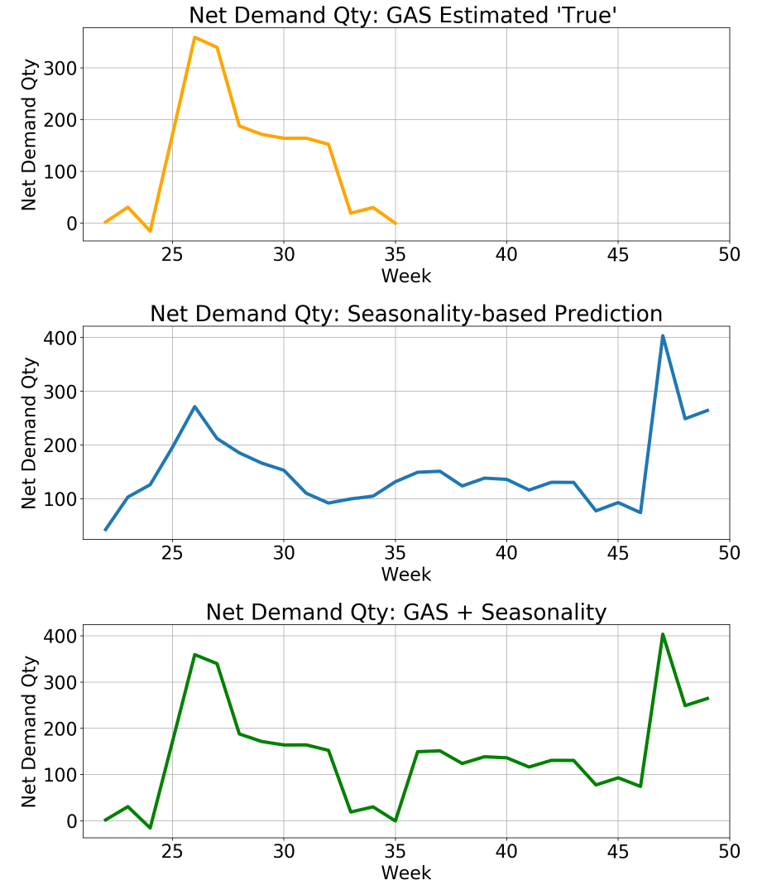
Demand forecasting full season
Full season estimate:
observed-estimated true net demand quantity
+
Seasonally inferred unobserved net demand quantity
=
Estimated full season true net demand quantity

Slide 10
Demand forecasting full season
Full season estimate:
Observed-estimated true net demand quantity
+
Seasonally inferred unobserved net demand quantity
=
Estimated full season true net demand quantity

Slide 11

Demand forecasting More layers
GAS
Factors for attributes, to model individual sources of variation; e.g. color, fabric, fit, price.
New articles share the same attributes…
Seasonality
Category experimentation
Model choices

