Slide 1
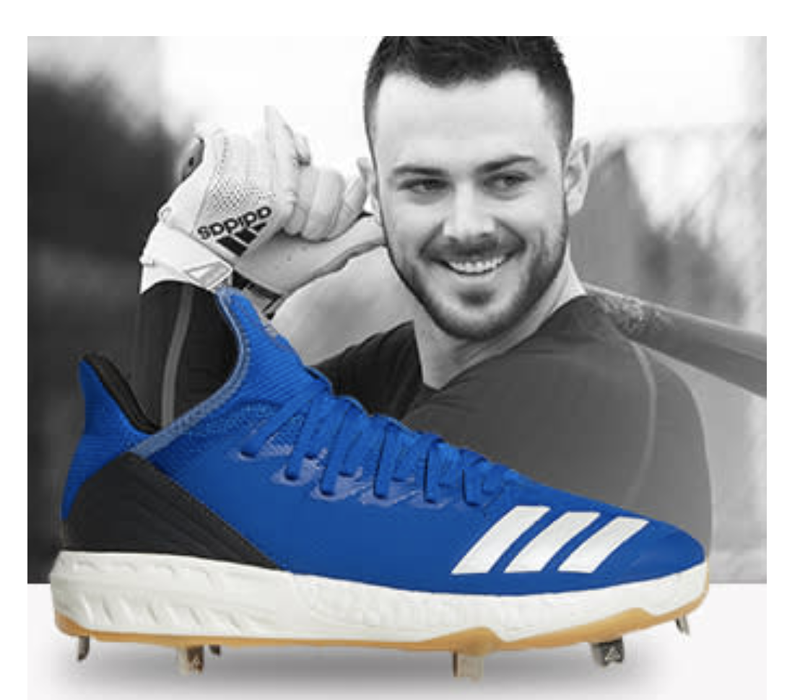
Demand forecasting optimizing overestimation
We don’t have a crystal ball
We make predictions, with uncertainty
We can quantify and incorporate uncertainty
But we know underprediction is worse than overprediction
Margin > cost
Should we buy what we predict? No.

Slide 2
Demand forecasting optimizing overestimation
How can we maximize profits per article given cost/margin asymmetry?
I propose a framework and solution to answer this important question
Incorporate our prediction
Incorporate our degree of uncertainty
Incorporate article margin
Incorporate article cost

Slide 3
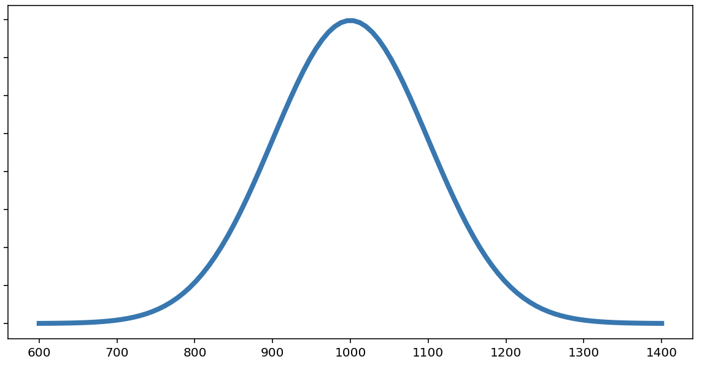
Demand forecasting optimizing overestimation
Suppose we predict Boost Icon 4 cleats will sell 1000 units
We characterize our prediction with a distribution
A distribution incorporates our degree of confidence

Slide 4
Demand forecasting optimizing overestimation
Our prediction as the mean.
Standard deviation reflects confidence
Base on model, buyers, article, etc.
Here: Normal(1000, 100)
→ 95% confident net demand qty will be between 800 and 1200.
Flexibility/versatility in choosing distribution, mean, and variance.

Slide 5
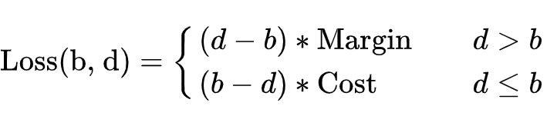
Demand forecasting optimizing overestimation
Buy: b units
Demand: d units
Define Loss function:

Slide 6
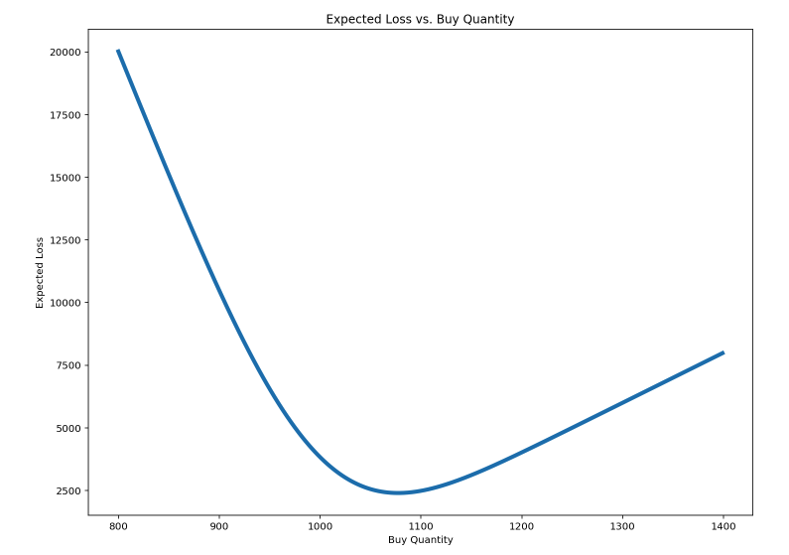
Demand forecasting optimizing overestimation
We can maximize expected profits!
Choose b to minimize expected losses
Suppose we predict:
net_qty ~ N(1000, 100)
And know:
Margin = 80, cost = 20.
Then we buy 1077 units
123 x 20 = €2460 saved

Slide 7
Demand forecasting Distribution framework
What if we adopt this framework more broadly?
All predictions as distributions
Many benefits
Evaluation: compare prediction distributions to empirical distributions (statistical methods exist)
Easier to incorporate disparate information into single distribution than prediction, and that translates probabilistically into a buy number
Asymmetric/skewed distributions
e.g. marketing campaign – large upside

Slide 8
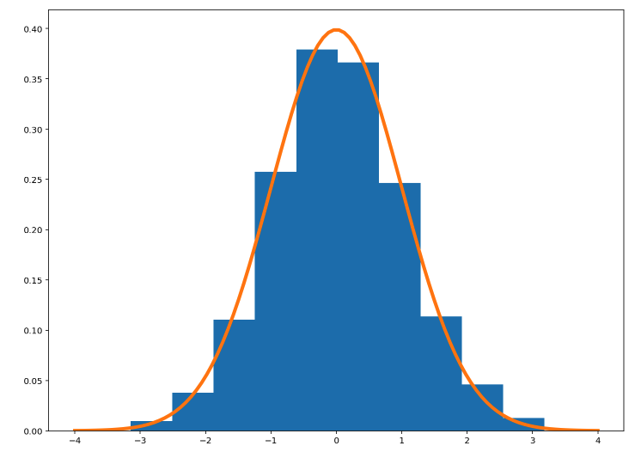
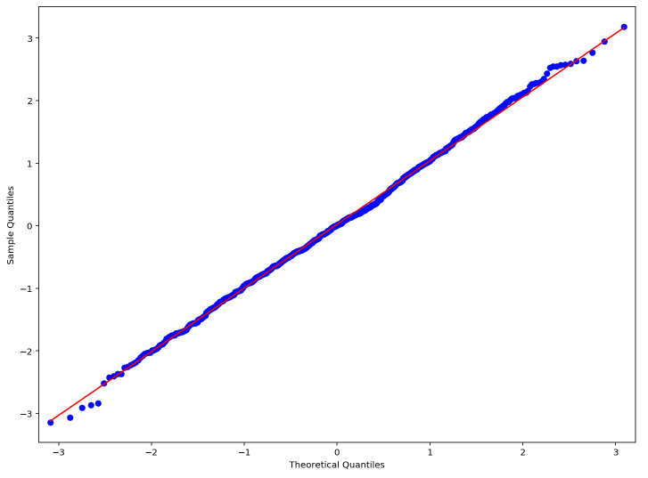
Demand forecasting Distribution framework: evaluation
Calibration
Weatherman: 40% chance of rain
How often does it rain when he says 40% chance?
E.g. predict N(1000, 100) – observe 1150 = 1.5 standardized
Kolmogorov-Smirnov test

Slide 9
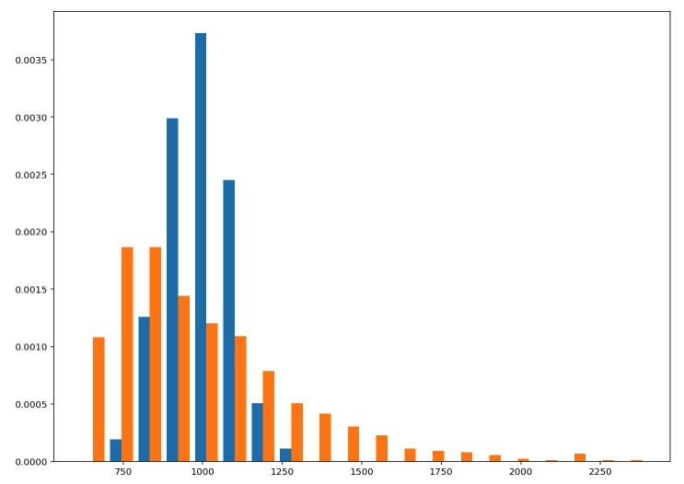
Demand forecasting Distribution framework
Easier to incorporate disparate information into single distribution than prediction, and that translates probabilistically into a buy number

Slide 10
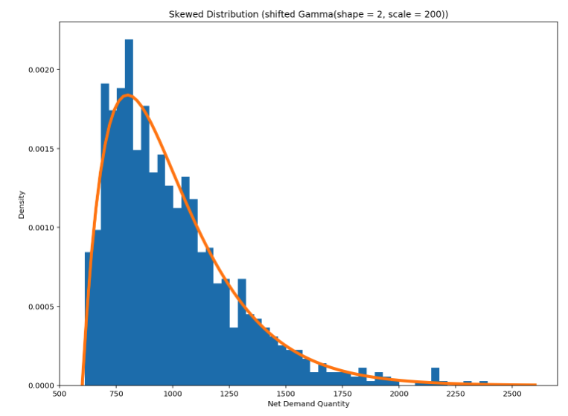
Demand forecasting Distribution framework
Asymmetric/skewed distributions
e.g. marketing campaign – large upside
Distribution can capture small probability of large impact
Mean: 1000 units
Buy 1200 units

Slide 11
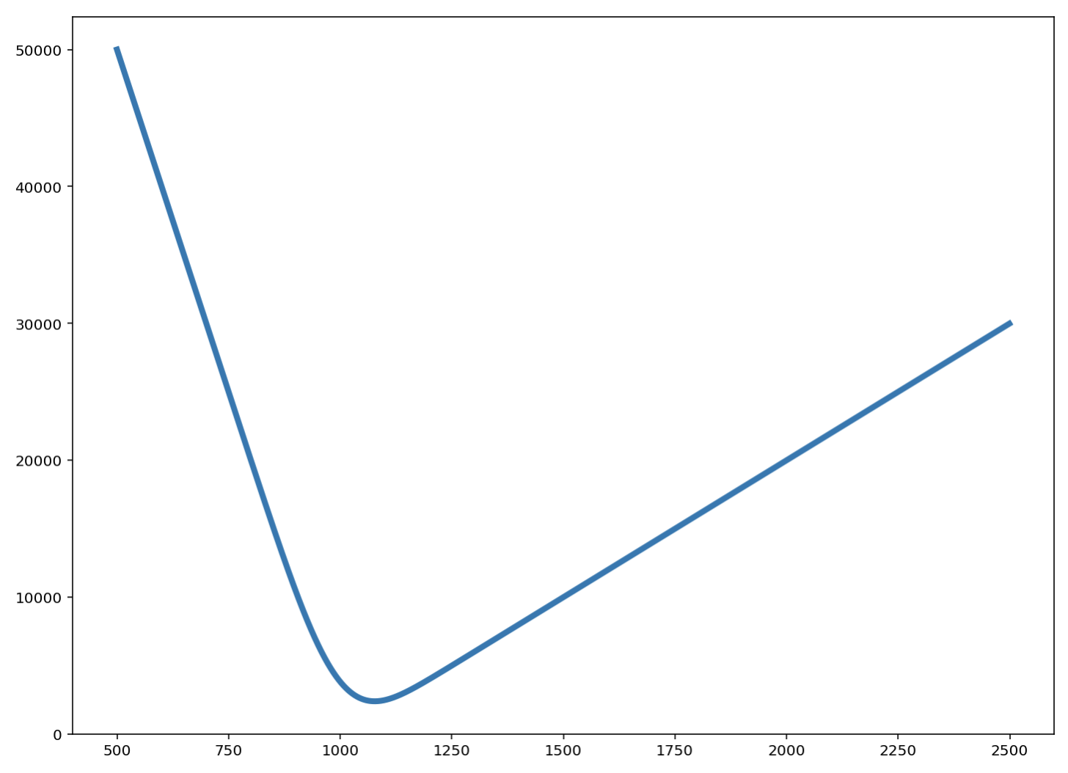
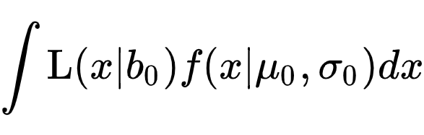

Demand forecasting optimizing overestimation (SUPPLEMENTAL SLIDE)
Minimize $E\left[L | b\right]$. --- expected value of loss function --- over all b
Normal density f
Mean $μ_{0}$ (our prediction)
Confidence-informed $σ_{0}$,
Expected value of loss function:
Minimize over buy quantity $b_{0}$
Suppose we predict net_qty ~ N(1000, 100), and margin = 80, cost = 20.
Then we buy 1077 units.

