Slide 1
Demand forecasting optimizing overestimation
We don’t have a crystal ball
We make predictions, with uncertainty
We can quantify and should incorporate uncertainty
But we know underprediction is worse than overprediction
Margin > cost
Should we buy what we predict? No.

Slide 2
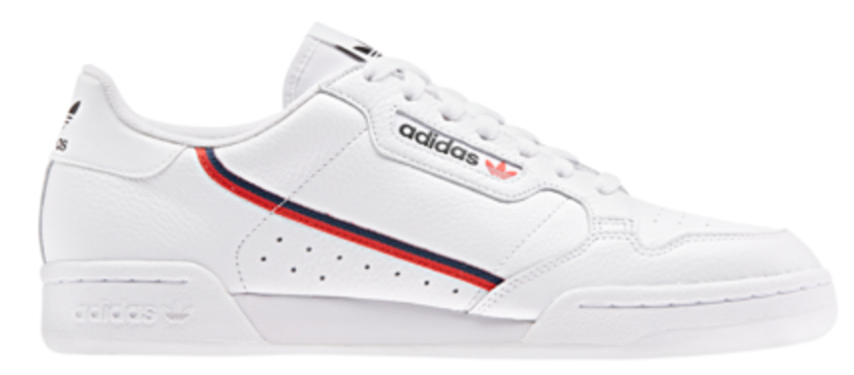
Demand forecasting optimizing overestimation
How can we maximize profits per article given cost/margin asymmetry?
I propose a framework and solution
Incorporate our prediction and uncertainty
Incorporate article margin and cost

Slide 3
Optimizing overestimation Prediction distribution
Suppose we predict these Stan Smiths (G27706) will sell 38000 units
We make our prediction as a distribution, rather than point estimate
This more accurately reflects reality, and statistical modelling
A distribution incorporates a degree of confidence
DAA, buyers, tea leaves, crystal ball, Artem

Slide 4
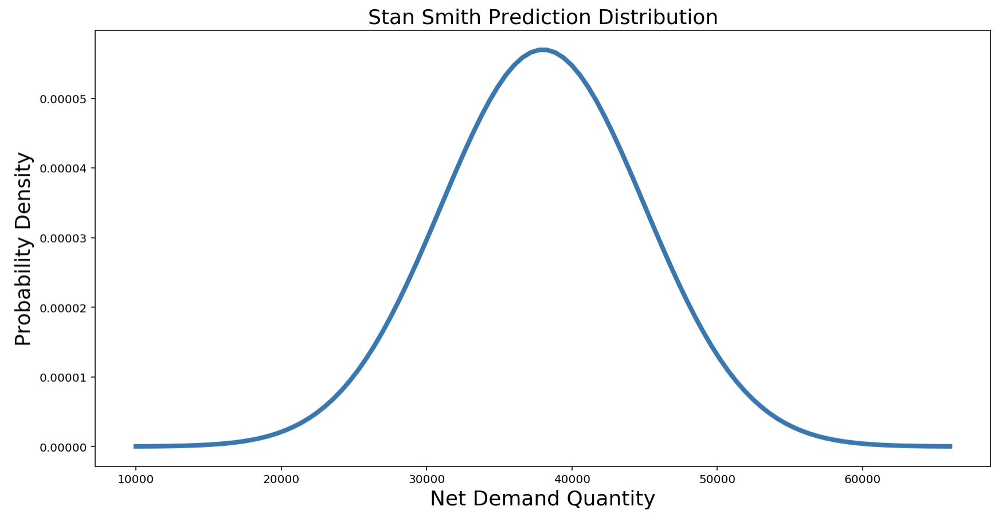
Optimizing overestimation Prediction distribution
Our prediction as the mean.
Standard deviation reflects confidence
Base on model, buyers, article, etc.
Here use Normal(38000, 7000)
→ 95% confident net demand qty will be between 24000 and 52000.
Flexibility/versatility in choosing distribution, mean, and variance.

Slide 5
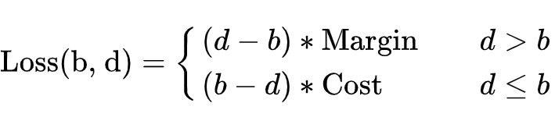
Optimizing overestimation Loss function
Buy: b units
Demand: d units
Define Loss function:
Loss function in words:
Underprediction: margin times number of missed sales
Overprediction: cost times each article leftover

Slide 6
Demand prediction distributions framework summary
Prediction distribution incorporates uncertainty
Cannot realistically expect any one outcome
Many possible outcomes, with associated *probabilities*
Loss function -- calculate the cost of under/over prediction for article with cost and margin
Maximize profit: minimize expected value of loss function
Minimize loss function: predict/buy perfectly (with your crystal ball, on your unicorn)
Minimize the expected value of the loss function (with your degree)

Slide 7
Demand prediction distributions framework summary
Expected value is an integral → sum of losses weighted by their probability
Each buy has an associated expected loss
“Expected” -- on average, in the long run, if history repeated many times
Buy the number of units that minimizes expected losses

Slide 8
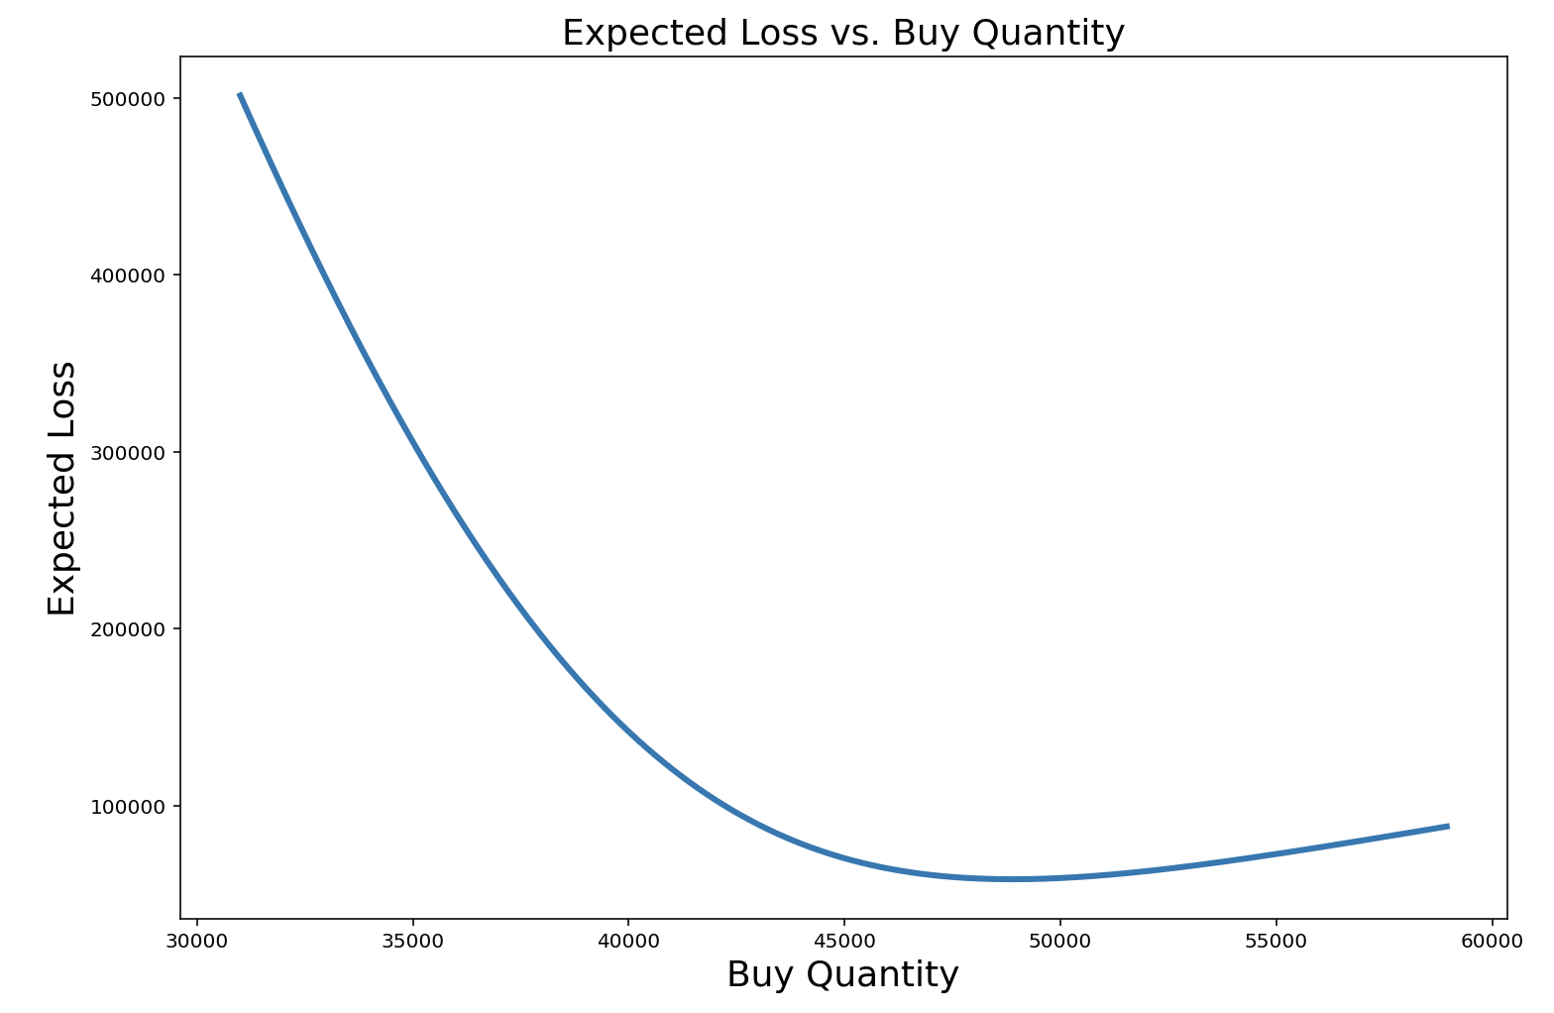
Optimizing overestimation Minimize Expected loss
Recall, Stan Smith prediction distribution:
net_qty ~ N(38000, 7000)
Margin = €65.80, cost = €4.20.
Buying 48900 units maximizes expected profits
Current approach: “20% buffer”
→ €8127 expected increase in profit for this article

Slide 9
Demand forecasting Distribution framework
What if we adopt this framework more broadly?
All predictions as distributions
Additional benefits
Asymmetric/skewed distributions
e.g. marketing campaigns with large upside
Easier to incorporate disparate information into single distribution than prediction, and that translates probabilistically into a buy number to maximize profits
Evaluate predictions: comparing distributions is easy
predictions vs. empirical

Slide 10
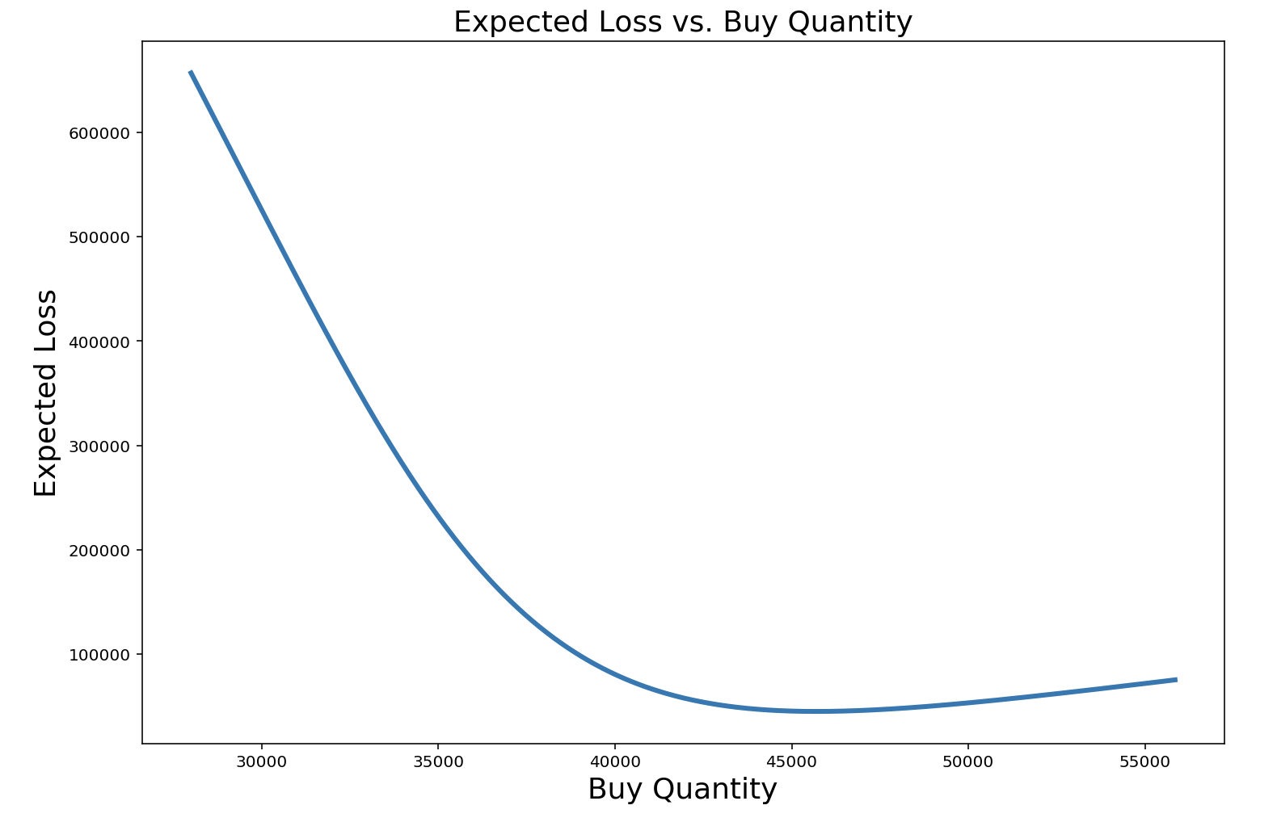
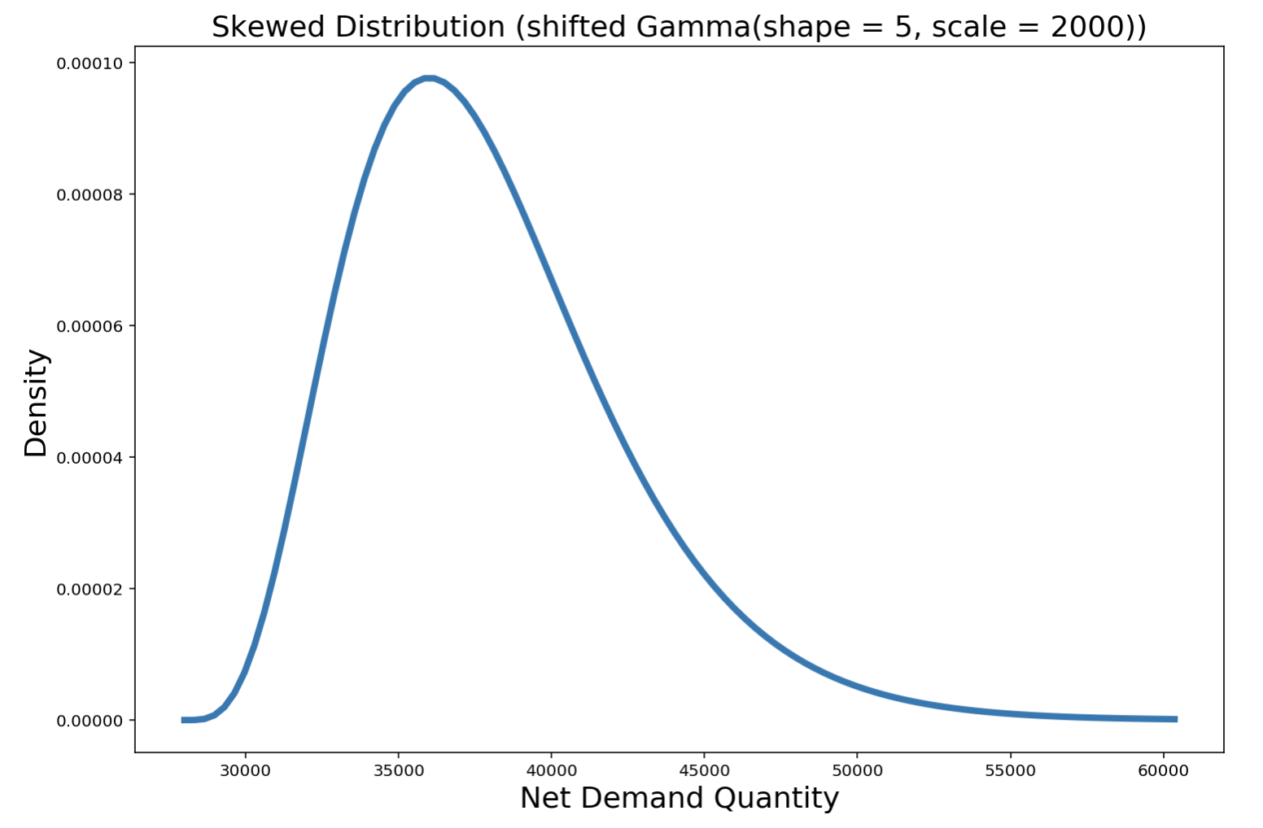
Framework extensions skewed prediction distributions
Asymmetric/skewed distributions
e.g. marketing campaign – large potential upside
Distribution can capture increased upside; e.g. gamma
Mean: 38000 units
Optimal buy: 45700 units
Virtually identical to ‘20% buffer’ approach

Slide 11
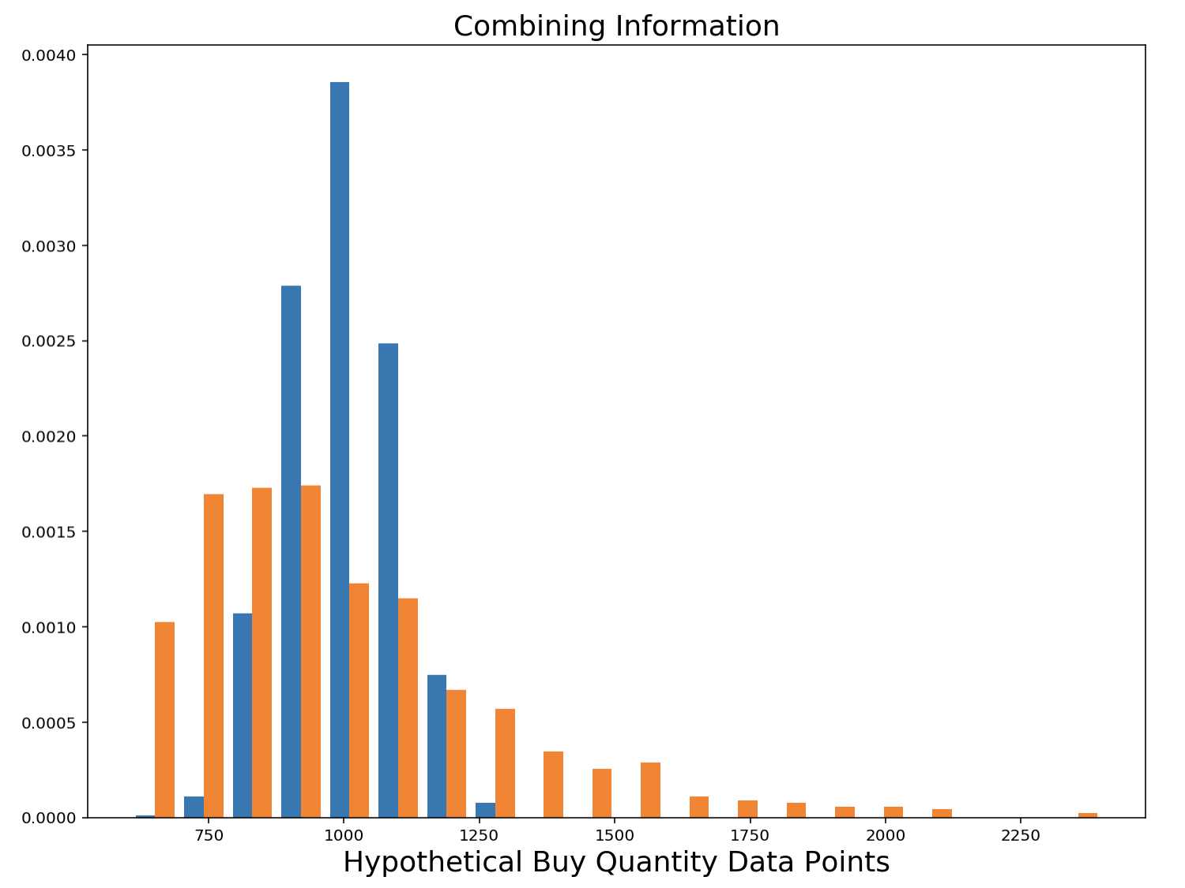
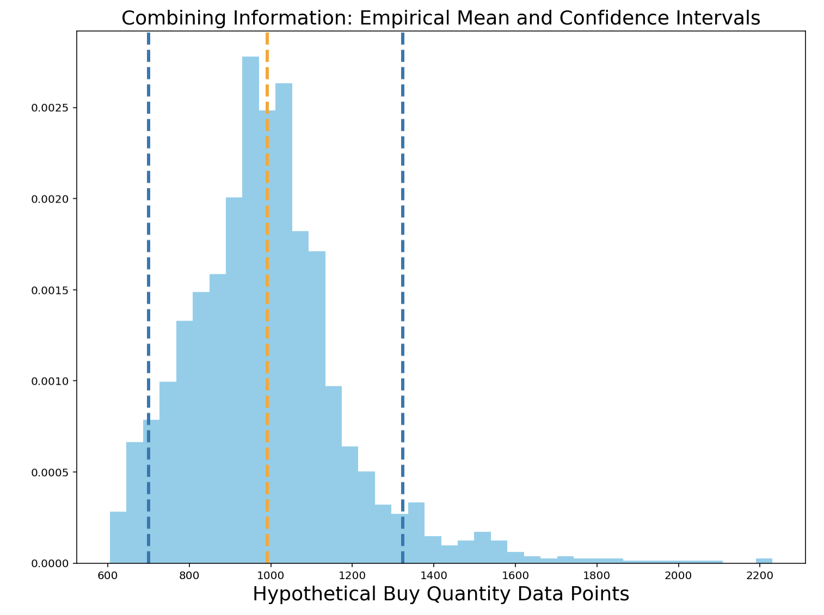
Framework extensions integrative prediction distributions
Incorporate disparate information streams into prediction distributions
Translate probabilistically into buy and confidence intervals

Slide 12
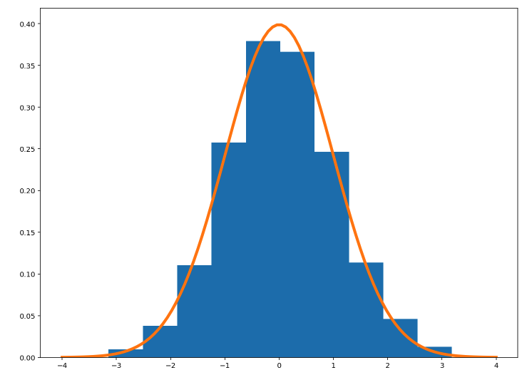
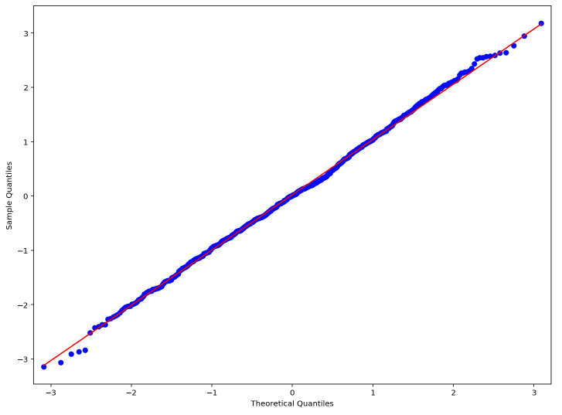
Framework extensions Evaluate prediction distributions
Calibration
Weatherman: 40% chance of rain
How often does it rain when he says 40% chance?
E.g. predict N(1000, 100) – observe 1150 = 1.5 standardized
Kolmogorov-Smirnov test

Slide 13
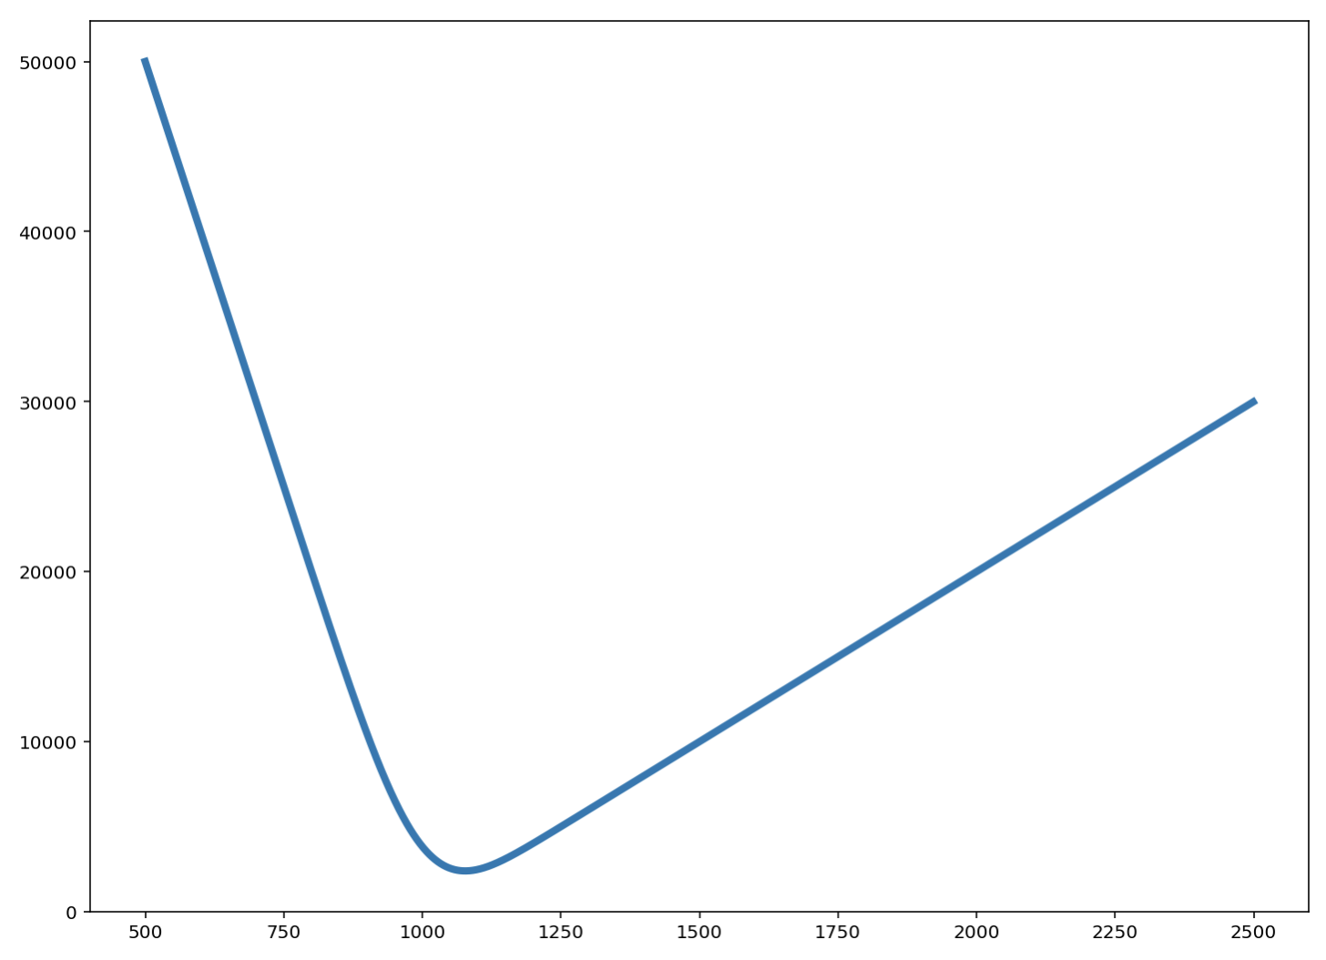
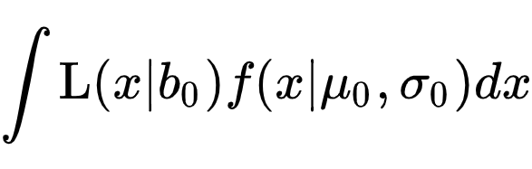

Demand forecasting optimizing overestimation (SUPPLEMENTAL SLIDE)
Minimize $E\left[L | b\right]$. --- expected value of loss function --- over all b
Normal density f
Mean $μ_{0}$ (our prediction)
Confidence-informed $σ_{0}$,
Expected value of loss function:
Minimize over buy quantity $b_{0}$

