Slide 1
TicWatch Keeping up to date on all your current stock information.
Shawn Fitzpatrick, Jeff McFarlane, Craig Christensen
Notes:
Presenter = Craig
Give keyboard and mouse access to Shawn
Keeping up to date on all your current stock information.
0 - 30 sec

Slide 2
GoToMeeting & GitHub
Working remotely can be a big challenge, however, technology today provides a solution to this obstacle.
Frustrating at times
Echo
Have a plan of attack.
Use the time wisely.
Agreed to each research topics then…
Teach yourself then teach each other.
#?*! happens.
When life gives you lemons…use GoToMeeting & GitHub
Notes:
Ability to communicate well
Craig > Shawn > Jeff
Share experiences with GoToMeeting/GitHub
Learn on our own then come together and taught eachother
30 – 5:00

Slide 3
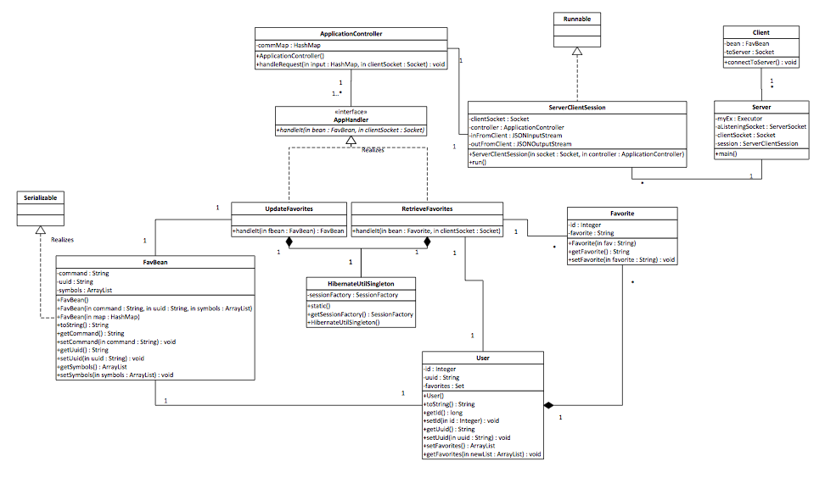
Visualizing the Outcome
Notes:
Jeff
By creating diagrams helped visualize the flow and relationships of classes that allows to organize the code in a more efficient modular manner
7:00 – 8:00

Slide 4
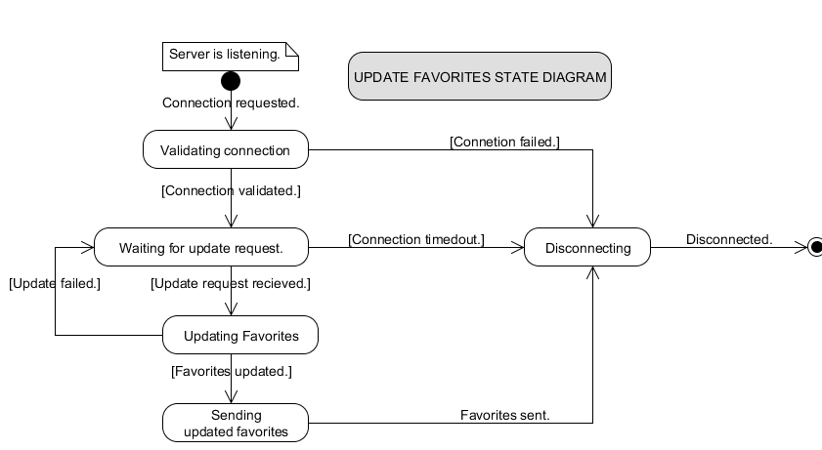
UML fosters change
Notes:
Shawn
8:00 – 9:00

Slide 5
cwcraigo’s JSON Service
FROM
http://www.finance.yahoo.com/d/quotes.csv?f=nsl1c1p2oghx&s=AAPL+GOOG+ORCL
TO
http://www.cwcraigo.com/stockfeed.php?symbols=AAPL+GOOG+ORCL
produces JSON string
Notes:
Originality
Craig
Simplify Java code and distribute work load.
10 - 11

Slide 6

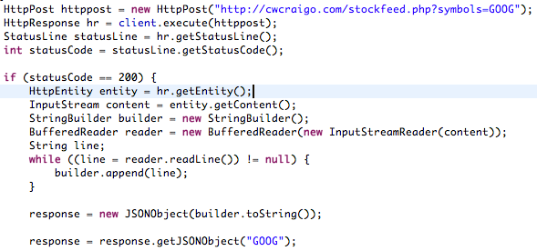
Smarter not Harder
Which would you choose?
Notes:
Explain why options were selected
Craig
Working smarter not harder.
Finding alternatives.
9 - 10

Slide 7
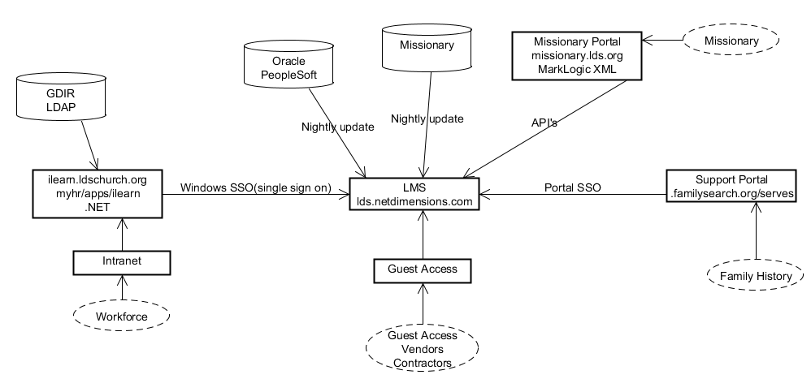
Learning while solving real problems
Notes:
Shawn
11 - 13

Slide 8
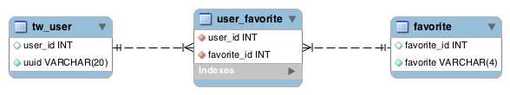
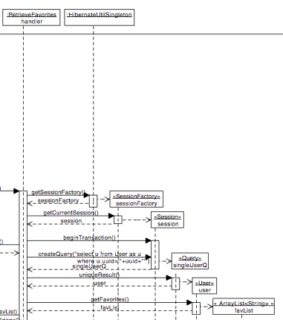
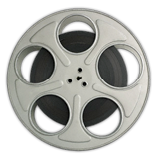
Hello Hibernate
What!? No SQL!?
Notes:
Creativity
Craig
Database Design
What!? No SQL!?
Jeff
Hibernate
READ THE BOOK FIRST
Adds layer of security
Middle man
13 - 15

Slide 9
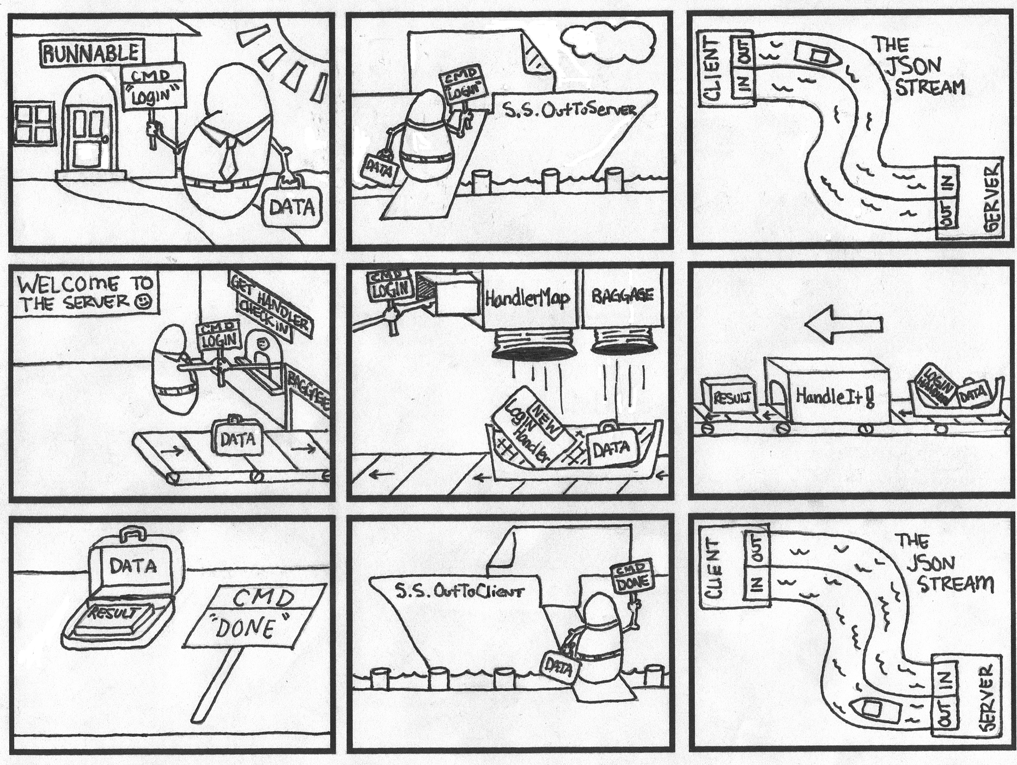
Cool Concepts
Illustration by Chad Allen
Notes:
Openness to new ideas
Craig
Wanted to implement in current/existing projects
15 - 16

Slide 10
Think first, then act.
Learn and understand the technology first.
Ask about other’s experiences.
Learn the alternatives.
Ask lots of questions.
Simplify, simplify, simplify.
When planning use simple tools. (ex. whiteboard, paper/pencil)
Using software too soon makes it too complicated.
Think smarter, not harder.
Saves resources.
Teamwork is key.
Notes:
Self reflection/meta-cognition (aka. awareness or analysis of one's own learning or thinking processes)
Craig/Jeff
UML helped programming
5:00 – 7:00

Slide 11
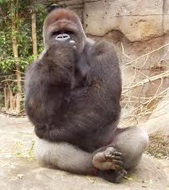
I think, therefore I am.
Notes:
ALL – Jeff > Shawn > Craig
Summary of self reflection.

Slide 12
Rejected TicWatch descriptions
Watching your stock like an annoying tick in your hair.
Watching your stock like a persistent stocker.
This app will NOT Tic you off.
Watch out! You’re loosing all you’re money!

