Slide 1
TicWatch Keeping up to date on all your current stock information.
Shawn Fitzpatrick, Jeff McFarlane, Craig Christensen
Notes:
Intro to our app and the basic info about it.

Slide 2
GoToMeeting & GitHub
Working remotely can be a big challenge, however, technology today provides a solution to this obstacle.
Have a plan of attack.
Use the time wisely.
Teach yourself then teach each other.
#?*! happens.
When life gives you lemons…use GoToMeeting & GitHub
Notes:
All – start with Jeff then Shawn then Craig
Ability to communicate well
Share experiences with GoToMeeting/GitHub
Learn on our own then come together and taught eachother

Slide 3
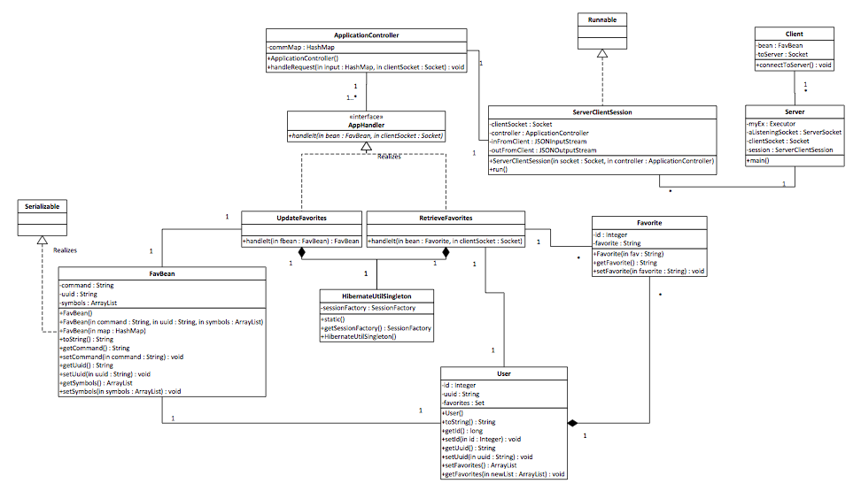
Visualizing the Outcome
Notes:
Jeff
By creating diagrams helped visualize the flow and relationships of classes that allows to organize the code in a more efficient modular manner

Slide 4
Think first, then act.
Learn and understand the technology first.
Ask about other’s experiences.
Learn the alternatives.
Ask lots of questions.
Simplify, simplify, simplify.
When planning use simple tools. (ex. whiteboard, paper/pencil)
Using software too soon makes it too complicated.
Think smarter, not harder.
Saves resources.
Teamwork is key.
Notes:
Craig/Jeff
Self reflection/meta-cognition (aka. awareness or analysis of one's own learning or thinking processes)
UML helped programming

Slide 5
cwcraigo’s JSON Service
FROM
http://www.finance.yahoo.com/d/quotes.csv?f=nsl1c1p2oghx&s=AAPL+GOOG+ORCL
TO
http://www.cwcraigo.com/stockfeed.php?symbols=AAPL+GOOG+ORCL
produces JSON string
Notes:
Craig
Simplify Java code and distribute work load.
Originality
Created own service to produce JSON string.

Slide 6

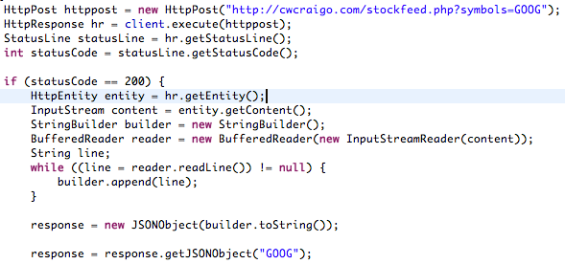
Smarter not Harder
Which would you choose?
Notes:
Craig
Working smarter not harder.
Finding alternatives.
Explain why options were selected
Use of JSONInputStream with HttpRequest.

Slide 7
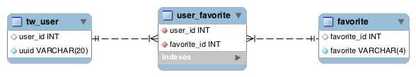
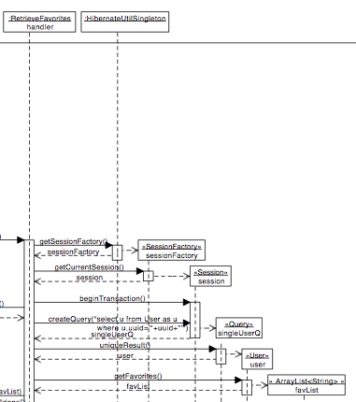

Hello Hibernate
What!? No SQL!?
Notes:
Craig
Database Design
What!? No SQL!?
Jeff
Hibernate
READ THE BOOK FIRST
Adds layer of security
Middle man
Creativity

Slide 8
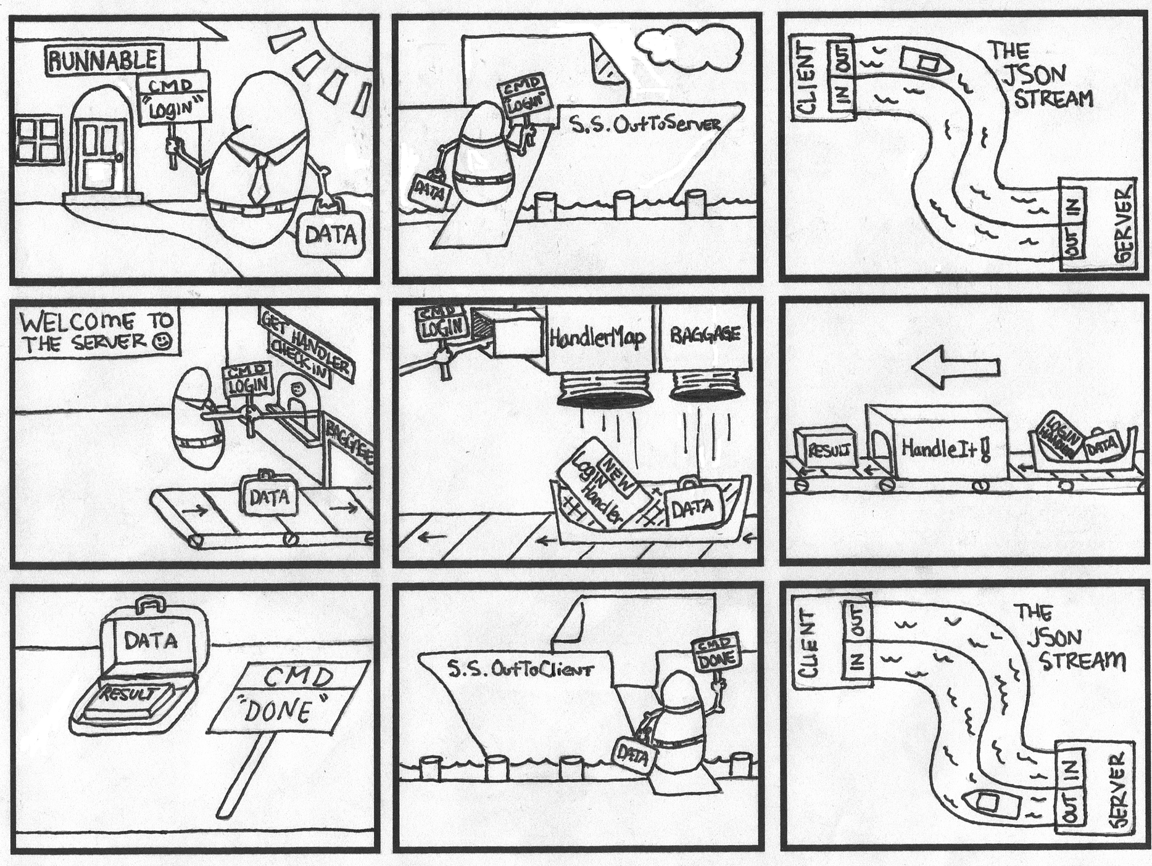
Cool Concepts
Illustration by Chad Allen
Notes:
Craig
Wanted to implement in current/existing projects
Openness to new ideas
Application Controller Pattern

Slide 9
Rejected TicWatch descriptions
Watching your stock like an annoying tick in your hair.
Watching your stock like a persistent “stock”er.
This app will NOT “Tic” you off.
“Watch out!” You’re loosing all your money!

