Slide 1
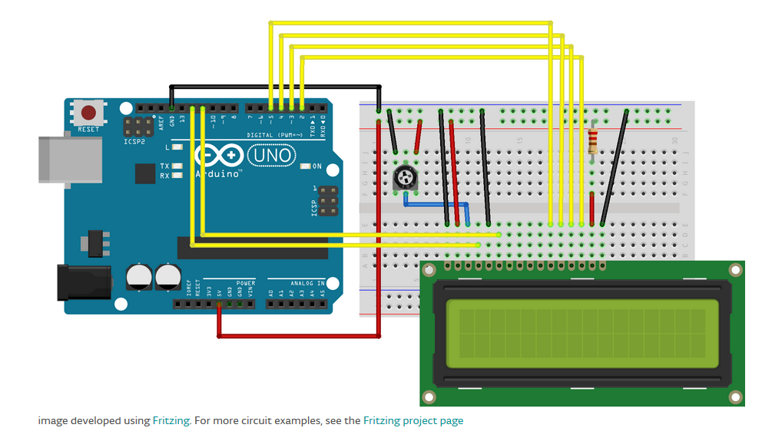
Note: the long yellow wires that connect the breadboard to the digital sockets here at the top were shifted left one socket each on the Arduino-side of the actual model so as to free socket 2 for the grey wire of the stick-control (stick-control schematic on next slide).

Slide 2
