Slide 1


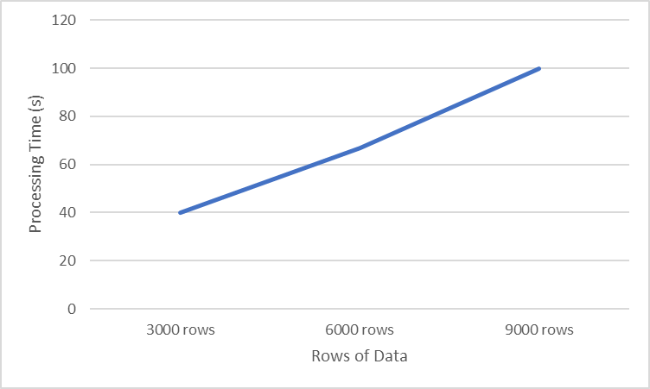

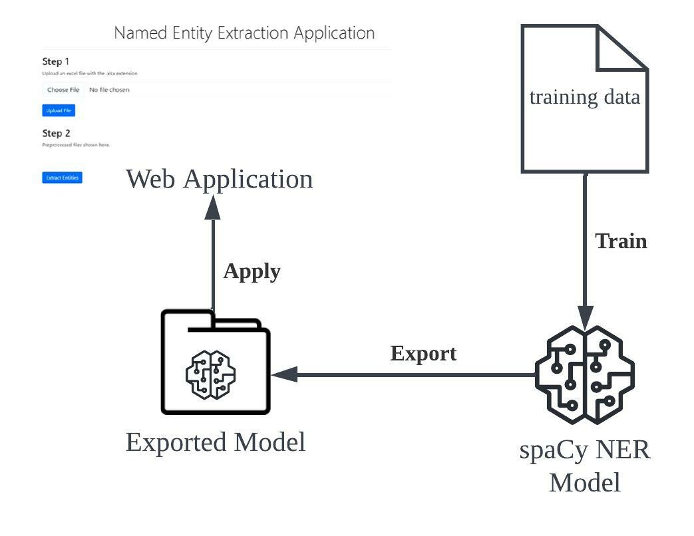


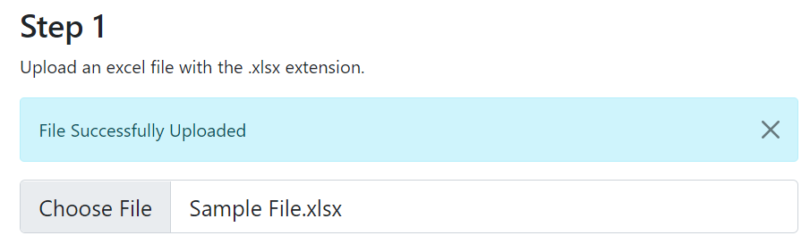

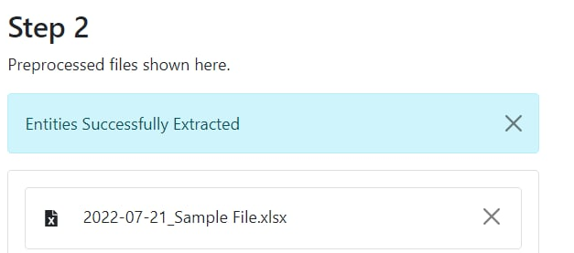
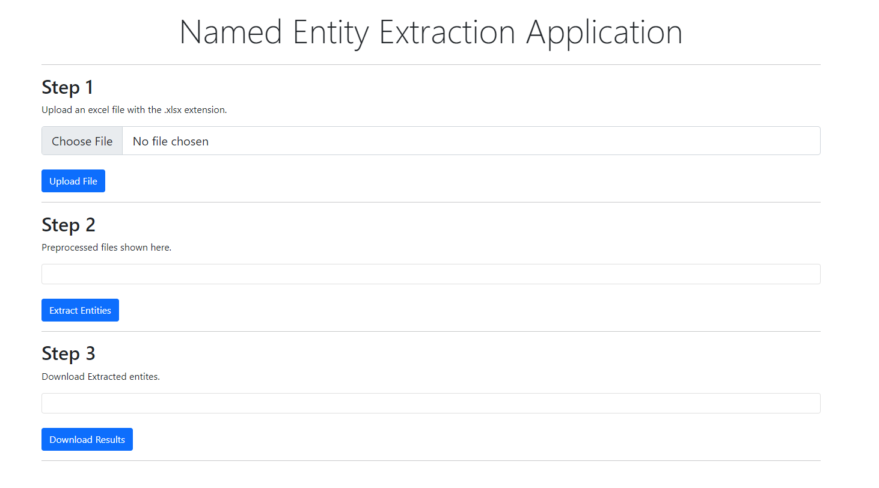





FACULTY: Information & Communication Technology
STUDENTS: Chen Xin Xin, Chong Wei Wen Reuben, Leong Kah En,
Whitney Tan Wenhui, Jevan Ng Jia Qi
ACADEMIC SUPERVISOR: Dr. Muhammed Fauzi Bin Abbas
INDUSTRY SUPERVISOR: Mr Rek Chong
Self-learning Named-Entity Recognition Platform
Introduction
Performance
Element Materials Technology is facing difficulties in keeping track of all the lab information around the world. The client expressed his concern that their Excel sheet is restricting their capability in performing data analysis since the data is not very standardised and it is time-consuming for them to pick up the key information.
Our team has developed web-based tool, a Named-Entity Recognition Platform, that is capable of predicting and extracting key entities to speed up the data cleansing process.
Rows of Data | Processing Time (in seconds)
3000 | 30s
6000 | 67s
9000 | 100s
Accuracy Measurements | Accuracy Values
Precision | >99%
Recall | >98%
F-score | >99%
Figure 1: Graph for Processing Time Versus Input File Size
Solution
Figure 2: Snippet of Precision, Recall and F-score Generated from Performance Report
* Precision: the accuracy of making predictions of objects being labelled
* Recall: the accuracy of making predictions of objects that are not being labelled
* F-score: the average between Precision and Recall
Benefits
More Efficient
This platform incorporated a spaCy model that makes use of the technology of Name-Entity Recognition for information extraction which helps users speed up their data cleansing procedure by detecting the key entities.
Step 1. Select an input file
Machine Learning
The training of the spaCy model is a part of machine learning as the model not only learns all the entities that are fed to it but also the patterns of such entities. It is able to predict entities even when they are not within the training data.
Step 2. Click ‘Upload File’
Reusable
The spaCy model is reusable, once the model is extracted, it will be saved in a folder and could be used on multiple web applications for a similar use case.
Step 3. Click ‘Extract Entities’
Conclusion
Step 4. Click ‘Download Results’
In conclusion, our web application is an easy-to-use and convenient tool that helps users speed up their data cleansing and data extraction process as compared to their tradition manually method.
The output file generated is also automatically altered to a format such that it is more readable and unclustered with many columns. This is particularly useful when the user has to keep track of multiple columns of data and yet does not want a messy file.
Technologies

