Slide 1
Commentary · working draft
The Education Exception
A commentary in three acts, on why development predicts where wellbeing is high but not when it rises — and on the one construct that behaves differently
Working synthesis for the co-author team · August 2026
SDG: 42 countries, 661 series · HDI × World Happiness Report: 151 countries, 2011–2023 · Subnational HDI: 239 regions · European Social Survey: 36 countries, 351,023 respondents, rounds 5–11 (2010–2023)

Slide 2
THE SETUP
THE ARGUMENT
Development rose almost everywhere. Wellbeing did not follow it.
I
We replicate the SDG result outside the SDGs.
The same design on the HDI, against a second wellbeing survey, and one spatial scale down. It collapses every time.
II
So what is it about education?
It is the one construct that holds at every level of aggregation — but only measured as attainment and access, not parity or measured learning.
The SDG paper now under review makes a narrow, awkward claim: the association between development indicators and happiness is strong when countries are compared with one another, and close to absent when each country is compared with its own past. Thirty of the 42 countries with usable SDG coverage show a significant SDG–happiness association in levels. Two do in year-to-year changes.
There is an obvious way to dismiss that result. The SDG framework is a sprawling, politically negotiated instrument of more than two hundred indicators with uneven coverage; a null finding inside it says as much about the framework as about the world. This commentary closes that escape route, and then reports the one thing in the data that does not behave the way everything else does.
III
Which makes the policy question unavoidable.
What this means for priorities, what kind of education it points at, and the question we are putting to the field.

Slide 3
ACT I
I
Replicating the collapse beyond the SDGs
Run the original design on a second development framework, against a second wellbeing instrument, and one spatial scale down. The levels-to-differences collapse appears every time. The subnational HDI plays a different role: it asks whether the national pattern survives disaggregation.
71% → 5%
of countries significant, SDG levels → differences
42% → 2%
the same collapse under the HDI composite
15% → 9%
of cells, against a second wellbeing survey (ESS)

Slide 4
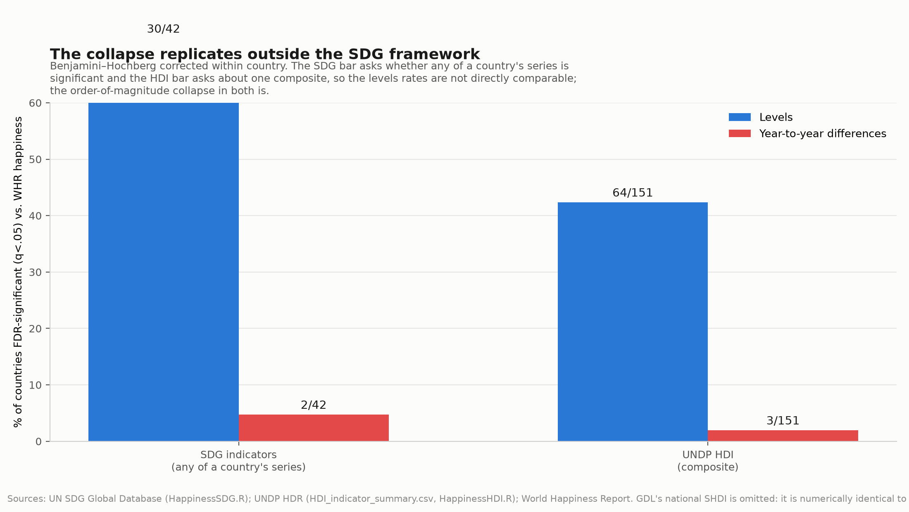
REPLICATION 1 · THE HDI
A deliberately parsimonious index behaves exactly like the sprawling one
The Human Development Index is the opposite of the SDG framework in every way that the dismissal relies on: three dimensions rather than seventeen goals, a single custodian, a stable definition, near-universal coverage. Substituting it for the SDG indicators and holding everything else fixed gives 64 of 151 countries FDR-significant in levels and 3 of 151 in first differences — 42% down to 2%.
The SDG framework collapsed from 71% of countries to 5%. The two rates are not directly comparable, because the SDG test asks whether any of a country's several hundred series is significant while the HDI test asks about one composite; that difference is exactly why the SDG levels rate is higher. What compares is the collapse itself, and it is an order of magnitude in both. Whatever produces the asymmetry, it is not the design of the SDG indicator set.
Countries with an FDR-significant development–happiness association, levels versus first differences, under the SDG framework and under the HDI composite.
I

Slide 5
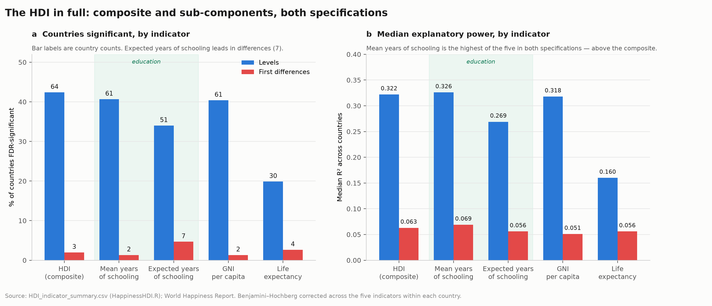
THE STRUCTURE UNDERNEATH
The composite is not the whole result — the five indicators behave differently
HappinessHDI.R reports the composite alongside its four sub-components in both specifications, and the sub-components do not simply track the composite. Mean years of schooling has the highest median R² of the five in levels (0.326) and in differences (0.069) — above the composite HDI itself (0.322 and 0.063). Income is level with it in levels and below it in differences; life expectancy is clearly weakest in levels (0.160, 30 of 151 countries).
The result worth carrying forward is in the differences column. Expected years of schooling is significant in 7 of 150 countries — more than the composite's 3, and more than any other indicator. Seven countries is a small number and the collapse is still severe, so this is not a survival story. But it does mean the education pair leads under both specifications rather than only in the cross-section, which is the strongest form the Act II argument can take.
The HDI composite and its four sub-components, levels and first differences. Benjamini–Hochberg corrected across the five indicators within each country.
I

Slide 6
WHAT THE SUBNATIONAL HDI IS FOR
Not a second producer — a test of whether the national pattern holds inside countries
The Global Data Lab's SHDI cannot serve as an independent replication, and the commentary should not present it as one. At national level it is numerically identical to the UNDP HDI: all 1,696 overlapping country-years agree exactly, because GDL derives the national figure from the UNDP series. Running the collapse design on it reproduces the HDI result by construction rather than by corroboration.
Its actual value is disaggregation. GDL's region-level values are its own — only 655 of 58,224 region-years coincide with their country's national figure — so the SHDI is what lets us ask whether the national development–wellbeing relationship holds at subnational level, and where it does not. That question is the subject of Act III, and the answer turns out to be the most policy-relevant result in the commentary.
I

Slide 7
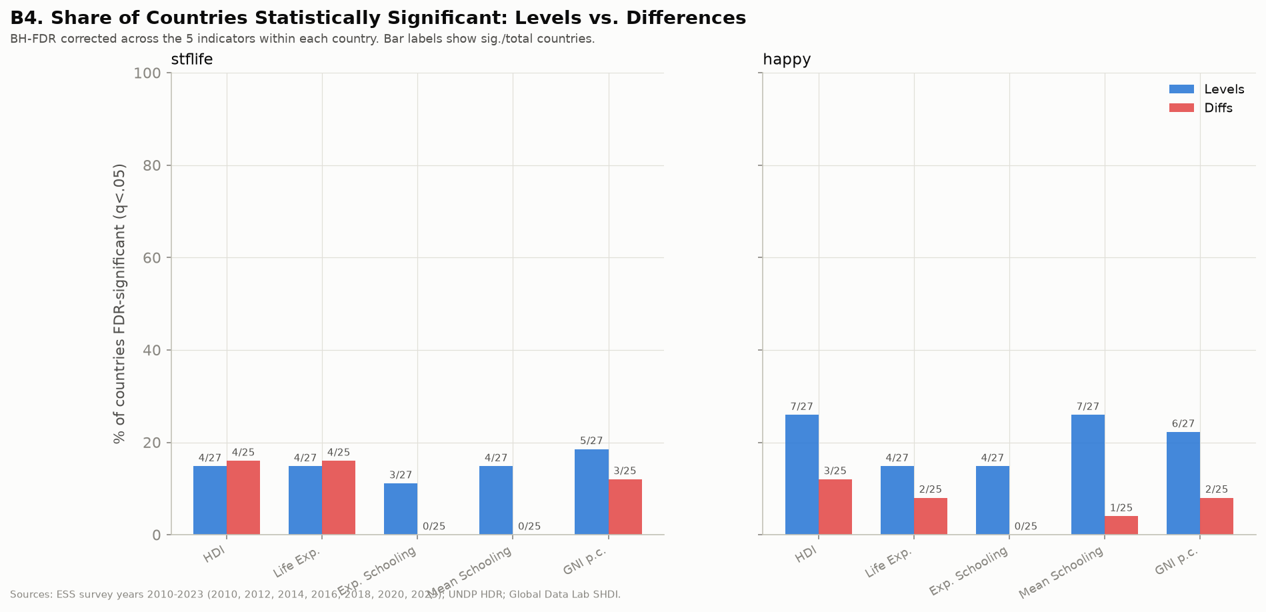
REPLICATION 3 · A SECOND WELLBEING INSTRUMENT
It is not an artifact of the Cantril ladder either
The World Happiness Report's ladder is a single self-anchoring item asked by one survey house. Replacing it with the European Social Survey's own life-satisfaction and happiness items — 36 countries, 351,023 respondents, seven roughly biennial waves from 2010 to 2023 — preserves the asymmetry.
Statistical power is much lower here: seven biennial waves against twelve or more annual World Happiness Report years, so individual country tests are fragile and the ESS replication should be read as corroboration rather than as independent confirmation at the same strength.
The same design with ESS life satisfaction in place of the Cantril ladder. 15% of levels cells and 9% of differences cells are FDR-significant.
I

Slide 8
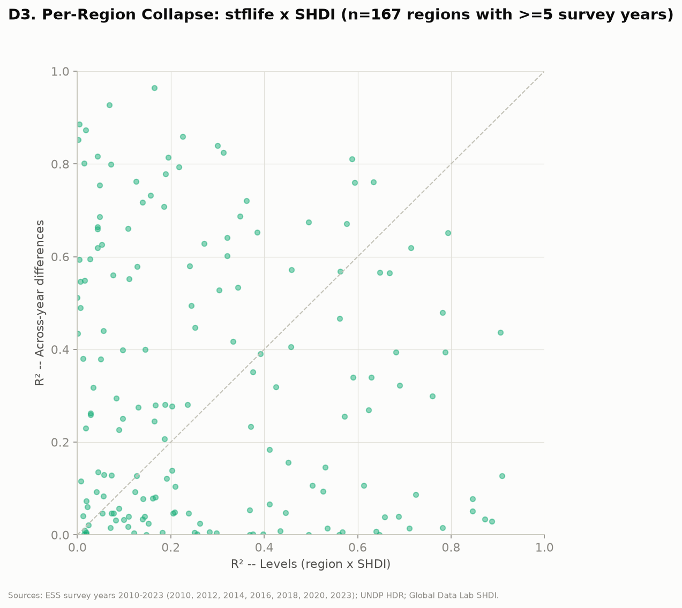
REPLICATION 4 · ONE SCALE DOWN
And it holds across 239 European regions
Region-level subnational HDI against region-mean life satisfaction reproduces the same levels-over-differences pattern, noisier as expected. The result is now documented at three scales — SDG-national, HDI-national, SHDI-regional — and against two wellbeing instruments.
Regional subnational HDI against region-mean ESS life satisfaction, 239 European regions.
I

Slide 9
WHERE ACT I LEAVES US
Two independent replications and one scale test. The commentary can therefore state the asymmetry as a property of the development–wellbeing relationship rather than of any particular index, and move on to the question that actually matters: given that almost nothing survives the move to within-country change, what carries the level signal?

Slide 10
ACT II
II
So what is it about education?
Ranked indicator by indicator, what predicts happiness in levels is survival and basic infrastructure. Education looks like the SDG framework's weakest domain and the HDI's strongest. Both readings are correct, because the two frameworks are not measuring the same thing.
12.7%
SDG4 access & participation, un-pooled from 3.3%
40.9%
of countries, HDI mean years of schooling
32 / 36
countries, ESS respondents' own attainment

Slide 11
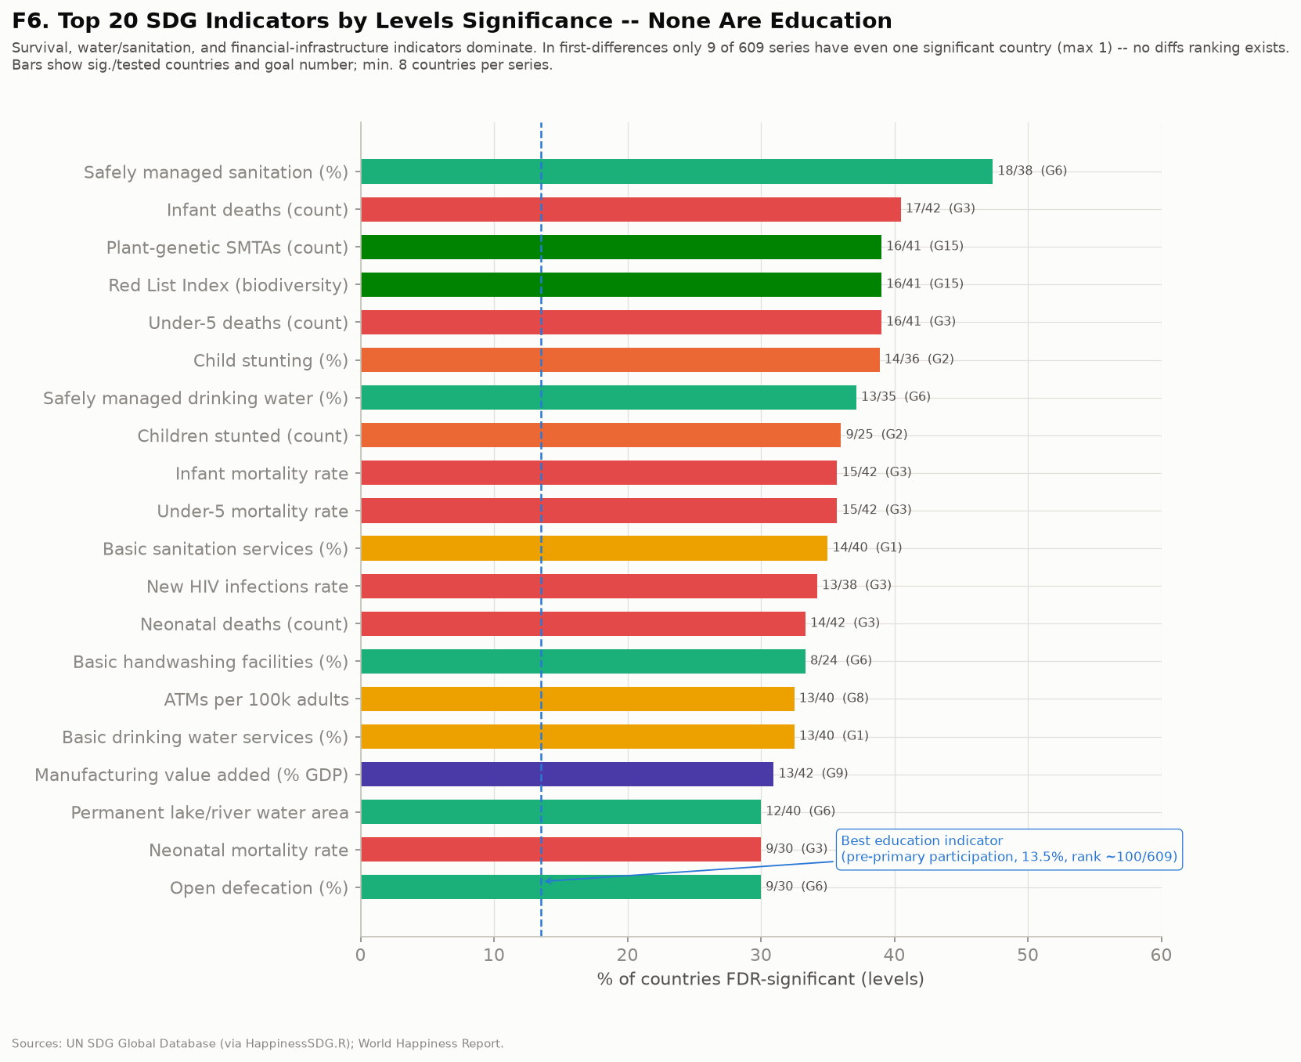
THE AUTOPSY
What survives in levels is the raw development gradient
Ranking the 609 SDG series measured in at least 8 countries by the share of countries in which they are FDR-significant puts child mortality, stunting, water and sanitation, and access to financial services at the top. These are survival and basic infrastructure — the steep part of the development curve, not the 2030 Agenda's institutional superstructure.
The best-performing education indicator ranks about 100th of 609 — and it is participation in organized learning before primary entry, an access measure, which is the same construct Act II turns on. In first differences, only 9 of the 661 series have even one significant country, which is why there is no differences ranking to report at all.
The 20 highest-ranking SDG series of 609, by share of countries FDR-significant in levels.
II

Slide 12
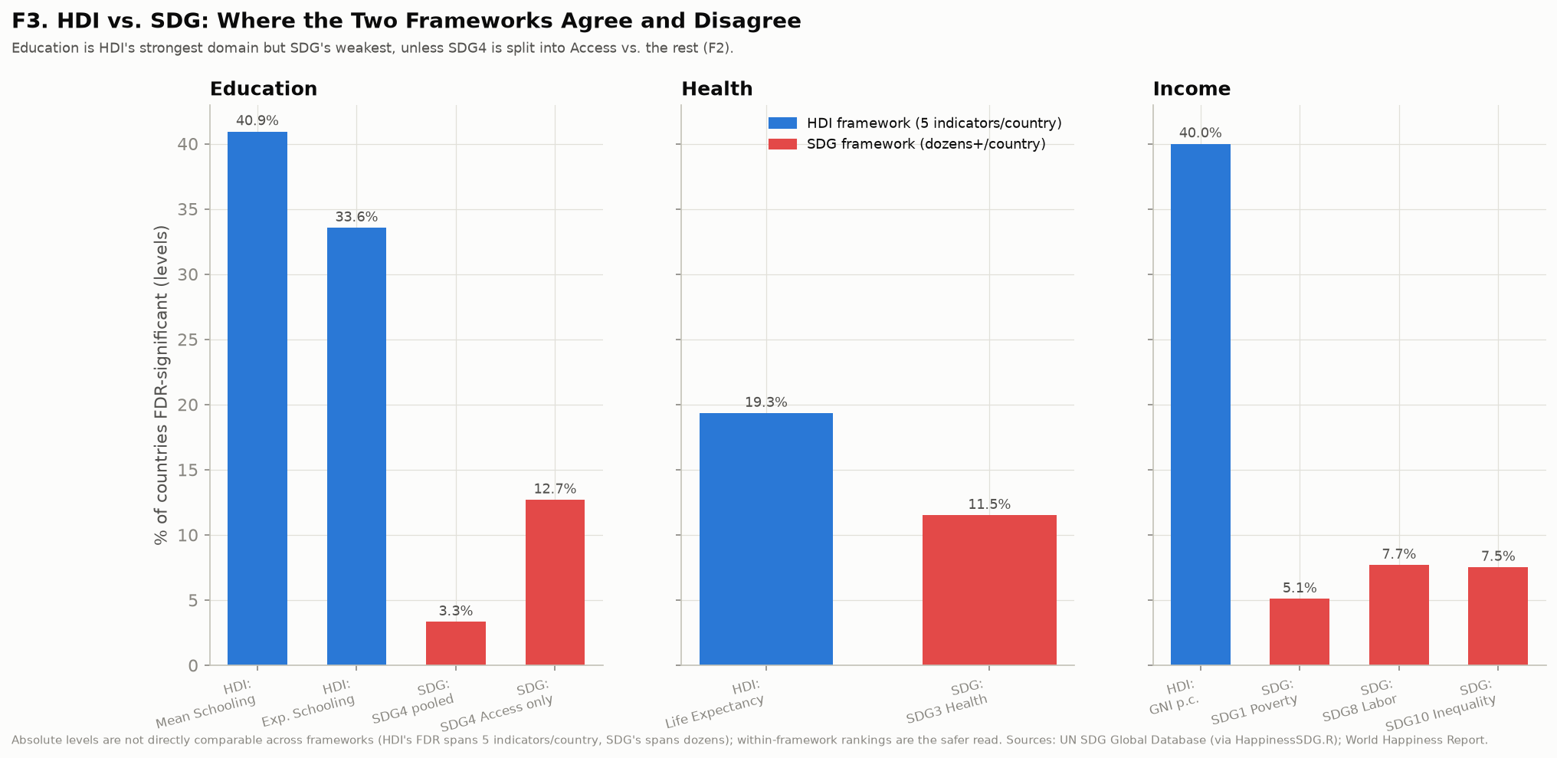
THE CONTRADICTION
Yet inside the HDI, education is the strongest domain
Mean years of schooling is FDR-significant against World Happiness Report happiness in 61 of 150 countries (40.7%) and expected years of schooling in 51 of 150 (34.0%), against 61 of 151 (40.4%) for GNI per capita and 30 of 151 (19.9%) for life expectancy. Education supplies two of the HDI's three strongest components; pooled SDG4 sits at 3.3%. This is the sharpest disagreement between the two frameworks anywhere in the project.
The education pair also leads in first differences, where expected years of schooling is significant in 7 of 150 countries against the composite's 3 (Act I). Education is ahead under both specifications, not only in the cross-section.
The same domains under both frameworks. Absolute levels are not directly comparable across frameworks; the within-framework rankings are the safer read.
II

Slide 13
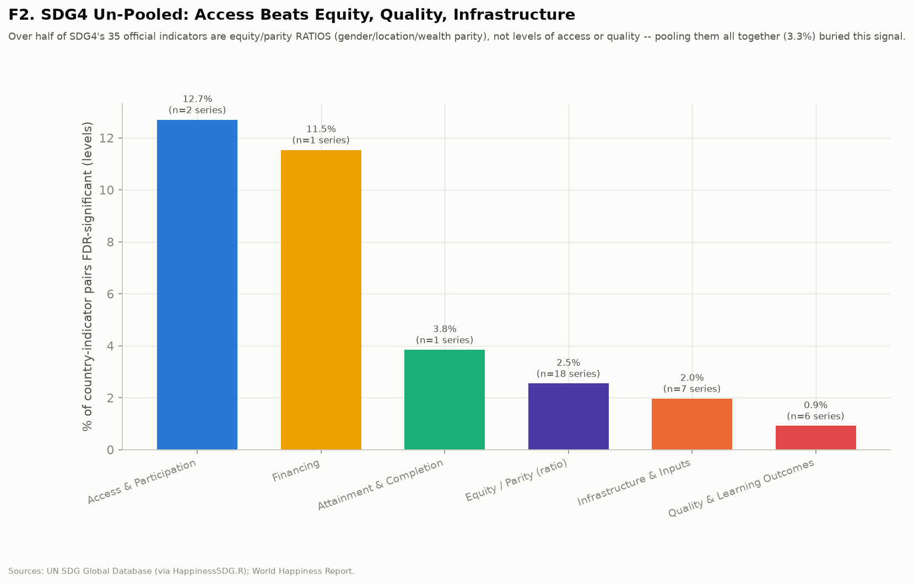
THE RESOLUTION
SDG4's 3.3% describes no construct that exists
SDG4's 35 official series do not measure one thing. Eighteen of them are equity or parity ratios — gender, location, or wealth parity indices — which is a different quantity from the level of access. Six measure learning outcomes, seven measure infrastructure and inputs, and only two measure access and participation directly.
Split by construct, access and participation reaches 12.7%, comparable to SDG3 health at 11.5%, while learning outcomes sit at 0.9% and parity ratios at 2.5%. The pooled 3.3% is an average across constructs that point in different directions, and it describes none of them. That is a methodological finding in its own right: pooling within a goal can manufacture a null.
SDG4 split by what each indicator actually measures, with the pooled figure marked.
II

Slide 14
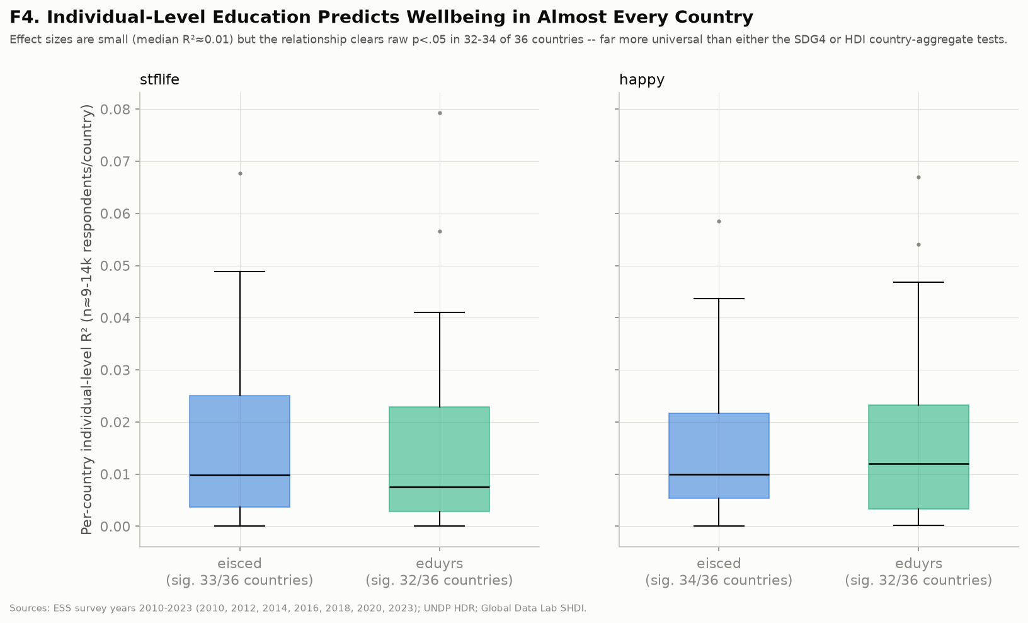
ALL THE WAY DOWN
The signal survives to the individual respondent
ESS respondents' own educational attainment predicts their own life satisfaction in 32 to 34 of 36 countries, depending on whether attainment is measured as the harmonised ISCED category or as years completed. The effects are small — median R² around 0.01 — but nothing else in this project is that consistent across countries.
Per-country tests of respondents' own attainment against their own life satisfaction, 36 ESS countries.
II

Slide 15
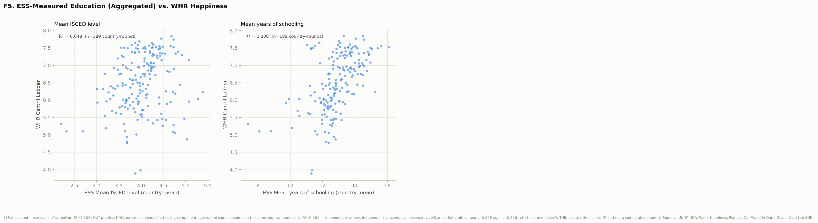
TRIANGULATION
Two surveys, two outcomes, one answer
Aggregating ESS respondents' reported years of schooling to the country level and regressing World Happiness Report happiness on it gives R² = 0.308 across 189 country-rounds. The HDI's own mean-years-of-schooling series, on exactly the same cells and the same outcome, gives 0.161. An independently measured schooling variable does not merely reproduce the HDI's — it roughly doubles it.
An earlier draft compared 0.308 against 0.326 and called them near-identical. That was an error: 0.326 is the median within-country time-series R² from HappinessHDI.R, not a cross-country figure, so the two were never comparable. The corrected comparison is stronger, not weaker.
Country-aggregated ESS schooling against WHR happiness, beside the HDI's own schooling component.
II

Slide 16
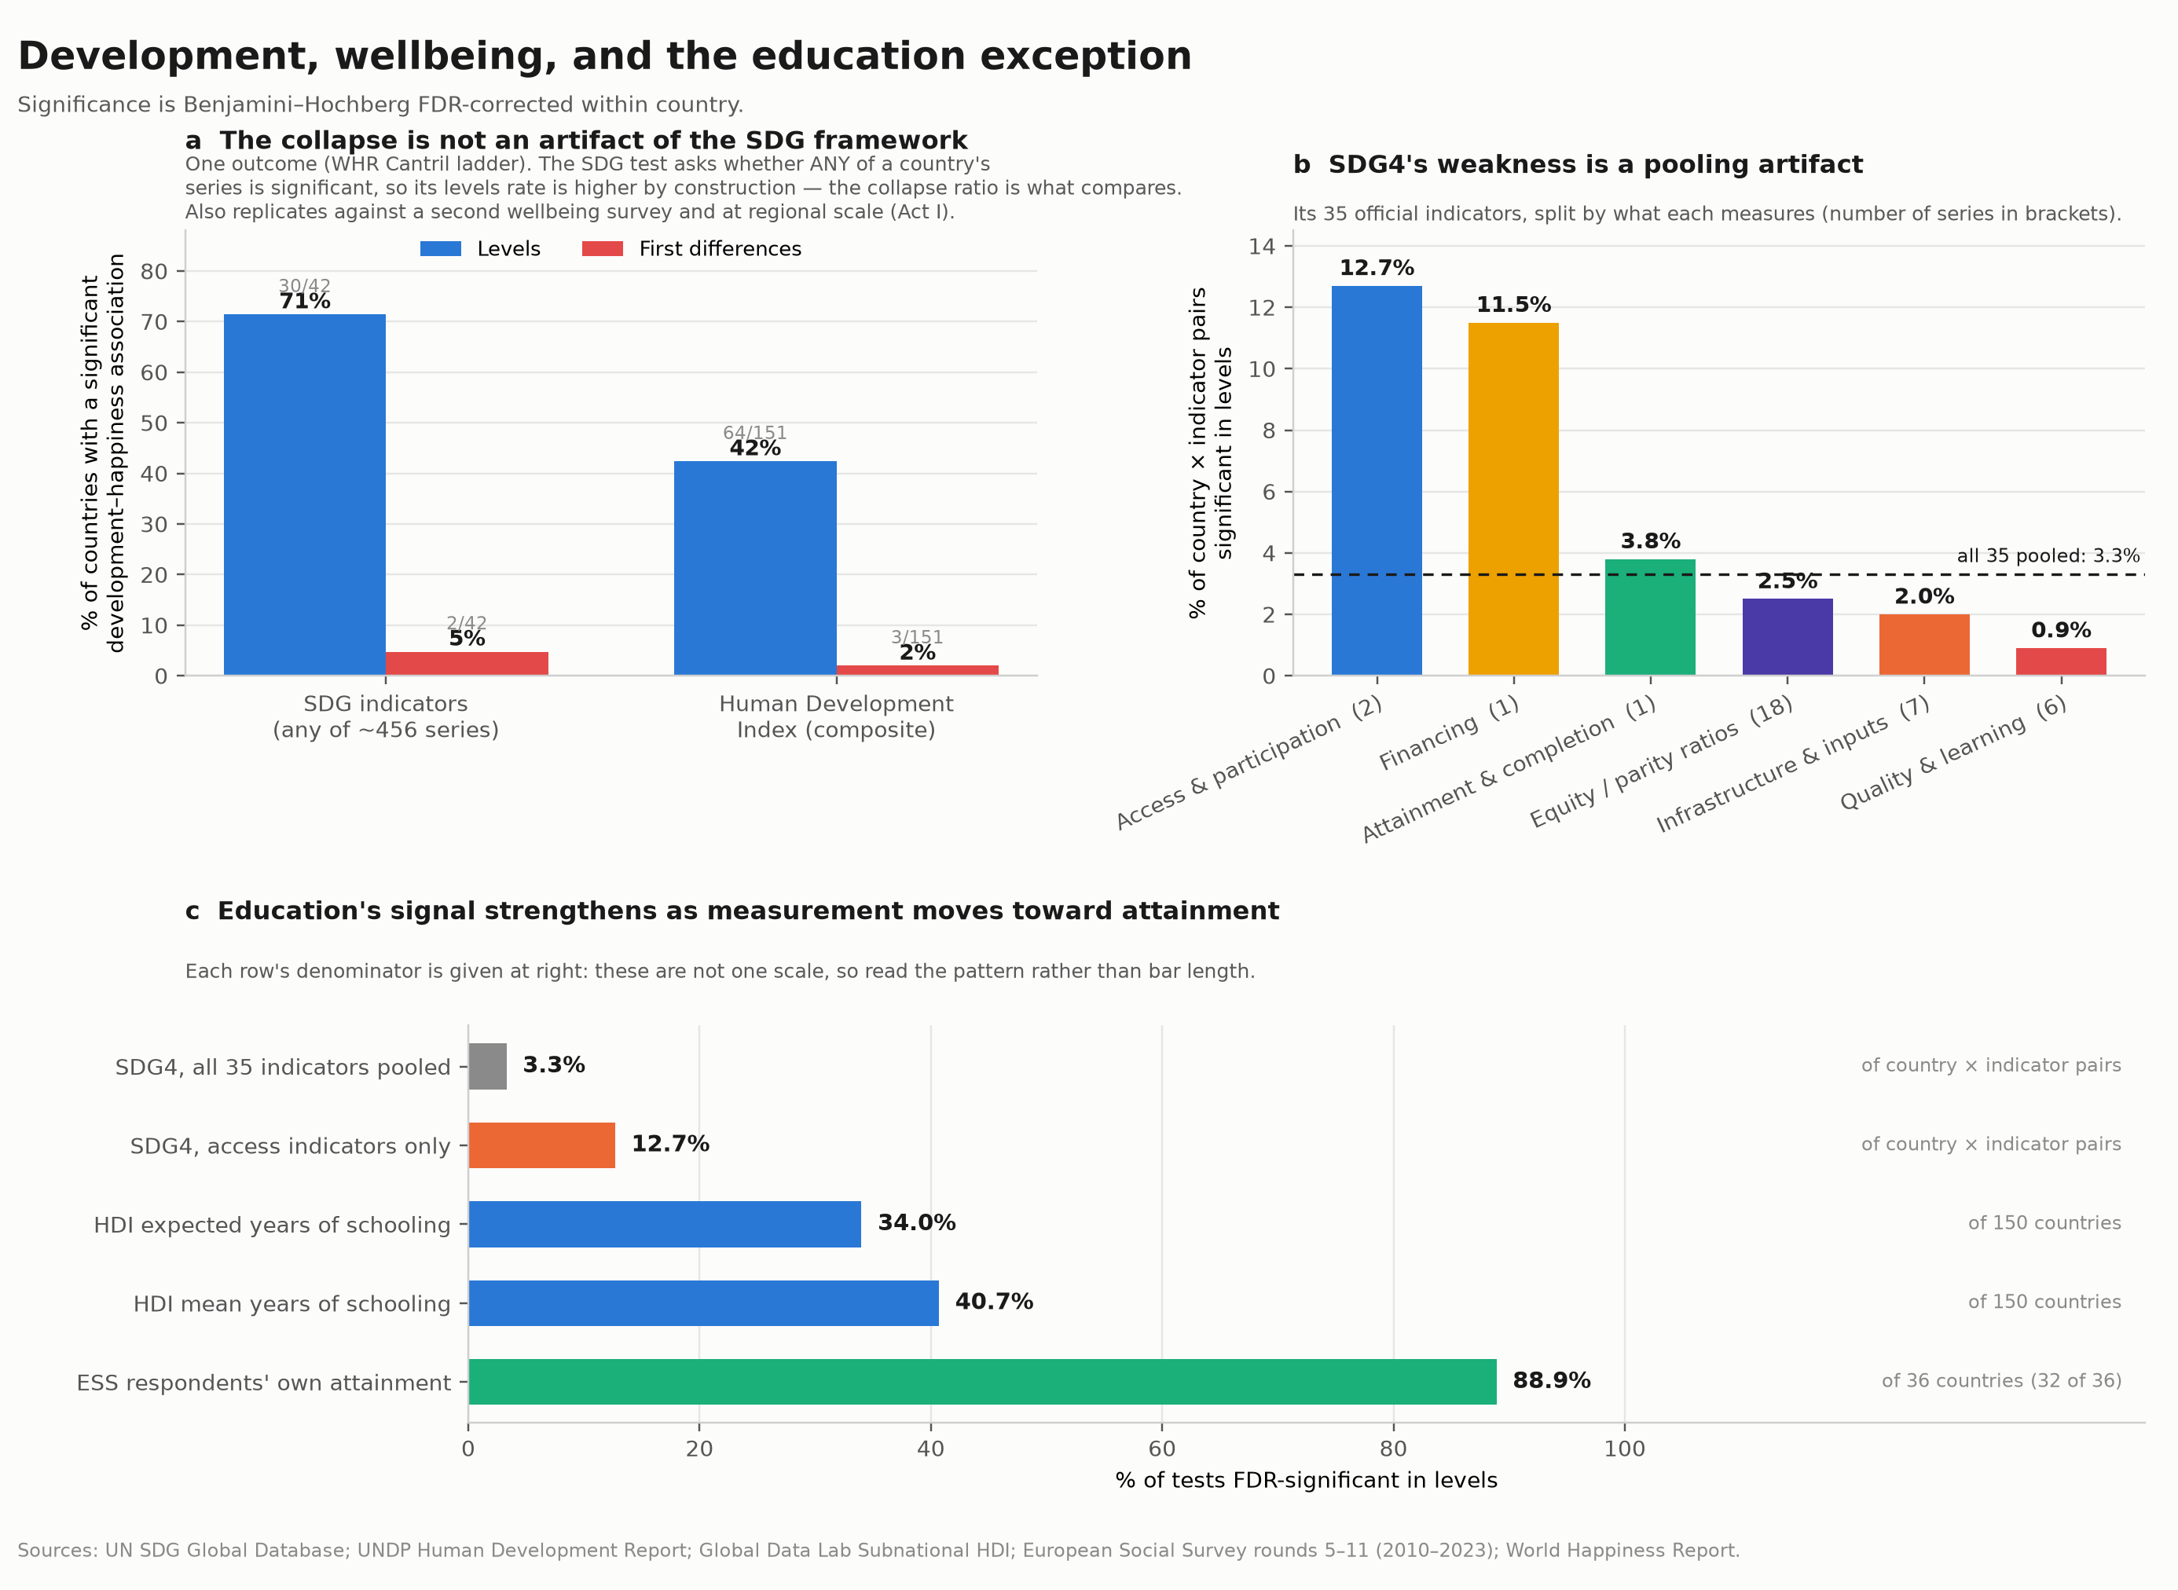
THE COMPOSITE
The three panels the commentary needs
Commentaries carry one or two display items, so the three results that carry the argument have to share a figure: the replicated collapse, SDG4 un-pooled, and education's signal as the unit of measurement moves from pooled indicators down to individual respondents.
One caution to keep in the caption: panel c's rows do not share a denominator. It shows that the construct holds at every level of aggregation, not that the effect grows.
Proposed Figure 1 for submission. Draft — panel c's denominators differ by row and are labelled at right.
II

Slide 17
WHERE ACT II LEAVES US
The precise claim, and the one the commentary must not overstate: education does not escape the differences collapse. Nothing does — expected years of schooling leads that column with 7 of 150 countries, which is a lead over the composite and still a collapse. Education is the exception in consistency — the one construct whose level signal holds across frameworks, producers, wellbeing instruments, and units of observation all the way down to the individual, and it holds only when education is measured as attainment and access.

Slide 18
ACT III
III
Priorities, and what kind of education
Two questions follow. Where should the lever be pulled — which turns on scale, because the ordering of predictors inverts inside countries. And what kind of education, because the wellbeing signal sits with attainment and access rather than with the measured learning the post-2030 architecture is built around.
+0.87 → +0.12
development, between countries → within them
12.7%
access & participation
0.9%
measured learning outcomes

Slide 19
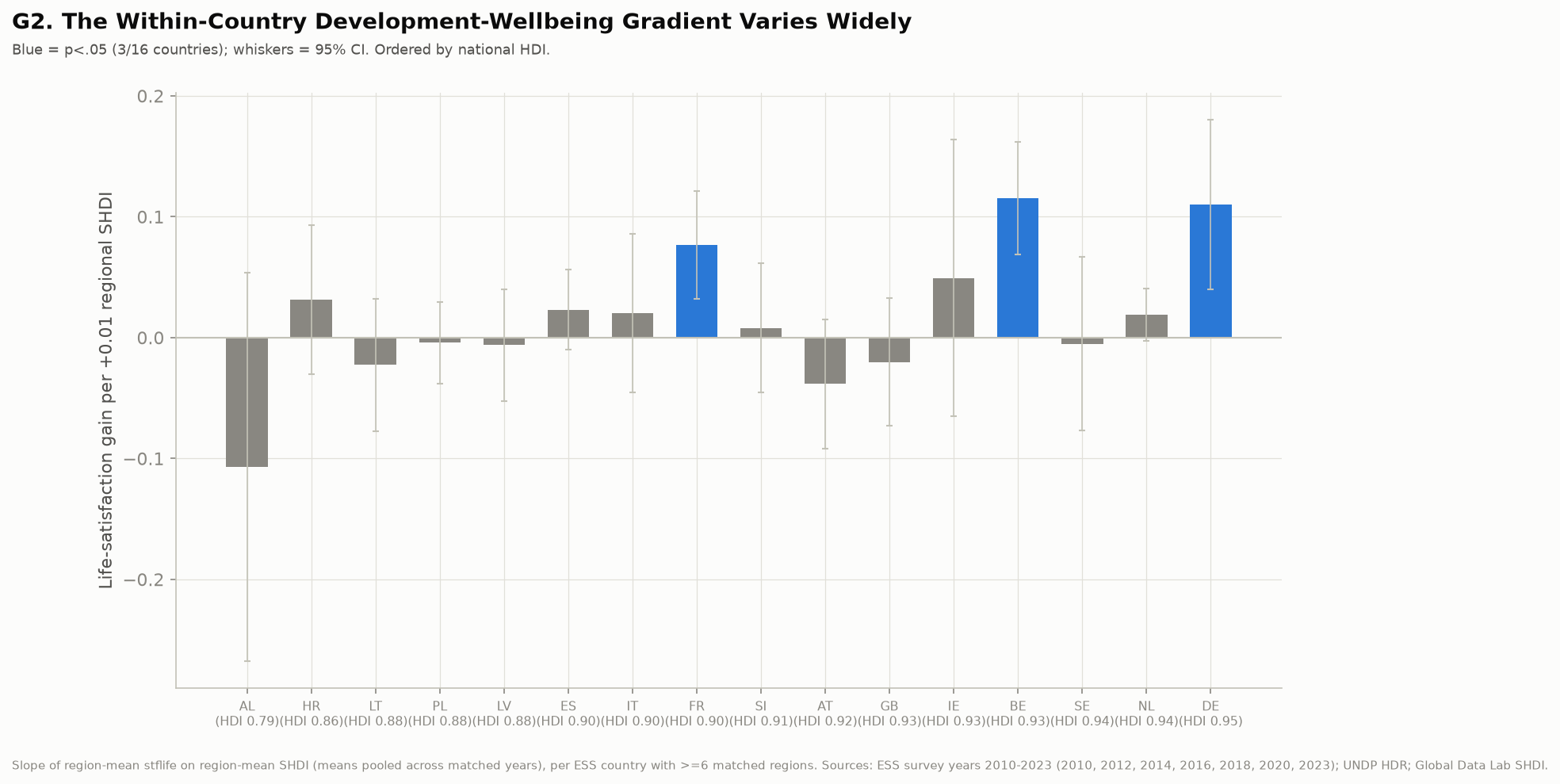
WHERE THE LEVER IS
Development inequality inside countries mostly does not become wellbeing inequality
Below the Very High tier, countries contain multitudes. Germany's regions span 0.05 of subnational HDI; China's span 0.30 and India's 0.19 — several development tiers' worth of variation inside single countries. If regional development drove regional wellbeing, this is where it would show.
It mostly doesn't. Holding country fixed and regressing region-mean life satisfaction on regional subnational HDI gives a significantly positive gradient in only 3 of 16 ESS countries — France, Belgium, and Germany — and the gradient is not steeper where internal inequality is larger. Which country's ladder you are on matters more than which rung you occupy within it.
Within-country gradients of region-mean life satisfaction on regional SHDI, 16 ESS countries ordered by national HDI.
III

Slide 20
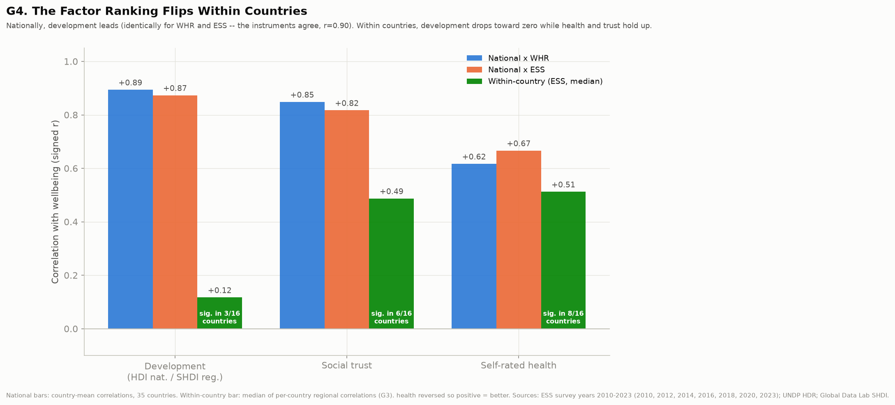
THE FLIP
Health and social trust do inside countries what development does between them
Between countries, development leads and the two wellbeing instruments agree almost exactly: the HDI correlates at r = +0.89 with World Happiness Report happiness and +0.87 with ESS life satisfaction, with trust and health close behind and all three positive.
Within countries the ranking inverts. Development falls to a median regional correlation of +0.12, significant in 3 of 16 countries, while self-rated health holds at +0.51 (8 of 16) and social trust at +0.49 (6 of 16). The World Happiness Report cannot see this at all — it has no subnational values. It is the specific thing the ESS adds.
Two cautions on the detail. The health-versus-trust ordering is not stable: aggregating region means across waves rather than within them reverses it, putting trust at +0.57 and health at +0.50. What is stable, under every specification we tried, is that both sit near +0.5 while development sits near zero. And per-country coverage varies sharply — Italy matches only 30% of respondents to a region, Sweden 57%, Croatia 69%, against 91–100% elsewhere. Dropping those three, or dropping regions built on fewer than 200 respondents, leaves the flip intact.
Candidate Figure 2. National correlations beside within-country regional correlations, for development, health, and trust.
III

Slide 21
ON PRIORITIES
Indicator dashboards are not wellbeing instruments
Development indicators tell you reliably where wellbeing is high. They tell you almost nothing about when it will rise. Across every framework tested here, year-on-year indicator movement carries essentially no wellbeing information within the measurement window — a decade or so.
The implication is about horizon and instrument, not about whether development matters. A monitoring architecture designed to reward annual indicator movement should not be read as tracking wellbeing, and a government that improves its dashboard position in a given year should not expect a wellbeing dividend inside the same electoral cycle.
III

Slide 22
ON WHAT KIND OF EDUCATION
The consensus moved to learning; the wellbeing evidence points at attainment
Global education policy has shifted decisively over the past decade from schooling to learning — the learning-crisis framing, learning-poverty targets, and an indicator architecture built around measured proficiency. The premise is that years in school without demonstrated learning are an empty metric.
Every level of aggregation we can test points the other way. Attainment and access carry the wellbeing signal — 12.7% for SDG4 access, 34.0% and 40.7% for the HDI's schooling components, 32 of 36 countries at the individual level — while measured learning outcomes sit at 0.9% and parity ratios at 2.5%.
III

Slide 23
WHAT WE CANNOT SAY
Three limits that keep this a question rather than a recommendation
None of this is causal. The design is correlational throughout, and the levels results in particular are cross-sectional comparisons between countries.
Schooling cannot be separated from what schooling stands in for. Years attained proxy labour-market position, economic security, autonomy, and social standing, and this design cannot pull them apart. Individual effects are small: a median R² near 0.01.
The within-country results are Europe-only. The ESS is the only regional wellbeing source with the coverage this design needs — Gallup's subnational files are paywalled — so the priorities argument generalises across 16 European countries and not beyond them. That belongs in the text as a scope condition, not buried in a limitations paragraph, because the ranking flip is the most policy-relevant result here and will be the most contested.
Some of the parity and learning indicators' weakness is coverage rather than construct — they are the youngest and thinnest series in the SDG database, and thin series fail significance tests for uninteresting reasons. The commentary should concede this explicitly and say what would settle it.
III

Slide 24
THE ASK
Should wellbeing be a criterion for education targets after 2030?
That is the question the commentary exists to pose, and it has a sharp form: we have built a global education monitoring architecture around measured learning outcomes, and the wellbeing evidence points at years attained. If both are to be kept, someone has to say what the education system is being optimised for.
A commentary cannot settle that. It can put the disagreement on the record with the evidence attached, which is what the three acts are for.
III

Slide 25
WHERE ACT III LEAVES US
The recommended framing for submission: lead with the education exception as the positive finding, use the generalised collapse as the backdrop that makes it surprising, and close on the target-setting question. That ordering makes Act I load-bearing without making it the story.

Slide 26
Decisions for the team
Five things the acts do not settle, in the order they block drafting.
FRAMING
Lead with the education exception and use the generalised collapse as Act I backdrop — recommended — or lead with the robustness result and treat education as the coda. This decides title, abstract, and venue.
DISPLAY ITEMS
Commentaries allow one or two. Proposed: the three-panel composite as Figure 1, the ranking flip as Figure 2. Everything else moves to supplementary.
SCOPE OF THE WITHIN-COUNTRY WORK
It now sits inside Act III as the evidence on priorities. Does it belong there, or in a third paper? It is the most policy-relevant and the most contested result we have, and it is Europe-only.
DATA INVESTMENT
The Global Data Lab's separate Education & Work dataset carries 43 subnational schooling indicators by cohort and sex. Pulling it would let us test the education finding subnationally. Before submission or after review?
METHODS NOTE
Pooled R² and significant-country share tell different stories at several points. Proposal: report both throughout and discuss the divergence explicitly as a secondary contribution.

Slide 27
Evidence appendix
Everything the three acts rest on but do not carry. In submission these become supplementary material.

Slide 28
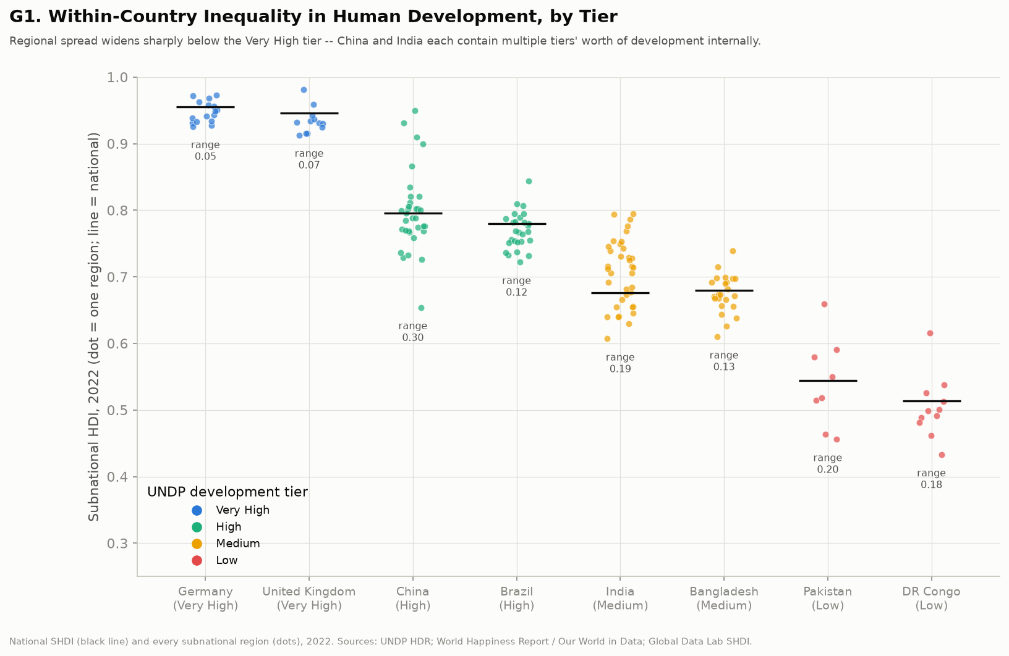
APPENDIX
Regional development spread within countries
Every region a dot, two countries per UNDP development tier, 2022. Germany's regions span 0.05 of SHDI; China's span 0.30, India's 0.19.

Slide 29
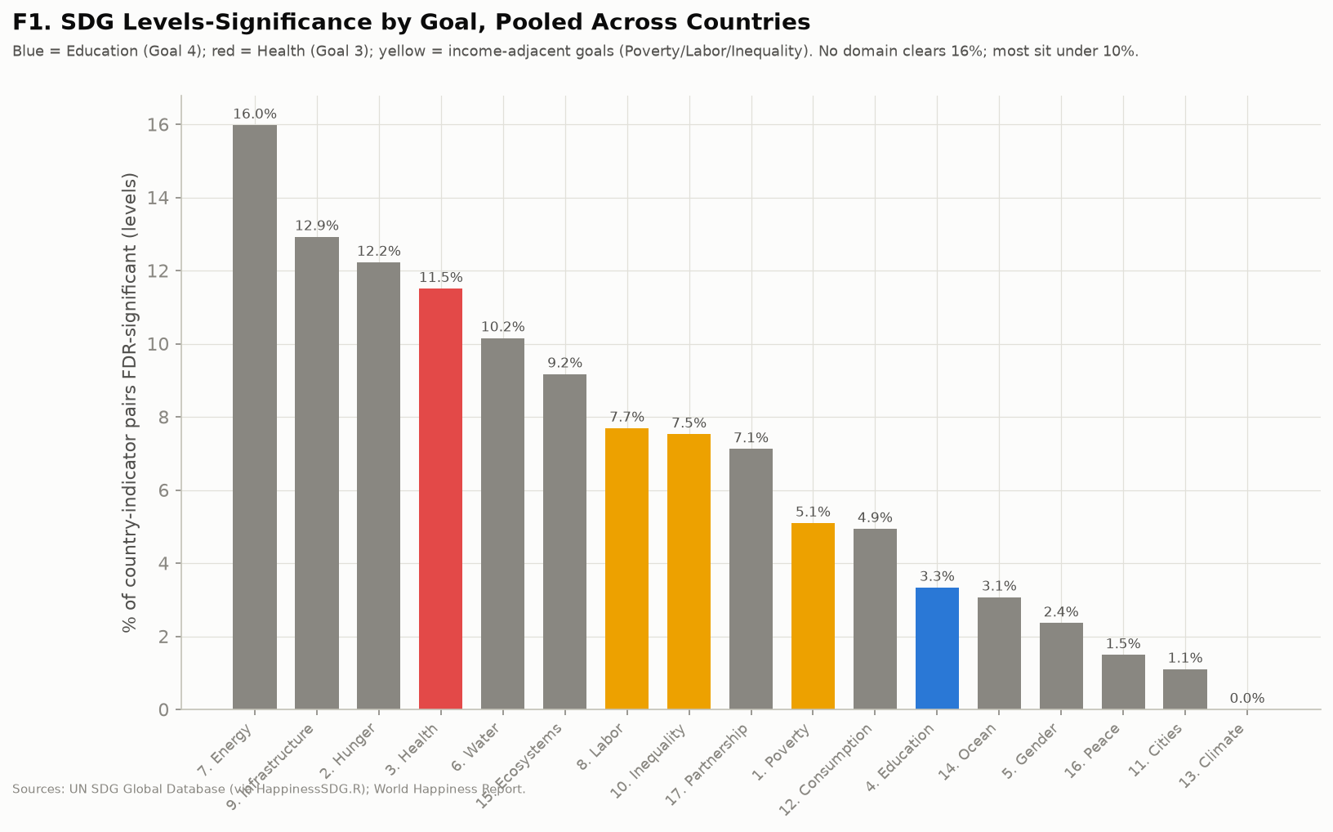
APPENDIX
SDG significance by goal, pooled
The leading goal (Energy, 16.0%) clears FDR significance in barely one country-test in six; pooled Education ranks 12th of 17.

Slide 30
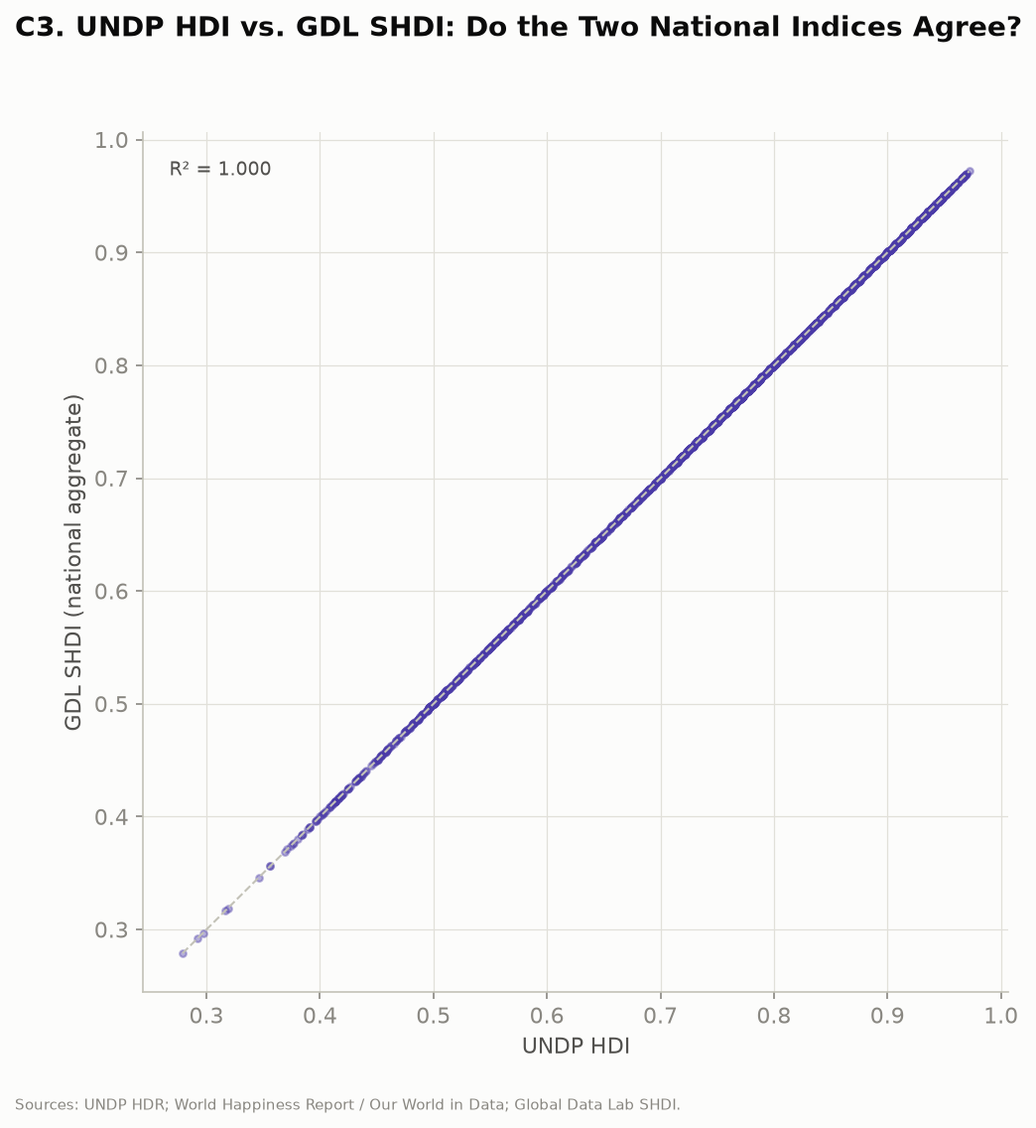
APPENDIX
GDL national SHDI against the UNDP HDI
The two are the same series — R² = 1.000, every country-year identical, because GDL derives the national figure from the UNDP index. Retained to document the check, not as validation: agreement here says nothing about the subnational disaggregation, which is where GDL's own data begins.

Slide 31
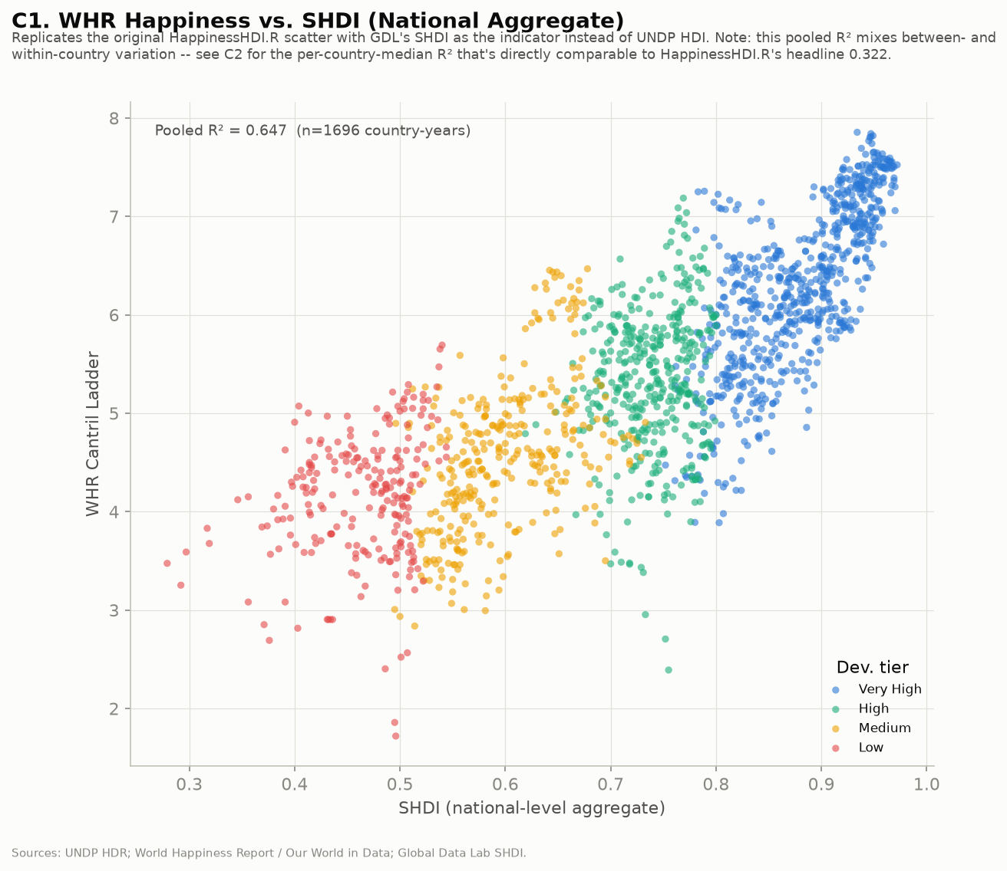
APPENDIX
Subnational HDI against WHR happiness, levels
The familiar development-tier gradient with SHDI in place of HDI.

Slide 32
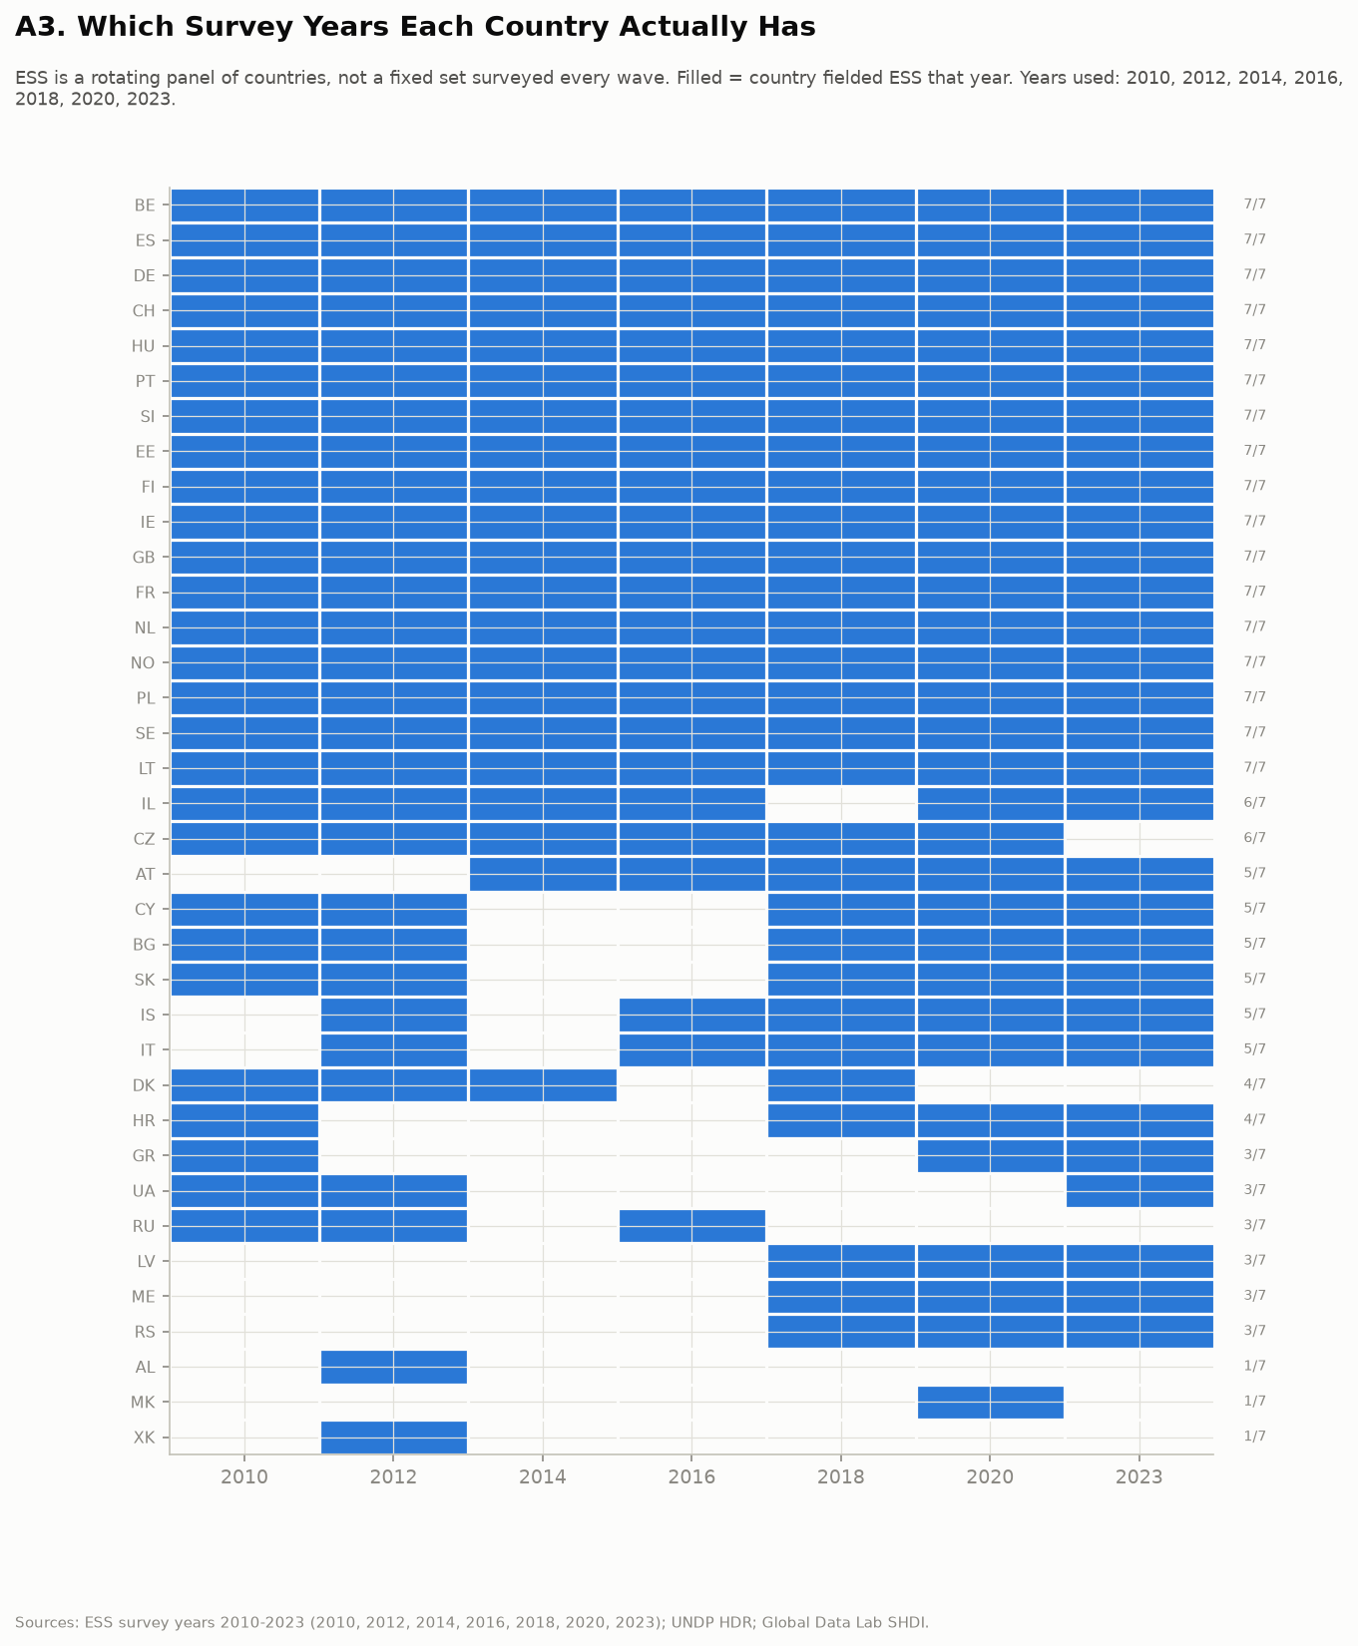
APPENDIX
ESS coverage by country and year
A rotating panel: 36 countries, roughly biennial from 2010 to 2023, with 17 countries present in all seven waves. This is the power constraint behind every ESS significance test.

Slide 33
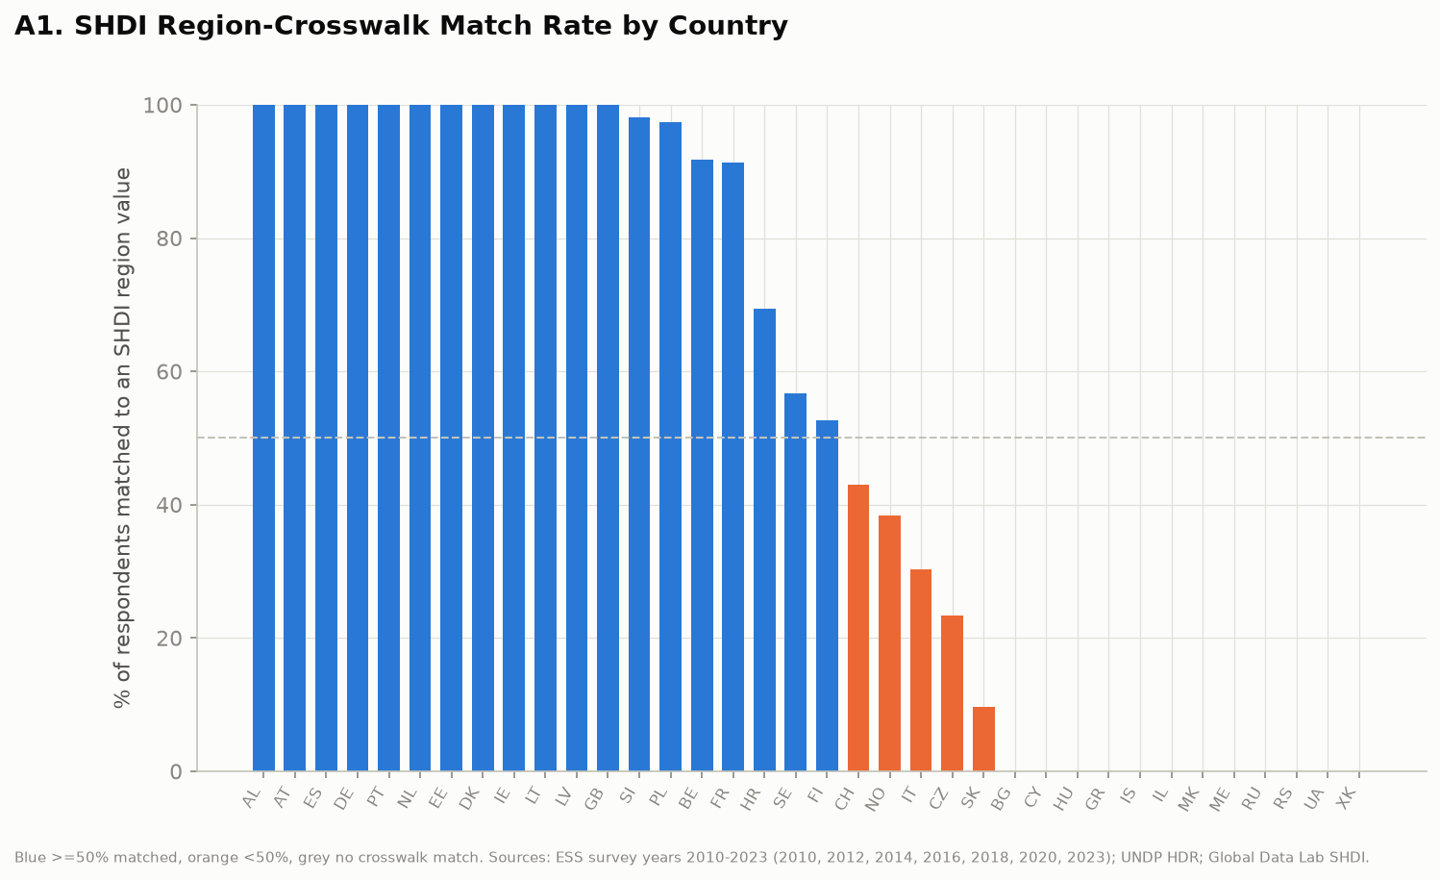
APPENDIX
ESS-to-SHDI region crosswalk
62% of respondents, across 24 of 36 countries, matched to a subnational SHDI value through the NUTS-to-GDL crosswalk.

Slide 34
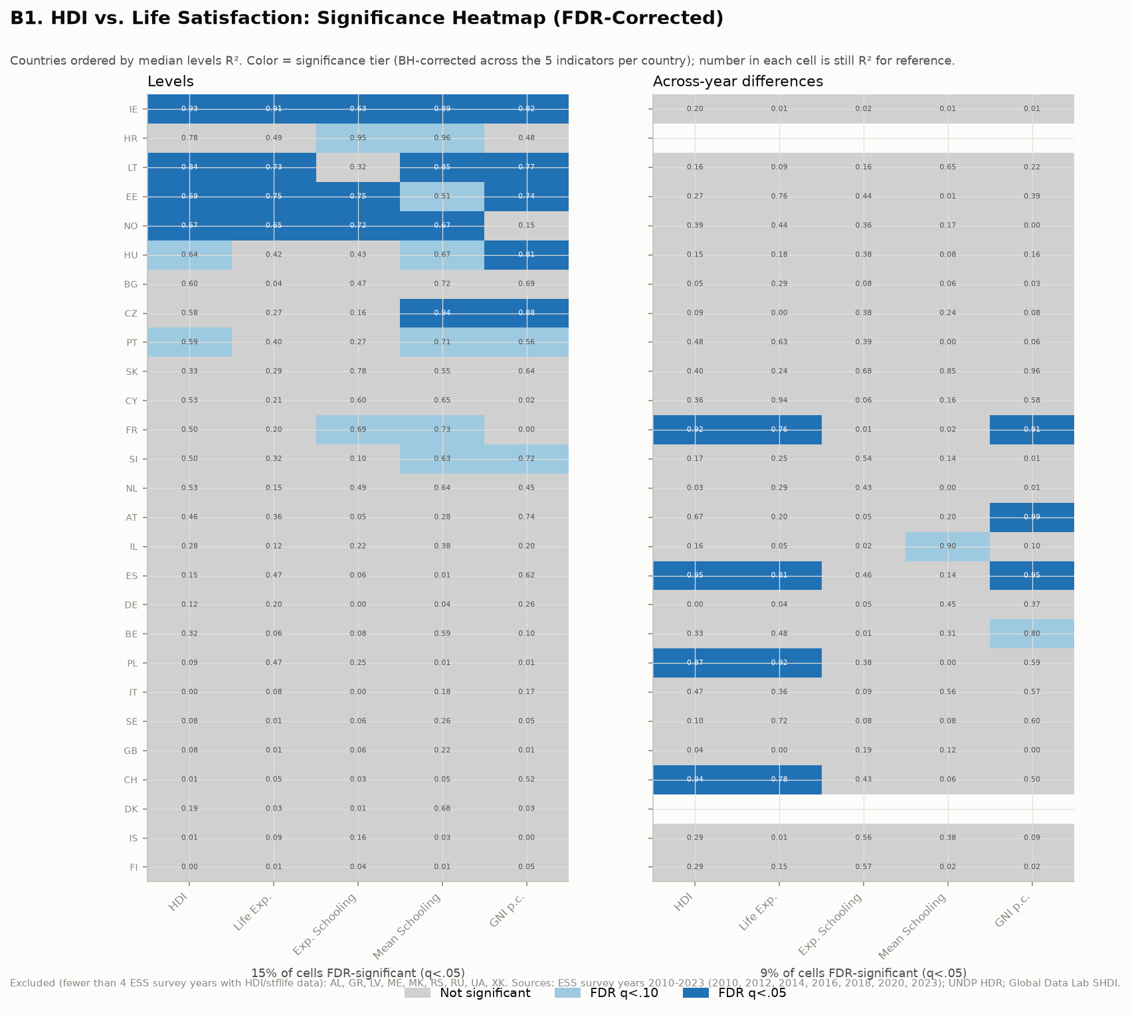
APPENDIX
Country × indicator significance, ESS
15% of levels cells and 9% of differences cells FDR-significant; direction consistent with the WHR results, power much lower.

Slide 35
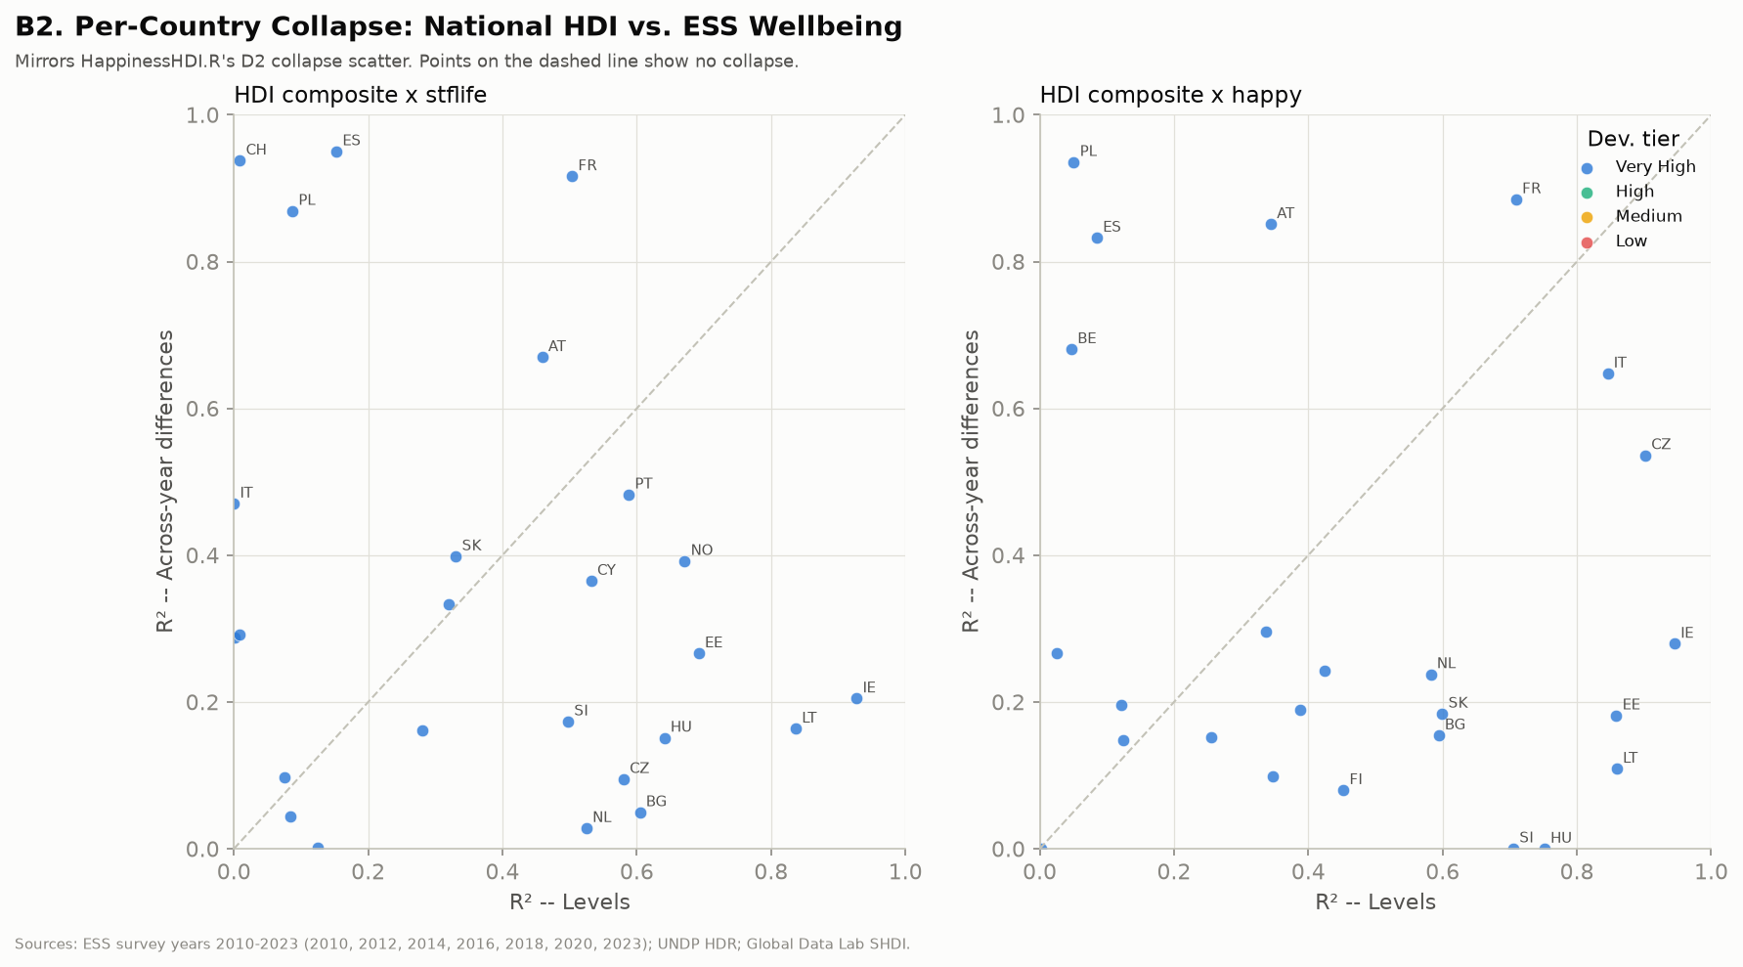
APPENDIX
Per-country collapse, ESS
More above-the-line exceptions than the WHR analysis shows — sparse waves cut both ways.

Slide 36
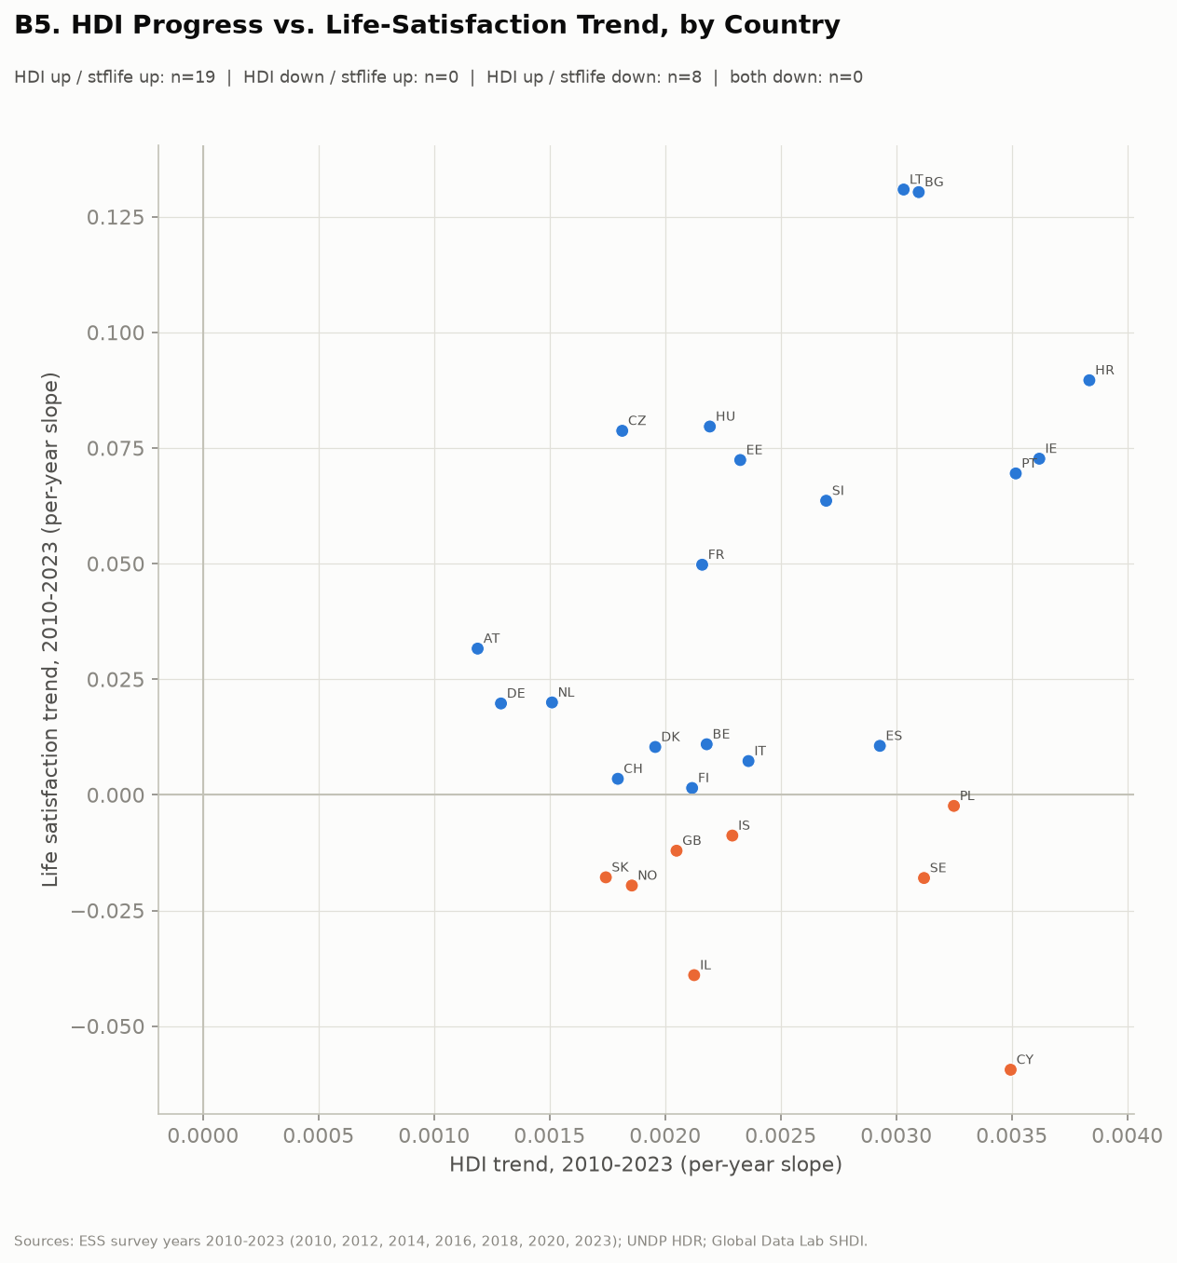
APPENDIX
HDI progress against life-satisfaction trends, 2010–2023
HDI rose nearly everywhere. ESS life satisfaction rose in 19 countries and fell in 8.

Slide 37
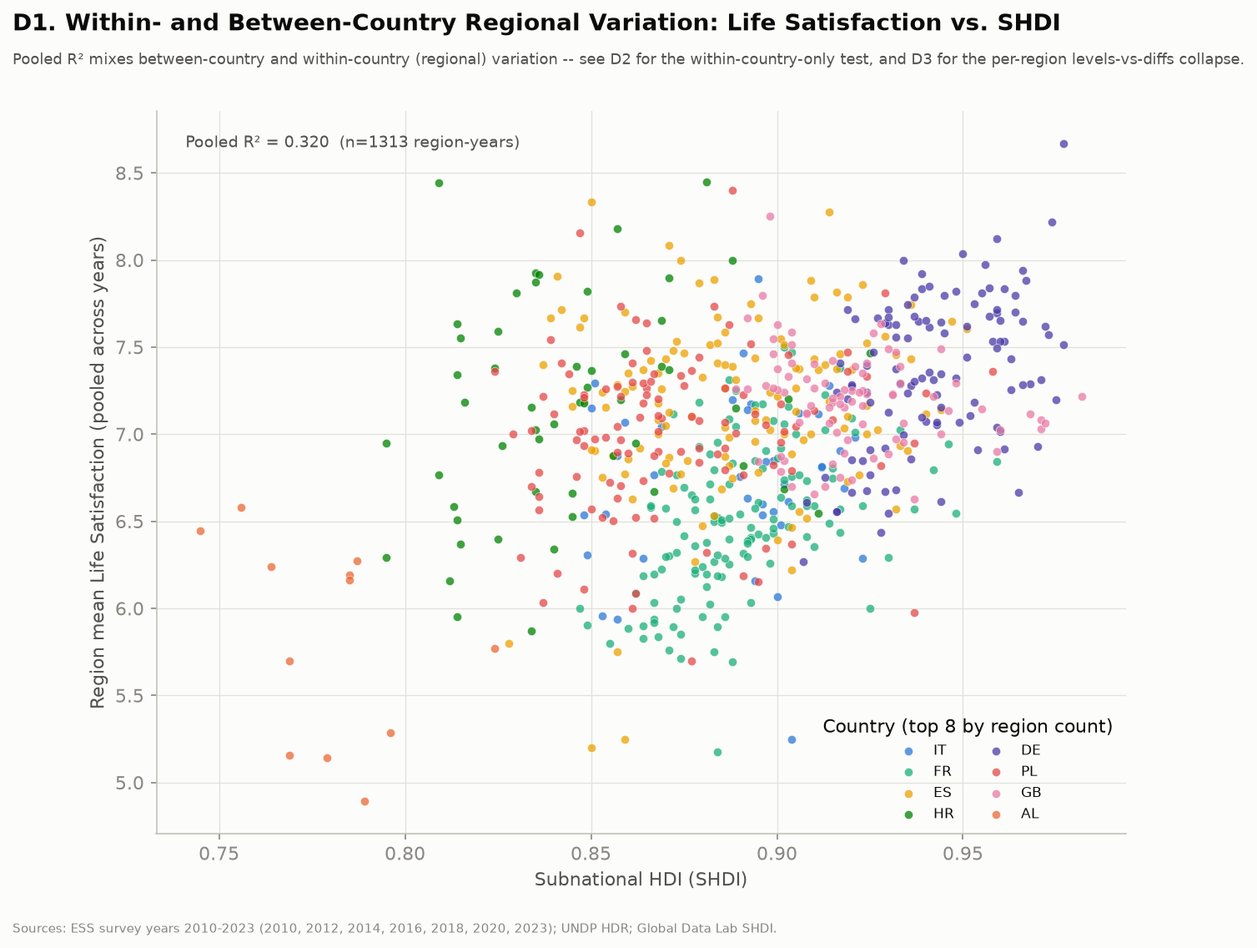
APPENDIX
Region-level SHDI against life satisfaction, pooled
1,313 region-years, pooled R² = 0.32 — this mixes between- and within-country variation, which the within-country panels separate.

Slide 38
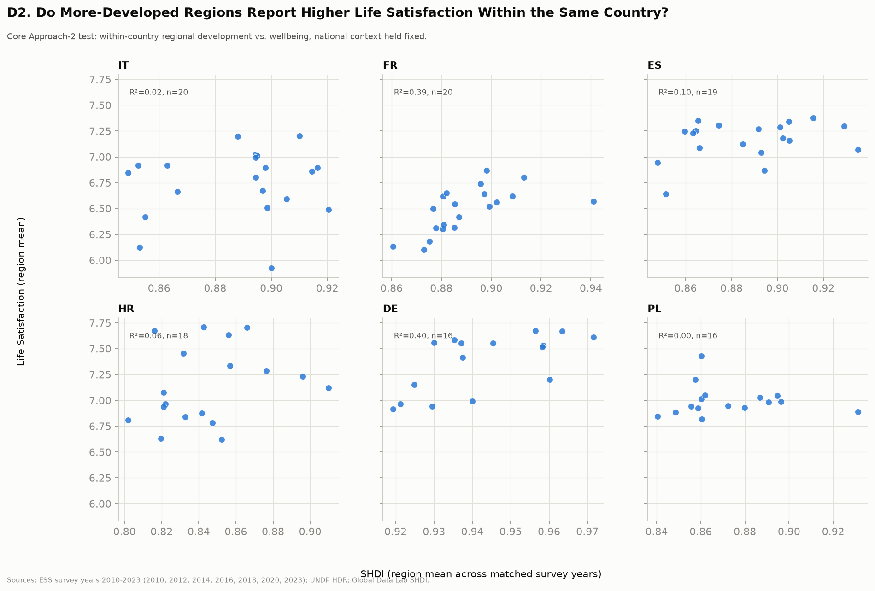
APPENDIX
Within-country regional gradients, small multiples
Holding country fixed, the regional development–wellbeing gradient is weak in most countries. France is the clearest exception.

Slide 39
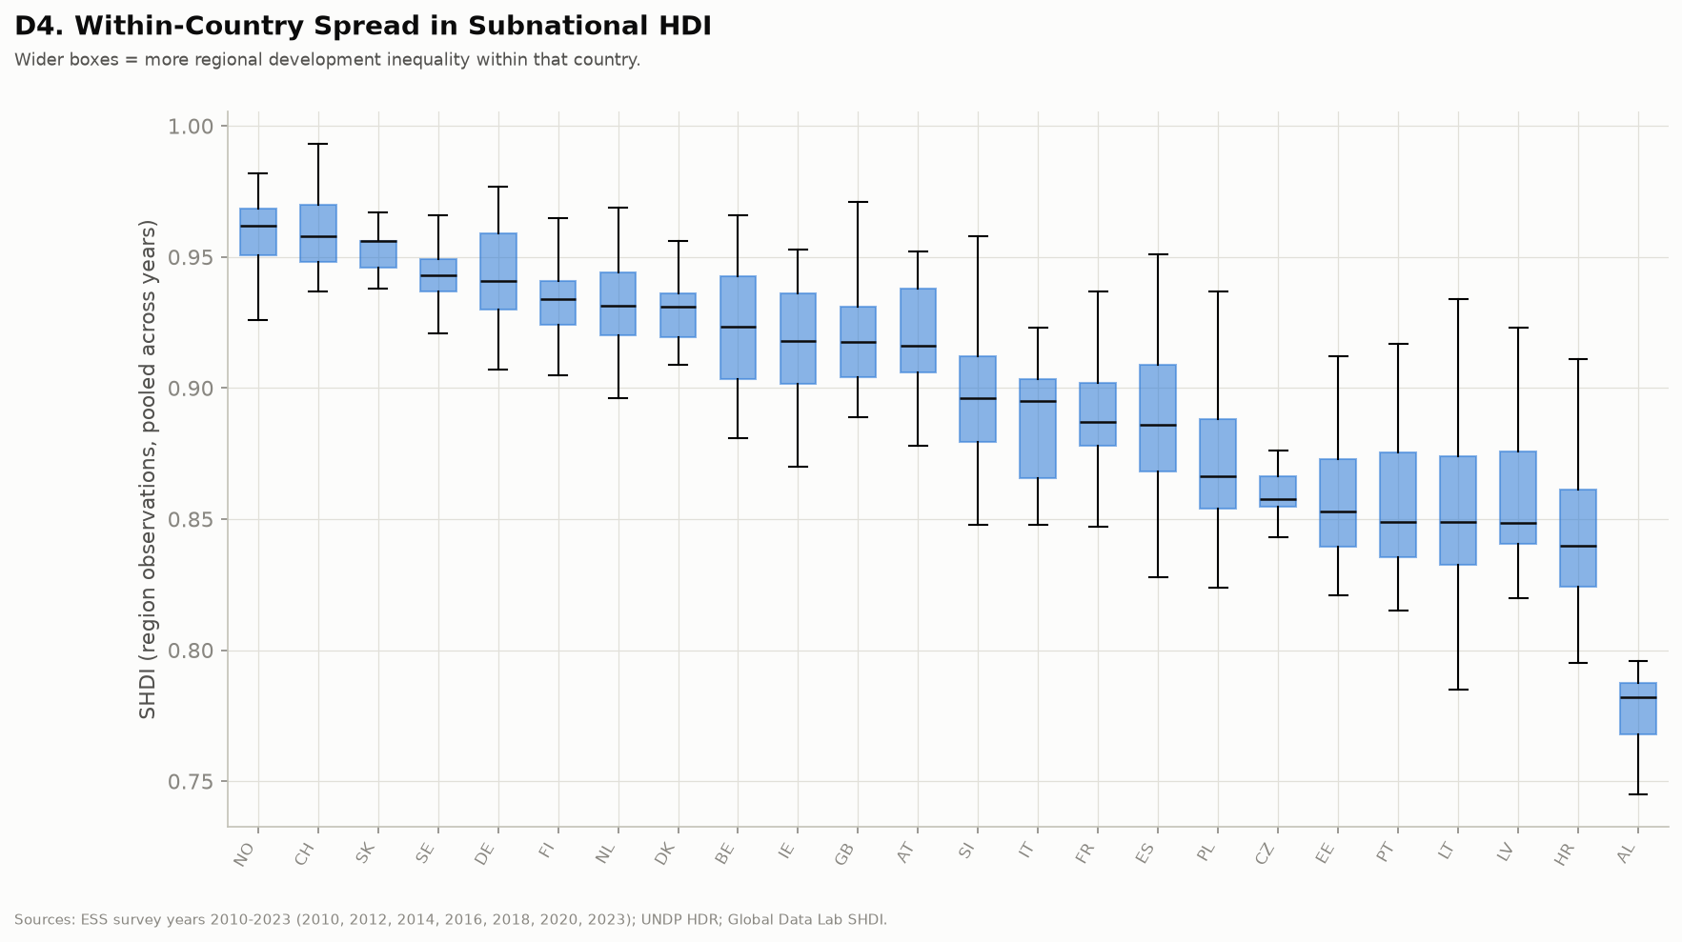
APPENDIX
Regional SHDI spread within ESS countries
Italy and Poland carry several times the internal development inequality of Germany or the Nordics.

Slide 40
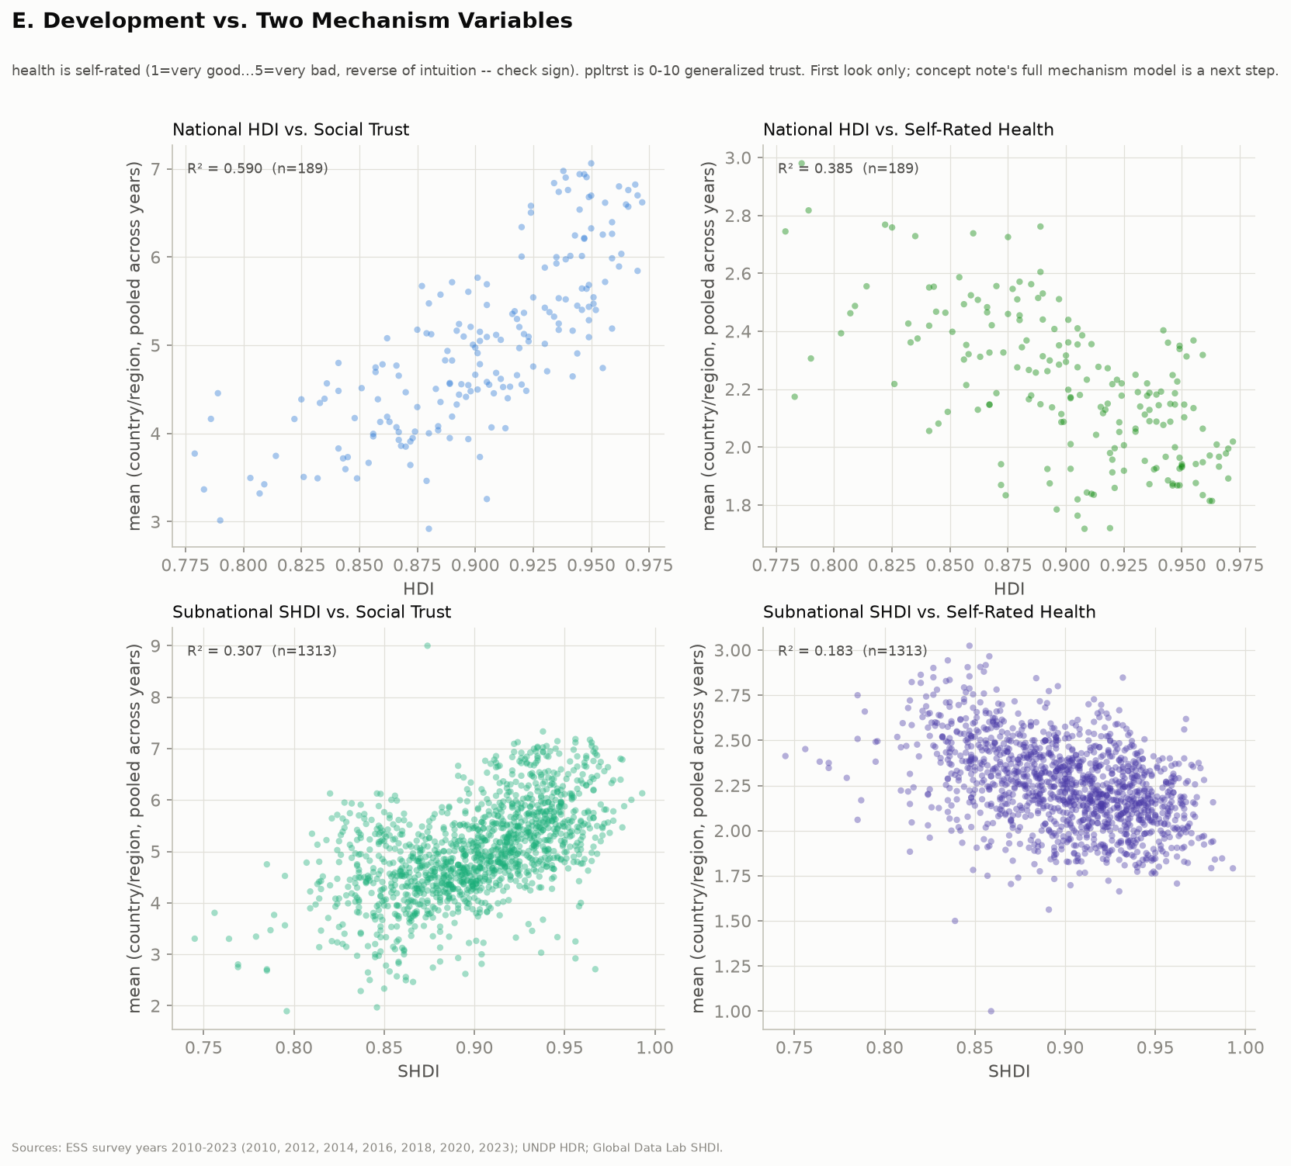
APPENDIX
Trust and health as rival predictors, nationally
Self-rated health out-predicts the HDI nationally on significant-country share, 37% against 19%.

Slide 41
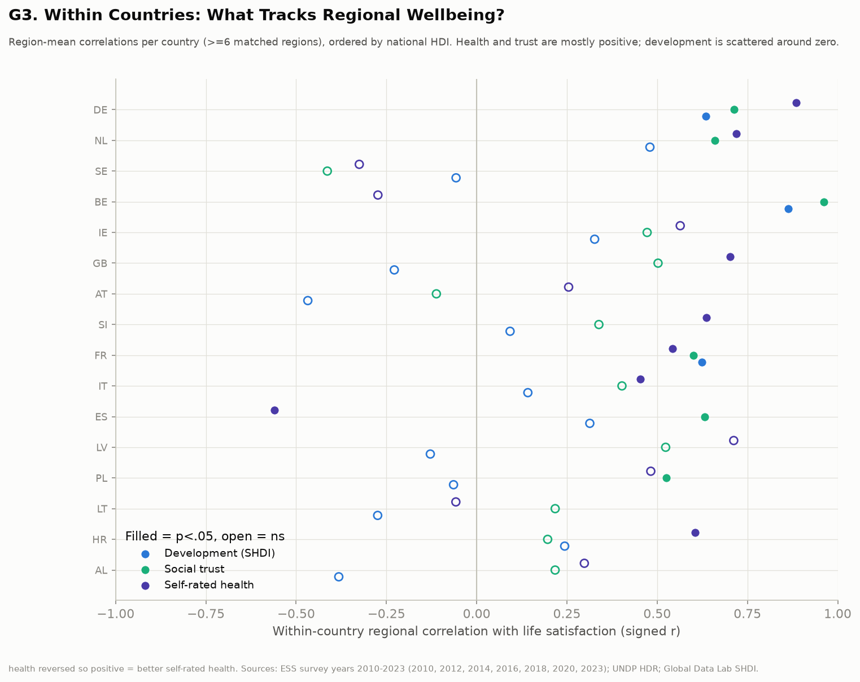
APPENDIX
Per-country detail behind the ranking flip
Signed within-country regional correlations for all 16 countries; filled markers are p < .05. Sweden reads negative on all three, but only 57% of Swedish respondents carry a usable region code, so that result should not be interpreted.

