Slide 1


Missouri Primary Care Health Home Initiative
Notes:
Kathy B

Slide 2
Agenda
What is a Primary Care Health/Medical Home?
Overview of Missouri Primary Care Health Home Initiative
FAQs and “Rules of Thumb”
Data Collection and Reporting
NCQA/PCMH Recognition
Training and Technical Assistance
Notes:
Kathy B

Slide 3
What is a Medical Home?
Medical Homes Provide:
comprehensive and coordinated care in the context of individual, cultural, and community needs
Medical, behavioral, and related social service needs and supports are coordinated and provided by provider and/or arranged
emphasize education, activation, and empowerment through interpersonal interactions and system-level protocols
at the center of the medical home are the patients and their relationship with their primary care team
Notes:
Kathy B: Medical Homes have their roots in Community Oriented Primary Care, Services for Children with Special Healthcare Needs, and the Care Model. Many different definitions. This is the one adopted by many primary care organizations in Missouri. The Health Home defers from a Patient Centered Medical Home in the fact that a Patient Centered Medical Home is your entire practice and your way of doing business and the health home is designed to provide more intensive services to a subset of a practices population that has more disease and is more costly to the system.

Slide 4
Section 2703 of the Affordable Care Act
Section 2703 of the Affordable Care Act allows states to amend their Medicaid state plans to provide Health Home Services for enrollees with qualifying chronic conditions.
States are eligible for an enhanced federal match for eight quarters (Missouri’s ended December 31, 2013)
Missouri – approved in 2011 for two Medicaid State Plan Amendments to be able to provide Health Home Services to Missourians who are Medicaid eligible participants with chronic illnesses.
Notes:
Kathy B
Enhanced Federal Match requires 10% State Match to receive 90% Federal Match ($1 of state money leverages $9 of federal money)
Missouri will have three types of health homes:
Primary Care Health Home for individuals with chronic disease: CMS Approval 12-23-11 Effective Date 1/1/12
Community Mental Health Center Health Home for individuals with serious and persistent mental illness: CMS approval 10-20-11 Effective date 12-1-11
Multi-payer Health Home for the entire population of Anthem covered lives in the 84 county MFH Region

Slide 5
Missouri’s Health Homes
Two health home initiatives in Missouri
Primary Care
Behavioral Health
Similarities and Differences
PCHH incorporates behavioral health care into the traditional primary care model through the addition of a behavioral health consultant (more on the BHC later)
CMHC healthcare homes incorporate primary care into the traditional behavioral health model through the addition of nurse care managers and primary care physician consultants (they don’t provide primary care, but do provide care management/care coordination for both mental and physical health for their participants)
Notes:
Kathy B

Slide 6
Missouri PCHH Original Qualifying Conditions
Combination of Two
Diabetes (CMS approved to stand alone as one chronic disease and risk for second)
Heart Disease, including hypertension, dyslipidemia, and CHF
Asthma
Overweight (BMI ≥ 25 or 85th percentile)
Tobacco Use
Developmental Disabilities
Notes:
Kathy B

Slide 7
Missouri PCHH Updated Qualifying Conditions
New as of October 1, 2016
Behavioral Health Conditions (only one of these)
Anxiety
Depression
Substance Use Disorder*
Pediatric Asthma**
Obesity (BMI ≥ 30 or 95th percentile)**
*must have at least one provider certified to provide medication-assisted treatment
**stand-alone conditions – must meet certain criteria
Notes:
Kathy B

Slide 8
Participating Sites
Initial participating sites:
18 FQHCs and 6 Hospital Affiliated Providers
Expansion during the Spring 2014 legislative session
Expansion during the Spring 2016 legislative session
Current Participating Organizations:
25 FQHCs (two have delayed implementation)
11Hospital Affiliated Providers
2 Clinics
Medicaid/Uninsured Threshold
Using EMR for six months
Apply for National Committee for Quality Assurance (NCQA) Patient Centered Medical Home Recognition within 18 months
Organizations Selected to Participate (initial)
18 FQHCs 6 Hospitals
Organizations Selected to Participate (expansion)
4 FQHCs 4 Hospitals 2 Clinics 1 Health Dept
Notes:
Kathy B

Slide 9
Goals of the Primary Care Health Home Initiative
Reduce inpatient hospitalization, readmissions and inappropriate emergency room visits
Improve coordination and transitions of care
Improve clinical indicators ( e.g. A1C, LDL, blood pressure)
Implement and evaluate the Health Home model as a way to achieve accessible, high quality primary health care and behavioral health care;
Demonstrate cost-effectiveness in order to justify and support the sustainability and spread of the model; and
Support primary care and behavioral care practice sites by increasing available resources and improving care coordination to result in improved quality of clinician work life and patient outcomes.
Notes:
Kathy B: These goals are the overarching goals of the Missouri Primary Care Health Home State Plan Amendment

Slide 10
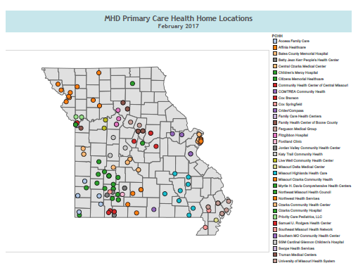
Notes:
Kathy B

Slide 11
Use of Health Information Technology to Link Services
CyberAccess
Demographics Diagnoses Providers Labs
Procedures Medications Care Coordination
Electronic Health Records
Performance Measures Patient Portal
ProAct
Medication Adherence
Data Warehouse (DRVS)
Clinical Information
Notes:
Kathy B
MO HealthNet (“MHN”) maintains a web-based electronic health record (EHR) accessible to enrolled Medicaid providers, including primary care practices, CMHCs, pharmacies and schools.
A module of the CyberAccess allows enrollees to look up their own healthcare utilization and receive the same content in laypersons’ terms. The information facilitates self-management and monitoring necessary for an enrollee to attain the highest levels of health and functioning.

Slide 12
Reports
Hospitalization and ER visit notifications
High utilizers (reports and graphs)
Possible PCHH enrollees
Monthly enrollment/discharge list
Payment rejects
Staffing/payment comparisons
Retrospective payments
Periodic care coordination reports (e.g. HCBS, DD)
Managed care participants
Notes:
Kathy B
The Data Management, Analytics, and reporting will be covered in more detail on a series of webinars that will be hosted by MHN.

Slide 13
Health Home Services (“Touches”)
Comprehensive care management
Care coordination
Health promotion
Comprehensive transitional care including follow-up from inpatient, ER, other settings
Patient and family support
Referral to community and support services
NOTE: Touches must be documented
Notes:
Kathy B
Section 2703 of the ACA outlined the health home services
Definitions for each Health Home Service is provided in the next set of slides in the presentation

Slide 14
Health Home Services: Comprehensive Care Management
Identification of high-risk individuals and use of patient information in care management services; assessment of preliminary service needs;
Care plan development, which will include patient goals, preferences and optimal clinical outcomes;
Assignment by the care manager of health team roles and responsibilities;
Development of treatment guidelines that establish clinical pathways for health teams to follow across risk levels or health conditions;
Monitoring of individual and population health status and service use to determine adherence to or variance from treatment guidelines and;
Development and dissemination of reports that indicate progress toward meeting outcomes for patient satisfaction, health status, service delivery and costs.
Notes:
Kathy B

Slide 15
Health Home Services: Care Coordination
Implementation of the individualized care plan (with active patient involvement)
Appropriate linkages, referrals, coordination and follow-up to needed services and supports -- e.g.
appointment scheduling
facilitating and making referrals and follow-up monitoring
participating in hospital discharge processes
communicating with other providers and clients/family members.
Notes:
Kathy B

Slide 16
Health Home Services: Health Promotion
Providing health education specific to an individual’s:
chronic conditions
development of self-management plans with the individual
education regarding the age appropriate immunizations and screenings
support for improving social networks and providing health promoting lifestyle interventions, including but not limited to, substance use prevention, smoking prevention and cessation, nutritional counseling, obesity reduction and prevention and increasing physical activity.
Health promotion services also assist patients to participate in the implementation of their treatment plan with a strong emphasis on person-centered empowerment to understand and self-manage chronic health conditions.
NOTE: Newsletters or other educational materials can be used if they are targeted to a person’s specific conditions.
Notes:
Kathy B

Slide 17
Health Home Services: Comprehensive Transitional Care
Comprehensive transitional care including follow-up from inpatient and other settings – Medication Reconciliation
Member of the health home team provides care coordination services designed to streamline plans of care, reduce hospital admissions and interrupt patterns of frequent hospital emergency department use.
The health home team member collaborates with physicians, nurses, social workers, discharge planners, pharmacists, and others to continue implementation of the treatment plan with a specific focus on increasing patients’ and family members’ ability to manage care and live safely in the community
Shift the use of reactive care and treatment to proactive health promotion and self management.
Notes:
Kathy B

Slide 18
Health Home Services: Patient and Family Support
Advocating for individuals and families, assisting with obtaining and adhering to medications and other prescribed treatments.
Health home team members are responsible for identifying resources for individuals to support them in attaining their highest level of health and functioning in their families and in the community
For individuals with developmental disabilities the health team will refer to and coordinate with the approved developmental disabilities case management entity
Notes:
Kathy B
Examples of Resources and Supports: including transportation to medically necessary services. A primary focus will be increasing health literacy, ability to self manage their care and facilitate participation in the ongoing revision of their care/treatment plan.

Slide 19
Health Home Services: Referral to Community and Support Services
Assistance to patients including but not limited to:
obtaining and maintaining eligibility for healthcare
disability benefits
housing
personal need and legal services
For individuals with developmental disabilities the health home team will refer to and coordinate with the approved DD case management entity for this service.
Incorporation of community health workers into PCHH (pilot project)
Notes:
Kathy B

Slide 20
Payment Method
Providers that meet the health home requirements will receive a Per-Member-Per-Month (PMPM) payment for performing health home services and activities (“touches”)
Current PMPM rate is $63.72
Providers pay a small PMPM to MPCA to cover administrative costs associated with data management, training, technical and administrative support, and practice coaching
Notes:
Kathy B – history of “cost of living” increase annually

Slide 21
Enrollment Eligibility
Participant must meet the following criteria:
MO HealthNet eligible
Not be locked into hospice
Meet spend-down, and/or pay any premiums due
Have paid/final claims (excluding original claims that were reversed/ voided) with an approved PC diagnosis in one of the first five positions on a claim.
Have qualifying condition(s)
Have at least $775 in spend (proxy – one ER visit or hospitalization)
If seen by more than one eligible health home provider the patient is attributed to the health home provider seen the most during the analysis period
Notes:
Kathy B
Additional detail regarding the auto enrollment process used can be found on MO HealthNet Division’s Health Home website: http://dss.mo.gov/mhd/faq/pages/health-homes-implementation-patient-auto-assignment.htm
The procedure for adding, discharging, or transferring patients to the health home will be shared on conference calls and webinars hosted by MHD as well as e-mail correspondence from MHD
Questions can be addressed to MHD via e-mail at: ask.mhd@dss.mo.gov

Slide 22
Current Enrollment Process
Determine eligible diagnoses and other criteria (e.g. patient has PCP at clinic/organization)
Check eMOMED for current Medicaid eligibility and spend down status
Check CyberAccess to determine whether person is already enrolled in a health home
Prepare and submit enrollment forms
Name form using Lastname, Firstname convention.
Send only one type of form in an email
Make sure each form is only sent one time
Send forms to enrollment coordinator (info on form)
Notes:
Kathy B
Webinar on enrollment forms will be August 30th; processing enrollment/discharge and transfer forms will also be addressed in New Provider Webinar in September.
Questions can be addressed to MHD via e-mail at: ask.mhd@dss.mo.gov

Slide 23
Care Team
IT
Admin
RN
RN Care Manager.
Care Coordinator
Patient
Health Home Director
BHC
RN/LPN/MA
Specialist
Provider
Notes:
Kathy: The Primary Care Health Home Initiative focused on utilizing the patient centered medical home model as the foundation for improvement.
In order to meet this movement, it required addition and sometimes restructuring of the care teams.
In the redesigned care teams, the patient is the center of care, receiving a full range of comprehensive services provided by a team of health professionals where the patient is engaged in their own care.
The initiative also identified four distinct positions to be included in the care team which are noted in the yellow highlighted boxes on the graph. The funding for the staff positions is supported by the large Per Member Per Month Payment Angela discussed in the previous section of the presentation.

Slide 24
Health Home Team Members
Health Home Director (1:2500)
Nurse Care Manager (1:250)
Behavioral Health Consultant (1:750)
Care Coordinator (1:750)
Physician Champion
__________________
Administration
Information Technology
Notes:
Kathy: Health Home Team Member roles were outlined in the State Plan Amendment approved by CMS. Detailed information regarding the roles for each health home team member will be outlined in the next group of slides.

Slide 25
Health Home Director
Provides leadership for the implementation and coordination of health home activities
Coordinates activities of other health home staff
Champions practice transformation based on health home principles
Monitors health home performance and leads improvement efforts
Training and technical assistance
Data management and reporting
Notes:
Kathy

Slide 26
Nurse Care Manager
Must be RN for PCHH
Direct relationships with patients and coordination with primary care team, specialty care teams, and inpatient facilities.
Develop care plans
Utilize MHD health technology programs & initiatives (i.e., CyberAccess and ProAct)
Monitor HIT tools & reports to identify gaps in care and needed services for enrollees
Address medication alerts, hospital admissions/ discharges and ER visits - including medication reconciliation
Identify and address high utilizers
Monitor & report performance measures & outcomes
Notes:
Kathy

Slide 27
Behavioral Health Consultant
Focus on managing a population of patients versus specialty care
Support care team in identifying and behaviorally intervening with patients to improve their physical health condition
Assist with high utilizers
Behavioral supports to assist individuals in improving health status and managing chronic illnesses
Assistance with medication adherence, treatment plan adherence, self management support/goal setting, and facilitate group classes
Brief interventions for individuals with behavioral health problems (not long term hour long therapy sessions)
Brief coaching sessions for SBIRT
Notes:
Kathy

Slide 28
Care Coordinator
This role does not stipulate a specific licensure requirement as the nurse care manager however many health homes have found it helpful to have someone with clinical knowledge such as a LPN or MA in this role.
Assist with referral tracking and feedback
Assist with performance improvement and data management.
Process enrollment/discharge/transfer forms
Provide assistance with enabling services such as transportation, food, housing, etc.
Reminding enrollees regarding keeping appointments, filling prescriptions, follow-up on self-management goals, etc.
Requesting and sending medical records for care coordination
Notes:
Kathy

Slide 29

Physician Champion
Serves in a leadership capacity promoting and implementing the health home and medical home model
Creates the strategic vision and drives the investment necessary to create the needed PCMH infrastructure
Participates in health home planning meetings and activities
Participates in development and maintenance of health home program structure and policies
Promotes health/medical home transformation to all physicians
Works with physicians who resist changes resulting from transition to the health home/medical home model
Review data showing results of health home implementation
Notes:
Kathy

Slide 30
FAQs and “Rules of Thumb”
Weekly emails contain important information for people who work directly or indirectly with PCHH. Please read them.
FAQ handout
Notes:
Kathy

Slide 31
Importance of Communication
Communication with and between care team members
Communication with patient/families
Accurate patient contact information/Patients desired way to receive communication
Verifying with patient their contact information
Ask “How can I reach you today”
What communication preference do you have
Communication with hospitals, specialists, and community partners
Electronic Communication sources
Patient portal
Email/secure messaging
HIE
Notes:
Angela

Slide 32
Medical Home Neighborhood Partnerships
Hospital Partnership
MOU
Workflow to receive ER/IP discharge information
Key contact person
Electronic access
State provides Daily ER/IP notification for PCHH enrollees
Specialty Services
Other Community Resources
Health Department
Family and Community Trust (Caring Communities)
Notes:
Angela

Slide 33
Data Management and Analytics
Notes:
Angela

Slide 34
Stakeholder | Role/Responsibilities
Missouri Primary Care Association (MPCA) | Project Owner, receives reports Support staff at FQHCs & PCCs when needed for questions around reporting and data accuracy
Federally Qualified Health Centers (FQHC’s) | Transmit clinical data through DRVS connector
Primary Care Clinics (PCC’s) | Transmit clinical data through flat file upload
Azara Healthcare | Provide access to DRVS reporting tool and maintains measures in the tool. Assist PCCs in flat file submission
MO HealthNet | Receives reports
Missouri Institute of Mental Health (MIMH) | Conducts evaluation of PCHH program Assists PCCs with data validation as needed in partnership with MPCA and Azara.
Notes:
Angela

Slide 35

Data Flow Process
MPCA sends all reports to MO HealthNet for FQHCs & PCCs each month
MPCA
CMS
MPCA has direct access to all reports
EHR & PMS Connected to data warehouse (pulls data nightly)
FQHCs
Azara data warehouse
CMS reporting from MO HealthNet
FQHC have direct access to reporting tool to pull its own reports
List of PCHH Enrollees transferred to warehouse on a monthly basis
Directly Connected PCCs
PCCs have direct access to reporting tool to pull its own reports.
MO HealthNet
PCC monthly uploads flat file to Azara warehouse
Standard PCCs
Notes:
Angela: This slide shows the data flow process for the performance measures for the Primary Care Health Home Initiative. There are two mechanisms for how the data gets into the Azara data warehouse: For FQHCs and Directly connected Primary Care Clinics data is pulled nightly from the Electronic Health Record and Practice Management System. Due to the direct connection reports are available directly out of DRVS. For Standard Primary Care Clinics data is submitted via a flat file on a monthly basis. MPCA supplies reports out of the Azara Data warehouse on the performance measures to MO HealthNet on a monthly on behalf of all the health homes.

Slide 36
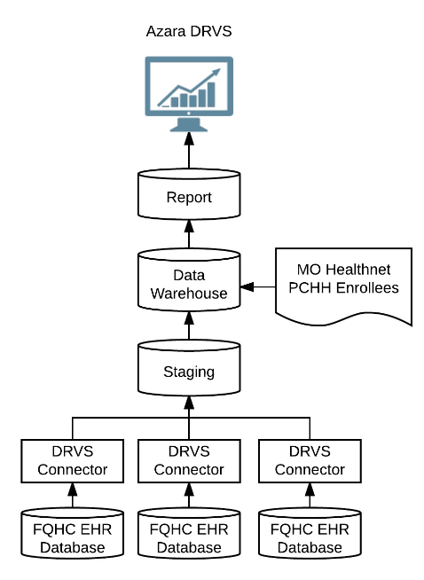
FQHC Technical Overview
FQHC’s are directly connected to DRVS
Nightly data refresh
PC-SPA is one of many reports available in DRVS.
PCHH Enrollee & Medicaid Filters allows users to filter reports & measures to relevant populations.
Azara handles all data extraction and submission.
Data issues can be handled via our dedicated support team: support@azarahealthcare.com
Notes:
Angela

Slide 37
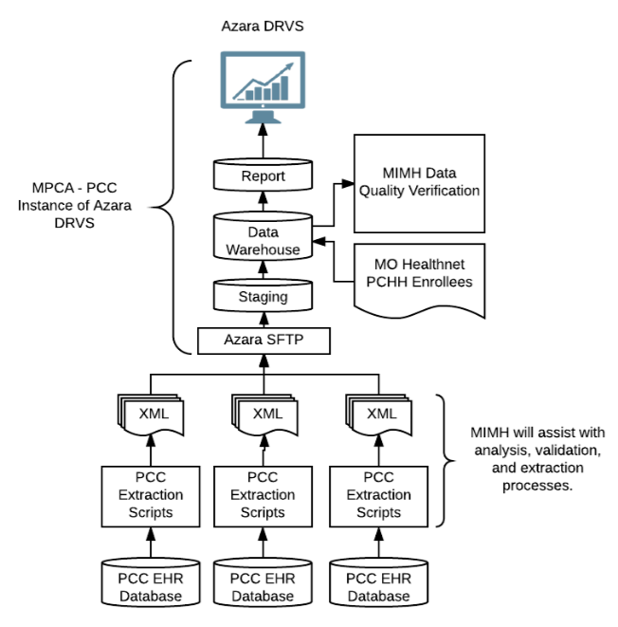
Non-FQHC Technical Overview
Data submitted monthly utilizing flat files via a secure server
Data from all Medicaid patients seen at the participating primary care locations should be submitted with monthly data.
Technical specifications are supplied and must be utilized in order for data to report properly.
Notes:
Angela

Slide 38
Performance Goals and Measures
Care Coordination
Behavioral Health and Substance Abuse Screening and Use
Chronic Disease Management: Diabetes, Cardiovascular disease, Asthma
Preventative Health: Weight Assessment and Follow-up for Children and Adults, Population Health LDL Control
Whenever possible national measure definitions were utilized from the National Quality Forum, Healthy People 2020, Meaningful Use, HEDIS, etc. to assist with alignment across programs.
Notes:
Angela

Slide 39
Primary Care Health Home Performance Measures
Adult LDL < 100
Adult Hypertension Controlling High Blood Pressure (NQF 0018)
Childhood Weight Screening and Counseling
Child Weight Screening / BMI (NQF 0024)
Child Weight Screening / Nutritional Counseling (NQF 0024)
Child Weight Screening / Physical Activity (NQF 0024)
Pediatric and Adult Asthma Controller Medication:
Use of Appropriate Medications for Asthma Ages 5-11 (NQF 0036)
Use of Appropriate Medications for Asthma Ages 12-18 (NQF 0036)
Use of Appropriate Medications for Asthma Ages 19-50 (NQF 0036)
Use of Appropriate Medications for Asthma Ages 51-64 (NQF 0036)
Adult Diabetes A1c > 9 (NQF 0059)
Adult Diabetes A1c < 8 (NQF 0059 modified)
Adult Diabetes BP < 140/90 (NQF 0059 modified)
Adult Diabetes LDL Management - LDL < 100(NQF 0064)
Screening for Clinical Depression and Follow-Up Plan (NQF 0418)
Adult BMI Screening and Follow-up (NQF 0421)
Care Coordination (MPCA PCHH)
Adult SBIRT Drug Use (MPCA PCHH)
Adult SBIRT Excessive Drinking (MPCA PCHH)
Adult SBIRT Substance Abuse Screening and Follow Up (MPCA PCHH)
Notes:
Angela
14 performance measures with two having age or component breakdown. Measures in bold apply to both Pediatric and Adult practices . As you can see the majority of the measures are NQF or modified NQF measures. In the future we will be adding age breakdown to the screening for clinical depression and care coordination.

Slide 40
EHR & PMS Data Collection
Many measures require data elements typically captured by your EHR system (labs, vitals, diagnosis)
10 measures/components discussed may require building of new templates and/or enhancing existing templates to collect necessary data elements
All data elements must be captured in structured fields
This allows for reports to be generated from the system
Measure definition and data specification documents are available to provide for further guidance regarding required elements for each measure
Notes:
Angela

Slide 41
Structured vs. Unstructured Data
There is tremendous value in recording data using a common vocabulary and methodology. Creates data which can be recognized, ordered, analyzed, reported & shared.
Data not captured
in structured
fields is not
reportable
.
STRUCTURED DATA
UNSTRUCTURED DATA
Dictation, Transcription,
Voice recognition typing, Free text,
Memo fields
Radio buttons, Locked down Pick-lists, Checkboxes,
NDC-ID (Meds),
ICD-9/10/SNOMED(Dx), LOINC (Labs),
CPT (Procedures)
Notes:
Angela
Key to successfully capturing quality data is to ensure data is entered into structured data.
Structured data vs unstructured.

Slide 42
Key Components
PCHH measures require qualifying encounter at least once per year so it is important to get PCHH patients that haven’t been seen in last year you work with them to come in for a face to face planned visit.
Review and Validate Workflow - Are all staff documenting according to your policies, processes and procedures?
Required follow-up data elements documented in a structured field
PCHH team needs to work with IT team to be sure structured documentation is mapped to DRVS or included in monthly data submission
Notify MPCA Quality Coaches to allow notification of Azara prior to or shortly after to allow assessment of impact on flat file data submission for PCCs and DRVS mapping for FQHCs and directly connected PCC:
Upgrade of EMR
New or updated templates and documentation fields/locations
Changes in Workflow
Notes:
Angela
Data specs will be reviewed twice a year in June and December to evaluate if any changes need to be made to make reports calculate properly.
When ICD10 went live in October there were some impacts to measures with Asthma severity now being included as code and the asthma measures now require the organization utilize the codes that specify asthma severity for patients with asthma to be included in their numbers. Impacts all age groups. Childhood BMI requires: BMI percentile, Height, and Weight otherwise will show zeros for childhood BMI measure.
Azara and MPCA are currently updating the data specs for the PCCs. Majority of changes were removal of duplicate requirements in various data sets. Primary additions are to the childhood BMI requiring BMI percentile, height, weight, and asthma severity (ICD 10 codes associated with asthma severity.

Slide 43
Care Coordination
Requires two dates documented in structured fields:
Date of discharge from inpatient or ER
Date of Medication Reconciliation performed by Nurse Care Manager in person with patient or over the phone with patient with input from the PCP
MOHealthNet supplies daily notification of ER visits and inpatient prior authorizations to assist with the care coordination measure
Notes:
Angela
Daily notification reports for ER visits or prior authorizations for inpatient admissions from MOHealthNet are for the PCHH use and not provided to MPCA/Azara. For most organizations (PCHHs associated with hospitals may be different) the discharge date must be manually entered into a structured field in a date format-discharge date shouldn’t be entered until the patient is actually discharged. The discharge date is what starts the clock on the three days for the completion of the care coordination including contact by the nurse care manager via phone or in person and the completion of the medication reconciliation with the patient and input from PCP. The medication reconciliation should be a reconciliation of the medications prescribed and/or changed during the ER visit or inpatient admission.

Slide 44
Childhood Weight Assessment and Counseling
BMI measure requires BMI percentile, Height, and Weight due to the measure following the Meaningful Use Measure Specification
Date of Nutrition Counseling And Physical Activity Counseling for children must be documented in a structured field at least once per year regardless of the child’s BMI.
Generic Anticipatory guidance verbiage that does not specify nutrition/diet counseling AND physical activity counseling will not count for this measure
Notes:
Angela

Slide 45
Depression Screening and Follow-up
Utilize Age Appropriate Depression Screening
Adolescents 12-17 years of age
Adults 18 and older
Screening tool score must be documented in structured field(s)
All positive screenings must have documented follow-up in a structured field(s)
What constitutes follow-up?
PHQ2 → PHQ9 →Date of Follow-up for further assessment
PHQ9 → Date of Follow-up for further assessment
Follow-up for further assessment could include referral to BHC or addressed by provider during visit
Notes:
Angela
when the PHQ2 is used as the primary screening and is positive the PHQ9 can be utilized and counted as a follow-up to the positive PHQ2 screening. If the PHQ9 is positive then follow-up would need to documented to show completion of the screening process. Measure is looking for depression screening score and if score indicates positive results the date of follow-up must be documented in a structured field within one day. If the date of the follow-up is not recorded you will not get credit for completing the screening.

Slide 46
SBIRT Screening and Follow-up
Screening tool score must be documented in structured field(s)
All positive screenings must have the date of documented follow-up in a structured field(s)
Follow-up for further assessment includes completion of ASSIST performed by trained staff member, brief education, and/or referral to BHC
Notes:
Angela
Score for each question not just overall score is needed. The SBIRT prescreen is utilized for the other two SBIRT measures. Questions 1-3 are utilized for the excessive drinking measure and patients that are positive (score of 4 or greater on first three questions) are counted in the numerator for the excessive drinking measure. Question 4 is utilized for the SBIRT Drug Use measure and patients that are positive (answer yes to question 4) are counted in the numerator for the SBIRT drug use measure.

Slide 47
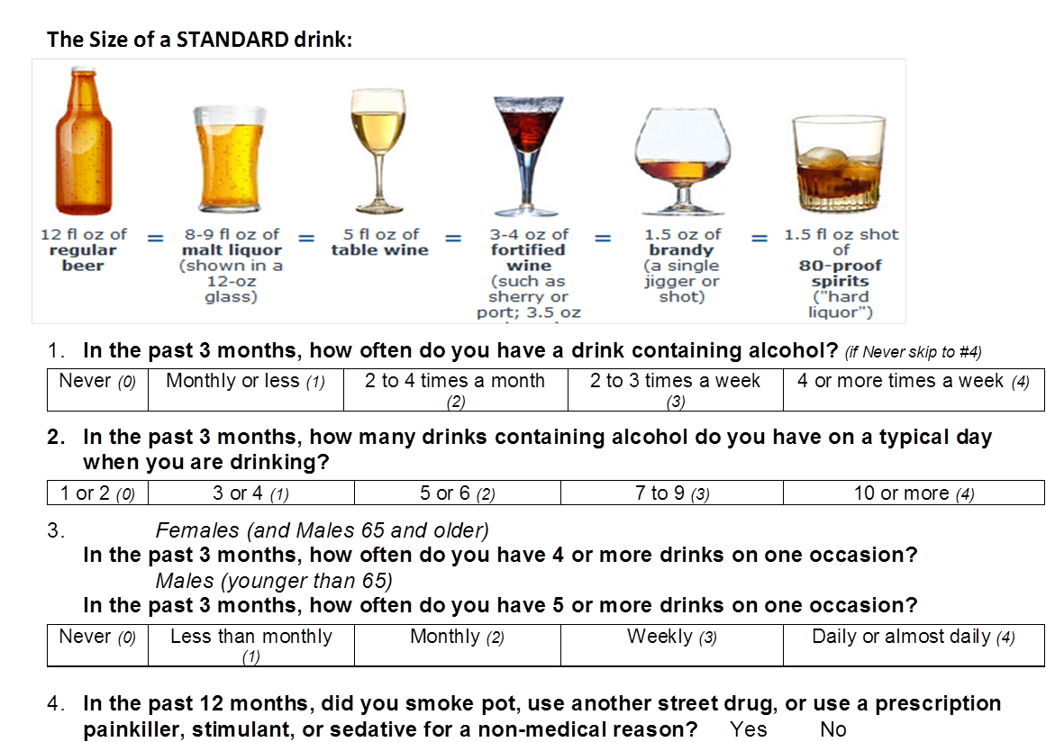
Notes:
Angela

Slide 48
SBIRT Prescreen Scoring
Pre-screen is positive and World Health Organization ASSIST needs to be completed if:
Question 1 score + Question 2 score + Question 3 score is a combined score of > = 4
OR
Question 4 = Yes
Notes:
Angela

Slide 49
BMI Ages 18-64 and >=65
Height and Weight need to be documented on each patient at least once per year. Without both height and weight documented the EMR will not calculate BMI.
Height carries over for one year from encounter to encounter.
Date of documented Follow-up is required for patients that are:
Outside normal parameters
Normal parameters
Ages 18-64: 18.5-24.9
Ages 65 and older: 22-29.9
Be sure to capture the work of all staff members i.e. rooming nurse/MA, Nurse Care Manager, BHC, Provider, Dietitian related to BMI follow-up for underweight or overweight.
Date of follow-up documented in structured fields commonly includes education/referral regarding nutrition, diet, physical activity, community programs/classes, and/or lifestyle changes that support weight management
Notes:
Angela

Slide 50
Performance Measure Outreach
Team of Quality Coaches from MPCA will provide:
Assistance with quality, integrity, and validation on performance measures/components
Monthly performance measure improvement correspondence, trend charts, areas for improvement
Tracking of DRVS scorecard access or flat file submission utilizing usage reports in DRVS
MPCA Quality Coaches are Super users of CMT ProAct tool and create medication adherence reports that are shared monthly with PCHH organizations to assist with population health management and strategy for outreach to high utilizers
Notes:
Angela

Slide 51
Final dates for accessing FQHC reports and PCC data submission
Last day to access scorecard in DRVS without notifying MHD
Access PCHH SPA scorecard in DRVS
15th
25th
16th
MPCA checks usage in DRVS to see if scorecard was accessed
FQHC
Last day to submit late data to Azara without notifying MHD
Flat File uploaded and submitted to Azara
7th
24th
8th
MPCA checks reports to see if data is available
PCC
Notes:
Angela: MO HealthNet has established a set of data submission/report access deadlines each month for both FQHCs and Directly connected Primary Care Clinics and for Standard Primary Care Clinics. PCC data is processed the morning of the 8th, 15th, and 25th of the month so data that misses the processing date will not process until the next processing date.

Slide 52

Role and Importance of Data Quality
Notes:
Angela

Slide 53
Data Quality is Essential
Accurate, complete, valid data for ALL reported measures are essential
Data validation & mapping
Connectivity & data transfer
Importance of standardized workflow data capture
Internal policies and procedures to assure good quality data
Notes:
Angela
GIGO – if you don’t put time and effort into data validating/mapping you will get inaccurate reports.
If you data needs to be transferred to a PHM reporting system if is important to monitor the connectivity and data transfer to ensure there is no lag time in data transfer: lag time and lack of connectivity/data transfer impacts your data
Consistent and standardized training to ensure consistent data entry/documentation in EHR. Education on what structure data consists of and training on where to key in structured data. No free texting/scanned/rogue workflows
You not only need sound P&P relating to EHR data entry/workflow but you have to ensure those P&P’s are enforced and adhered to.

Slide 54
Common Data Quality Issues
Data connectivity and transfer
Template design & capture
Documentation
Workflow
Notes:
Angela
Here are some common themes or issues that can impact data reporting. Majority of issues impacting data has been around data transfer or template design/implementation.
We want to ensure that the data is collected and reported accurately and you to feel comfortable with the data is representing.
Ensure data is captured to optimize workflow

Slide 55
Using Data for Performance Improvement
Right People Have Access to Data
Care Team (provider, nurse, front office, ancillary support, BH)
Leadership
Worker bees
Not just IT
What your data is telling you
Use of Data
Drive Change/Improve Outcomes
Pre-visit Planning
Reporting
Identify care gaps
Monitoring Progress
Act on you data
PDSA – is it working?
Notes:
Angela
Make sure everyone has access to the data
Interpret the data
Use the data, don’t just use the data reports for a door stop..
Act on data key points: What is working well and what is not working well. Do you see a trend in the right direction? If not go back to the draw

Slide 56

Ongoing Data Hygiene
Make data hygiene part of your daily, weekly, monthly, and annual routines.
Daily: Visit Planning Tools
Weekly: Registry and Care Management Reports
Monthly: QI and Performance Improvement, Data Validation of a subset of measures
Quarterly: Reports to Medicaid, C-Suite, Board, etc.
Annual: HEDIS, PQRS, UDS, etc. Reports (check stubborn data points quarterly to impact change )
Assign responsibility and accountability for these activities.
Notes:
Angela
TIPS: to make your data actionable.
MPCA has developed a data validation tool for the PCHH measures to assist with resolving data mapping and/or flat file data issues.
I will now turn the presentation back over to Angela to close out the presentation.

Slide 57
Training and Technical Assistance
Notes:
Angela

Slide 58

Training and Technical Assistance
Investing in training and technical assistance is essential to the success of the health home.
Primary Types
MPCA Quality Coaches
Care Team Forums
Behavioral Health and Primary Care Integration
SBIRT
Notes:
Angela
Investment in training and technical assistance is critical to success of the health home.
The training focused on specific skill sets (such as motivational interviewing); staff responsibilities and alignment of other initiatives such as the NCQA PCMH Recognition. Also, sharing of best practices and mentorship between primary care organizations was included in training agenda.
I will go in to more detail on each of the primary types in the following slides.

Slide 59
Quality Coaching
Data Quality, Integrity and Performance Improvement
High Utilizers and Population Health Management
NCQA PCMH Recognition Application and Renewal Assistance
Quality Improvement and Practice Transformation
Notes:
AHN updated 3.4.16

Slide 60
PCH
Data Quality, Integrity and
Performance Improvement
Coordination and liaison between CHCs/PCHH organizations and Azara
Assistance with quality, integrity, and validation of performance measures
Assistance with resolution of DRVS mapping issues
Monthly performance measure improvement correspondence, trend charts, areas for improvement
Tracking of DRVS scorecard access utilizing usage reports in DRVS
Best practices and models for utilization of clinical registries to drive performance improvement
Assistance with pre-visit planning and care gap identification utilizing data from EHR, DRVS, and CyberAccess
Notes:
AHN updated 3.4.16

Slide 61
High Utilizers and Population Health Management
MPCA Quality Coaches are Super users of Care Management Technologies ProAct tool and create medication adherence reports that are shared monthly with PCHH organizations to assist with population health management and strategy for outreach to high utilizers
Correspondence regarding high utilizers included with monthly quality coach outreach to PCHH organizations to include strategies for engaging high utilizers.
Reduction of potentially avoid emergency room visits training and technical assistance: Partnership with MO HealthNet and MO Institute of Mental Health
Assist with the development of educational materials and resources regarding right care at the right time (when to choose UC, PCP, ER)
Webinar on how to utilize the reports recording available for on demand future viewing
Webinar series planned on the topics identified in PCHH high utilizers and focus group of PCHH organizations
Notes:
First webinar on high utilizers and chronic pain recorded and available for on demand viewing.

Slide 62
NCQA PCMH Recognition Application and Renewal Assistance
Four NCQA PCMH Certified Content Experts to provide initial and renewal application assistance.
Training and TA of NCQA PCMH process and Standards
Participation in NCQA PCMH recognition meetings of the PCHH/CHC organization team
Documentation review prior to submission serving as mock review to identify gaps or issues
Assistance with preparation of response to NCQA audit and information requests.
Tracking of NCQA Recognition status including site recognition level and expiration dates
Notes:
AHN updated 3.4.16

Slide 63
Quality Improvement and
Practice Transformation
Assistance to PCHH/CHC organizations on Plan Do Study Act (PDSA) cycles to improve clinical, financial, and operational excellence
Workflow analysis
Training and technical assistance on quality improvement and practice transformation
Care team training and technical assistance
Facilitate peer networking between PCHH/CHC organizations for sharing of best practices
Notes:
AHN updated 3.4.16

Slide 64
Missouri Primary Care Association Center for Health Care Quality Team
Quality Coaches
Angela Herman-Nestor, MPA, CPHQ, PCMH-CCE
Noelle Parker, MBA, CMPE, PCMH-CCE
Kathy Davenport, RN, CPHRM, PLNC, PCMH-CCE
Machelle Dykstra
Data Analyst
Tim Wittmann
Center for Health Care Quality Director
Sam Joseph
Notes:
Angela
MPCA has a team of four practice coaches with a variety of training/expertise areas.

Slide 65

Care Team Forums
Training for Primary Care Health Home Team Members
Focus on team-based care
Best Practices for addressing high risk enrollees and high utilizers of services
Strategies for utilizing data and technology solutions to drive quality improvement and patient-centered care.
Peer to Peer Networking
Condition and skill specific sessions
BH/PC integration for health home team
PCHH Care Team Training (April 26-27, 2017)
Notes:
Angela
The Care Team Forums were developed from the requests and needs we received from the primary care health homes organizations.
Care Team Forums provide an opportunity for health homes to receive training, peer to peer support and networking to support team-based care, learn about best and promising practices developed by other health homes, condition and skill based sessions as well as strategies for sustaining and enhancing patient centered medical home efforts and practice transformation.

Slide 66
Behavioral Health and Primary Care Integration
Focus on assisting Behavioral Health Consultants provide integrated services in the primary care setting
Format of Training and Technical Assistance
Centralized and regional Face to Face Meetings for BHCs
Care Team Forums for BH/PC integration for health home team
Quarterly administrative telephone consultation
Webinars for primary care providers on common behavioral health topics
On-site technical assistance
Telephone/e-mail consultation
Notes:
Angela
The Behavioral Health Consultant role was a new role for the primary care practices. The transition of licensed clinical social workers and clinical psychologists from providing traditional 6o minute closed door therapy sessions to being embedded in primary care team providing brief interventions in the exam rooms.
The training was funded by the Missouri Department of Mental Health and the St. Louis Behavioral Medicine Institute is the contractor that provides the training and technical assistance for the Behavioral Health Consultants and integration

Slide 67
Initial BHC Training
First 3-6 months of Hire Date
Complete Online Didactics
Phone/Email Consultation with SLBMI Consultant
Site Visit (for new PCHH Organizations)
Contact Information:
St. Louis Behavioral Medicine Institute
1129 Macklind Avenue
St. Louis, MO 63110
Dawn Prentice, LCSW
314-881-3457
Dawn.Prentice@uhsinc.com
Ronald Margolis, Ph.D.
Ronald.Margolis@uhsinc.com
Notes:
Angela
The Behavioral Health Consultant role was a new role for the primary care practices. The transition of licensed clinical social workers and clinical psychologists from providing traditional 6o minute closed door therapy sessions to being embedded in primary care team providing brief interventions in the exam rooms.
The training was funded by the Missouri Department of Mental Health and the St. Louis Behavioral Medicine Institute is the contractor that provides the training and technical assistance for the Behavioral Health Consultants and integration

Slide 68
Screening, Brief Intervention, and Referral to Treatment (SBIRT)
Evidenced based primary prevention program for addressing risky substance use
Integrated into general medical and other community settings
Key elements:
Screen everyone 18 years and older using the four question pre-screening tool
Follow-up for positive prescreen tool utilizing the World Health Organization ASSIST tool that is completed in eSBIRT
Brief Intervention when indicated
Referral for Treatment as needed
Uses a public health model incorporating population screening and brief interventions into routine practice
As part of a continuum of care its primary focus is on the more common risky drinking and drug use rather than alcohol or drug dependence.
Notes:
Angela
SBIRT

Slide 69
SBIRT Required Training/Certification
Screening (Training typically completed by rooming staff such as nurse, MA)
Why and how to administer the brief screen to identify patients who need a closer look at their alcohol or substance use risks. (Two training modules and quiz, about 30 minutes.)
Brief Education/Intervention (Training typically completed by rooming staff such as nurse, MA)
Assess patients for risky alcohol and drug use and use the personal risk assessment report to guide a brief motivational education session to those at moderate levels of risk. (Five training modules and quizzes, about 70 minutes.)
Brief Coaching (Training must be completed by BHC)
Coach patients with significant alcohol and drug use risks in a 6 session manualized process using motivational enhancement and cognitive behavioral therapy techniques. (Training modules, quiz, sample recording and phone/Skype feedback session, about 4 hours.)
Notes:
Angela SBIRT

Slide 70
SBIRT Training/Certification Contact
Matthew G. Hile, PhD Missouri Institute of Mental Health
matthew.hile@mimh.edu
webmaster@mimh.edu
eSBIRT.org
FAQs
BHC specific information and links
Notes:
Angela SBIRT

Slide 71
National Committee for Quality Assurance (NCQA) Patient Centered Medical Home Recognition
Notes:
Angela

Slide 72
Payers are Driving PCMH Recognition, Performance and Practice Transformation
Centers for Medicare and Medicaid
Health Resources and Services Administration: Bureau of Primary Health Care (HRSA-BPHC)
Insurers-Private and Public
Foundations
Payers want value: better outcomes with cost savings
Notes:
Angela: Payers are driving Patient Centered Medical Home Recognition, performance improvement, and practice transformation. Payers want better outcomes with costs savings while improving patient satisfaction.

Slide 73
National Committee for Quality Assurance (NCQA) Patient Centered Medical Home Recognition
Recognition Requirement:
New Health Homes
By the eighteenth month following the receipt of the first Health Home payment, Practices shall submit to DSS evidence that the Practice has submitted an application to NCQA for each site participating in the health home.
Each health home site must receive recognition at Level 1 or higher as a NCQA Patient-Centered Medical Home
Existing Health Homes
Must maintain NCQA Patient Centered Medical Home Recognition
Notes:
Angela: MO HealthNet requires Primary Care Health Home organizations that are not currently recognized to submit a NCQA PCMH recognition application for each site participating in the health home within 18 months following the receipt of your first health home payment. Practices must receive recognition at Level 1 or higher. For health homes that currently have NCQA PCMH recognition they must maintain NCQA PCMH Recognition when their three year recognition period expires.

Slide 74
Performance Progress
A1c, LDL, and Blood Pressure
Notes:
Kathy B

Slide 75
Good news! Small changes make a big difference
Blood cholesterol
10% ↓ = 30% ↓ in CVD (120-100)
High blood pressure (> 140 SBP, 90 DBP)
6 mm Hg ↓ = 16% ↓ in CVD, 42% ↓ in stroke
Diabetes (HbA1c > 7)
1% ↓ HbA1c = 21% decline in DM related deaths, 14% decrease in MI, 37% decline in microvascular complications
Stratton, et al, BMJ 2000
Hennekens CH. Circulation 1998;97:1095-1102.
Rich-Edwards JW, et al. N Engl J Med 1995;332:1758-1766.
Bassuk SS, Manson JE. J Appl Physiol 2005;99:1193-1204
Notes:
Kathy B

Slide 76
A1C Levels Over Time
1 point drop in A1c
21% ↓ in diabetes-related deaths
14% ↓ in heart attack
31% ↓ in microvascular complications
CMHC-HHs
PCHHs
Notes:
Kathy B

Slide 77
Conclusions—LDL
About 45% had uncontrolled LDL levels
Cohorts with elevated LDL levels showed more than a 10% reduction
Cohorts with normal LDL levels increased by 7 to 8 points but remained in the low 80’s
Notes:
Kathy B

Slide 78
LDL Levels Over Time
10% ↓ in LDL level
30% ↓ in cardiovascular disease
CMHC-HHs
PCHHs
Notes:
Kathy B

Slide 79

Conclusions Blood Pressure
20-24% had uncontrolled blood pressure levels
Cohorts with elevated blood pressure levels showed more than a 6 point drop in both systolic and diastolic pressure
Systolic and diastolic pressure increased 1 to 5 points in cohorts with normal blood pressure levels, with systolic pressure averaging in the low 120’s and diastolic pressure averaging in the mid 70’s
Notes:
Kathy B

Slide 80
Blood Pressure Changes Over Time
6 point drop in blood pressure
16% ↓ in cardiovascular disease
42% ↓ in stroke
CMHC-HHs
PCHHs
Notes:
Kathy B

Slide 81
PCHH-Reduction in Blood Pressure
6 point drop in blood pressure
16% ↓ in cardiovascular disease
42% ↓ in stroke
Notes:
Kathy B

Slide 82
Outcomes: Reducing Hospitalization
Notes:
Kathy B

Slide 83
Initial Estimated Cost Savings after 18 Months
CMHC Health Homes
20,031 persons total served (includes dual eligibles)
Cost decreased by $76.33 PMPM
Total cost reduction $15.7 M
PC Health Homes
23,354 persons total served (includes dual eligibles)
Cost decreased by $30.79 PMPM
Total cost reduction $7.4 M
Notes:
Kathy B

Slide 84
Community Health Pilot Project
Pilot adding community health workers to PCHH team
Kansas City and southwest Missouri area
Funded by two health foundations in Missouri and portion of PMPM payment
Original end date June 30, 2017 – requesting extensions
Looking into sustaining CHWs in health homes and broader Medicaid population
Working with MO Dept. of Health and Senior Services on statewide CHW Advisory Group
Developing core competencies, training requirements
Cost decreased by $30.79 PMPM
Total cost reduction $7.4 M
Notes:
Kathy B

Slide 85
MO HealthNet Primary Care Health Home Initiative Contact Information
Dr. Samar Muzaffar, MO HealthNet Medical Director
Samar.muzaffar@dss.mo.gov
573-751-7179
Kathy Brown, PCHH Program Manager
Kathy.brown@dmh.mo.gov
573-751-5542
Notes:
Kathy

Slide 86
MPCA Quality Coaches
3325 Emerald Lane
Jefferson City, MO 65109
573-636-4222
Angela Herman-Nestor: aherman@mo-pca.org
Kathy Davenport: kdavenport@mo-pca.org
Noelle Parker: nparker@mo-pca.org
Machelle Dykstra: mdykstra@mo-pca.org
Data Analyst: Tim Wittmann twittmann@mo-pca.org
Center for Health Care Quality Director:
Sam Joseph: sjoseph@mo-pca.org

Slide 87
What Questions
Do You Have?

