Slide 1
Blazor & GRPC

Slide 2
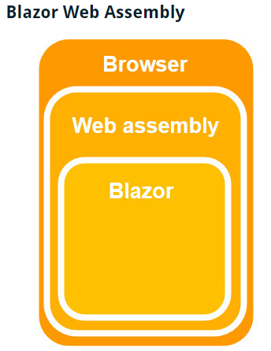
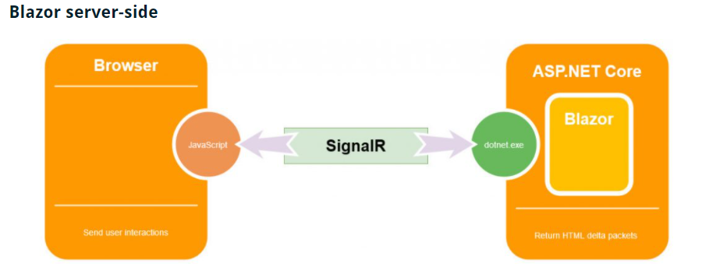
What is Blazor
Single Page Application framework
Runs Razor views
Server side Blazor (with SignalR)
Client side Blazor (with WebAssembly)

Slide 3
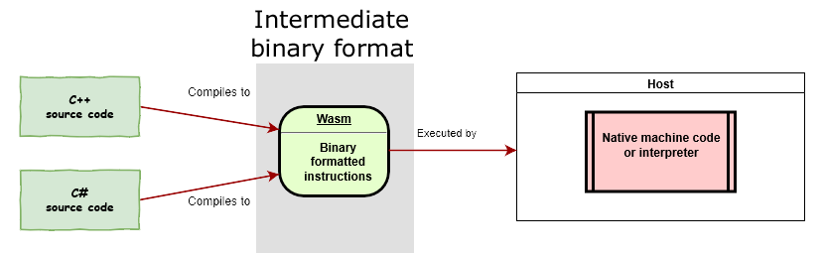
What is Web Assembly
Low-level assembly-like language with a compact binary format that runs with near-native performance and provides languages such as C/C++, C# and Rust with a compilation target so that they can run on the web.
Designed to complement and run alongside JavaScript — using the WebAssembly JavaScript APIs, you can load WebAssembly modules into a JavaScript app and share functionality between the two.

Slide 4
What is GRPC
Based around the idea of defining a service, specifying the methods that can be called remotely with their parameters and return types (RPC - remote procedure call)
gRPC uses Protocol Buffers, Google’s mature open source mechanism for serializing structured data
Works on HTTP/2

Slide 5
DEMO

Slide 6
Q&A

