Slide 1
Failure List Script
DATE
Cameron Ferguson

Slide 2
Script Overview
Uses FileMaker data to generate an excel file which summarizes failure information
FileMaker Search
.Tab file
Excel
file
Export
Run Script
Search Window | Export Time | Script Time | Total time
1 Year | ~8 min | 5 Sec | 8min 5 sec
1 Month | 10 sec | <1 Sec | 11 sec
1 Week | <1 sec | <1 sec | 1 sec
1 Day | <1 sec | <1 sec | <1 sec

Slide 3
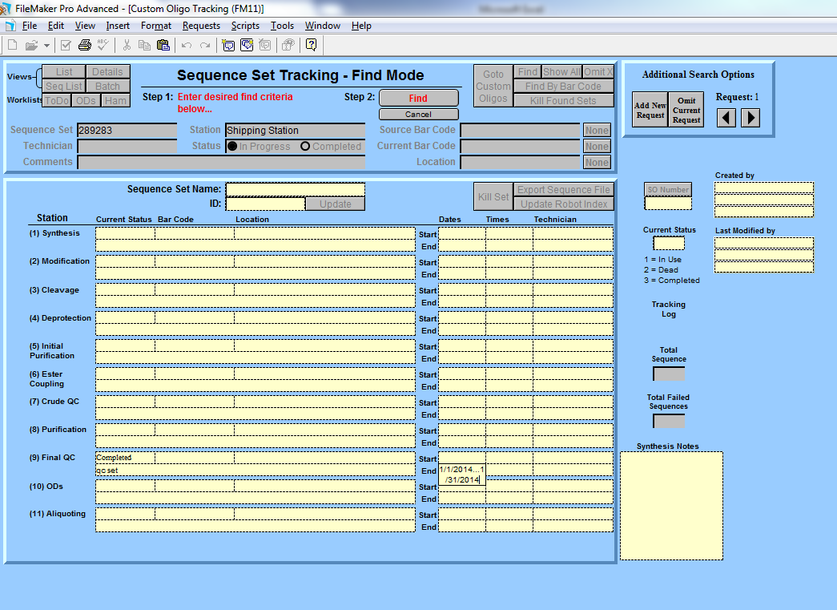
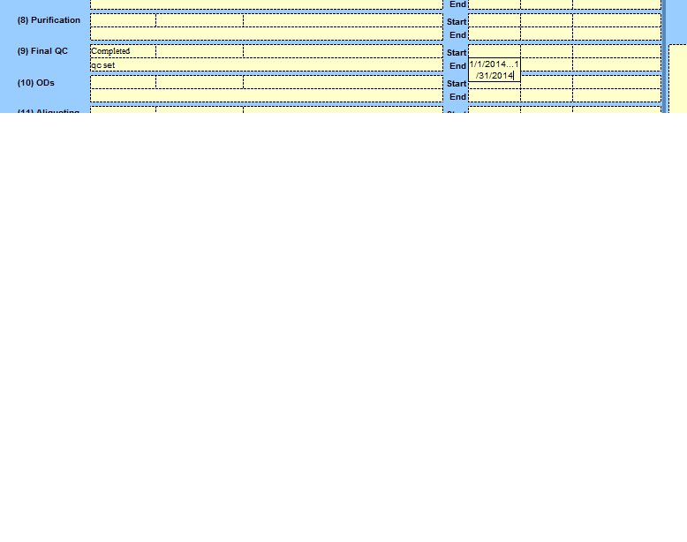
Filemaker Search
Filemaker Search
Time frame
Other Boxes
Export
Save location
Catagories
Time
.Tab File
Size
Contents
Run Script
How to Run
Script Logic
Time
Excel File
Different sheets
Size

Slide 4
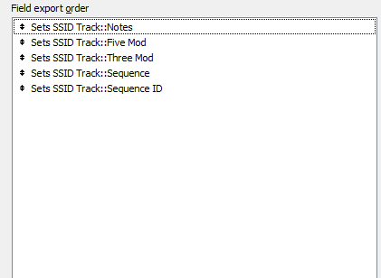
EXport
Filemaker Search
Time frame
Other Boxes
Export
Save location
Catagories
Time
.Tab File
Size
Contents
Run Script
How to Run
Script Logic
Time
Excel File
Different sheets
Size
Switch to Seq List view
File > Export Records
Save in the same folder as the Script OR remember the location
Choose Fields to Export.
MUST BE EXPORTED IN
THE SAME ORDER
Can take a long time for a large numbers of records (10 min)

Slide 5
Raw Data
# of Seq: 345780
Removed Sequences
Blank “notes”
293137
Non-Failure Filter
see
Extra Material
Archive material
Collection
Stellaris o
Pass
Wobble o
Wobbles o
Recheck
Relot
Re-lot
comb
# of Seq: 52643
Non-Failure Notes
6440
Important Notes Data
# of seq: 46203

Slide 6
Failure Aggregation
Raw Data
# of Seq: 345780
ms o -> Ms Okay
ms n -> Ms Not Okay
assig -> Reassign
base -> Base-swap
wrong m -> Wrong Mass
flush -> Flushed
3 stel-> Stellaris Failure
every sample -> Stellaris Failure
all samples failed -> Stellaris Failure
stellaris f -> Stellaris Failure
more then three -> Stellaris Failure
more than 3 -> Stellaris Failure
extra tet -> Extra TET
tet -> Poor Tet Coupling
biotin -> Poor Biotin Coupling
extra fam -> Extra FAM
fam -> Poor FAM coupling
contamin -> Contamination
purity -> Poor Purity
n- -> N- Failure
syn -> Synthesis failure
colum -> Column Issue
flp-> No FLP no dn -> No FLP
dmt -> DMT left on
depur -> Depurination
mmt -> MMT left on
phosp -> Poor Phosphate coupling
poor j -> Poor Joe coupling
incom -> Incomplete Deprotection
benz -> Incomplete Deprotection
cyano -> Incomplete Deprotection
deprot -> Incomplete Deprotection
dye -> Dye failure
scram -> Plate Scrambled
yield -> Low Yield
yeild -> Low Yield
no dn -> Low Yield
-x or + x (x is 1:9) -> Impurity Present
Removed Sequences
Blank “notes”
293137
# of Seq: 52643
Non-Failure Notes
6440
Important Notes Data
# of seq: 46203
Preliminary Failed Seq Data
# of seq: 46203
Failure Aggregation
Notes:
Order: MS okay first, low yield later. Numbers LAST.
varied notes: Stellaris failures
Spelling: Yield Notes

Slide 7
Always one Excel File
Raw Data
# of Seq: 345780
Summary
Removed Sequences
Blank “notes”
293137
Reason List
# of Seq: 52643
Non-Failure Notes
6440
Mod Analysis
Failed Seq Data
# of seq: 34820
Analysis
Important Notes Data
# of seq: 46203
Sometimes
Separate Excel Files
Ms Okay
8110
Sequence ID
Analysis
Reassign
3273
Sequence Name
Analysis
Preliminary Failed Seq Data
# of seq: 46203
Failure Aggregation

Slide 8
.Tab file
Filemaker Search
Time frame
Other Boxes
Export
Save location
Catagories
Time
.Tab File
Size
Contents
Run Script
How to Run
Script Logic
Time
Excel File
Different sheets
Size
Tab seperated file
Can open and view raw file in Notepad
~16MB for 1 year

Slide 9
Run Script
Filemaker Search
Time frame
Other Boxes
Export
Save location
Catagories
Time
.Tab File
Size
Contents
Run Script
How to Run
Script Logic
Time
Excel File
Different sheets
Size
How to Run
Must have R installed
Must know how to open an R window
Type in
Source(script location), hit enter
Ex) source('C:/Users/cferguson/Desktop/Failure_List/failurelist.R”)
Or
Source(“failurelist.R”)
Script will now ask:
What is the data file called? Don't forget the extension...
type in the name (and if necessary) the location of the .tab file. Hit Enter
"What is the output file called?... “
Type in the name you wish the data file to be saved as. No extension necessary

Slide 10
Run Script
Filemaker Search
Time frame
Other Boxes
Export
Save location
Catagories
Time
.Tab File
Size
Contents
Run Script
How to Run
Script Logic
Time
Excel File
Different sheets
Size
Script Logic
Reads in raw data file, specified by user
Removes sequences that have no notes
Cleans up file to contain no uppercases or extra spaces
Removes sequences that have non-failure related notes
Ex) relot, recombine, wobble okay, etc
Changes failure notes to standardized failures
Ex) more than 3 stellaris failures & 3 stellaris failures both become: Stellaris Failures
Ex) low yield at ods lucy r 1/8/14 and low yield at ods 01/20/14kt, becomes: Low Yield
Attempts to account for spelling errors and slight variation, but is not Perfect (more on this later)
Groups failures by Failure Reason, counts number of sequences with that note, generates table with Failure Reason and # of times it occurred
Failure Reason must be EXACTLY the same to be grouped.
Generates similar data for failures by Sequence ID and again by Three prime and Five prime mod combinations
Generates summary information:
Total number of sequences analyzed, % with notes, % failed, etc
Writes Excel File with each table a separate Sheet. Name specified by user

Slide 11
Excel file
Filemaker Search
Time frame
Other Boxes
Export
Save location
Catagories
Time
.Tab File
Size
Contents
Run Script
How to Run
Script Logic
Time
Excel File
Different sheets
Size
A typical Excel File with 4 sheets.
Example

Slide 12
Future Aims/Needs
Need: Uniform Failure Names
Will make script easier, and data better
May take some time
Need input from all departments that write notes
Want: Sequence ID counts to be weighted by number of times sequence was made
Want: Impurity list, showing number of times a specific weighted impurity has shown up
Want: Direct FileMaker connection
Want: Suggestions, Ideas, categories, etc
Search Window | Export Time | Script Time | Total time
1 Year | ~8 min | 5 Sec | 8min 5 sec
1 Month | 10 sec | <1 Sec | 11 sec
1 Week | <1 sec | <1 sec | 1 sec
1 Day | <1 sec | <1 sec | <1 sec

