Slide 1
CPD v2 Gold Pads
Caleb Fink

Slide 2
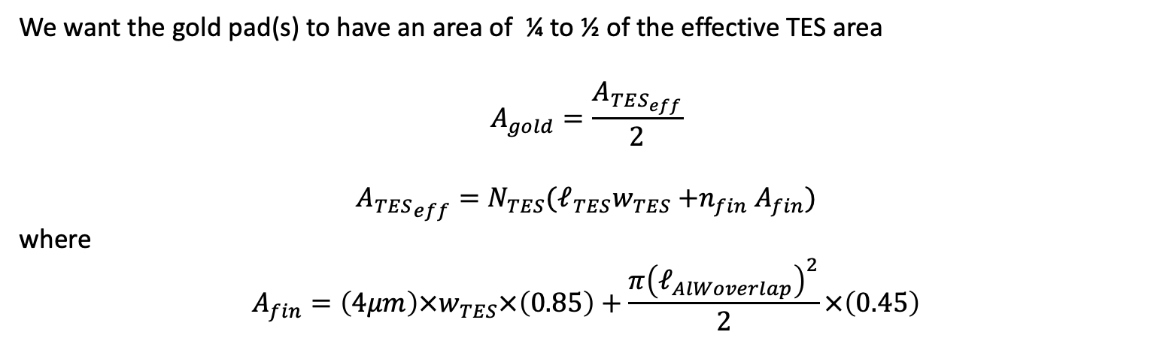
Gold Pad Size
We want the gold pad(s) to have an area of ¼ to ½ of the effective TES area
$$A_{gold}=\frac{A_{TES_{eff}}}{2}$$
$${{A_{TES}}_{eff}=N}_{TES}{(ℓ}_{TES}w_{TES}{+n}_{fin}A_{fin})$$
where
$$A_{fin}=\left(4μm\right)×w_{TES}×\left(0.85\right)+\frac{π{\left(ℓ_{AlWoverlap}\right)}^{2}}{2}×\left(0.45\right)$$
Effective volume factor for fin connector
Effective volume factor for overlap region

Slide 3
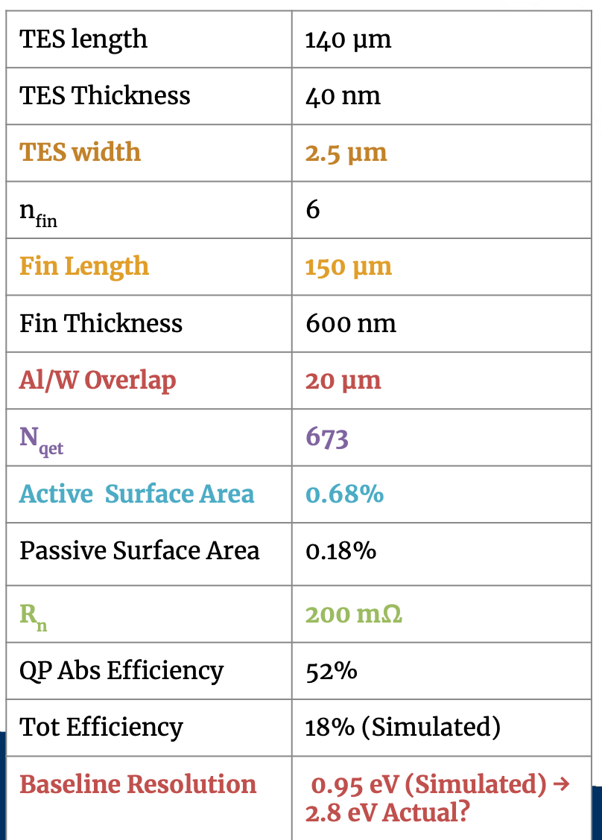
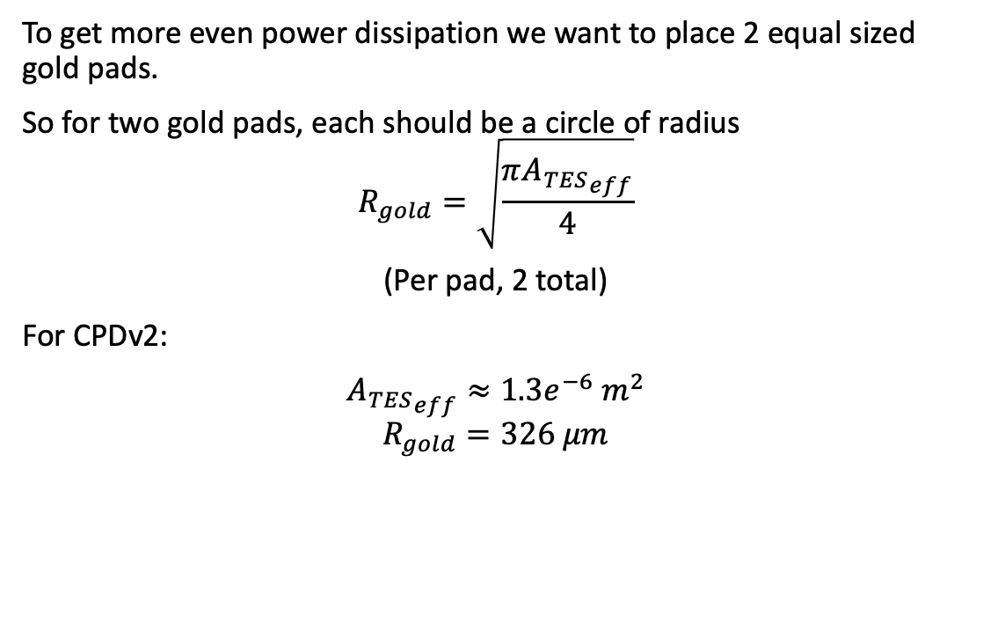
To get more even power dissipation we want to place 2 equal sized gold pads.
So for two gold pads, each should be a circle of radius
$$R_{gold}=\sqrt{\frac{π{A_{TES}}_{eff}}{4}}$$
(Per pad, 2 total)
For CPDv2:
${A_{TES}}_{eff}≈1.3e^{−6} m^{2}$
$$R_{gold}=326 μm$$

Slide 4
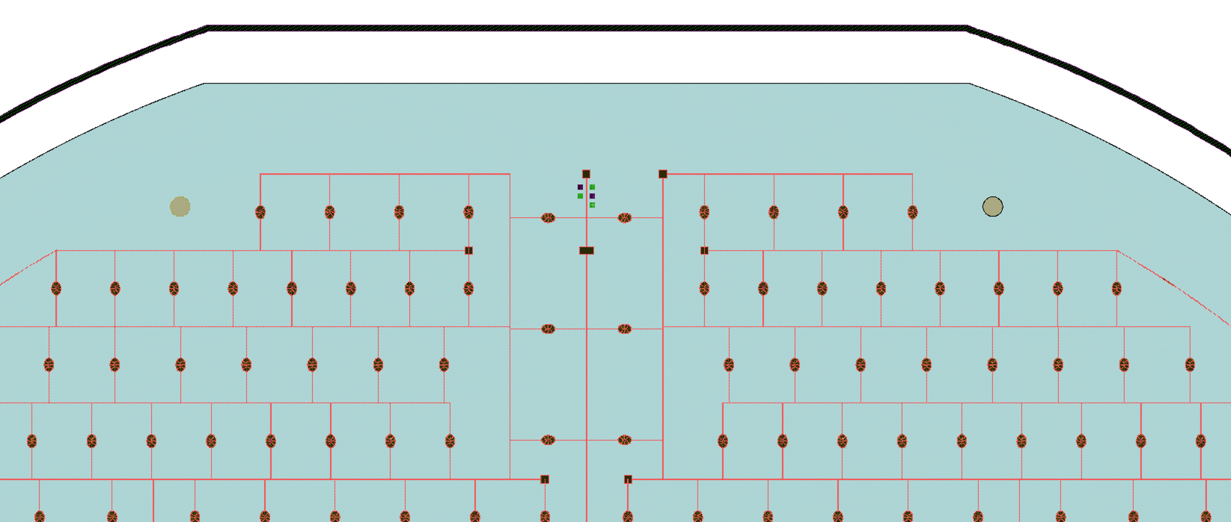
Placement
About 3 mm from edge of wafer
Edge of wafer
Bonding pads
Gold Pads

