Slide 1
A Hadoop Based Genomic Structural Variation Detection Pipeline
Chris Whelan
CS 506 – Problem Solving with Large Clusters

Slide 2
Structural Variations
  Structural Variations are large rearrangements in a genome
    Deletions - removing a chunk of DNA
    Insertions - inserting a novel chunk of DNA
    Duplications - copying a chunk of DNA
      a.k.a copy number variation or tandem repeats
    Inversions - reversing the order of a chunk of DNA
    Translocations - moving a chunk of DNA from one chromosome to another

Slide 3
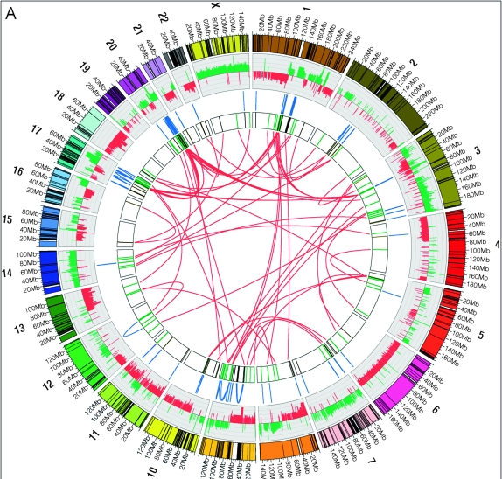
Structural Variations
  SV's are common in cancer
  This is a map of rearrangements in a breast cancer cell line (Hampton et al. 2009, Genome Research)

Slide 4
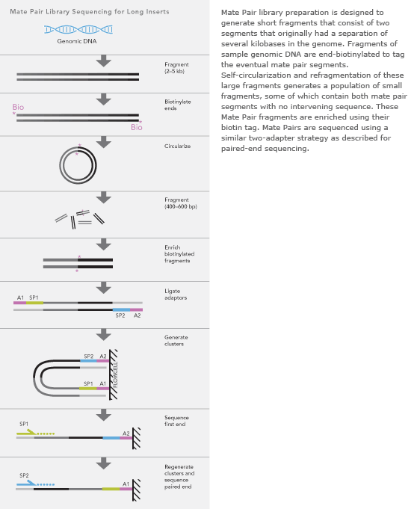
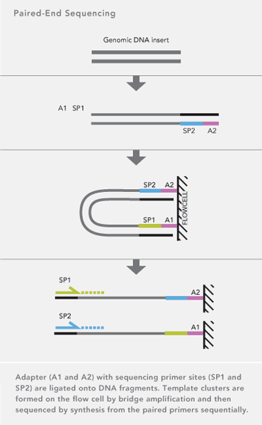
Paired End Short Read Data
Paired-end and mate-pair sequencing give pairs of reads an approximate distance apart
200-300 bp
3000-4000 bp

Slide 5
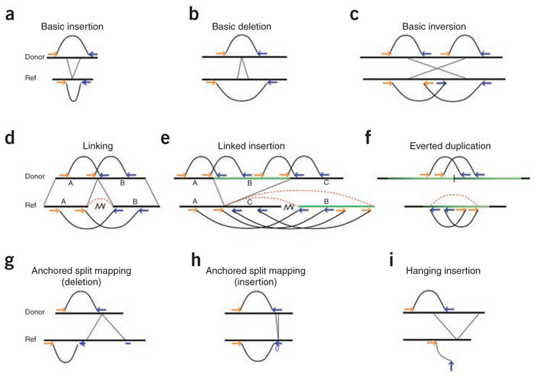
Finding Variations with Mate Pair Data
Medvedev et al 2009, Nature Methods

Slide 6
Current Strategies
General framework of existing approaches:
  Map reads to the genome
    Some reads have many possible mappings; some approaches use multiple mappings (VariationHunter, HYDRA), most do not
  Remove any pairs for which the aligner did not find a concordant mapping
    Concordant: within some range of the mean insert size
  Attempt to cluster the remaining discordant read pair mappings
  Clusters containing a certain number of read pairs are used to call SV's

Slide 7
Goals
Want to use all possible mappings for a read pair
Don't throw away evidence:
  Concordant pairs
  Secondary alignments
Use Hadoop to manage the large number of possible mappings
Examine the evidence for an SV at each location in the genome

Slide 8
My Pipeline
Map 1: Align each read in a pair independently to the genome with Novoalign – allow up to 10 alignments for each end
  Emit (Read Pair ID, alignment)
Reduce 1: Produce all possible pairs of read alignments
  Emit (Read Pair ID, Read1 Alignments X Read2 Alignments)
Map 2: For each paired alignment:
  Compute an SV score: evidence from this alignment for a structural variation
  Divide the span that this alignment covers into windows
  Emit (Window location, SV score)
Reduce 2: Sum all SV scores for each window
Finally, visualize distribution of scores across the genome and call SV's at the peaks

Slide 9

Scoring Variant Likelihood at Each Locus
Novoalign assigns a posterior probability to each possible mapping:
Based on an aligned insert size s and the expected distribution of insert sizes ~ N(μ,σ), call the likelihood of the alignment pair spanning a deletion P(S < s – ασ)
Let the read's vote v be 1 if p > .5; -1 otherwise
Each read contributes a score of
        P(A_{end1}|R,G) * P(A_{end2}|R,G) * v

Slide 10
Experiments
Using a simulation pipeline:
  Add random structural variations to a genome sequence (Human Chromosome 2)
  Simulate 10,000,000 Illumina mate pairs from the modified genome sequence
Compare to output from two published SV callers: HYDRA and BreakDancer
Using a very simple sliding window to call peaks in my output distribution: from each value subtract the average of the values in the neighboring 50kb

Slide 11
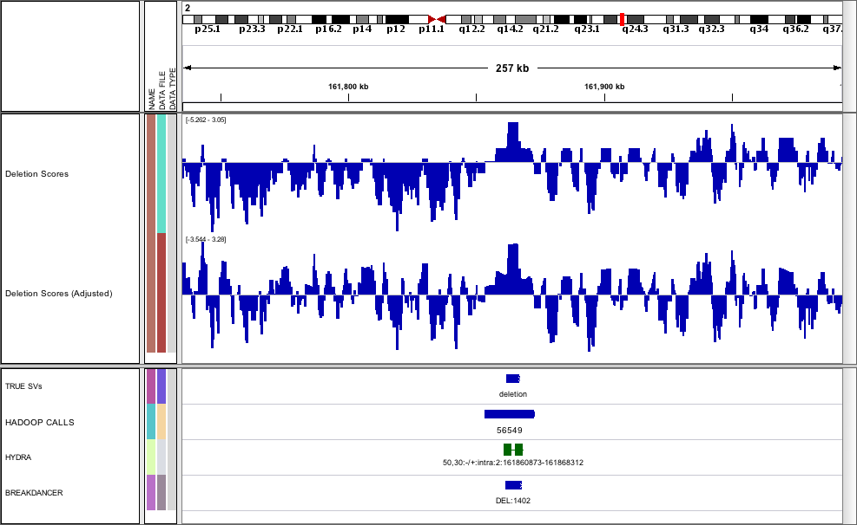
Visualizing Results

Slide 12
Evaluating Results
 | True Positives | False Positives
New Workflow | 24 | 122
HYDRA | 28 | 52
BreakDancer | 35 | 70
True SV's: 75
Too many false positives for my method
Need better peak calling technique
Did identify 7 SV's that both HYDRA and BreakDancer missed

Slide 13
Future Work
Better method for calling peaks from deletion scores
  Anecdotally, many actual SV's had peaks in the score distribution, but didn't make the threshold
Add scoring functions for other types of SV
  Scoring function in the current implementation is designed for deletions but suprisingly does well with insertions and inversions
Optimize parameters of scoring functions
Allow more mappings
Expand to multiple chromosomes

